Slide 1
Global Brigades
9/25

Slide 2
If you haven’t already…
Join our GroupMe for updates!

Slide 3
In-Person Brigade Updates
Brigade Options:
Honduras
Panama

Slide 4
In-Person Brigade Updates
Brigade Options:
Guatemala
January, February and March Options

Slide 5
In-Person Brigade Updates
Brigade Options:
Greece
Ghana
Booking is slightly more difficult, requires demand
Some missing stations in the itinerary, such as dental
Pharmacy program available
Requires visa
Requires more vaccines/treatments, including yellow fever and malaria

Slide 6
In-Person Brigade Updates
Brigade Options:
Belize!

Slide 7
Telebrigades
Telebrigade Options:
Honduras: $195-$295
Greece: $250-$350
Ghana: $250-$350

Slide 8
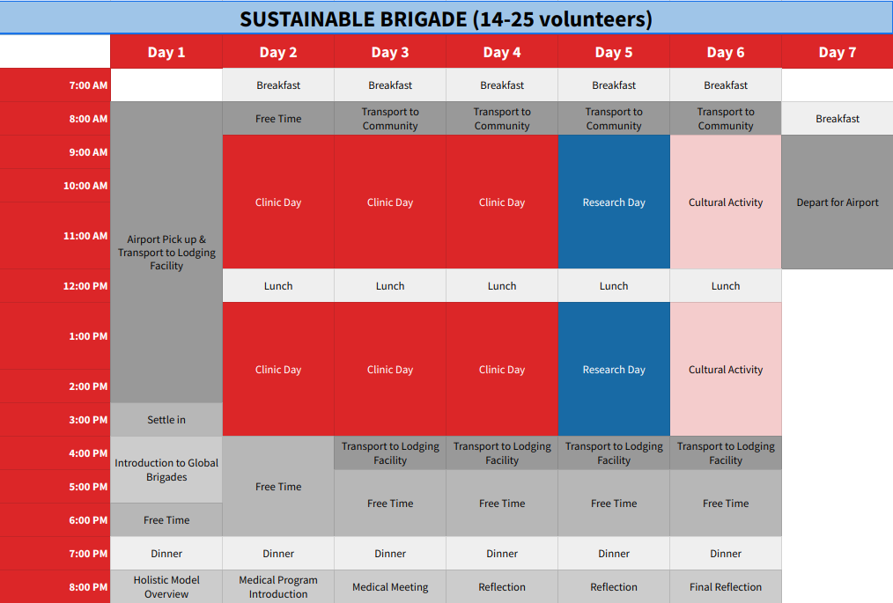
Sample Itinerary: Potential Add-Ons?
Notes:
Potentially more add-on days into itinerary: public health, cultural days

Slide 9
Fundraising!
Goal: At least one fundraiser before the end of October
Boba fundraisers
Bake sales
Nicaraguan Coffee Beans

Slide 10
Thank You!
Questions?

