Slide 1
Election Meeting GBM!
Welcome to our candidates!

Slide 2
Agenda
Club Overview
Candidate Profiles
Results and Onboarding Meeting

Slide 3
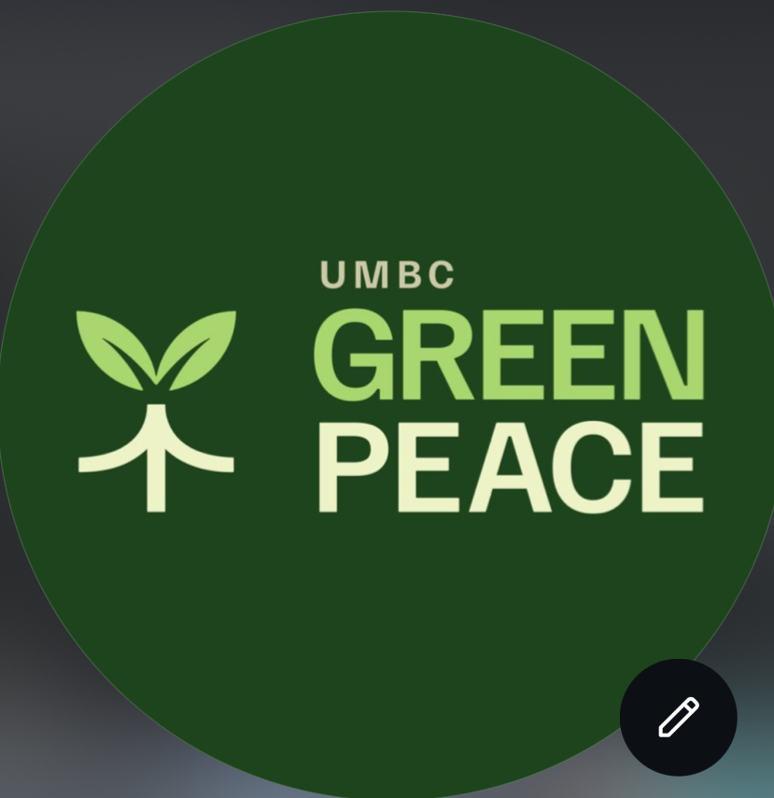
What is UMBC Greenpeace?
Mission
Advocate for environmental issues, bring awareness to UMBC students and surrounding communities, and take action to protect the environment.
Who are we?
We are UMBC Greenpeace, a group of students committed to environmental awareness. We act on environmental issues through participating in a variety of different events and work to advocate for better green initiatives.
We hope to expand what we do as a club and see what new takes new board members as well!

Slide 4
Role expectations
President: Set meetings with all the board members, brainstorm ideas for events, network at tabling events and handle communications, and delegate tasks to other board members. Time Commitment: 1-5 hrs/week, depending on event schedule.
Vice President: Be of assistance to the president, book rooms for meetings, handle other email communications, and lead general body meetings. Time Commitment: 1-5 hrs/week, depending on event schedule.
Treasurer: Create budgets alongside e-board members for upcoming semester, attend SABSC trainings, order supplies from SABSC, attend finance board meetings, keep track of payments. Time Commitment: 1-5 hrs/week, depending on budget deadlines.
Secretary: Keeping track of deadlines and due dates on Google calendar, take meeting minutes, posting on myUMBC, assist other e-board members. Time Commitment: 1-5 hrs/week, depending on event schedule.

Slide 5
01
Candidates

Slide 6
President Candidates

Slide 7

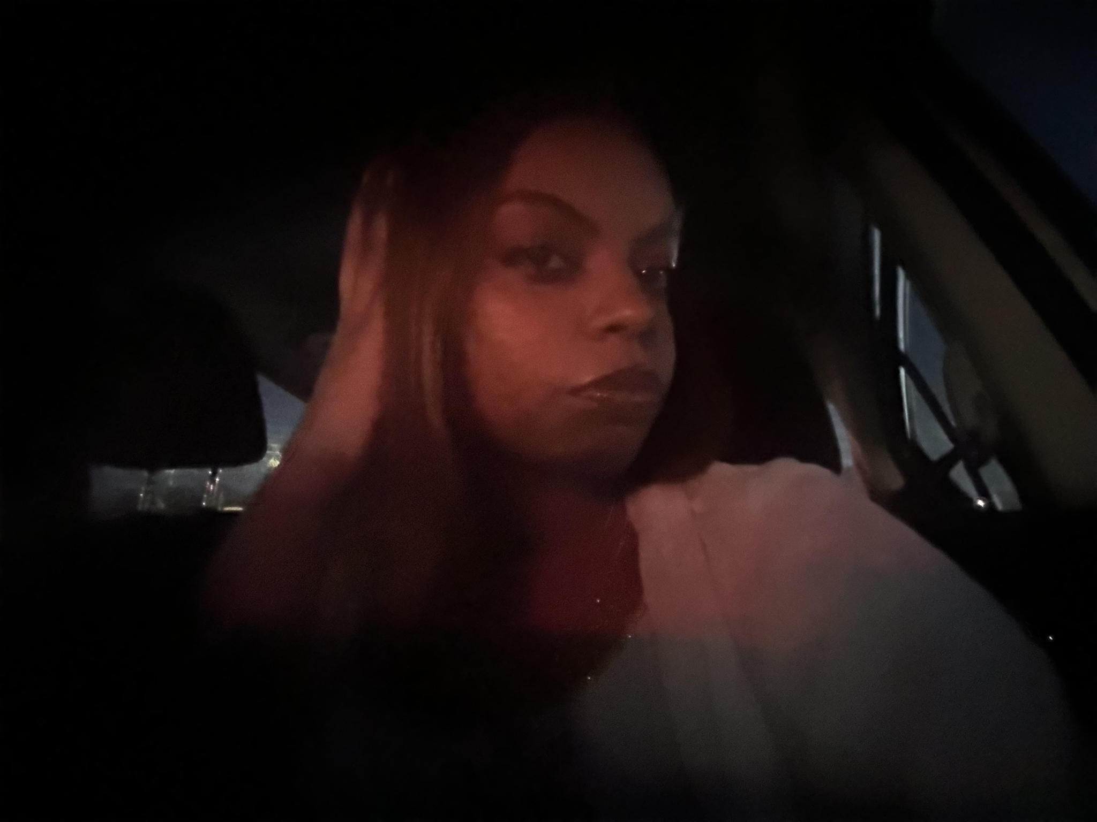






Why Addis?
Finance Economics B.S
-Has experience with EWB as their First Year Representative
-Great at planning, organizing, and anticipating potential outcomes
-Great at taking responsibility, and hopes to continue to help build Greenpeace from the innerworks
-Great at concentrating on tasks, achieving goals, and maintaining a friendly demeanor
Fun fact: I’ve designed a t-shirt before
Here is why I would like to run for President!!
Passionate about building strong group cohesion
Proven track record of reliability
Detail Oriented Approach to everything
Open minded and flexible
Dedicated to preserving our planet
Passionate advocate for the environment and its recipients

Slide 8
Vice President Candidates

Slide 9
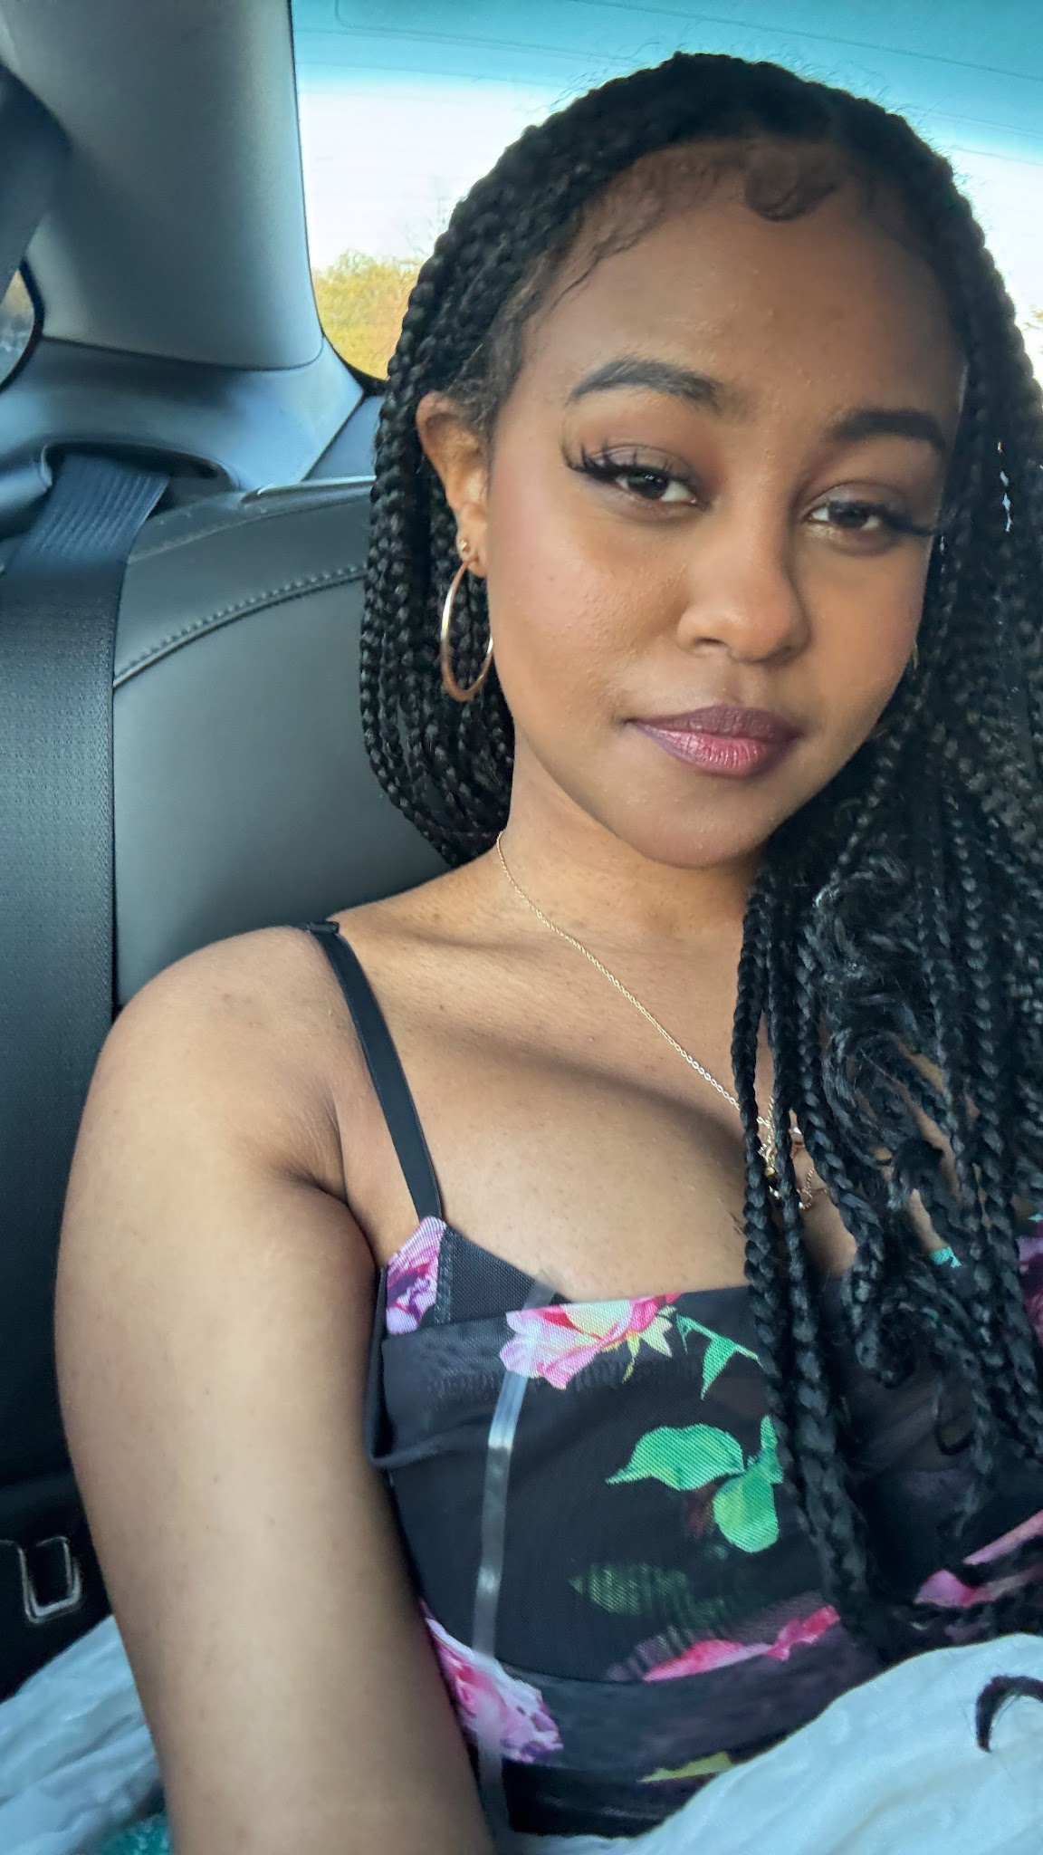
About me
Position
Secretary
Fun fact
Info Systems Major with a psychology minor
I have a huge garden in my backyard!
What made me run for this position?
I’m running for this position because I have a love for the environment and a strong desire to take action, not just talk about change.
Hanna Taye

Slide 10
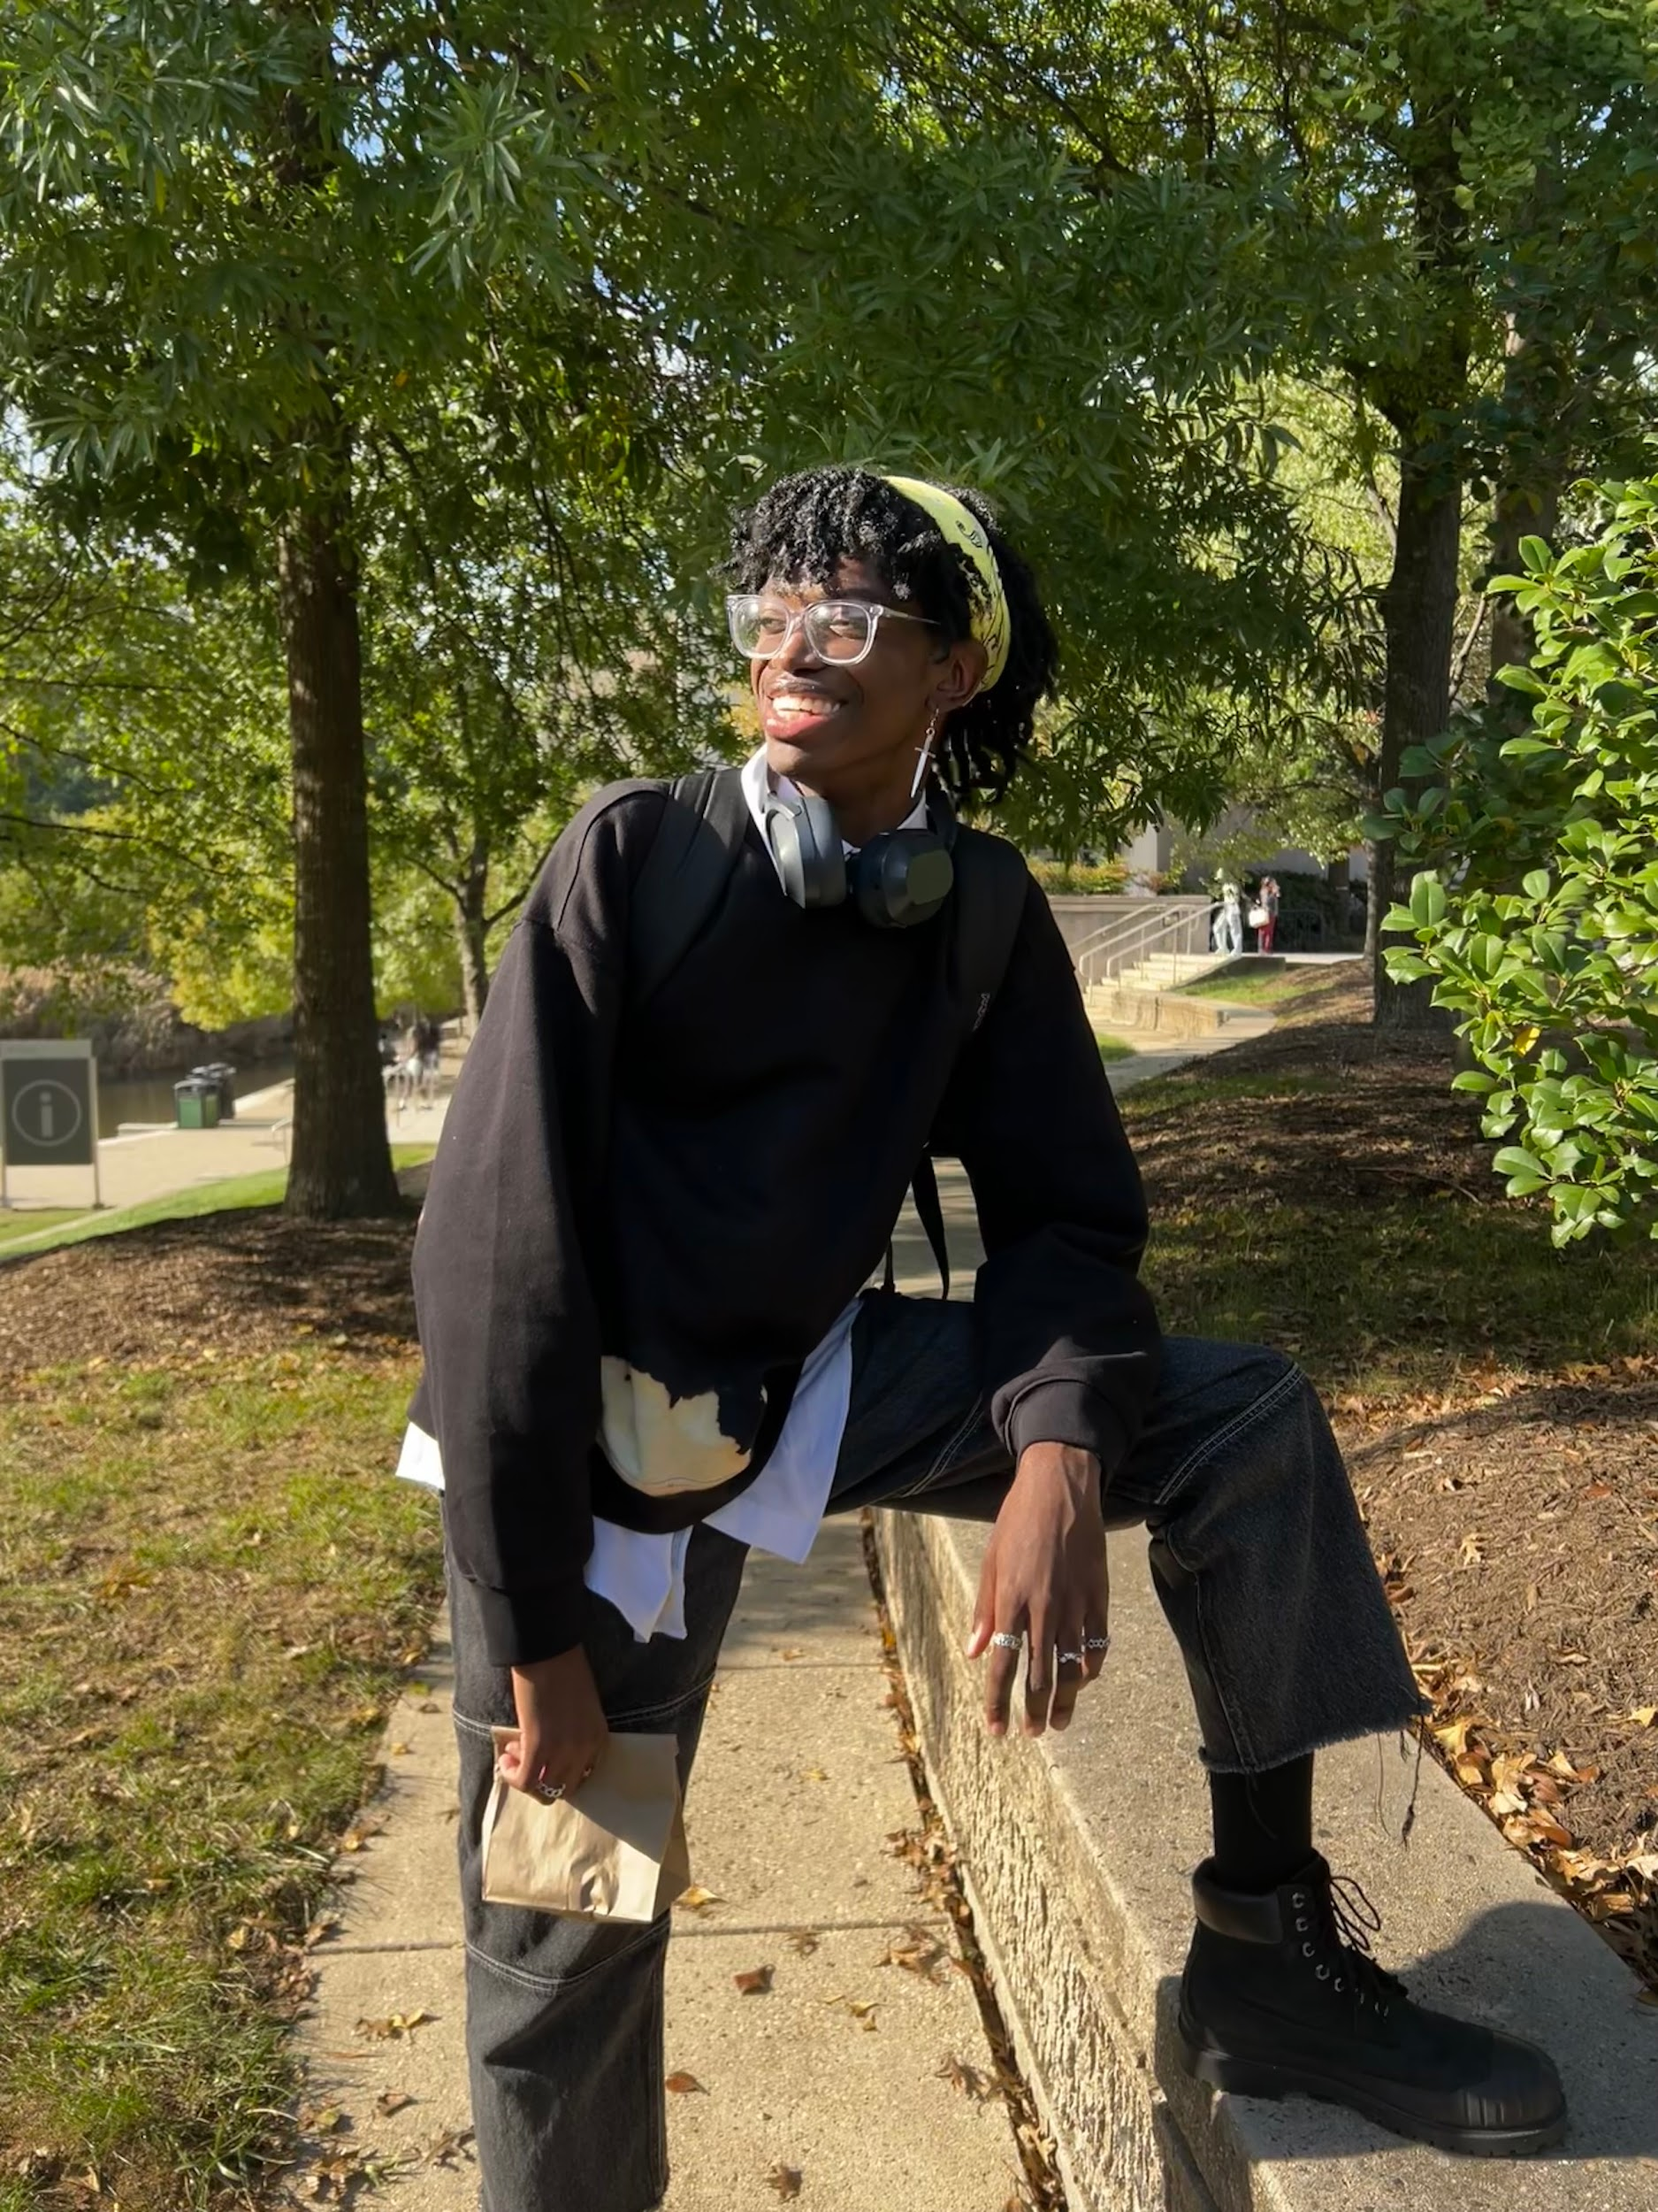
Nuku Attipoe
~Major: MechE & Psychology B.A.
~Fun Fact: despite my best efforts I am unable to wink
~Why am I running?: as someone who would like to be more involved in my community as well as explore environmentalism as a general interest of mine, this is the perfect opportunity to do so especially with people who salso hare this interest

Slide 11
Sufiyan Malik
I am willing to facilitate conversations that link environmental issues with rights, justice, and well-being of all. I believe that we can work together to create everlasting change here at UMBC and far beyond through education, activism, and outreach, and I would consider it an absolute honor to do so.

Slide 12

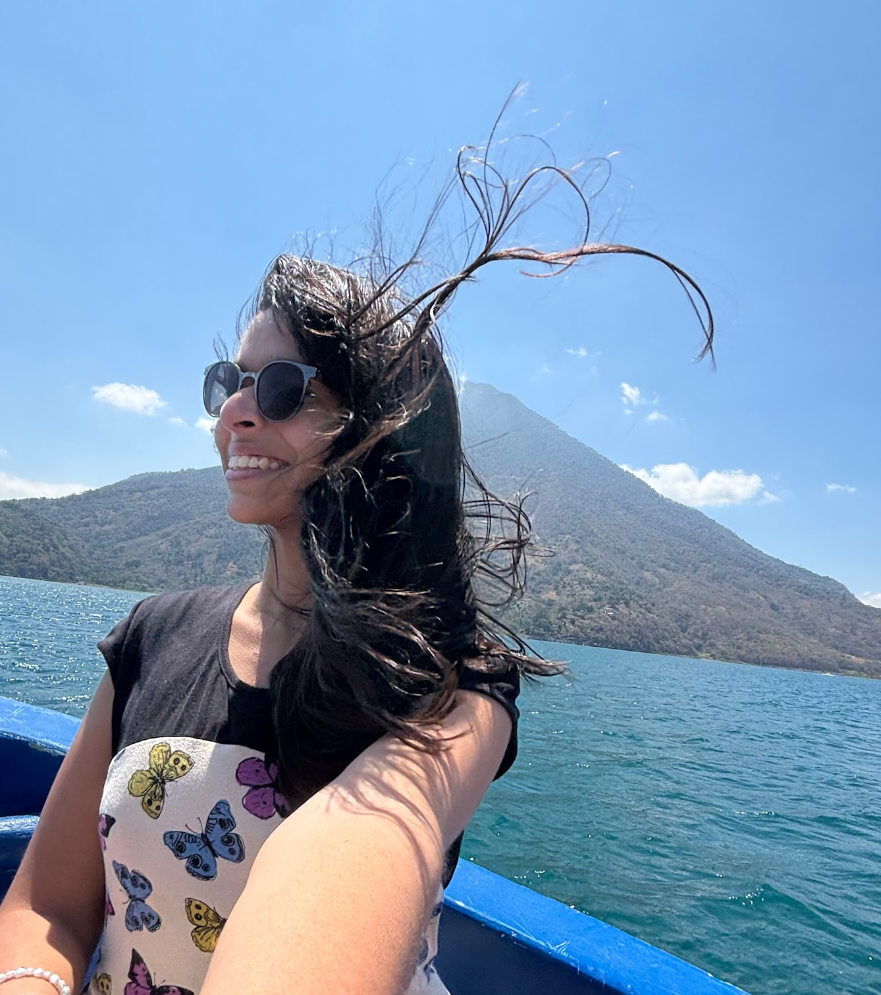
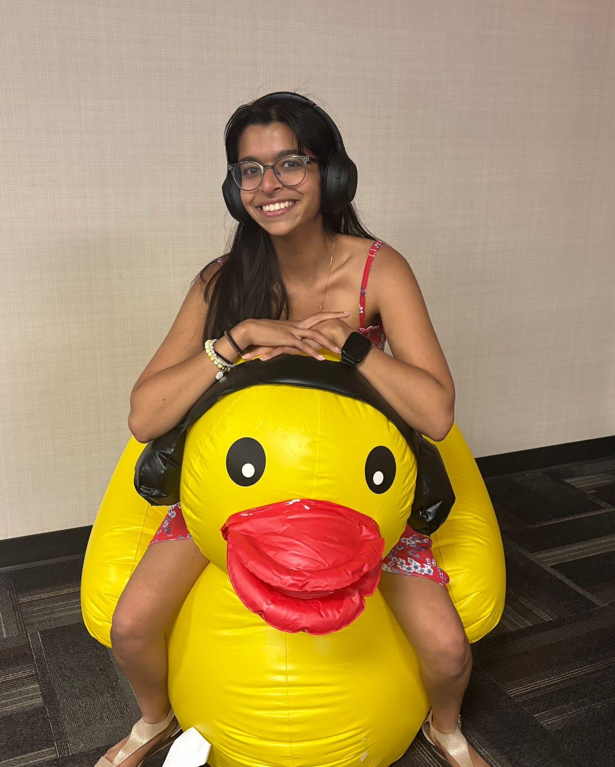
Nikita Lobo 4 VP
Upcoming Junior. Computer Science, ges cert (she/her)
“Somebody doesn’t have to . everything but everyone has
to do something” .
Fun fact
I have been to 8+ countries & have looked after 30+ animals (unrelated)
Why am I running ?
I have not been involved with greenpeace at this
chapter, but I did attend a few JH events, and have been
part of numerous E-boards.
As VP I hope to be able to help facilitate larger
research events, create connections with nearby
sustainability groups to support the community.
I will also work diligently with the elected E-board
members to align what this club does to what the
community wants out of the club.

Slide 13
Treasurer Candidates

Slide 14





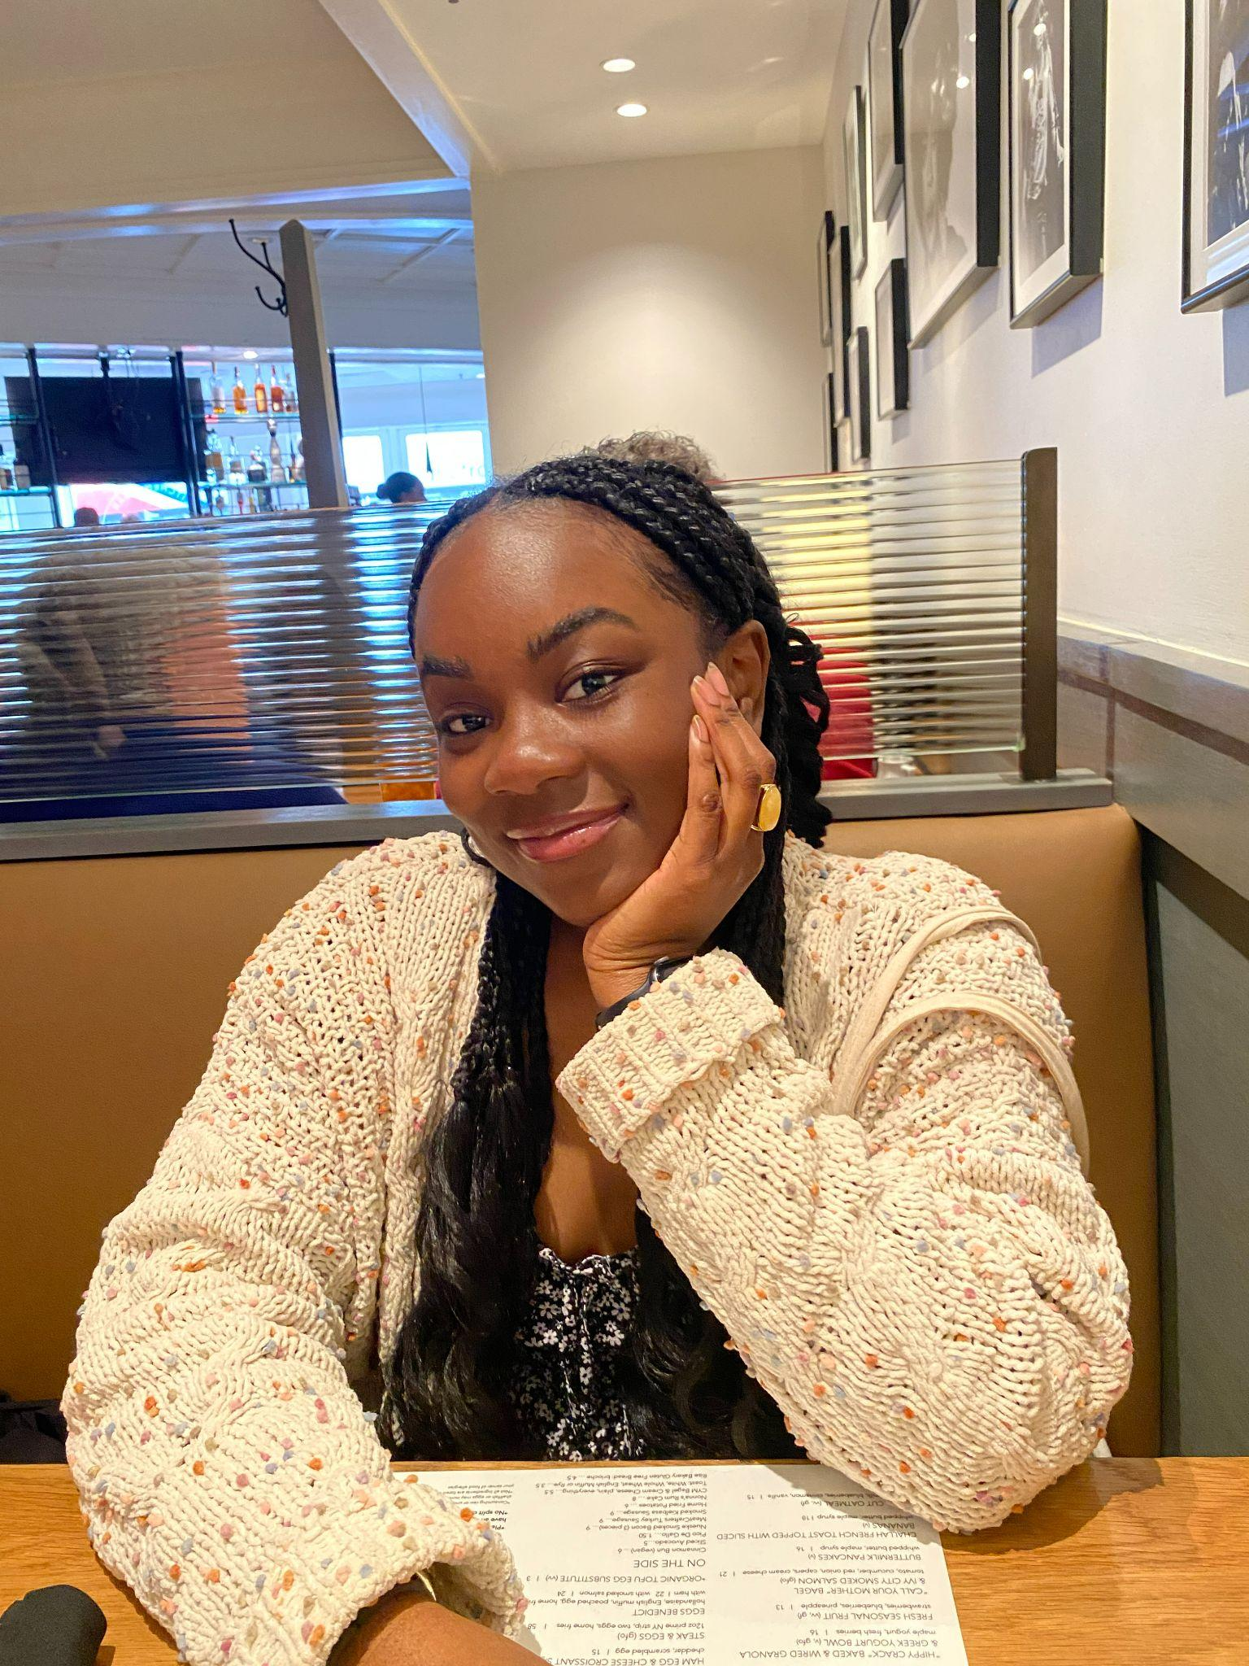



Richeda Adansi
Major: GES B.S.
Fun Fact: My favorite type of plants are succulents and I also garden with my mom!!
Why I’m running:
I am eager to take a more active role in supporting our organization’s initiatives, and if I am chosen as the Treasurer, I will do just that. Making sure the financial health and stability of our organization is key to our ability to carry out solutions, raise awareness, and advocate for our environmental goals with the UMBC community and everywhere else we can make an impact. I am a dedicated and detail oriented individual, as Treasurer, I will carefully and precisely take note of our club’s finances, provided up-to-date reports of our financial standing, and ensure our finances are used responsibly for any upcoming activities and events.

Slide 15
Secretary Candidates

Slide 16

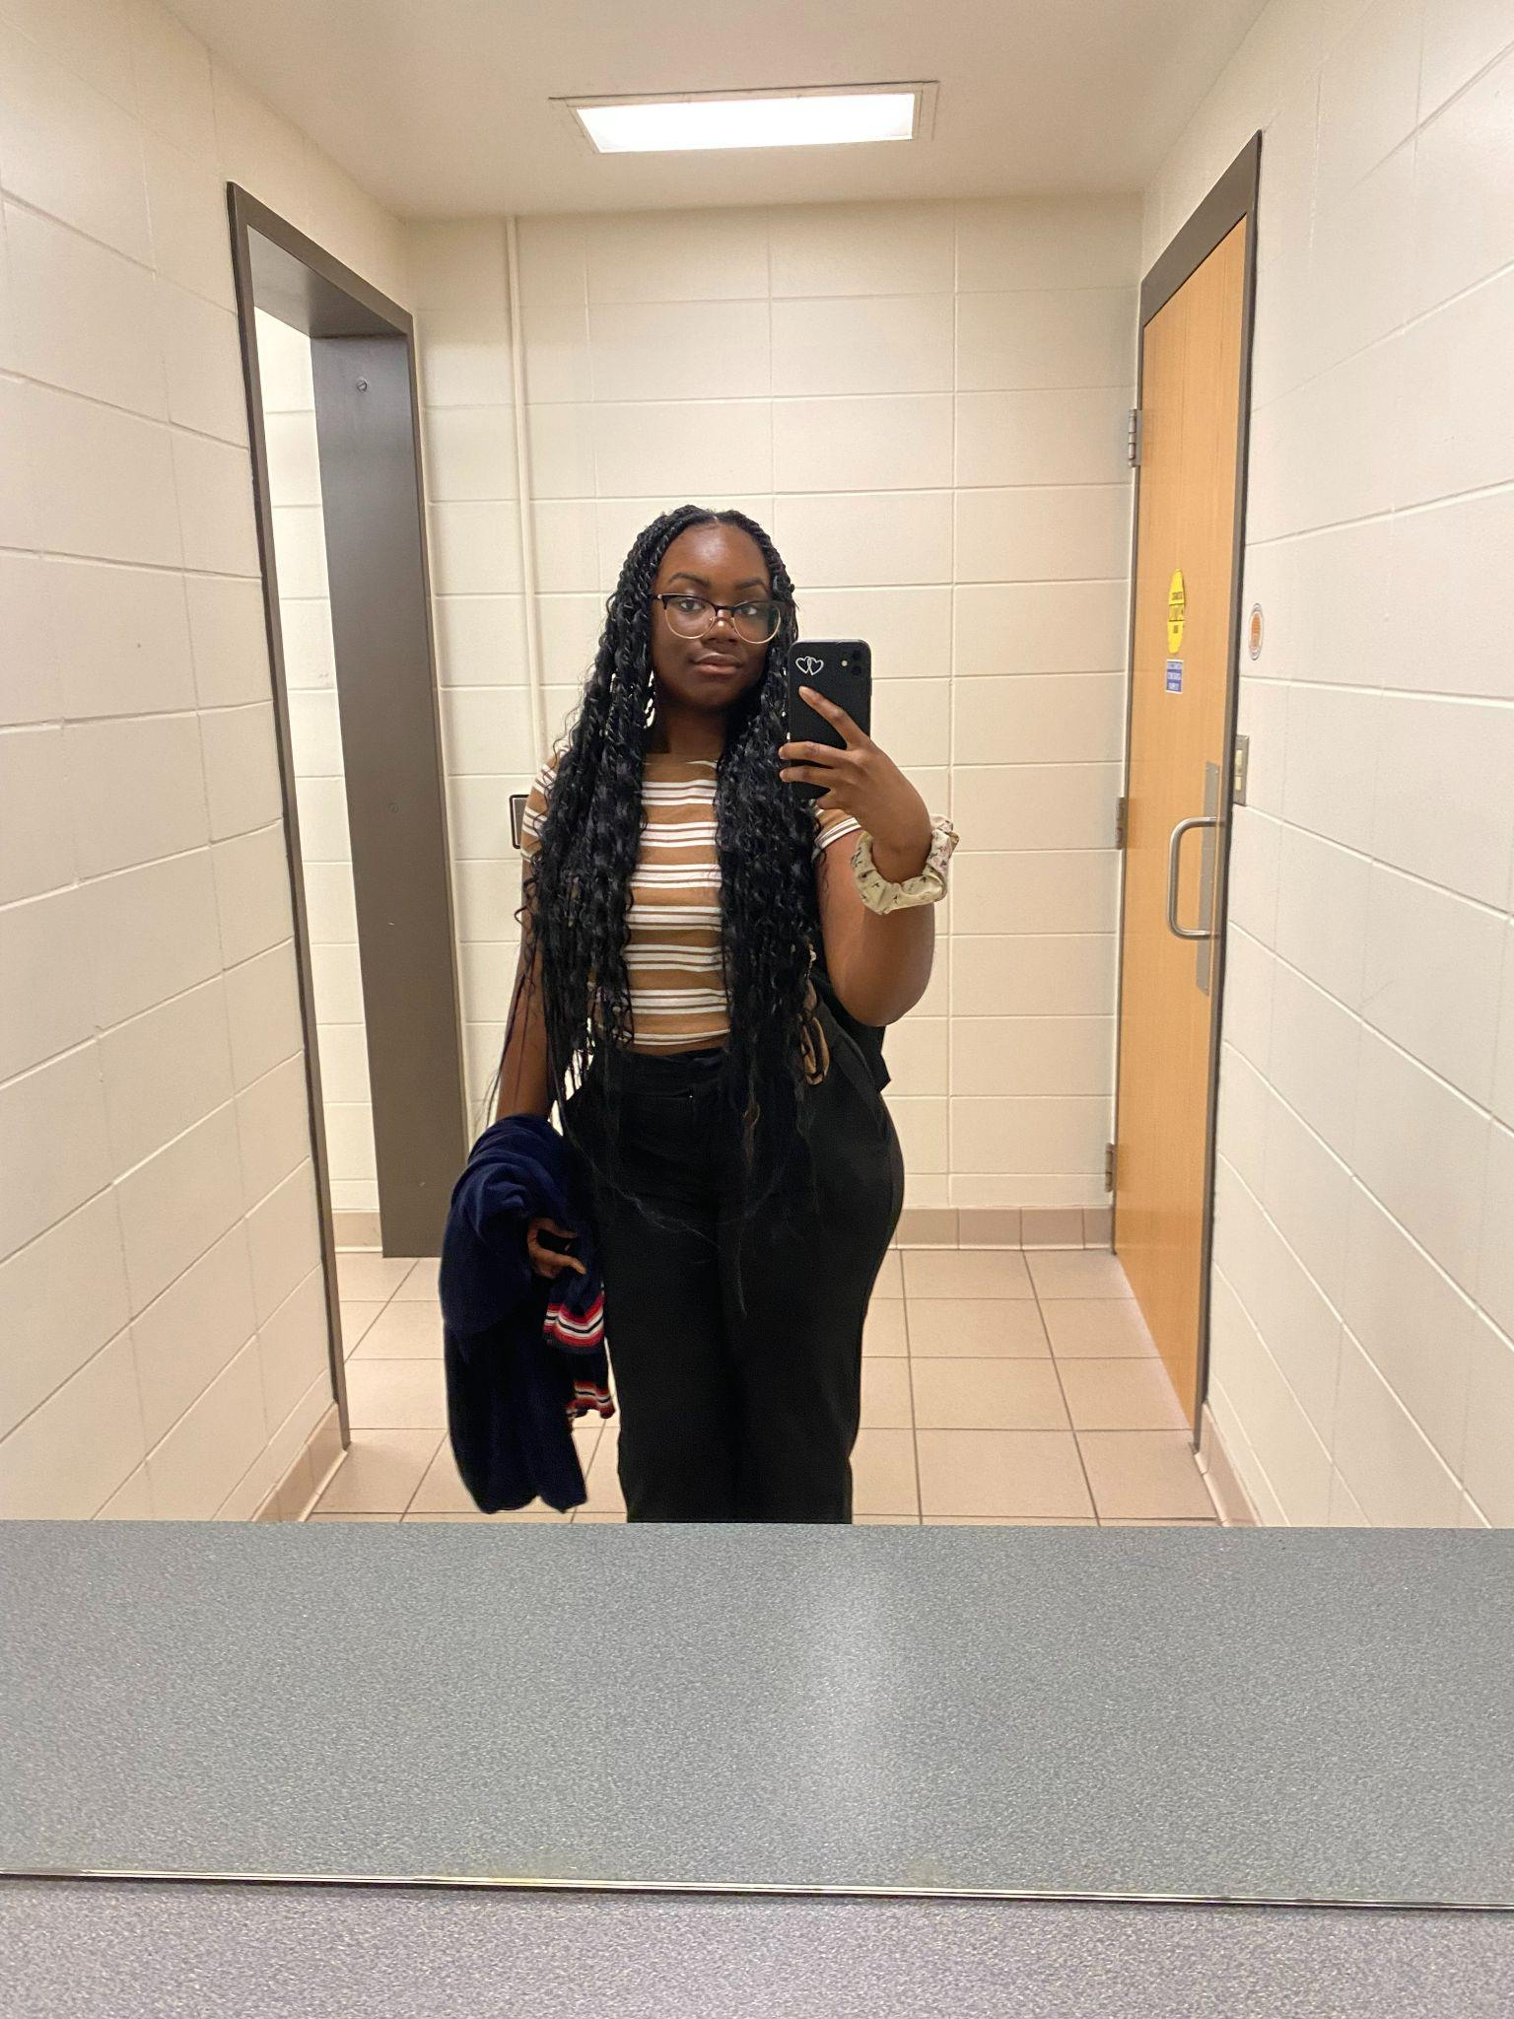
Richeda Adansi
Major: GES B.S.
Fun Fact: I’m was born in El Paso, Texas
Why I’m running:
I want to be more involved in environmental activism. I believe we need to play an active role in how we shape our environment and doing that involves aiding our local community through finding solutions, creating awareness, and advocacy. I am also very dedicated to my work, once I start something I put my best foot forward and strive to do my best! I will ensure every member in Greenpeace is given up to date information on meetings and events as well as provide clear communication and be open to any feedback.

Slide 17
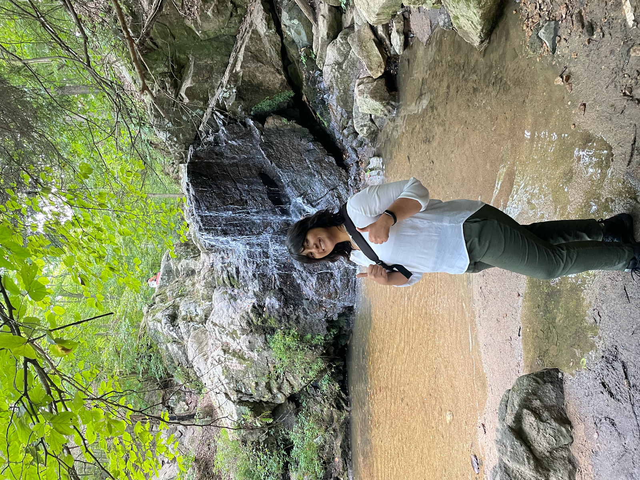
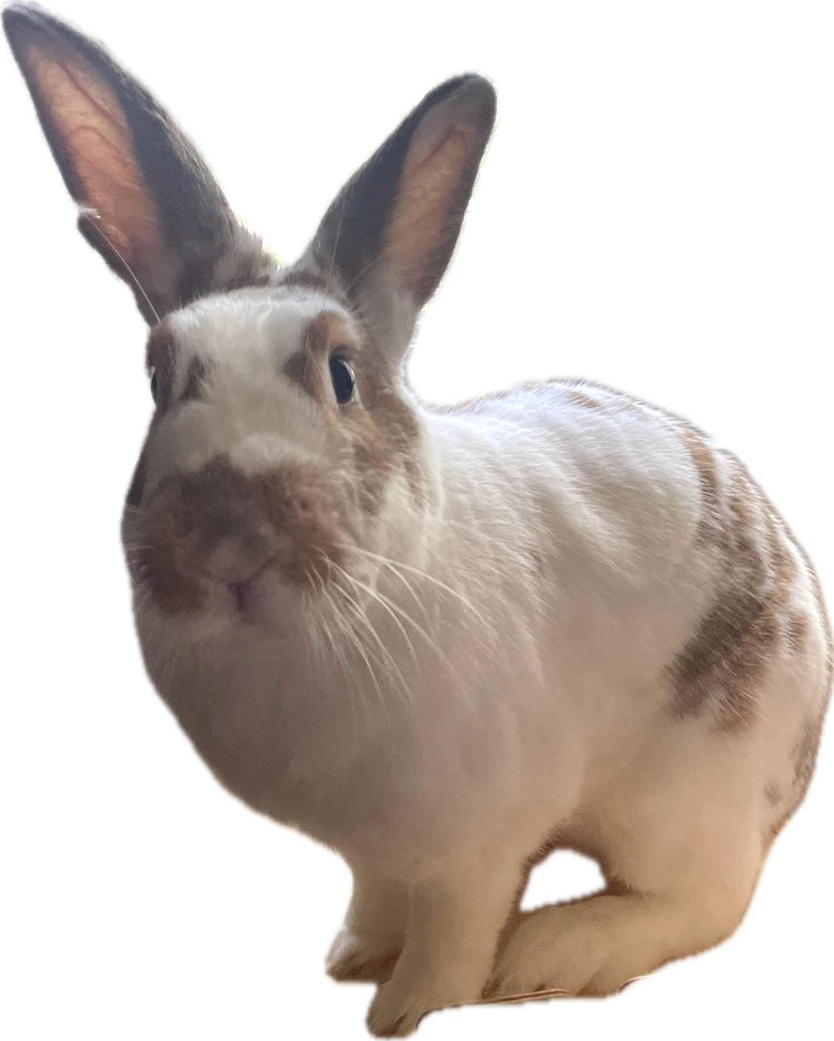
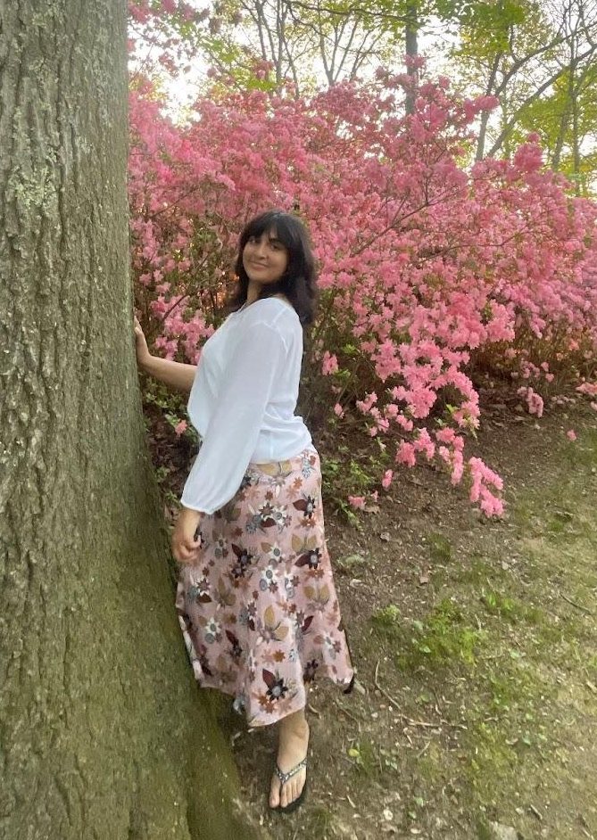
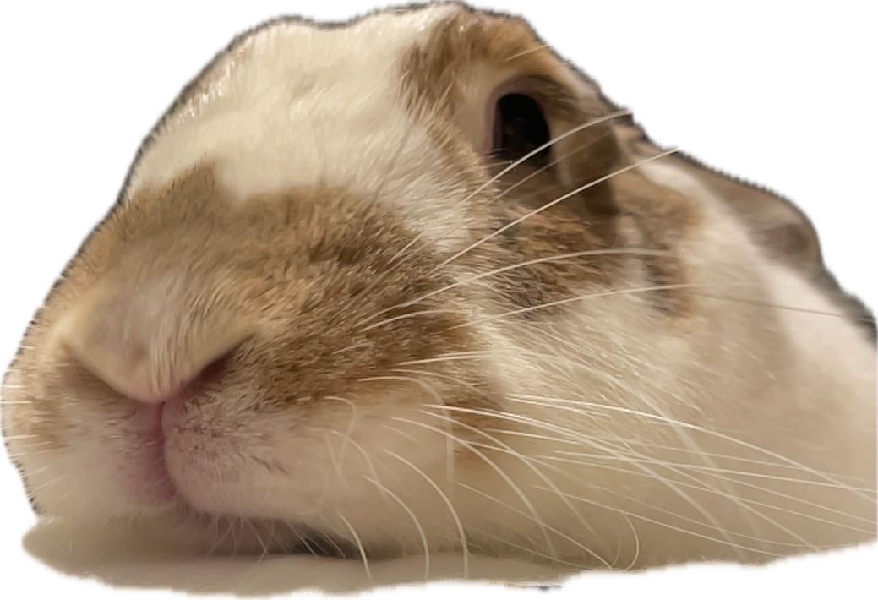
Amal Imtiaz
Major: Psychology B.S.
Fun Fact: I have a grumpy pet rabbit named Snoopy who sits with me while I study.
Why I’m Running:
Being a part of Greenpeace means working alongside a community of like-minded students who share my concern for the future of our environment! As secretary of UMBC Greenpeace, I hope to contribute by keeping our communications timely and clear, expanding volunteer and advocacy opportunities for members, and helping make the club a more active and known presence on campus.
Thanks!

Slide 18
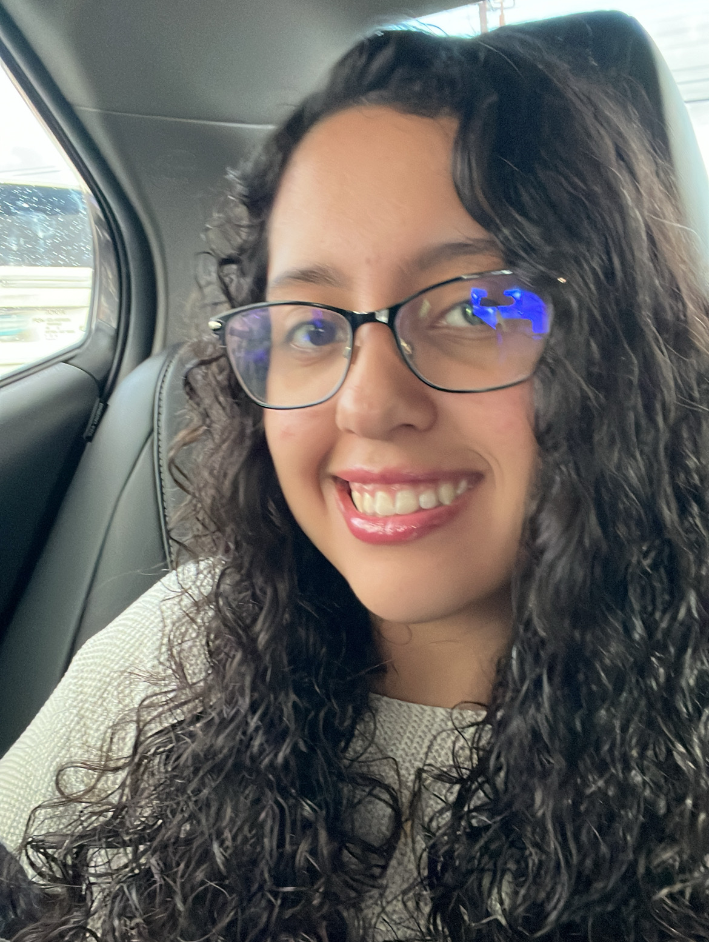
Social Media Coordinator: Victoria Beltran
-Major: Biological Sciences
-Fun Fact: Spanish is my first language and I’m fluent in both English and Spanish.
-Why I’m running: I’ve been a part of greenpeace this past semester and I’ve really enjoyed it. My goal is to promote Greenpeace and all we have to offer.

Slide 19
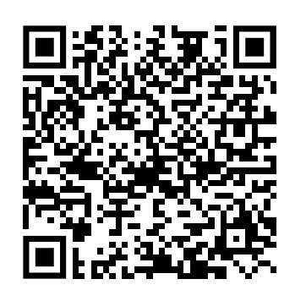
Results
We will allow voting for the whole week UNTIL FRIDAY, MAY 9TH at the end of day
Results will be posted by that Sunday and we will have an onboarding meeting shortly after
If meeting Sunday virtually in the evening works for the candidates, we will meet then to give you all the information for the club!
Voting Form >

Slide 20
Study Abroad Presentation!
Education abroad office website: https://studyabroad.umbc.edu/

Slide 21
Thanks
Does anyone have any questions?
addyouremail@freepik.com
+91 620 421 838
yourwebsite.com
Please keep this slide for attribution

