Slide 1
The Good, the Bad, and the Ugly: Personal Finance on TikTok
Carrie Sorenson
“The University of Maryland is an Equal Opportunity Employer and
Equal Access Programs”

Slide 2
A little about me
FCS Educator since 2017
AFC®

Slide 3
Our Plan for Today
College students and financial literacy
How we find the information we need
Sorting the good from the bad
Where to find good information

Slide 4
What financial decisions are you making now? What decisions do you think you will be making in the next 5 years?

Slide 5
Upcoming Important Decisions
Student loans
Building credit
Starting first job (in career path)
This would be a lot, even for someone well prepared!

Slide 6
Are most college students prepared?

Slide 7
Financial education is inconsistent
Many schools have no personal finance requirement
College students report learning from friends and family
They also report needing more information

Slide 8
If you couldn’t ask friends or family and needed financial information, where would you go?

Slide 9
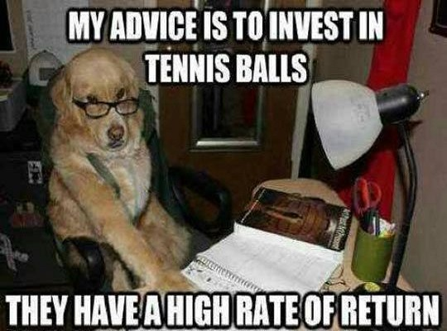
Finance Advice is Everywhere…

Slide 10
Let’s imagine a situation…
You want to get your first credit card and search online for one. You get:
Ads
Tips and tricks
Information about the importance of your credit score
Now you need to know how credit scores work
So, you Google that
It’s midnight and you’re tired, so you give up or make a decision

Slide 11
Information Overload
Totally human
Can also result in financial decisions that aren’t the best ones possible

Slide 12
Good, Bad, and Ugly: Info Sources
Friends and family
Social media
Government agencies
Financial institutions
Notes:
Friends and family – could be out of date or wrong, social media – could definitely be wrong, Govt agencies – good info but can be dense and hard to understand, financial institutions – could be good, could be selling something

Slide 13
Evaluating Information Sources
Who should we evaluate?
How can we evaluate?

Slide 14
Start with Initial Red Flags
Too good or too easy to be true?
Is this person or organization selling a product? What?
What sort of credentials does this person have? Who do they work for?
What is the mission of this organization? How do they make their money?

Slide 15
Example: Too Good to Be True
The TikTok:
What’s a piece of information it feels illegal to know?
That you can start a S Corporation and not have to pay taxes

Slide 16
Example: What are they selling?
The TikTok:
You can become a millionaire very young if you open a specific type of account with a specific company

Slide 17
Example: What are their credentials?
The TikTok:
Someone claims there is secret bank account at the Federal Reserve for every American citizen, you just have to look it up using your Social Security number

Slide 18
Example: How do they make money?
There are many companies out there promoting products that are free to use (think free budgeting apps, credit score monitoring, or even a credit score boost).
But if you aren’t paying them, then how are they making money?

Slide 19
Start with these reputable sources
Consumer Financial Protection Bureau (CFPB)
Dallas Federal Reserve – Building Wealth
Federal Deposit Insurance Corporation (FDIC)

Slide 20
Some Great Books
The Behavior Gap
Loaded: Money, Psychology, and How to Get Ahead without Leaving Your Values Behind
Personal Finance Class textbook

Slide 21
In Person
An Extension class
College resources
Financial advisor
HUD Certified housing counselor

Slide 22
References
https://www.insidehighered.com/news/2022/02/25/survey-college-students-need-help-financial-literacy
https://www.cnbc.com/select/popular-personal-finance-tiktoks-fact-check/
https://www.vox.com/the-goods/22229551/tiktok-personal-finance-day-trading-tesla-scam
https://www.buzzfeed.com/gracehlee/high-school-student-learning-money-on-tiktok

Slide 23
Carrie Sorenson
330 Montevue Lane, Frederick, MD 21702
301.600.1598 / cjrsoren@umd.edu

