Slide 1
Wise Up! Preventing Identity Theft
Thursday, April 6th 2022
Kevin Mitchell (kevinm@umbc.edu)
Kashif Khan (kkhan@umbc.edu)

Slide 2
Housekeeping
Respect one another
Mute yourself if you’re not speaking
Ask questions…we welcome them!
Utilize the chat feature
Session will be recorded
FinancialSmarts

Slide 3
Session Goals and Objectives
By the end of this session, participants will be able to:
Define identity theft
Identify different forms of identity theft.
Understand the financial and emotional impact of identity theft.
Know how to prevent identity theft.
Know what to do if they are a victim of identity theft.
FinancialSmarts

Slide 4
Poll #1
FinancialSmarts
Notes:
How many Americans have had their identity stolen per year?
1 Million
5 Million
9 million (correct answer)
12 million

Slide 5
What Is Identity Theft? Someone uses your personally identifying information, like your name, Social Security number, account number, or credit card number, without your permission, to commit fraud or other crimes.
FinancialSmarts

Slide 6
FinancialSmarts

Slide 7
What’s Your Thoughts/Experiences with Identity Theft?
FinancialSmarts

Slide 8
Poll #2
FinancialSmarts
Notes:
Which of the following is a way to steal your identity?
Shoulder Surfing (correct answer)
Opening a bank account
Showing your Social Security card to your employer
All of the above

Slide 9
How do thieves steal your identity?
FinancialSmarts

Slide 10
Dumpster Diving
“Dumpster Diving” – digging through your trash – is still one of the most popular methods for stealing large amounts of your personal information.
What are thieves trying to steal?
FinancialSmarts

Slide 11
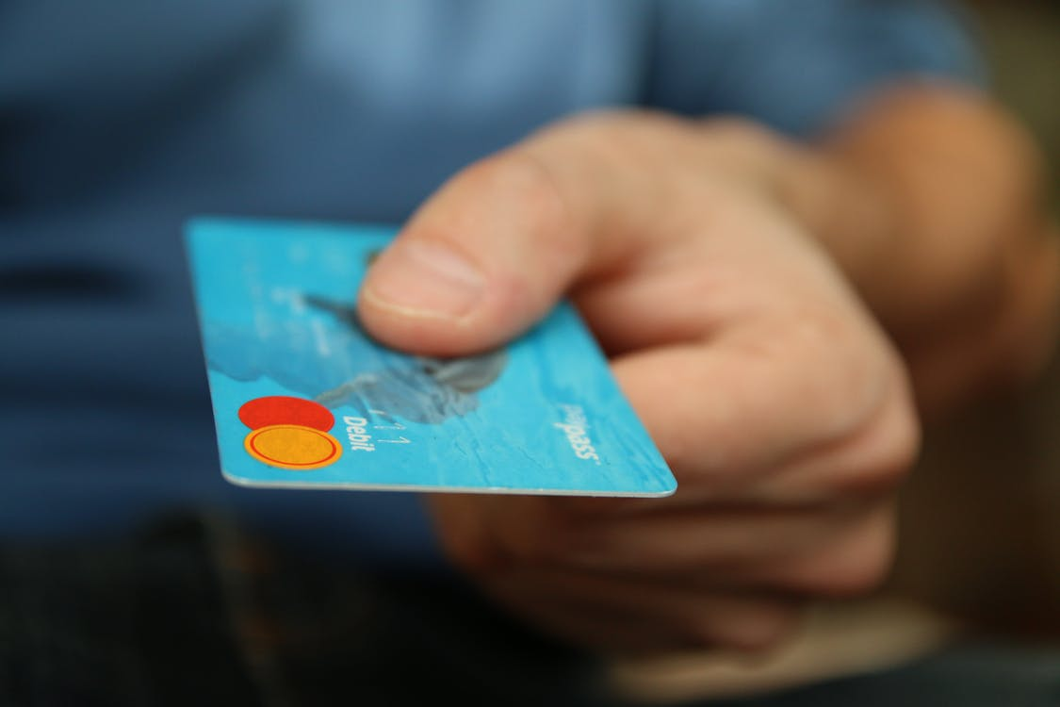
Skimming
Skimming is a method used by identity thieves to capture payment and personal information from a credit card holder.
Thieves often use a device called a skimmer
Some machines act like point-of-sale technology.
Card users are warned to always keep their cards in their sight and to cover the pin pad when inputting security codes at ATMs.
FinancialSmarts

Slide 12
Shoulder Surfing
Shoulder surfing can occur anytime you're sharing personal information in a public place.
At a restaurant
At an ATM
At the airport
FinancialSmarts

Slide 13
Phishing
Scammers use email, text messages, or phone calls to trick you into giving them your personal information.
They may say they’ve noticed some suspicious activity or log-in attempts
Claim there’s a problem with your account or your payment information
Say you must confirm some personal information
Include a fake invoice
Want you to click on a link to make a payment
Say you’re eligible to register for a government refund or Stimulus
Offer a coupon for free stuff
FinancialSmarts

Slide 14
Changing Addresses
Address fraud is a form of identity theft where an individual uses the change of address process to reroute your mail to a different address.
Signs of Change of Address. You receive a move validation letter.
You stop receiving mail.
The billing address for your credit card changes.
You get notified that an account has been opened in your name.
FinancialSmarts

Slide 15
Pre-Texting
Pretexting is another form of social engineering where attackers focus on creating a good pretext, or a fabricated scenario, that they use to try and steal their victims’ personal information. Pretexting attacks rely on building a false sense of trust with the victim.
FinancialSmarts

Slide 16
Identity Theft Methods - Summary
Dumpster Diving
Skimming
Shoulder Surfing
Phishing
Changing Your Address
Pretexting
FinancialSmarts
Notes:
Kevin
https://freesvg.org/identity-theft-symbol pulled from a site that says this image is public domain

Slide 17
What are other methods of identity theft?
FinancialSmarts

Slide 18
What do thieves do with your stolen identity?
Credit Card Fraud
Phone and Utility Fraud
Bank and Finance Fraud
Government Document Fraud
Other Fraud
FinancialSmarts

Slide 19
Poll #3
FinancialSmarts
Notes:
Which is a warning sign that someone is using your information?
You find credit card charges you didn’t make (correct answer)
You get bills for medical services you did not use (correct answer)
Debt collectors call about debts that are not yours (correct answer)
Debit card transactions are taking a long time to process

Slide 20
Signs You May Be a Victim of Identity Theft
Information regarding credit you never applied for
Statements from lenders and/or businesses that you never contacted
No statements from bills that you should pay
Missing mail in general
Credit card purchases, or account withdrawals you don’t recognize
Claims you owe money for an account you have never opened or used
Email/ App/ Text notifications of purchases/ tracking / changes in account information
FinancialSmarts

Slide 21
Steps To Take If You Suspect You Are A Victim
Contact bank or financial institution(s) and credit card issuers – freeze or close the account
Contact 3 major credit bureaus: request a fraud alert and a copy of your credit report
Equifax: 1-800-685-1111
Experian: 1-888-397-3742
TransUnion: 1-800-680-7289
FinancialSmarts

Slide 22
Steps To Take (continued)
Report the identity theft to the FTC at identitytheft.gov or 877-438-4338
File a police report
Notify appropriate authorities about lost license or passport immediately
Passport: Notify U.S. Dept. of State, Passport Services, Consular Lost/Stolen Passport Section at www.travel.state.gov/passport/lost/lost_849.html
License: Report to the issuing states Department of Motor Vehicles at http://www.usa.gov/Topics/Motor_Vehicles.shtml
Maintain a written chronology of contact and follow-up.
FinancialSmarts

Slide 23
Secure your Accounts
Password Managers
Password Generator: hCqC#Db8Q7fE
Most Popular Password managers are
LastPass https://www.lastpass.com/
Bitwarden https://bitwarden.com/
Dashlane https://www.dashlane.com/
1Password https://1password.com/
FinancialSmarts

Slide 24
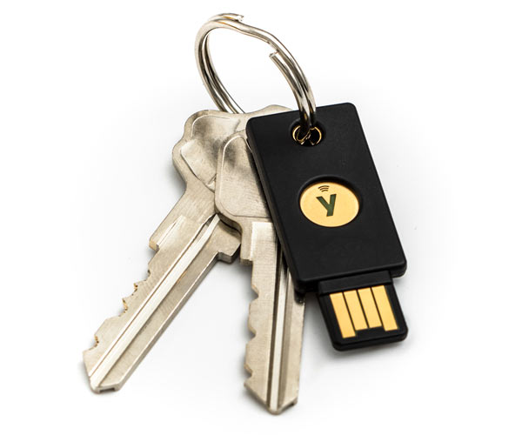
Add a second Layer of Protection
Use software-based apps to add extra layer of Protection
Google/Microsoft Authenticator Apps
UMBC uses DUO: sends request to a registered device: Accept or Deny
Physical Key: Google YubiKey
FinancialSmarts

Slide 25
Monitor your Credit and Finances
Keep track of your accounts and transactions
Mint – visualize your spending and income
Credit Karma - Actively track your credit score
Mint: https://mint.intuit.com/
Credit Karma https://www.creditkarma.com/
FinancialSmarts

Slide 26
Poll #4
FinancialSmarts
Notes:
What can you do to protect your identity online?
Always use the same password for every account
Create a unique password with special characters ( correct answer)
Be Cautious of personal information you are sharing online ( correct answer)
Shop only on secure sites (correct answer)

Slide 28
How to Prevent Identity Theft?
FinancialSmarts

Slide 29
Be Prudent with Your Social Security Number
Don’t carry around your social security card with you
If a job or organization asks for multiple forms of identification offer another one
Don’t Use Your SSN as a Password
Ask questions
FinancialSmarts

Slide 30
Shred, shred, shred
Documents Containing Financial Information
Documents Containing Personal Information
Documents Containing Account Information
Junk Mail
Child- and School-Related Mail
FinancialSmarts

Slide 31
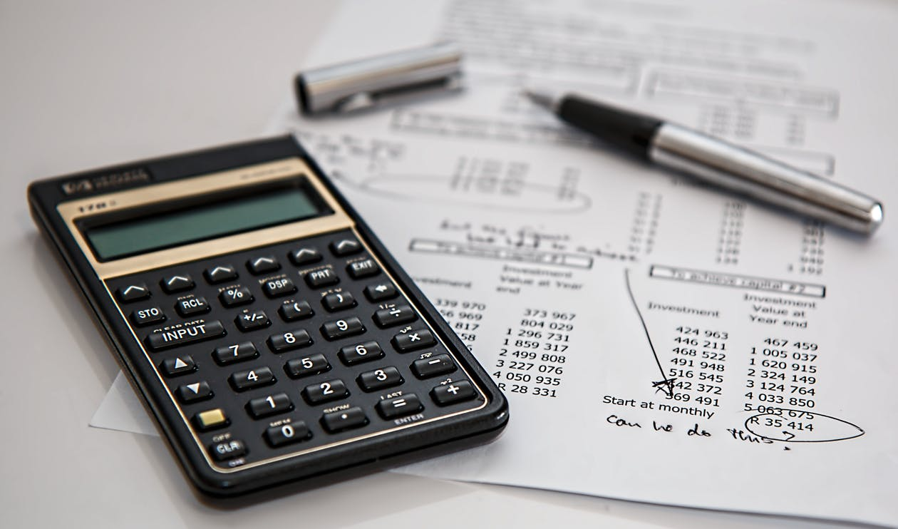
Review bank account activity regularly
Early identification of fraudulent activity on your account
Speak to your bank about enabling fraud alerts
FinancialSmarts

Slide 32
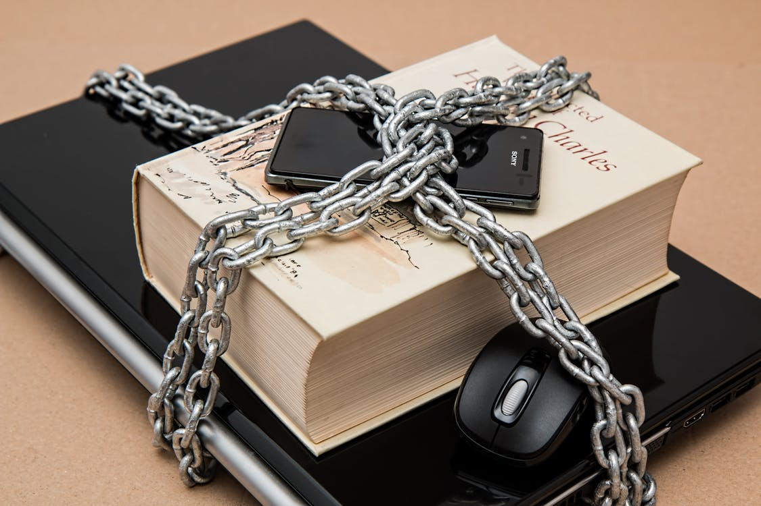
Protect your PINs and passwords
If possible don’t write down your passwords
Use a different complex password for every website. Use a password manager to keep track of your password
Add multi-factor authentication for accounts that offer it.
Keep track of when websites have been hacked and change all associated password. Use websites like HaveIBeenPWNed
FinancialSmarts

Slide 33
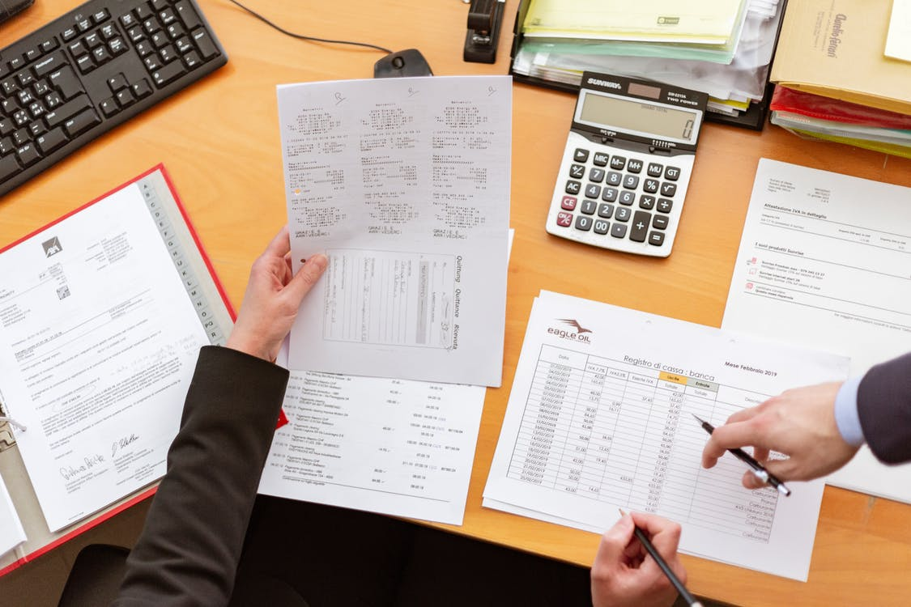
Order your free credit report annually
Why do I want a copy of my credit report?
How do I order my free report?
How long does it take to get my report after I order it?
FinancialSmarts

Slide 34
Protect your mail
Do not leave it in your mailbox overnight
Tell your Post Office when you will be out of town
Upgrade to a locking mailbox with drop slots
Sign up for Informed Delivery® by USPS®
FinancialSmarts

Slide 35
How to Prevent Identity Theft - Summary
Be prudent with your Social Security number
Shred, shred, shred
Review bank account activity regularly
Protect your PINs and passwords
Order your free credit report annually
Check your mailbox
FinancialSmarts

Slide 36
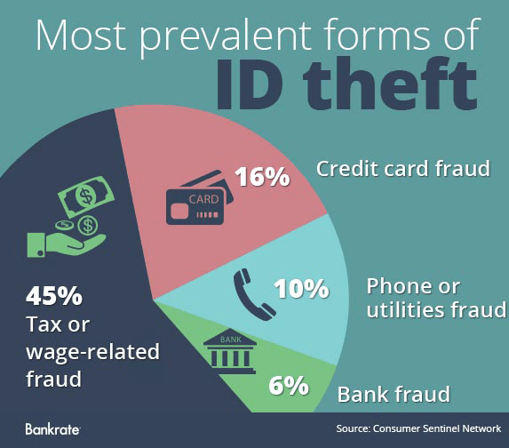
Think You Are Safe?
FTC reports that 18-29 year olds are most commonly affected
FinancialSmarts

Slide 37
Now What?
Secure personal information in your room or apartment
Do not give out personal info unless you’ve initiated the contact
Guard your mail and trash
Keep your Social Security card in a secure place
Update your virus protection software regularly
FinancialSmarts

Slide 38
Thoughts/Reactions/Questions
FinancialSmarts

