Slide 1
How to Navigate Student Loan Repayment
Ben Carey
Business Development Manager
443.910.1974
Ben.carey@studentconnections.com
Notes:
Hi everyone and welcome to session about How to Navigate Student Loan Repayment.
My name is Ben Carey, and I’m the director of product innovation at a company called Student Connections. We primarily work with college students to provide financial education resources, semi-regular college debt letters to ensure students know how much they’ve borrowed each year, and we provide outreach services both to students in school who need support with enrollment, and students who have left school and are starting to enter student loan repayment.

Slide 2
What’s the Latest on Student Loan Debt Relief?
Notes:
It’s important to note that things haven’t been “normal” with student loans for a while. Let’s take a look at what’s been going on since 2020.

Slide 3
Student Loan Debt Relief
Key Events Since 2020
March 2020 - Payments and accruing interest were initially suspended
2021-2022 - Number of federal student loan servicers went from 8 to 6
August 2022 - One-time student loan cancellation announced August 2022
October 2022 - Application was released
November 2022 - Courts suspended accepting and processing of applications for one-time debt relief
February 2023 - Supreme Court heard arguments from two court cases
Notes:
Payments and accruing interest were initially suspended March 2020 – the pause has been extended eight times since
Number of federal student loan servicers went from 8 to 6
In August 2022, one-time student loan cancellation was announced
Application was released Oct. 18, 2022 - more than 26 million applied
Courts suspended the accepting and processing of applications for one-time debt relief
The Supreme Court heard arguments from the two cases currently blocking loan cancellation

Slide 4
Student Loan Debt Relief
Current Status: ON HOLD (awaiting Supreme Court decision)
Ruling in Favor of Loan Forgiveness
Ruling Against Loan Forgiveness
Federal Student Aid (FSA) can process applications already received and begin accepting new applications
More than 40 million borrowers will be eligible for some relief
Students out of school with a federal balance remaining will be expected to begin payments
All students out of school with a federal balance will be expected to begin payments
Notes:
Supreme court heard cases February 2023
A decision is expected before the end of June 2023
If ruling is in favor of debt forgiveness, FSA can process applications already received and begin accepting new applications
More than 40 million borrowers will be eligible for some relief
If ruling is against, all students out of school with a federal balance will be expected to begin payments after 3+ years of not having to

Slide 5
When Will Loan Payments Begin?

Slide 6
When Will Loan Payments Begin?
Students in Payment Pause
Students About to Graduate
Between June 20 and August 30
60 days after the final Supreme Court Ruling
Or August 30, 2023 at the latest
Late Fall 2023
(after normal 6-month grace period)
Notes:
For students currently in the pause, rather than announce an end date, the government announced a timeframe for when the student loan payment pause will end. Bottom line: the earliest possible date is June 12 and the latest is August 30.
For students in school getting ready to graduate, you’ll enter your 6 month grace period and start payments late Fall 2023 - just like you normally would.

Slide 7
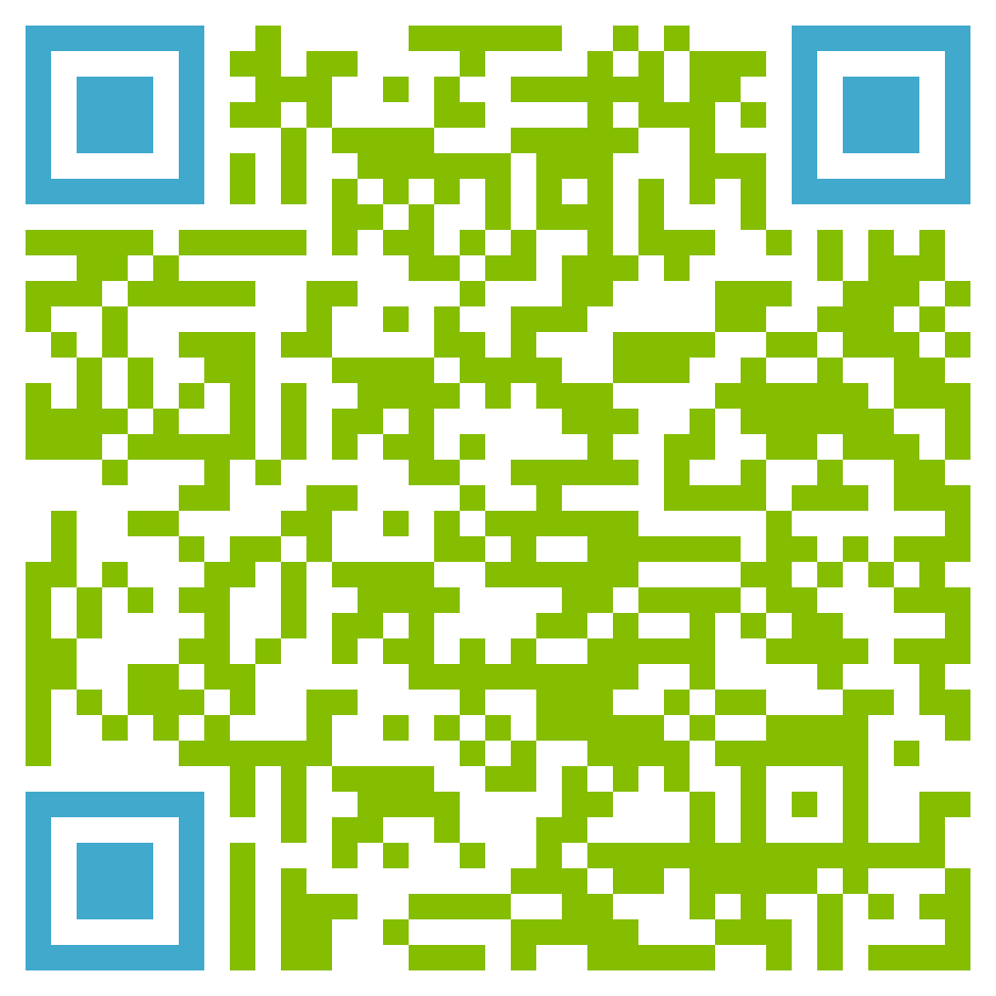
9 Things to Know About
Student Loan Forgiveness
Notes:
So let’s talk about the possibility of loan forgiveness being upheld.
You can scan the QR code to read our blog post with additional details.

Slide 8
1. How Do I Know if I Qualify for Student Loan Forgiveness?

Slide 9
1. How Do I Know if I Qualify for Student Loan Forgiveness
Must have eligible federal loans
Annual federal income for 2020 or 2021 must have been below $125,000 individual or $250,000 married
NOTE: If you borrowed in 2021-22 academic year, your parent’s income will be used (if you were considered a dependent student for financial aid purposes)
Notes:
Must have eligible federal loans
Your reported annual federal income for 2020 or 2021* must be below $125,000 individual or $250,000 married
You only have to meet the conditions for ONE year (2020 or 2021), NOT both years.
For those of you in school, if you received a federal student loan during the 2021-22 academic year – so last school year – and were considered a dependent student for financial aid purposes, your parent’s income will be used to qualify.
The good news is that you don’t have to worry about getting it. You’ll enter your individual income when applying. Federal Student Aid will email both you and your parent instructions on how to complete the rest of the process later on.

Slide 10
2. Are My Loans Eligible for Forgiveness?

Slide 11
2. Are My Loans Eligible for Forgiveness?
Do you have federal student loans disbursed prior to July 1, 2022?
Don’t Know?
Log in to StudentAid.gov go to “My Aid” Look for federal student loans owned by the Dept. of Education and disbursed prior to July 1, 2022
Notes:
Do you have federal student loans disbursed prior to July 1, 2022?
Don’t know? Log into StudentAid.gov and select “My Aid” in the dropdown menu. Look for federal student loans owned by the Dept. of Education and disbursed prior to July 1, 2022.
Note – if you have qualifying loans disbursed both before and after July 1 – only a portion of your overall debt can be cancelled. The portion that was disbursed before July 1, 2022.
For example
- If you had $5,500 in eligible loans for the 2021-22 school year, and then took out $5,500 in loans for the 2022-23 school year which were disbursed in August 2022 – only the loans for the 2021-2022 school year will qualify. Which some debt cancellation is still better than none.

Slide 12
3. How Much Student Loan Forgiveness Will I Get?

Slide 13
3. How Much Student Loan Forgiveness Will I Get?
If you meet loan type and income requirements
up to $10,000
If you had a Pell Grant
an additional $10,000
Up to $20,000 total debt relief
Notes:
If you meet the loan type and income requirements, you will qualify for up to $10,000 in debt relief.
If you received at least one Pell Grant, you may qualify for an additional $10,000 in relief (up to $20,000 total debt relief).

Slide 14
4. How Do I Know if I Received a Pell Grant?

Slide 15
4. How Do I Know if I Received a Pell Grant?
Not sure if you had a Pell Grant?
Log in to StudentAid.gov and go to “My Aid”
Notes:
Not sure if you had a Pell Grant? Log in to StudentAid.gov and go to “My Aid.”

Slide 16
5. What Do I Have to Do to Get the Forgiveness Applied?

Slide 17
5. What Do I Have to Do to Get the Forgiveness Applied?
Most have to complete a short application
Some automatically qualified
If you automatically qualified, you should have received an email and/or text message from FSA
Notes:
Some borrowers automatically qualified, but most have to complete a short application.
If you automatically qualified, you should have received an email and/or text message from FSA.

Slide 18
6. Will Student Loan Forgiveness Be Taxed?

Slide 19
6. Will Student Loan Forgiveness Be Taxed?
The one-time student loan debt relief won’t be taxed at the federal level
Some states may choose to apply taxes: NOT Maryland! ☺
Notes:
States that ARE taxing:
Indiana – basically something like $323 for $10,000 and $646 for $20,000
Minnesota
North Carolina

Slide 20
7. What if I Made Payments on my Student Loans During the Pause?

Slide 21
7. What if I Made Payments During the Pause?
If you made voluntary payments during the pause
And it brought your balance below the maximum amount you’re eligible to receive
Automatic refunds will be applied
Notes:
Automatic refunds will be applied if voluntary payments made during the pause brought your balance below the maximum debt relief amount you’re eligible to receive.

Slide 22
8. How Can I Avoid Student Loan Forgiveness Scams?

Slide 23
8. How Can I Avoid Student Loan Forgiveness Scams?
The most important thing to remember is
you NEVER have to pay
to receive student loan debt relief from FSA
Notes:
The most important thing to remember is that you NEVER have to pay to receive student loan debt relief from FSA.

Slide 24
9. Who Can I Contact for Help with Student Loan Forgiveness?

Slide 25
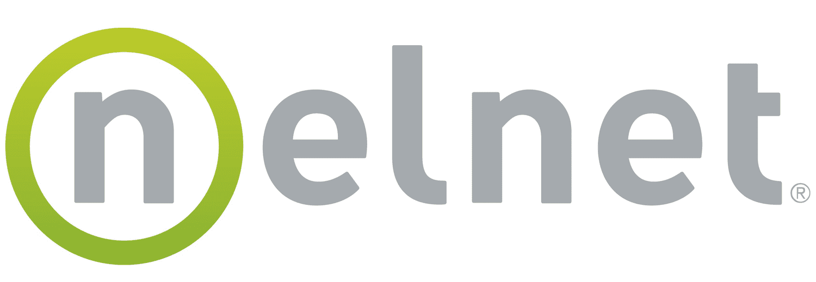
9. Who Can I Contact for Help?
Go to StudentAid.gov/DebtRelief for info
For answers to more specific questions, contact your loan servicer:
Notes:
You can find all of the details about federal student loan debt relief and how to apply for it at StudentAid.gov/DebtRelief. For answers to more specific questions, contact your loan servicer.

Slide 26
How to Prepare for the Challenges Ahead

Slide 27
Challenges Ahead
3+ year payment pause means millions of borrowers will enter repayment at the exact same time
Borrower support systems will have 36x the volume they were built to
25% fewer student loan servicers
Remaining servicers have reduced staff
Increasing attempts to scam student loan borrowers
Notes:
Due to 3+ year payment pause, millions of borrowers will all enter repayment at the exact same time
27+ million if loan forgiveness is shot down
18.2 million if loan forgiveness is upheld
The systems in place to support borrowers with key aspects of entering repayment will be overwhelmed with 36x the volume they were built to handle prior to 2020
Additionally, there are 25% fewer student loan servicers, and those that remain have reduced staff.
Increasing attempts to scam student loan borrowers

Slide 28
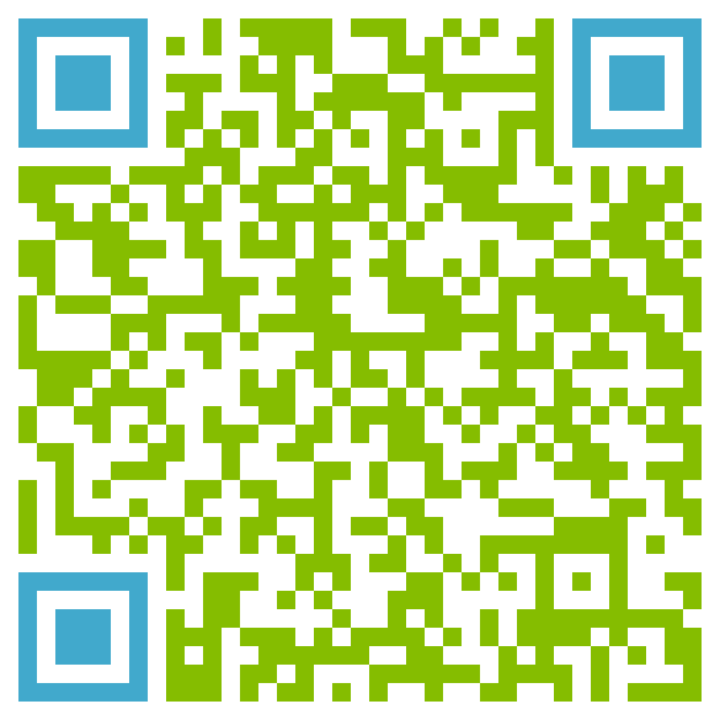
5 Steps
You Can Take Now
Notes:
Let’s talk about the things you can do proactively to limit the impact that these challenges may have.
You can scan the QR code to read our blog post with additional details.

Slide 29
1. Update Your Contact Info

Slide 30
1. Update Your Contact Info
Make sure your loan servicer and FSA have your latest contact info
Update your contact info and notification preferences on StudentAid.gov and your loan servicer’s profiles
Quick Tip
Sign up for alerts from FSA and the Department of Education Sign up for “Federal Student Loan Borrower Updates” at ED.gov/subscriptions
Notes:
Make sure your loan servicer and FSA have your latest contact info. This is the best way to make sure you stay current on changes to repayment over the next year.
TIP: Sign up for alerts FSA and ED
Sign up at ed.gov/subscriptions to be notified when the Student Loan Debt Relief application becomes available.
ADD text alerts from FSA (if available)

Slide 31
2. Review Your Monthly Payment

Slide 32
2. Review Your Monthly Payment
Log in to StudentAid.gov for payment info
If you haven’t, create an online account with your loan servicer:
Notes:
Sign into StudentAid.gov to check on what you’ll be paying each month.
If you haven’t already, create an online account with your Loan Servicer.
VISUAL - Loan servicer names/logos - FSA
RESOURCE: FSA Video about accessing account

Slide 33
3. Investigate Alternative Repayment Plans

Slide 34
3. Investigate Alternate Repayment Plans
Need a lower monthly payment?
IDR plans set the monthly payment based on household income and family size
Most limit monthly payments to 10% of discretionary income
This makes it possible to qualify for as low as a $0 monthly payment
 | $30,000 | $40,000 | $50,000
Single | $80 | $163 | $247
Family of 2 | $21 | $104 | $188
Family of 3 | $0 | $45 | $129
Family of 4 | $0 | $0 | $70
For example, someone with a balance of $27,000 and average interest rate of 3.9% will pay $272 a month with the Standard Repayment
Notes:
If you can’t afford your monthly payment, investigate income-driven repayment plans.
You can apply online or contact your loan servicer to switch plans free of charge.
RESOURCE: Loan Simulator & IDR Application

Slide 35
TIP: Compare repayment plans with Loan simulator
Go to StudentAid.gov/Loan-simulator
Notes:
Also note that you can change repayment plans for free at ANY time.

Slide 36
4. Build a Buffer

Slide 37
4. Build a Buffer
Preparing for the Unknown
Plan as if the court will rule against the program
Try to save enough cash to make your first monthly payment
If the debt relief goes forward, you’ll have some extra money to spend
If it’s rejected, you won’t get caught off guard
Notes:
We don’t know if the Supreme Court will uphold student loan debt relief.
The smart move is to plan as if the court will rule against the program.
Try to save enough cash to make your first monthly payment.
If the debt relief goes forward, you’ll have some extra money to spend.
If it’s rejected, you won’t get caught off guard.

Slide 38
5. Watch Out for Scams

Slide 39
5. Watch Out for Scams
Know the Facts
You never have to pay to apply for or receive student loan relief from FSA
No one should ever ask for your account username or password
Official emails from FSA come from noreply@studentaid.gov, noreply@debtrelief.studentaid.gov or ed.gov@public.govdelivery.com
Bottom Line: If you’re unsure, call your servicer or school
Notes:
Scammers thrive in confusion. It’s easier for them to take advantage of you if you don’t have the facts.
The Facts:
You never have to pay to apply for or receive student loan relief from FSA.
No one should ever ask for your account username or password.
Official emails from FSA come from noreply@studentaid.gov, noreply@debtrelief.studentaid.gov or ed.gov@public.govdelivery.com.
If you are unsure if an offer is legitimate, contact your school or loan servicer to verify.

Slide 40
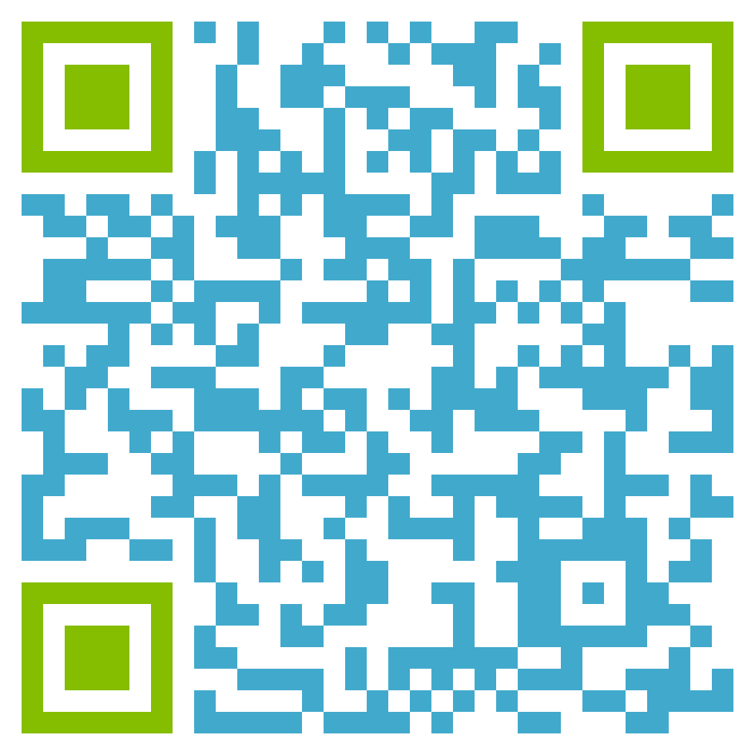
TIP: Sign up for official alerts
Sign up for Federal Student Loan Borrower Updates at ED.gov/subscriptions
Update your contact info on StudentAid.gov profile
Update your contact info on your loan servicer’s website
Learn more about avoiding scams here >>>
Notes:
Take these steps:
Sign up for alerts from official sources.
Make sure your contact information is up to date with FSA and servicers.
Learn more about how to avoid scammers in this article.

Slide 41
Want More Information about How Student Connections can Help?
Contact:
Student Connections
866.311.9450
www.repaymyloans.org

Slide 42
Questions?

