Slide 1
Creating an Academic Research Poster Using PowerPoint
*recorded
Notes:
JS shares screen

Slide 2
Introduction
Semhar Yohannes
semhar@umbc.edu
she/her

Slide 3
Introduction
Jasmine Shumaker
jshumake@umbc.edu
she/her

Slide 4
Overview
Poster 101
Content
Layout
Color/Font
Demonstration
Notes:
Mention that we will be stopping after each section to ask for questions, but Beck will be monitoring chat

Slide 5
Questions?
Who has created a poster before?
What software did you use and what was your experience like? (with the software and/or with the overall poster-making process)
Software: Keynote, Impress, Inkscape

Slide 6
Academic Research Poster
Definition: A visual communication tool that allows you to present your research in a clear, concise, and graphic format. It attracts attention, conveys information clearly, should initiate conversations, and can represent any stage of the research process. Researchers often create posters before the completion of the research project in order to invite feedback or collaboration.

Slide 7
Academic Research Poster
Goals
Communicate the results of the research
Attract attention and interest
Invite feedback or collaboration

Slide 8
Planning Stage
Step 1: Content
Step 2: Layout
Step 3: Color/font

Slide 9
Step One: Poster Content

Slide 10
Poster Content
It’s important to create the content beforehand and have it readily available either in word doc or excel file so you can cut/paste it into your PowerPoint slide
Time and energy…..

Slide 11
Planning Stage: Content
Title: catchy ~1-2 lines
Author: your name, faculty advisor’s name, names of collaborators, department & institution
Introduction/Abstract/Summary: short synopsis of your research~200 words
Notes:
These are the most popular sessions, no matter the discipline

Slide 12
Planning Stage: Content
Objectives:
the goals of the research
most often formatted in a bulleted list
Materials/Methods:
describe equipment and procedures
figures and flow charts
photograph or labeled drawing of organism or setup/~ 200 words

Slide 13
Planning Stage: Content
Results:
did the experiment work?
describe qualitative and descriptive results
refer to supporting charts or images/~ 200 words
Conclusion:
major results
state whether your hypothesis was supported
state the relevance of your findings to other published work
future directions/ ~300 words

Slide 14
Planning Stage: Content
References:
may use smaller font in this section to save room and then print a readable bibliography to pass out
Acknowledgments:
thank individuals for specific contributions and funding
include in this section explicit disclosures for any conflicts of interest and conflicts of commitment
~40 words

Slide 15
Planning Stage: Content
A poster that only includes text is dull
Types of images:
Photographs
Diagrams
Charts/graphs
Artwork

Slide 16
Planning Stage: Content
Image resolution should be no lower than 150 dpi to ensure their ability to print (over 600 pixels)
All images should be pictures (e.g. .tif, .gif for transparency, .jpg for non-transparent images)
Insert directly into PowerPoint (NOT linked from another program)
Preferred format: JPEG

Slide 17
Planning Stage: Content
Graphs or charts from Word/Excel: copy and paste into PowerPoint

Slide 19
Step Two: Poster Layout

Slide 20
Planning Stage: Layout
Simple!
Group related content
Images/text
White/negative space

Slide 21
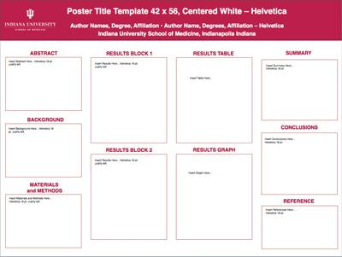
Planning Stage: Layout

Slide 22
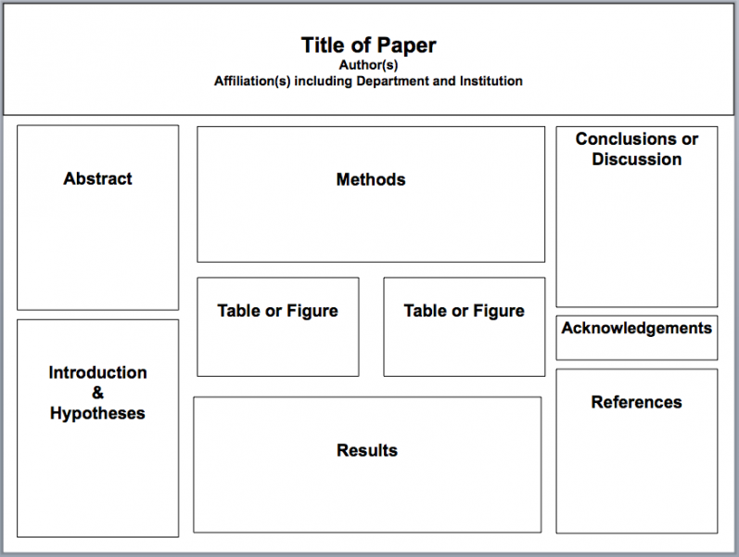
Planning Stage: Layout

Slide 23
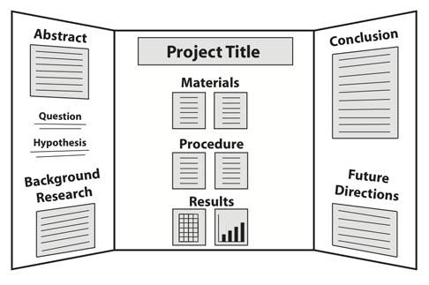
Planning Stage: Layout

Slide 25
Step Three: Poster Color/Font

Slide 26
Planning Stage: Color/Font
Color
2 or 3 colors only
Text: Black font
Background: Light colors (avoid dark background)
Shade difference

Slide 27
Planning Stage: Color/Font
Font Size
Title: 80-120
Subtitle: 48-80
Section Headers: 36-72
Body Text: 30-48
Font Style: Times New Roman, Arial, Arial Black, Franklin Gothic Heavy, Tahoma, Trebuchet, Verdana, Garamond, Book Antiqua, or Bookman Old Style
Notes:
Pause for questions at the end

Slide 28
UMBC Poster Examples
Notes:
Trade off!!!

Slide 34
Printing Services
Joe School: Geography; Cost is 50 cents per inch of length
Melissa Penley: Research Graphics Core Facility
Commonvision: Cost is calculated based on size and paper type
Fedex Kinkos
Walgreens
UPS Store

Slide 36
Start!
Notes:
https://umbc.box.com/s/9xmx7v57qcqsqh1dwshm5kufb8xkf0q3
https://umbc.box.com/s/5fplmjtwzlepqiamzjctxvz0y0c1gjpx
https://umbc.box.com/s/a9z8jqkyi5gy0wferfn6kj5qalu74lxi

Slide 37
Step One: Content
Create/gather poster content (text, graphs, photos)
MS Word
https://umbc.box.com/v/Poster

Slide 38
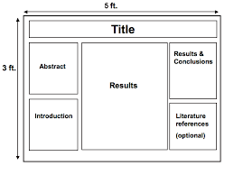
Step Two: Layout

Slide 39
Step Three: Color/Font
Font: Arial
Font Size:
Main Title: 80
Subtitle: 54
Section Headers: 48
Body Text: 40
Color:
Body Text: Black
Background: White
Title Box: Light Blue

Slide 40
Review Steps
Step1: Poster Content
Step 2: Poster Layout
Step 3: Poster Color/font

Slide 41
Open PowerPoint

