Slide 1
Writing Accountability Groups (WAGs)
Kickoff Meeting!
Fall 2026

Slide 2

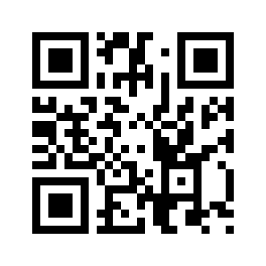
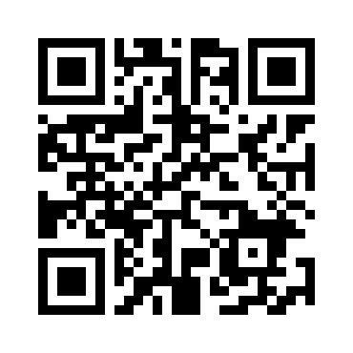
Stay up to date!
Mission
The mission of GEARS is to provide a platform for students to showcase their creative achievements, present research accomplishments, and share their experiences with peers.
GEARS aims to provide a friendly atmosphere to promote collaboration, improve communication skills, and celebrate the hard work of UMBC graduate students.
GEARS Webpage
GEARS Instagram

Slide 3

What are Writing Accountability Groups (WAGs)
Who: WAGs are comprised of a group of graduate students (usually 4-8 participants per group) interested in developing writing habits and accountability.
Why: Develop habits of writing every day for a short, manageable period of time by setting goals and being accountable to WAG peers.
When: WAG groups meet once a week for 60-90 minutes for 10-12 weeks. The group finds a weekly time mutually convenient to all group members.
What: Writing Accountability Groups (WAGs) are voluntary and facilitated by fellow UMBC graduate students.
Where: The group decides on a mutually convenient location to meet, whether in person or online.

Slide 4
What prevents you from setting aside time to write?

Slide 5

Expand your definition of “writing” to include any activity, such as:
Reading and summarizing articles
Outlining your paper or chapter
Entering or analyzing data
Creating a methodology figure
Organizing references

Slide 6
What strategies have worked for you to achieve your goals?

Slide 7
WAG Structure
15 min Goal Sharing
30 min Writing Time
15 min Wrap Up

Slide 8
WAGs Group Formation Process
We will form groups based on date/time availability by next week.
You will name the groups (eg. Retriever WAGS, etc).
You will determine consistent meeting time and meeting location (eg. online/offline).
You will identify a WAG facilitator to help organize and lead the group.
  You can have the same member as the facilitator throughout the semester or rotate it every week as well.

Slide 9
More Information on WAGs!
AOK Library Faculty has created a guide for facilitating Writing Accountability Groups. Visit here for more: https://lib.guides.umbc.edu/wags
WAGs were developed by Dr. Kimberly A. Skarupski, Ph.D., MPH. Visit here for more: https://www.wagyourwork.com/

Slide 10
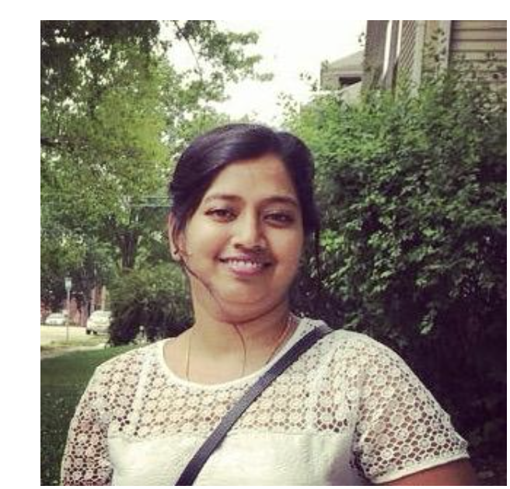
GEARS is here to help!
If you get stuck, or need any kind of help, please don't hesitate to contact us.
Swathi (swathin1@umbc.edu), one of our committee members is here to help you!

Slide 11
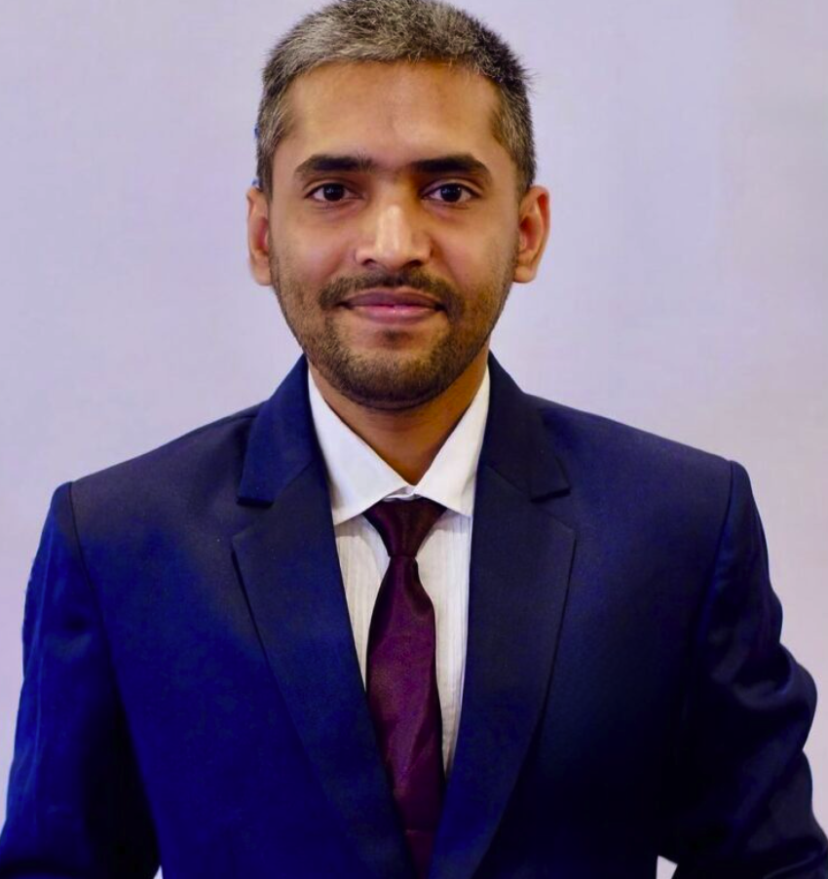
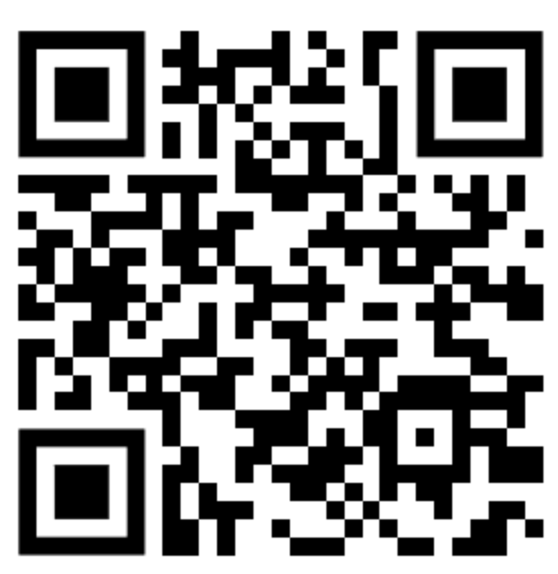
GSA Writing Advisor:
Harshal Singh Chauhan
The GSA Writing advisor is here to help!
Email: gsawa@umbc.edu
https://gsa.umbc.edu/writing-advisor/
Fall 2026
Mon: 12:00 PM – 6:00 PM
Tue: 9:00 AM – 2:00 PM
Thu: 9:00 AM – 2:00 PM
Fri: 12:00 PM – 4:00 PM

Slide 12

Application due date: Monday, October 12 by 12:00 PM.
Dates: October 21–23, 2026
Time: 9:00 am -4:00 pm
Food: Breakfast, coffee, and lunch are provided
1.Spend focused time writing proposal or dissertation.
2. Attend writing workshops and seminars.
3. Receive one-on-one coaching.
4. Learn how to communicate better with faculty.
5. Meet other graduate writers

Slide 13


Movie Night coming up!
Date - 10/16/2026
Time - 7-9PM
Venue - TBA soon

