Slide 1
UMBC 2020
How to Fund Your Graduate Education
START NOW!
Presented by
Frances Carter-Johnson, PhD and Patti Ordóñez, PhD
NSF GRFP Recipients
Graduate Research Fellowship Operations Center
Notes:
Patti
Hello and welcome. On behalf of the Graduate Research Fellowship Operations Center, we would like to present to you the National Science Foundation’s Graduate Research Fellowship Program, or the NSF GRFP for short. We’d like to inform you about the award details and some things to keep in mind as you construct a competitive application.

Slide 2









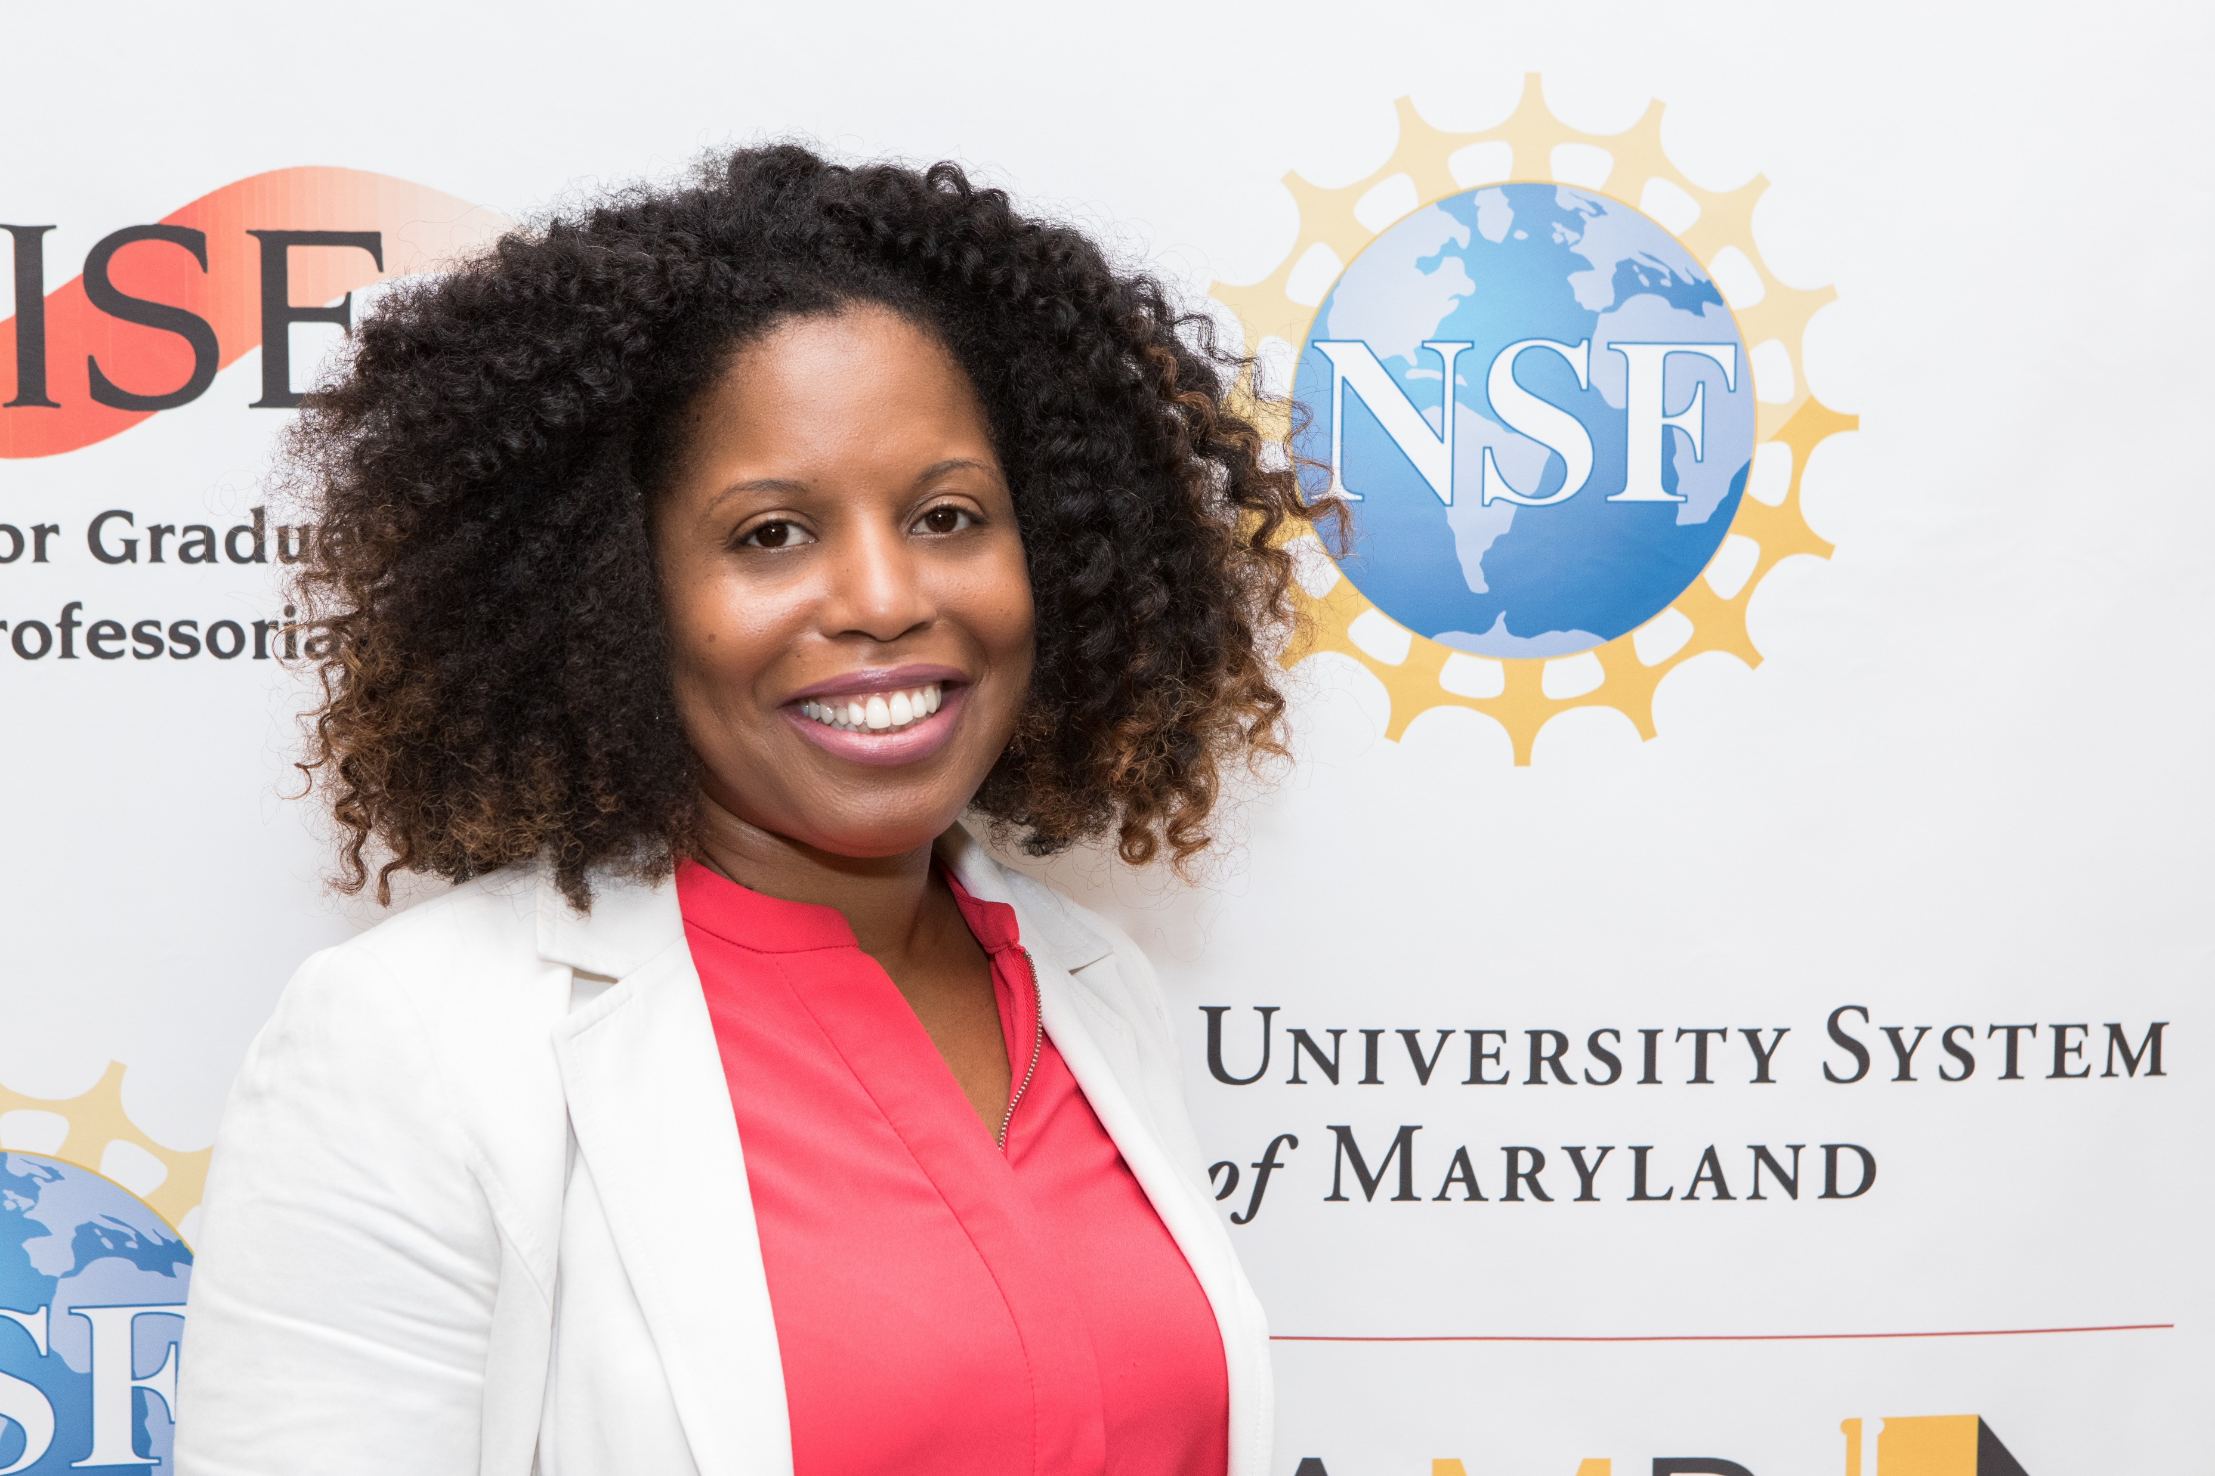

Who is Frances?
Physicist/Engineer
STEM ED
Policy Researcher
Education
Data Scientist
Apply at: https://www.research.gov/
Notes:
HBCUs a part of my family educational legacies with

Slide 3

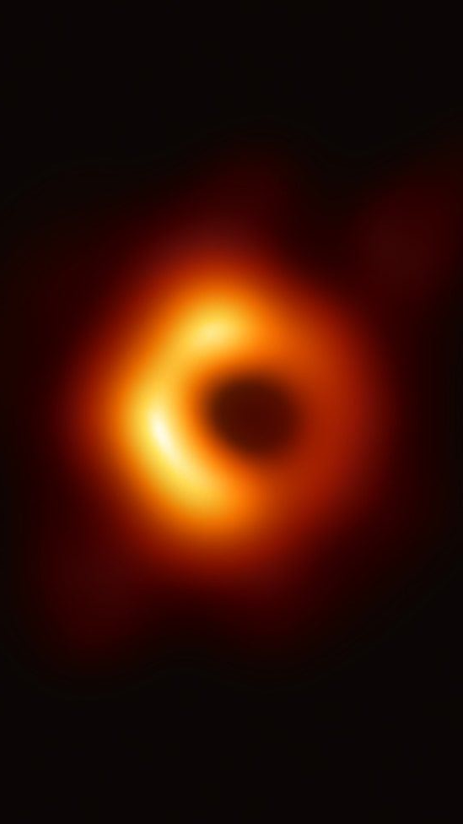






Who is Patti?
Teacher
Technical Trainer
Associate Professor
Apply at: https://www.research.gov/

Slide 4
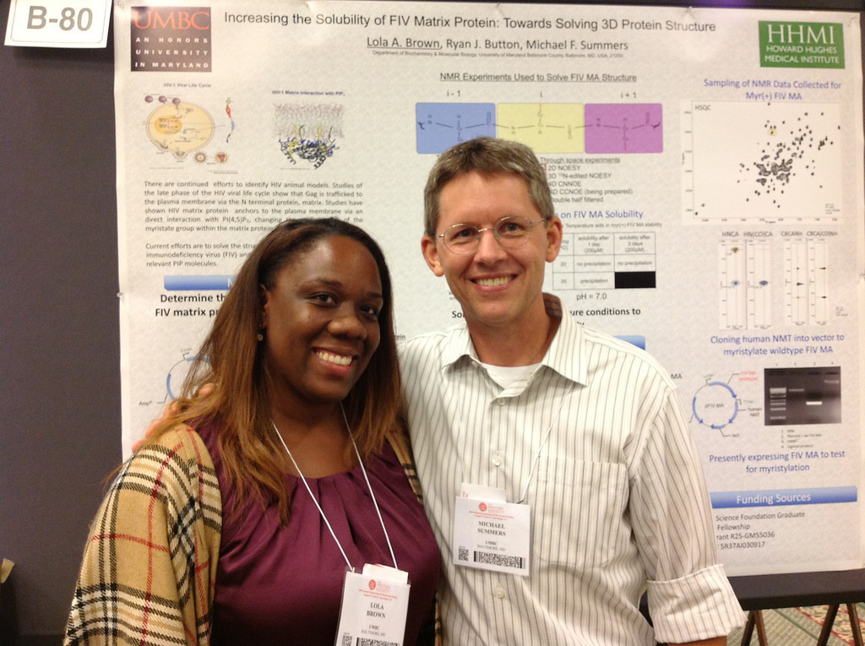
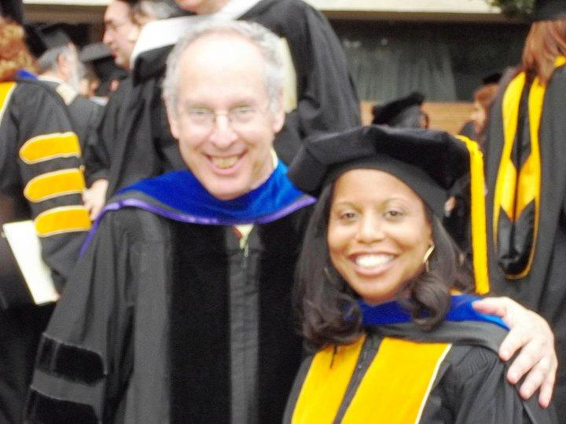
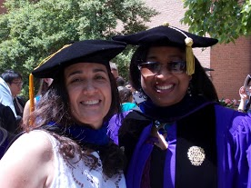
















Desperation brings inspiration!!!
Apply at: https://www.research.gov/
Notes:
Frances

Slide 5
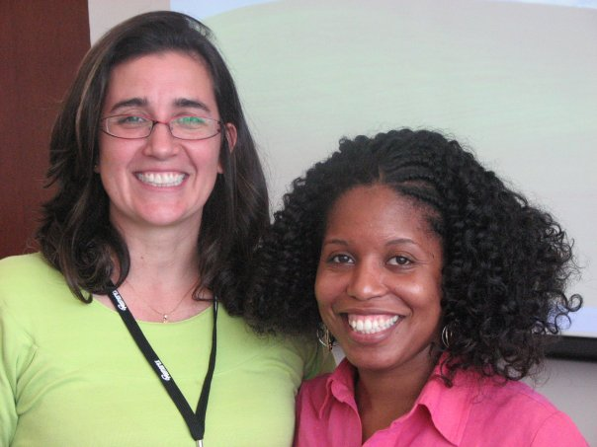

Apply at: https://www.research.gov/
Notes:
Frances

Slide 6
Seminar Outcomes
Inform you of graduate funding opportunities
Introduce several domestic and international fellowships
Guide preparation of winning applications
Discuss Personal Statement and Proposal
Brainstorm on Personal Statements
Begin to write Personal Statements
http://ccom.uprrp.edu/~pordonez/NSFworkshop
Notes:
Patti

Slide 7
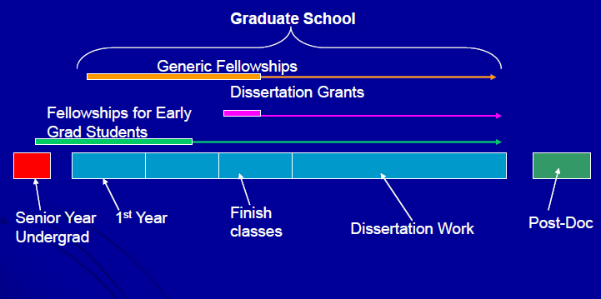
When can I get the money?
Continuum
Notes:
Frances
Resource from Megan Palsa of Texas A & M University

Slide 8
Where is the money?
Assistantships vs. Fellowships
Types of Fellowships
  University - BD, GAANN/Jacob Javits, Meyerhoff
  State & Regional – SREB, local congressmen
  Private - Hertz, Ford, Hughes, Woodrow Wilson, Jack Kent Cooke
  Industry - Honda, IBM, GEM…
  Agency - NASA, EPA, DHS, DoEd, DoEnergy, DOD, Air Force
  National/International - NSF GRFP/Fulbright
Notes:
Frances
GAAAN and Jacob Javits combined in FY 2012 for awards in 2013 and 2014.

Slide 9
The Good, the Bad and the Ugly
 | University Fellowship | Advisor Support | External Funding
Choose the advisor YOU want | May vary | Difficult to change advisors | Easier to change advisors
Advisor runs out of money | Department may support student, may need to switch advisors, sometimes dismissal | You or advisor need to come up with new source of funding | You will still be paid!
Partial funding | First year only | At advisor’s discretion | Many fellowships for 3+ years
Teaching requirement | Usually | At advisor’s discretion (may ask you to teach to supplement their financial support) | NO
Makes you more competitive for (academic) jobs | No | No | YES
Apply at: https://www.research.gov/

Slide 10
Show me the money…
  http://www.ncsu.edu/grad/financial-support/fellowships.html (fellowships by deadline date)
  http://gradschool.umbc.edu/funding/fellowships/
  http://www.finaid.com/ and http://www.fastweb.com/
  https://bigfuture.collegeboard.org/scholarship-search
  http://sites.nationalacademies.org/pga/Fellowships/PGA_046301
  http://hsf.net/en/scholarships/programs/
  https://scholarships.uncf.org/
  http://www.scholarshipexperts.com/
  http://fulbrightonline.org/ (International)
  http://ww2.kdp.org/images/PC_Resources/Finding_Funding_for_Grad_School.pdf
Notes:
Frances
Robin Walker at Missouri
For computer science
http://research.microsoft.com/apps/mobile/showpage.aspx?page=/en-us/collaboration/awards/fellows-women.aspx
http://www.google.com/anitaborg/
http://scholarships.hispanicfund.org/applications/subsectionID.1,pageID.123/default.asp
http://googleblog.blogspot.com/2007/01/uncfgoogle-scholarship.html

Slide 11
International style money
Websites to help you find the money
  http://www.ncsu.edu/grad/financial-support/fellowships.html (fellowships by deadline date)
  http://www.hhmi.org/programs/international-student-research-fellowships
  http://www.conacyt.gob.mx/index.php/becas-y-posgrados
  http://www.scholarshipportal.com/
  http://www.echoinggreen.org/fellowship/echoing-green-fellowship
  http://sites.nationalacademies.org/pga/Fellowships/PGA_046301
  http://www.scholarshipexperts.com/
  http://www.intlstudent.org/scholarships.html
  http://foreign.fulbrightonline.org/
  http://www.foreignborn.com/study_in_us/8-paying4school.html
Notes:
Frances
NCSU – Soros Fellowship and NRC Research Associate Programs with opportunities for foreign nationals; MUST Review each to see if eligible
HHMI – Support outstanding mid-career international students (2nd or 3rd year graduate students)
GEM – permanent residents
Marie Curie – for studying in Europe
Echoing Green – Business Innovation Fellowship to
Conacyt – Organization to support scientific innovation in Mexico. Offers scholarships to study domestically and abroad for Mexican citizens/professionals
ISO – International Student Org in the USA – list of scholarships for international students

Slide 12

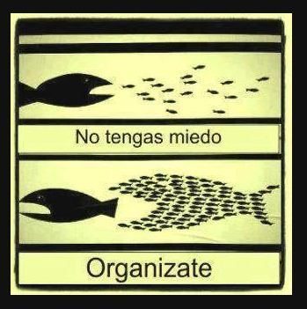
Organize Yourself
Don’t be scared
Get organized
Notes:
Patti

Slide 13
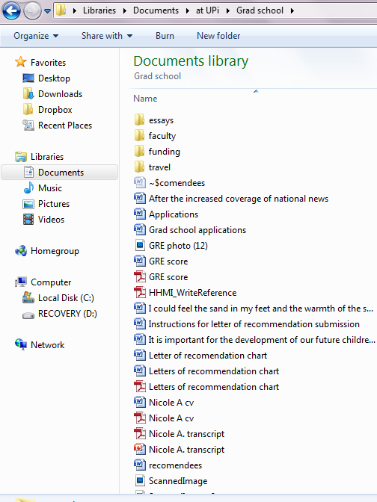

Separate by Folders
GRE Scores
CV
Transcript
Notes:
Patti

Slide 14
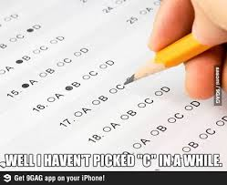
GRE Scores
CV
Transcript
Notes:
Patti

Slide 15

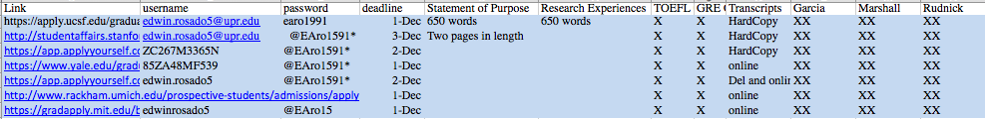
Keep Track
-Universities
-Links
-Usernames
-Passwords
-Essay questions
-Transcript submission
instructions
-Application submission
instruction
-Color coordinated (helps!)
Notes:
Patti

Slide 16
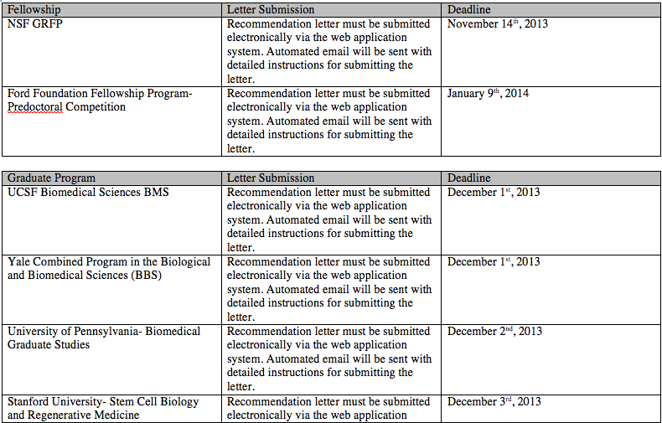
Sample Charts
Notes:
Patti

Slide 17
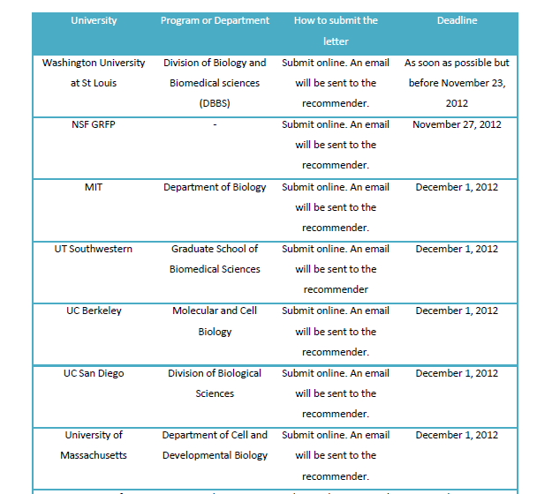
Sample Charts
Notes:
Patti

Slide 18
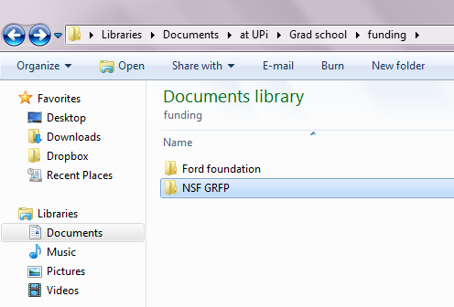
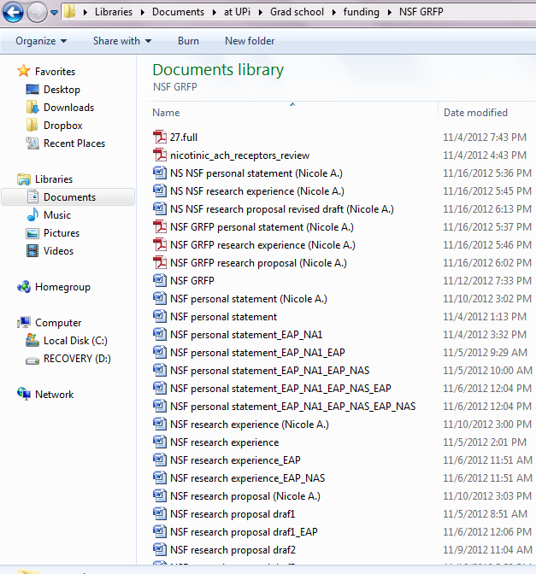
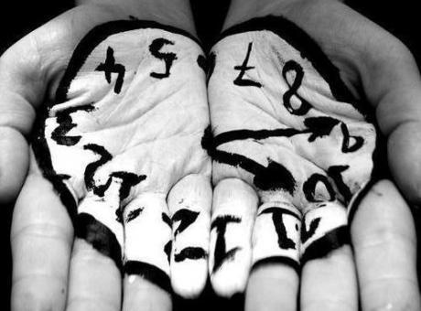
Many Drafts!!
Many Mentors!!
Notes:
Frances

Slide 19
Many Mentors
Identify mentors that are eager to be exposed to your ideas and willing to guide you during the process.
Choose those mentors that encourage strategic thinking and creativity while imparting a set of skills.
Mentors in and outside of your field of study.
Apply at: https://www.research.gov/
Notes:
Frances

Slide 20
Reflection
With what you know now, how are you better prepared to fund your graduate education?
Notes:
Patti

Slide 21

The NSF Graduate Research Fellowship Program
National Science Foundation
Graduate Research Fellowship Program Operations Center
Notes:
Frances –
Alternately, can show 60th anniversary video about the program…. http://www.nsf.gov/news/news_videos.jsp?cntn_id=126221&media_id=73501&org=NSF

Slide 22
Complete Application
Research.gov
Personal, Relevant Background and Future Goals Statement (3 pages)
Graduate Research Statement (2 pages)
Transcripts, uploaded into Research.gov
Three letters of reference recommended but two required
Additional information required for some candidates See Solicitation for eligibility requirements (available on www.nsfgrfp.org)
Apply at: https://www.research.gov/
Notes:
Frances

Slide 23
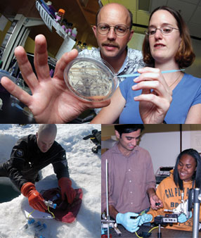
GRFP General Eligibility
U.S. citizens, nationals, and
permanent residents
Early-career students
Pursuing research-based
MS or PhD in NSF fields
Enrolled in accredited U.S.
institution by fall 2021
Applicants must self-certify in the application that they meet the GRFP Eligibility criteria
Apply at: https://www.research.gov/
Notes:
Patti

Slide 24
GRFP General Eligibility
U.S. citizens, nationals and permanent residents that will be enrolled in an accredited STEM research-based graduate program in the Fall.
Academic levels:
Seniors with no graduate study yet
Graduate students can apply 1 TIME ONLY in graduate school either as:
  First-year graduate students OR
  Second-year graduate students (≤ 12 months of graduate study by August)
Greater than 12 months of graduate study, with interruption in graduate study of 2 or more years (can have MS degree no doctoral degrees)
Apply at: https://www.research.gov/
Notes:
Patti

Slide 25

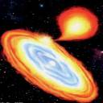
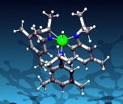
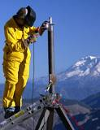
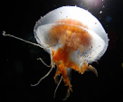

GRFP Supported Disciplines
Chemistry
Computer and Information Science and Engineering
Engineering
Geosciences
Life Sciences
Materials Research
Mathematical Sciences
Physics and Astronomy
Psychology
Social Sciences
Science, Technology, Engineering and Mathematics Education (research-focused)
Apply at: https://www.research.gov/
Notes:
Patti

Slide 26
Emphasis on three high priority research areas in alignment with NSF goals in 2020
Artificial Intelligence
Quantum Information Science
Computationally Intensive Research
NSF will continue to fund outstanding Graduate Research Fellowships in all areas of science and engineering supported by NSF. Applications are encouraged in all disciplines supported by NSF that incorporate these high priority research areas.
Apply at: https://www.research.gov/

Slide 27




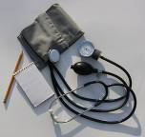

Not Supported by NSF GRFP
Business administration or management
Social work
Medical, dental, law, or public health programs
Joint science-professional degree programs, e.g., MD/PhD, JD/PhD, etc.
Education (except research-focused STEM Education programs)
See Solicitation (www.nsfgrfp.org)
Apply at: https://www.research.gov/
Notes:
Patti

Slide 28
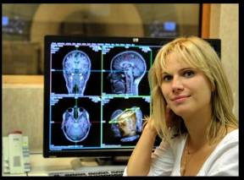
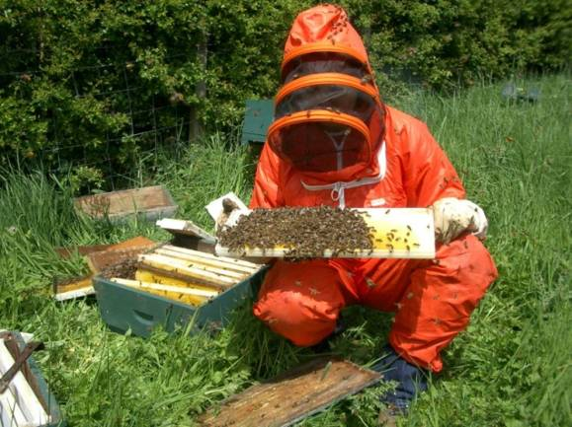
GRFP Cycle
Application: Available online August
Deadlines: Late October, early November (varies by field)
Awards: Announced late March to early April
Best Time to Start Preparing: Now
Apply at: https://www.research.gov/
Notes:
Patti

Slide 29
2020 GRFP Deadlines
2020 Deadlines:
October 19, 2020 (Monday): GRFP application deadline for Geosciences and Life Sciences
October 20, 2020 (Tuesday): GRFP application deadline for Computer and Information Science and Engineering, Engineering and Materials Research
October 22, 2020 (Thursday): GRFP application deadline for Psychology, Social Sciences and STEM Education and Learning
October 23, 2020 (Friday): GRFP application deadline for Chemistry, Mathematical Sciences and Physics and Astronomy
October 30, 2020 (Friday): GRFP application deadline for Reference letter
All documents are due by 5pm local time of applicant’s mailing address
Apply at: https://www.research.gov/
Notes:
Patti

Slide 30

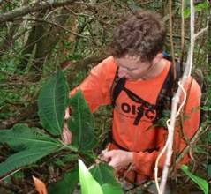
NSF Graduate Research Fellowship Program Goals
To increase the Nation’s human capacity in science and engineering by providing fellowships for early-career graduate students who pursue research-based master’s and doctoral degrees in NSF-supported disciplines
To support the development of a diverse and globally engaged US science and engineering workforce
Apply at: https://www.research.gov/
Notes:
Frances

Slide 31
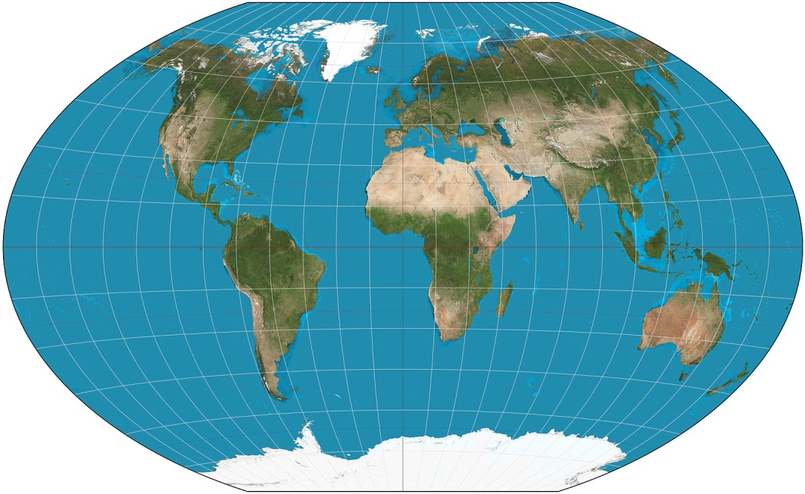
GRFP Key Elements
Five Year Award – $138,000
Three years of financial support
  $34,000 Stipend per year
  $12,000 Educational allowance to institution per year
International research
through GROW
Internships through GRIP
Access to XSEDE
cyberinfrastructure resources
Perform research through the GRFP in countries such as Chile, Denmark, Finland, France, Ireland, Japan, the Netherlands, Norway, Singapore, South Korea, Sweden and Switzerland!
Apply at: https://www.research.gov/
Notes:
Patti
Find out list of countries for GROW = Graduate Research Opportunities Worldwide
Co-Author of Freakanomics – Steven Levitt
Find out number of universities on the XSEDE grid = acceso a rede de supercomputadoras avanzadas en 19 universidades e instutitos en la nación americana
Flexible: choice of project, advisor & program
Unrestrictive: No service requirement
Portable: Any accredited U.S. institution
MS PhD
2,000 Fellowships offered annually, 2010 - 2013
~17% success rate

Slide 32
GRFP Unique Features
Flexible: choice of project, advisor & program
Unrestrictive: No service requirement
Portable: Any accredited U.S. institution
    MS PhD
2,000 Fellowships offered annually out of average 14,000 applications from 2010-2019
2018 - 2019 ~ 16% success rate (~12,300 applications)
Apply at: https://www.research.gov/
Notes:
Frances

Slide 33

Review Criteria
Two National Science Board-approved Review Criteria:
  Intellectual Merit: this criterion encompasses the potential to advance knowledge
  Broader Impacts: this criterion encompasses the potential to benefit society and contribute to the achievement of specific, desired societal outcomes
Apply at: https://www.research.gov/
Notes:
Patti

Slide 34
Intellectual Merit
  Panelists may consider the following with respect to the Intellectual Merit Criterion:
  the potential of the applicant to advance knowledge based on the totality of the content in the application, including the strength of the academic record, the proposed plan of research, the description of previous research experience or publication/presentations, and references
Apply at: https://www.research.gov/
Notes:
Patti

Slide 35
Broader Impacts
  Panelists may consider the following with respect to the Broader Impacts Criterion:
  the potential for future broader impacts as indicated by personal, professional, and educational experiences
Apply at: https://www.research.gov/
Notes:
Frances

Slide 36
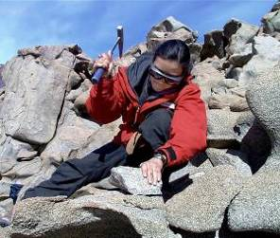
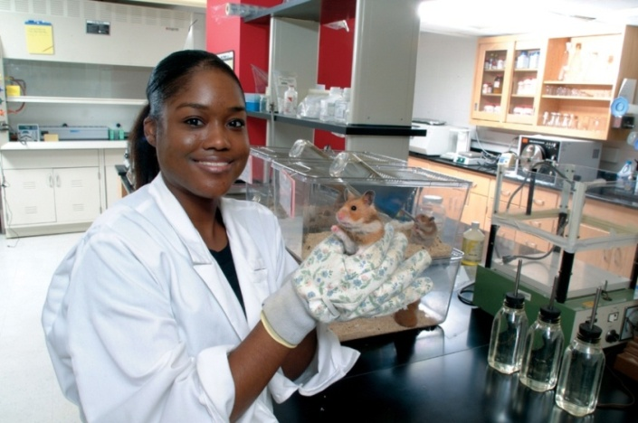
Intellectual Merit and Broader Impacts Assessment
Personal, Relevant Background and Future Goals Statement
Graduate Research Statement
Reference Letters
Transcripts
Apply at: https://www.research.gov/
Notes:
Patti

Slide 37
The following elements should be considered in the review for both criteria:
What is the potential for the proposed activity to
  Advance knowledge and understanding within its own field or across different fields (Intellectual Merit); and
  Benefit society or advance desired societal outcomes (Broader Impacts)?
To what extent do the proposed activities suggest and explore creative, original, or potentially transformative concepts?
Is the plan for carrying out the proposed activities well-reasoned, well-organized, and based on a sound rationale? Does the plan incorporate a mechanism to assess success?
How well qualified is the individual, team, or organization to conduct the proposed activities?
Are there adequate resources available to the PI (either at the home organization or through collaborations) to carry out the proposed activities?
Apply at: https://www.research.gov/
Notes:
Patti

Slide 38
Preparing a Competitive Application
Choose at least three reference writers
Give them ample time
Must know you as a scientist and personally
Share your application materials and the merit review criteria (Intellectual Merit and Broader Impacts) http://nsfgrfp.org/reference_writers/requirements/
Track letter submission using FastLane
Must have 2 letters but no more than 3
http://renettatull.wordpress.com/2011/03/03/youve-just-asked-for-a-letter-of-recommendation-now-i-need-some-things-from-you/
Apply at: https://www.research.gov/
Notes:
Patti

Slide 39
Preparing a Competitive Application
Read the Solicitation carefully – Are you eligible? What are requirements?
Address the Review Criteria (two NSF Merit Review Criteria -Intellectual Merit and Broader Impacts throughout)
Check for spelling and grammatical errors
Verify statements and transcripts uploads
For NSF, you must self-certify your eligibility according to the criteria in the Solicitation and that is your original work
Make sure you Press “Submit” button
Regularly check application status for # of reference letters
Make sure you are enrolled in graduate school by Fall 2021
Apply at: https://www.research.gov/
Notes:
Patti

Slide 40
Evaluation of applications
Panelists are academic and research experts in general discipline, not necessarily in your research topic
Panelists rate your application using the two Merit Review Criteria, Intellectual Merit and Broader Impacts
NSF requests panelists to provide constructive comments (applicants receive anonymous copies of the reviews)
Panels make recommendations to NSF
NSF awards fellowships and honorable mentions
Apply at: https://www.research.gov/
Notes:
Patti

Slide 41

Insight From An Experienced Panelist
Common Reasons Applicants Not Successful:
Poor Broader Impacts
Choice of prestigious school over research-matched school
Inappropriate or uninformative references
Weak personal statement
Apply at: https://www.research.gov/
Notes:
Patti
Aquí les ponemos algunas razones por las que panelistas de la beca rechazan una solicitud:
Broader Impacts pobres.
- Muchos estudiantes no hablan bien sobre sus broader impacts o dicen muy poco sobre ellos.
Estudiantes que prefieren escoger universidades prestigiosas versus universidades que tengan los recursos para el tema de investigación.
Estudiantes que escogen cartas de recomendaciones de profesores inapropiadas que no pueden hablar mucho sobre sus habilidades personales y de investigación. Esto pasa cuando los estudiantes escogen como referencia al profesor con el que harán su investigación a nivel graduado y este profesor todavía no sabe mucho sobre los estudiantes.
Ensayo personal débil y poco convincente que no habla bien sobre sus virtudes.
Maria - pull out the Tips for Applying PDF
Here are some reasons an experienced panelist cited they commonly see as “deal breakers” for applicants. Many do not address broader impacts very well and say very little on that entire area. Some believe that choosing a well-known institution for proposed study will score them points with the reviewers, when often it is not a good match for their research. Some will choose references that cannot speak much to their research or personal abilities, and so these letters of support come across weak. If applicants asked their proposed mentor to write a letter, sometimes their support is not very strong. Oftentimes, applicants will put together an unconvincing personal statement that does not fully portray their strengths. Really try to keep these points in mind when you are putting together the application, and your chances of winning an award will be greater.

Slide 42
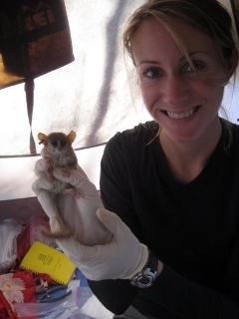
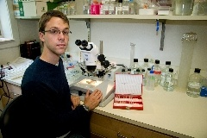
Resources at nsfgrfp.org
Tips for applying
Frequently asked questions (FAQ)
Find GRFP contacts
Important links for the GRFP
Panelist registration
Apply at: https://www.research.gov/
Notes:
Frances

Slide 43
Resources at Your University
UMBC Writing Center
  https://lrc.umbc.edu/tutor/writing-center/
Graduate Student Association Writing Advisor
  https://gsa.umbc.edu/writing-advisor/
Apply at: https://www.research.gov/
Notes:
Frances

Slide 44
More NSF Resources
NSF GRFP Website (nsf.gov/grfp)
Solicitation
FAQ and Guide links
Research.gov
Online application, user guides, official announcements
Phone and email
866-NSF-GRFP (673-4737)
  info@nsfgradfellows.org
And …
- Research Mentors
Former panelists
Program coordinators
Professors
NSF GRFP recipients
Family
Friends
Apply at: https://www.research.gov/
Notes:
Frances

Slide 45
More External Resources
NSF GRFP Winning Essays
  http://tinyurl.com/NSFGRFPExamples
Insights on Fellowship
  http://grfpessayinsights.missouri.edu/
Self-Scoring Rubric for Essays
  https://www.research.msstate.edu/rresources/pdf/NSF_fellowship_rubric.pdf
Apply at: https://www.research.gov/

Slide 46
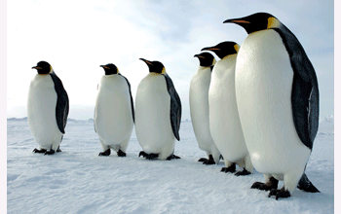
Win by Believing in Yourself, Your Community, and Your Talents
Avoid Self-Disqualification
All other applicants are “more qualified”
Research, activities, or contributions are not impressive enough
Not enough experience
Not able to express things well
NSF funds studies of emperor penguins who are rife with belief in themselves
Apply at: https://www.research.gov/
Notes:
Frances/Patti
A big issue a lot of applicants run into is they believe they can’t possibly be good enough to win an award that has a 10% success rate. You might invent a lot of things in your mind to tell yourself that you can’t possibly be qualified enough, that what you’ve done is not that great, your experience is not enough, and you just can’t say things the way you want them to come out. A lot of people think like this collectively, and these are all things that are usually untrue. Think of this application process as a community project. Talk to those people around you for advice and thoughts about what you might talk about. It is important to be confident about your abilities because that will come across in your application. If you have seen “March of the Penguins”, you know that they have to have a ton of belief in themselves and their community to produce just one baby in super harsh conditions. Humans have things much better, so by comparison this should be a piece of cake.

Slide 47

Apply to Win
Applying always produces a winning result!
Besides feedback on your ideas from experts, it is great preparation for:
  Other award applications
  Graduate school applications
  Job applications
  Writing publications
  Professional connections
…and you just might win the fellowship too!
  WATCH
  Your
  Destiny
Apply at: https://www.research.gov/
Notes:
Frances/Patti
If you go through this application process, you will always win. You are getting feedback from professionals in the field essentially for investing your time. To put things in perspective, this award is worth $122,500 in total benefits. Even if you spend 3 full time weeks on putting an application and get an award, you have worked for over $1,000 per hour. That is a nice hourly rate. The whole process is also great preparation for other awards you may want to apply, graduate school applications, job applications, publications, and professional connections. Of course if that’s not good enough, you might also win the fellowship. We wish you all the best and look forward to reviewing your application.

Slide 48

Reflection
What is graduate funding and Why is it important to try to fund your graduate education?
Notes:
Patti/ Frances

Slide 49
FORD FOUNDATION FELLOWSHIPS
Apply at: https://www.research.gov/

Slide 50
Ford Foundation Deadlines
2021 Competition Dates:
The 2021 Competition will open in September 2020.
2021 Dissertation and Postdoctoral application deadlines:
December 10, 2020 5:00 PM Eastern Standard Time (EST)
2021 Predoctoral application deadline:
December 17, 2020 5:00 PM Eastern Standard Time (EST)
Supplementary Materials deadline for submitted applications
January 10, 2021 5:00PM Eastern Standard Time (EST)
Notification of 2021 Awards
Mid-to-late March 2021
Apply at: https://www.research.gov/

Slide 51
http://ccom.uprrp.edu/~pordonez/NSFworkshop
Apply at: https://www.research.gov/
Notes:
Break

