Slide 1
UMBC 2020
Writing a Winning Application
Presented by
Frances Carter-Johnson, PhD and Patti Ordóñez, PhD
NSF GRFP Recipients
Graduate Research Fellowship Operations Center
Notes:
Patti
Hello and welcome. On behalf of the Graduate Research Fellowship Operations Center, we would like to present to you the National Science Foundation’s Graduate Research Fellowship Program, or the NSF GRFP for short. We’d like to inform you about the award details and some things to keep in mind as you construct a competitive application.

Slide 2
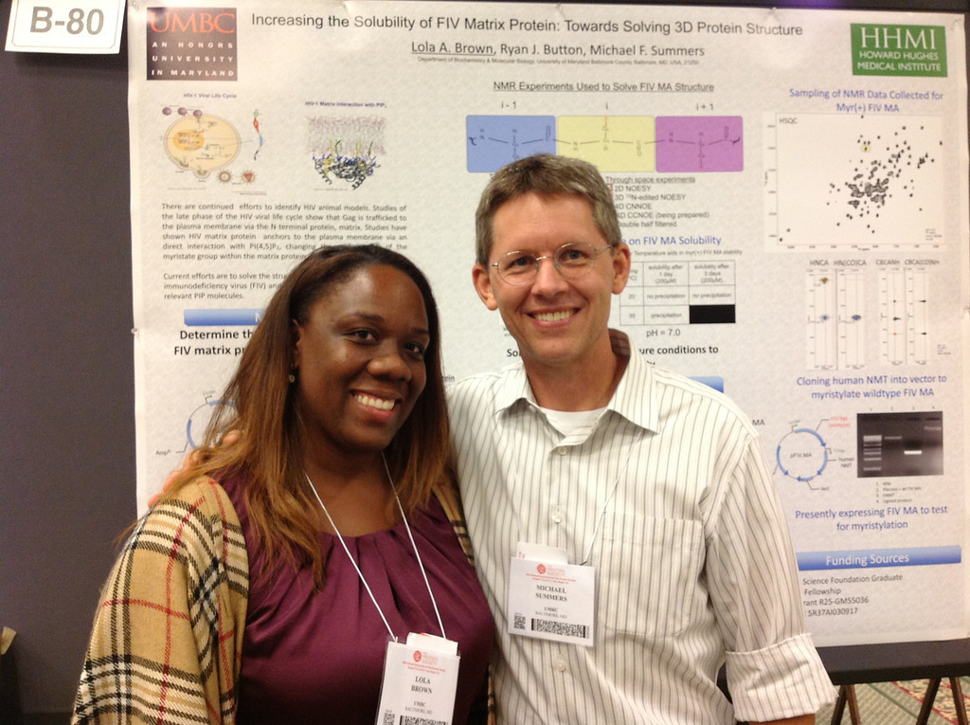
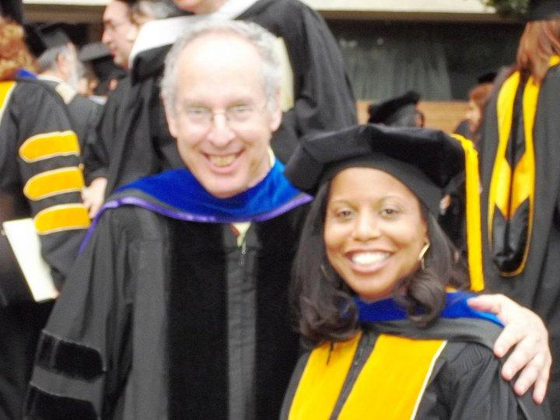
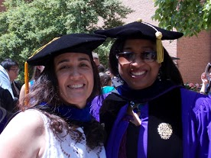



















Desperation brings inspiration!!!
Apply at: https://www.research.gov/
Notes:
Frances

Slide 3
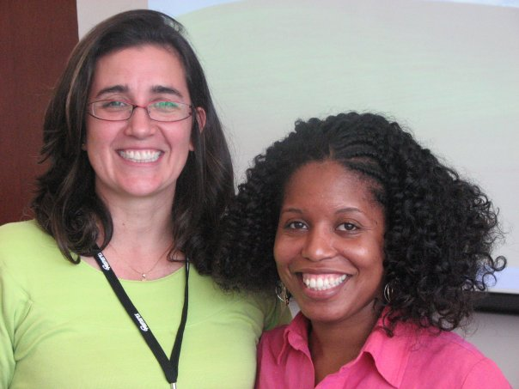

Apply at: https://www.research.gov/
Notes:
Frances

Slide 4







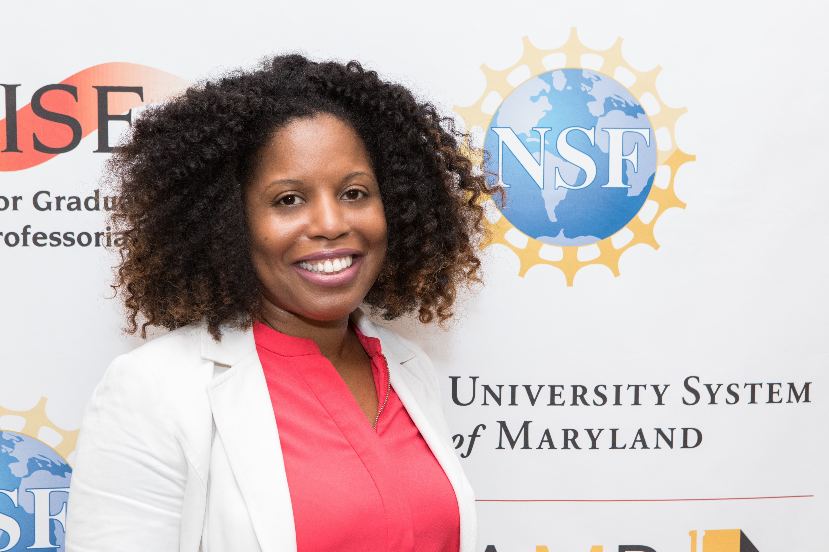
Who is Frances?
Physicist/Engineer
STEM ED
Policy Researcher
Education
Data Scientist
Apply at: https://www.research.gov/
Notes:
HBCUs a part of my family educational legacies with

Slide 5

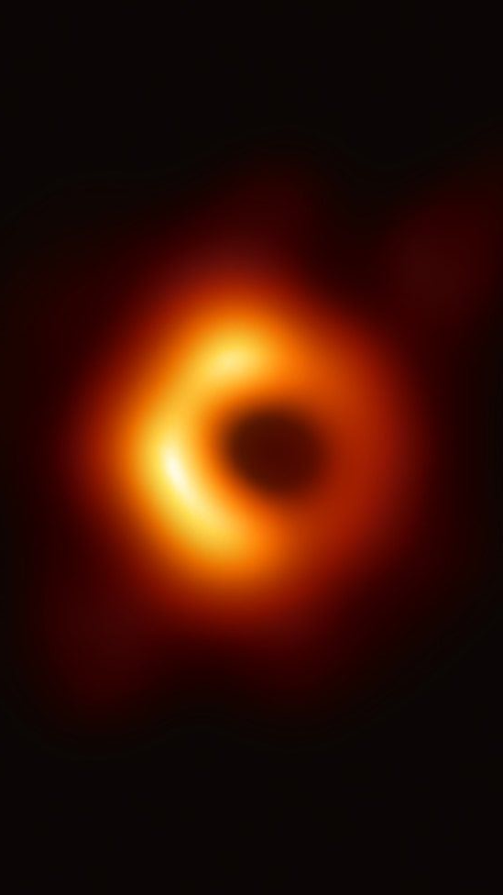






Who is Patti?
Teacher
Technical Trainer
Associate Professor
Apply at: https://www.research.gov/
Notes:
HBCUs a part of my family educational legacies with

Slide 6
Seminar Outcomes
Inform you of graduate funding opportunities
Introduce several domestic and international fellowships
Guide preparation of winning applications
Discuss Personal Statement and Proposal
Brainstorm on Personal Statements
Begin to write Personal Statements
http://ccom.uprrp.edu/~pordonez/NSFworkshop
Notes:
Patti

Slide 7
Complete Application
Research.gov
Personal, Relevant Background and Future Goals Statement (3 pages)
Graduate Research Statement (2 pages)
Transcripts, uploaded into FastLane
Three letters of reference required
Additional information required for some candidates See Solicitation for eligibility requirements (available on www.nsfgrfp.org)
Apply at: https://www.research.gov/
Notes:
Frances

Slide 8
Personal, Relevant Background and Future Goals Statement (3 pages)
  How do you envision graduate school preparing you for a career that allows you to contribute to expanding scientific understanding as well as broadly benefit society? Describe your personal, educational and/or professional experiences that motivate your decision to pursue advanced study in science, technology, engineering or mathematics (STEM). Include specific examples of any research and/or professional activities in which you have participated. Present a concise description of the activities, highlight the results and discuss how these activities have prepared you to seek a graduate degree. Specify your role in the activity including the extent to which you worked independently and/or as part of a team. Describe the contributions of your activity to advancing knowledge in STEM fields as well as the potential for broader societal impacts (See Solicitation, Section VI, for more information about BI)
Apply at: https://www.research.gov/
Notes:
Frances

Slide 9
Essay Critique
Before
After
Apply at: https://www.research.gov/
Notes:
Patti

Slide 10
Graduate Research Plan (2 pages)
Present an original research topic that you would like to pursue in graduate school. Describe the research idea, your general approach, as well as any unique resources that may be needed for accomplishing the research goal (i.e., access to national facilities or collections, collaborations, overseas work, etc.) You may choose to include important literature citations. Address the potential of the research to advance knowledge and understanding within science as well as the potential for broader impacts on society. The research discussed must be in a field listed in the Solicitation (Section X, Fields of Study).
Apply at: https://www.research.gov/
Notes:
Frances
Read and now the research field of your project, what info is missing? What don’t we know?
Brainstorming of many many projects you will like to propose
Talk to your mentors
Key points:
Novel approaches
In depth
Realistic plan

Slide 11
Essay Critique
Before
After
Apply at: https://www.research.gov/
Notes:
Patti

Slide 12
Tips to an Award-winning
Personal Statement
  Make it personal, make it yours! Highlight your UNIQUE perspective and outstanding characteristics!
  Scientific, not flowery.
  Show your passion. SHOW IT, DON’T TELL IT!
  Address Review Critieria
  Describe your most important research experiences and connect them to your personal experiences. -> INTELLECTUAL MERIT
  Specify throughout your essay:
    WHY do you want to go to grad school?
    WHAT are your future goals after grad school?
    WHICH research topics interest you the most?
    WHAT kinds of unique insights may you offer?
    HOW will the NSF GRFP help you achieve your goals?
    HOW you will give back to the community? ->BROADER IMPACTS
  Proofread, proofread, proofread.
Notes:
Frances
Robin Walker at University of Missouri

Slide 13
More External Resources
NSF GRFP Winning Essays
  http://tinyurl.com/NSFGRFPExamples
Insights on Fellowship
  http://grfpessayinsights.missouri.edu/
Self-Scoring Rubric for Essays
  https://www.research.msstate.edu/rresources/pdf/NSF_fellowship_rubric.pdf
Apply at: https://www.research.gov/

Slide 14
Guide to a successful research proposal
Read and know the research field of your project
  Where is the field moving?
  What is the next step of your research project from a summer program or at your home institution?
Brainstorming on the different project ideas
Discuss your research plans with your mentors
Key points:
  Novel approaches
  Hypothesis
  Expected outcomes
  Realistic plan
  IM and BI
Apply at: https://www.research.gov/
Notes:
Patti
Realistic plan -> research matches the university you applied to

Slide 15
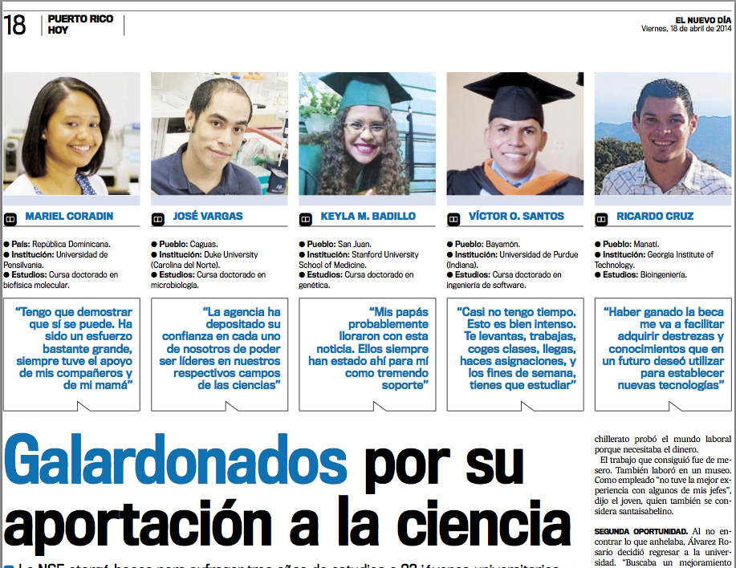
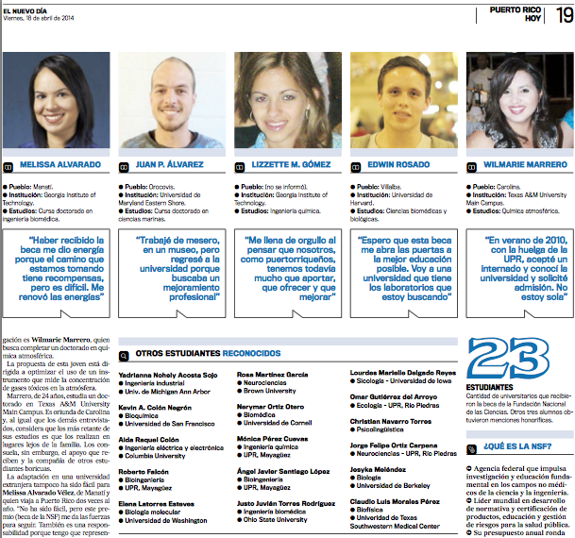
GRFP Recipients from PR
Apply at: https://www.research.gov/

Slide 16
Reflection
With what you know now, how are you better prepared to fund your graduate education?
Notes:
Patti

Slide 17



Thank you
  Questions?? Feel free to contact us…
  Frances Carter-Johnson, PhD
    fdecarter@gmail.com
  Patricia Ordóñez, PhD
    pattiordonez@gmail.com
    Thanks to NSF, CAHSI, Woodrow Winchester, Megan Palsa, Nicole Aponte, Jorge Ortiz-Carpena, Edwin Rosado for their contributions to this presentation.
This presentation and several other resources can be found at http://ccom.uprrp.edu/~pordonez/NSFworkshop
Notes:
Patti

Slide 18


Thank you
  Questions?? Feel free to contact us…
  Patricia Ordóñez, PhD
    pattiordonez@gmail.com
  María Ocasio Torres
    ocasiom1@suagm.edu
  Diana Silva
    dianavsilva@gmail.com
    Thanks to Frances Carter-Johnson, CAHSI, Woodrow Winchester, Nicole Aponte, Jorge Ortiz-Carpena, Edwin Rosado for their contributions to this presentation.
This presentation and several other resources can be found at moodle.com.uprrp.edu in the open course –
“How to fund your graduate education”
Notes:
Patti

