Slide 1
Fulbright Title Page

Slide 2
The Fulbright Program: An Introduction
The Fulbright Program
Program Goal
About the Program
To increase mutual understanding between the people of the U.S. and people of other countries through exchange
Created in 1946 by U.S. Congress
Sponsored by the U.S. Department of State’s Bureau of Educational and Cultural Affairs (ECA)
Student Program administered in U.S. by IIE
Administered overseas by bi-national commissions and U.S. embassies

Slide 3
Diversity and Inclusion
Diversity and Inclusion
1
2
Diversity
Inclusion
Fulbright strives to reflect the diversity of the U.S. society and societies abroad. The Program encourages involvement of people from traditionally underrepresented audiences in all grants, programs and initiatives.
Opportunities are open to people regardless of their race, color, national origin, sex, age, religion, geographic location, socioeconomic status, disability, sexual orientation, or gender identity.

Slide 4
Eligibility
U.S. Student Program Eligibility
Basic Eligibility
Graduating seniors
Recent graduates
Graduate students
Early career professionals, including creative and performing artists/musicians
U.S. citizen by the application deadline
Open to:
Bachelor’s degree or equivalent by start of grant
No doctorate at the time of application
Country-specific requirements
Notes:
Dan

Slide 5
Fulbright Award Types
Fulbright U.S. Student Program Award Types
1
2
English Teaching
Assistantship (ETA):
Study/Research Grant:
950+ awards
8-10 months
~140 countries
Independent research, study, or arts projects abroad
1300+ awards
8-10 months
~80 countries
Help teach English and U.S. culture in the classroom

Slide 6
Award Benefits
Award Benefits
Pre-Grant & In-Country
Post-Grant
Round-trip airfare
Monthly stipend*
Accident and sickness benefits
Other possible benefits*
• Support for dependents
• Research allowance
• Tuition
• Language lessons
• Enhancement activities
• Disability-related accommodations
The Fulbright network of alumni
State Department’s alumni website
Eligible for 12 months of noncompetitive eligibility (NCE) hiring status within the federal government
Lifetime Fulbright email address
Fulbright Association
* Varies depending on grant and host country.

Slide 7
Application Timeline
Application Timeline
APRIL–SEPT
Design project and prepare application, Fulbright Boot Camps
Campus Deadline
UMBC campus deadline – First Day of Fall Semester
National Deadline
National Application Deadline, Mid-October
NOV–DEC
National Screening Committees
JAN–MAY
Commissions/Embassies Foreign Scholarship Board
MARCH–JUNE
Final Notification

Slide 8
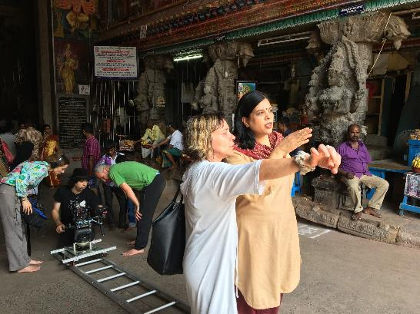
Fulbright-Hays Dissertation Award
The Fulbright-Hays Dissertation Award is funded by the U.S. Department of Education for research in areas studies and modern languages.
Projects deepen research knowledge on and help the U.S. develop capability in areas of the world that are not generally included in U.S. curricula. Projects focusing on Western Europe are not supported.
Open to U.S. citizens and permanent residents (!)
Application cycle varies annually (!)
Notes:
As a program that “represents the American people”, diversity and inclusion is critical to our work. We strive to have a broad range of American experiences represented by Fulbrighters abroad. With that in mind, we are actively seeking a diverse pool of applicants for the Fulbright program. No matter where you’re from in the US or how you identify, Fulbright welcomes you to participate.

Slide 9
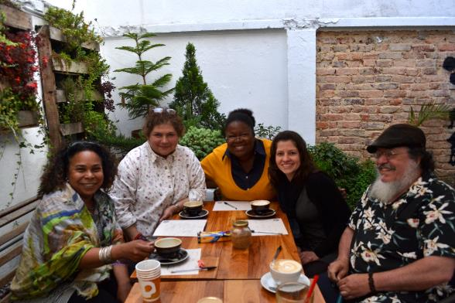
Eligibility for U.S. Scholar Program
U.S. citizenship
Degree and experience, as required by award:
Ph.D. or other terminal degree
MA and higher education teaching or professional experience
Professional and/or artistic experience with substantial accomplishments
Teaching experience as required
Compliance with policies on previous Fulbright Scholar awards and waiting periods between grants
Notes:
These are the overall eligibly requirements. The most essential one to keep in mind is that the program is only open to U.S. citizens. Green card holders are not eligible. For the “Degree and experience, as required by award” section, the categories listed are the most common ones seen in the “award requirements” tab.
The FFSB policy on alumni: 2 full years must elapse between the completion of a grant to the application deadline of the next grant. For this fall, applicants applying on September 15, 2022 need to have completed their grants before September 15, 2020 to be eligible in this regard.
Always be sure to review the award description or contact the Fulbright office to confirm eligibility regarding allowed disciplines for your award, career profile (e.g. postdoctoral vs. Distinguished Scholars, etc.)

Slide 10
Fulbright Scholar Awards – Which is for you?
4 Award Types:
Scholar Awards
Postdoctoral Awards
Distinguished Scholar Awards
International Education Administrator Awards
Flex Option
Available in 63 countries and all world areas
Allows multiple visits over two years
Fulbright Public Policy Fellowship
Global & Regional Awards
Notes:
Scholar awards are by far the largest category, ranging in grant length and professional profile. These can be for postdoctoral researchers to full professors and everyone in between.
Postdoctoral awards are specific to researchers who have completed their PhD within 5 years of the fellowship start date.
Distinguished Scholar awards are intended for more accomplished faculty. Some awards look for those at associate or full professor rank or above – always consult award description
IEA awards – for administrators at US campuses to participate in seminars abroad. These are not for faculty and do not support research or teaching.
The Fulbright Public Policy Fellowship is unique among Scholar awards, intended for early and mid-career professionals and practitioners to serve in placements in a foreign government ministry or institutions in select countries around the world. Graduates of public policy programs at U.S. universities plus early career faculty who are still practitioners can be great candidates for this opportunity!
Regional Research Awards exist in most world regions, allowing you to visit 2 or more countries throughout a region. There are also those that cross world regions, like the Global Scholar Award.
Note the Flexibility of Fulbright: Most awards do take place during the academic year. However, the length of time varies from award to award. If someone asks about doing research during the summer, the “flex” option for countries that offer it allow the most flexibility. However, the majority of awards take place during the academic year of the host country.

Slide 11
Selecting the Right Award
Match country interest, expertise, career profile, and proposal to the award description
Language ability (if applicable)
Discipline preferences, when specified
Project relevance to the host country and/or institution
Benefits to you and your community
Remember: you can only apply for ONE AWARD per application cycle
Notes:
Read award description carefully!
Career level – early career, mid-career, senior and senior academics, professionals and artists are all categories listed on the award descriptions
Language ability – note that many awards do not require a language other than English. Check award description’s application requirements for details!
Scholars can only apply for one award per cycle. If they have difficulty choosing, they should contact the regional staff listed on the award for guidance or attend an office hour.

Slide 12
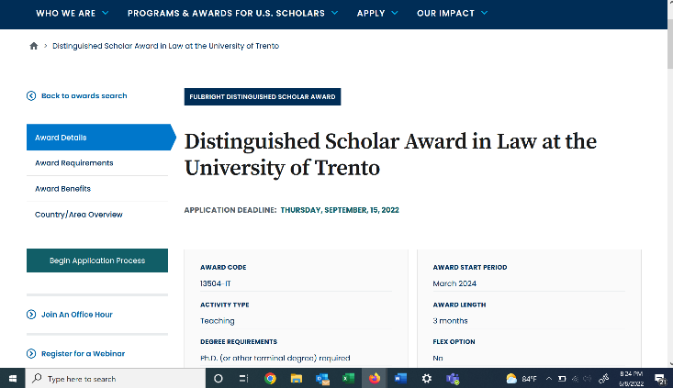
Understanding the Awards
Visit
fulbrightscholars.org to search awards
Notes:
EVERY AWARD contains 4 parts:
award details
award requirements
award benefits
country/area overview
Potential applicants should carefully read the information on EVERY tab to understand the award completely.
Please encourage scholars to pay specific attention to the “Award Requirements” tab. This provides critical information regarding eligibility, language proficiency requirements, and whether a letter of invitation is required. Note that the Award Details and Requirements tabs often have contacts listed at institutions abroad or the Fulbright office in country. I encourage you to not answer specific questions about any award requirements because they differ across awards. Remind the audience to consult the “Award Requirements” tab and reach out to the Fulbright office if they have any questions or need clarification.
If time allows at the end, I often will walk people through the application resources on the website + an award description

Slide 13
Application Cycle
2023-24 Competition Now Open
FEBRUARY
Catalog of Awards Opens
SEPTEMBER 15
Application Deadline
SEPTEMBER
Program staff conducts technical reviews for completeness
OCTOBER – NOVEMBER
U.S. peer review
NOVEMBER – JANUARY
Applicants notified of status. Recommended applications are sent to host countries and to the Fulbright Foreign Scholarship Board.
JANUARY – JUNE
Final decisions are made
JUNE – ONWARD
Participants prepare for departure
Notes:
Note that the notification window for hearing final decisions is wide but also accurate. People can year as early as January and as late as the end of May.

Slide 14
Stay Connected with Fulbright
Stay connected with us
Watch our webinars at us.fulbrightonline.org
Email us at Fbstudent@iie.org
Visit our website to learn more about the Fulbright U.S. Student Program
Watch videos at vimeo.com/fulbright and youtube.com/fulbrightprogram

Slide 15
UMBC Contact Information
UMBC Contact Information
Brian V. Souders, Ph. D.
Associate Director of Global Learning
Center for Global Engagement
Office: 227A Administration Building
Email: fulbright@umbc.edu
To schedule an appointment visit my Calendly site at <tinyurl.com/umbcglobalawards>.

