Slide 1
Designing a Summer Enrichment Course
A Workshop for SEA-CIRTL Fellows
February 24, 2023
Kerrie Kephart, Ph.D.
Associate Director, Faculty Development Center

Slide 2
What should your first step in planning your course be?
Take a minute and write in the chat what you think your first step will be in designing your course
BUT!
Don’t hit enter/send until I tell you to

Slide 3
LEARNING OBJECTIVES FOR TODAY’S SESSION
By the end of this session, you will be able to:
Apply principles of Backward Design and Bloom’s Taxonomy of Learning to design learning outcomes for your SEA course
Evaluate a variety of methods for assessing students’ mastery of the learning objectives to choose the most appropriate ones for your course

Slide 4
Backward Design
Learning
Goals What will students be able to do by the end of the lesson, unit, or course?
Assessment Evidence
How will students demonstrate what they have learned?
Learning Activities
What activities, experiences, and resources will lead students toward mastery?

Slide 5
Backward Design
Learning
Goals What will students be able to do by the end of the lesson, unit, or course?
Assessment Evidence
How will students demonstrate what they have learned?
Learning Activities
What activities, experiences, and resources will lead students toward mastery?
Wiggins & McTighe (1998, 2005)
①
②
③
In order to chart a proper course, first you need to know where you’re going.

Slide 6
Backward Design
Learning
Goals What will students be able to do by the end of the lesson, unit, or course?
Assessment Evidence
How will students demonstrate what they have learned?
Learning Activities
What activities, experiences, and resources will lead students toward mastery?
Wiggins & McTighe (1998, 2005)
THE PRINCIPLE OF ALIGNMENT:
All learning activities and assessments must align with the learning goals/objectives.

Slide 7
Writing Learning Goals
At the end of this 5-day experience, students will be able to…
What are the most important ideas or concepts students need to understand?
Which dispositions/attitudes about the topic should they gain?
Which specific skills should they acquire or refine?
Notes:
Take a moment and jot down some ideas on the worksheet under Part 1 of some ideas or concepts, skills, and/or dispositions/attitudes about the topic that you think would be important for the students to gain from your SEA course.
[1 minute]

Slide 8
Writing Learning Goals
At the end of this 5-day experience, students will be able to (1) do something, with (2) some content, by (3) using some method
Where:
is a concrete action verb
is how the knowledge, skill, or attitude will be applied and assessed
is some piece of knowledge, a skills, or an attitude the student is expected to develop, and
Notes:
We need to refine those ideas you just jotted down by articulating them as proper learning objectives.

Slide 9
Writing Learning Goals
A Sample Learning Goal
At the end of this 5-day experience, students will be able to (1) explain (2) how the science of exercise affects stress by (3) creating a short animated video with voiceover narration

Slide 10
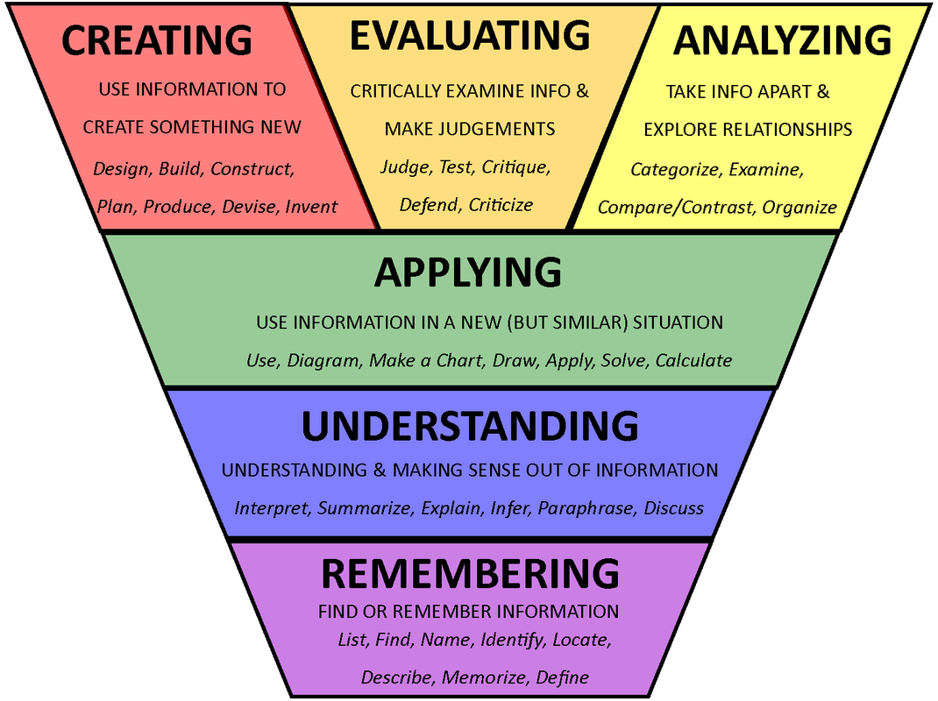
Bloom’s Taxonomy of Learning
Notes:
About those action verbs….

Slide 11
Writing Learning Goals
Write a Learning Goal
At the end of this 5-day experience, students will be able to (1) do something, with (2) some content, by (3) using some method
Notes:
Now it’s your turn:
Take one of the ideas you jotted down in Part I and rewrite it using the formula:
Students will be able to: 1) do something with 2) some content by 3) using some method

Slide 12
Designing Appropriate Assessments
DIRECT MEASURES OF LEARNING
INDIRECT MEASURES OF LEARNING
Objective tests
Essays
Presentations
Assignments
Portfolios
Self assessment
Peer feedback
End-of-course evaluations
Questionnaires
Focus groups
Exit interviews
Notes:
Look at these two lists of direct and indirect measures of learning. What do you think distinguishes the two different types of measures? What do you notice about them?
Direct measures of student learning require students to demonstrate their knowledge and skills. They provide tangible, visible and self-explanatory evidence of what students have and have not learned as a result of a course, program, or activity.
Indirect measures of student learning capture students’ perceptions of their knowledge and skills; they supplement direct measures of learning by providing information about how and why learning is occurring. Equally important: They can help the students themselves become more fully conscious of what they’re learning and how they’ve learned it, which is actually a very important step in helping the learning to become more permanent and fixed.
Let’s take a moment and think of a few more direct measures that you could use in your SEA courses. Remember, they should align with the learning outcomes and answer the question, “How will I know if they got it?”

Slide 13
PRINCIPLES OF COURSE & LESSON PLANNING
Start from the end and work your way backward
IDENTIFY LEARNING OUTCOMES:
What should students know and be able to do at the end of this lesson/unit/course?
DETERMINE EVIDENCE OF LEARNING:
How will I know if they got it?
PLAN LEARNING EXPERIENCES/ACTIVITIES:
What kinds of learning experiences will introduce them to the content, help them practice, and prepare them to demonstrate mastery?
In what order should the content and practice be introduced, and how long should they spend with each unit of content?

Slide 14
Course Outline
Lesson 1
Lesson 2
Lesson 3
Lesson 4
Lesson 5
Notes:
So, once you have determined the learning goals or outcomes for your course, and how you will know that students got it (i.e., you’ve decided how you’ll assess), then and only then can you start figuring out what kinds of learning experiences to plan for them for each day of the course so that they will be able to meet the course learning goals and demonstrate mastery.
For each day of the course, you will want to plan a learning outcome (or maybe a few learning outcomes), a way to introduce students to the new ideas and skills they’ll be working with that day, and lots of fun and interesting ways to use the ideas and practice the skills. You’ll also want to plan lots of ways to quickly and informally check to see if they’re getting it (called formative assessments) throughout the day’s lesson. But I think this is what you’ll be doing in an upcoming session.
You’ll want to practice inclusive course design by diversifying, as much as possible, the course materials, and to meet students where they are and recognize that they each have unique backgrounds, strengths, and abilities, you’ll want to plan multiple ways that students can demonstrate their learning and their developing skills, and by mixing up the teaching strategies you’re using.

Slide 15
ADDITIONAL RESOURCES
Faculty Development Center’s (FDC) Course Design page
FDC’s Designing Appropriate Assignments page
Wiggins, Grant and Jay McTighe. Understanding by Design, Expanded 2nd Edition. Pearson, 2005. (Available from FDC Library and AOK Library)
ABET’s Student Learning Outcomes webinar
Derek Bok Center @Harvard’s Inclusive Course Design webpage
Dr. Kerrie Kephart, kkephart@umbc.edu

