Slide 1
LAST GBM

Slide 2
FAQs
ISSA?
Information Systems?
Questions for Eboard?
IS program?
Careers?
UMBC?
IS professions?
Involvement on campus?
Notes:
Refer to google form responses

Slide 3
Networking
We strongly recommend staying in contact with individuals from networking events, clubs and organizations, and classmates through different social platforms.
Handshake
LinkedIn
Slack
Notes:
Janine

Slide 4
Benefits of Maintaining Connections
Close Relations
Classes
Clearances
Need to compile list of close connections when obtaining a security clearance.
Make new friends in the same field or have similar interests.
Always great to know someone in your class for group projects.
Notes:
Mun/Nick

Slide 5
FORMER EBOARD CONTACTS
Julie Tu - President
Muntaha Sultana - Executive VP
Helen Trinh - VP of Operations
Email: juliet4@umbc.edu
LinkedIn: https://www.linkedin.com/in/julie-tu-305280241
Email: msultan1@umbc.edu
Email: helent2@umbc.edu
LinkedIn: https://www.linkedin.com/in/helen-trinh-500702229/

Slide 6
FORMER EBOARD CONTACTS
Nicholas Randhawa-VP of Communications
Daniel Yang -Treasurer
Janine Goh - Secretary
Email: nrandha1@umbc.edu
Linkedin: https://www.linkedin.com/in/nicholas-randhawa-224689191
Email: dyang2@umbc.edu
Linkedin: https://www.linkedin.com/in/danielyang9823/
Email:
nt48051@umbc.edu

Slide 7
ELECTION RESULTS…
Notes:
Helen

Slide 8
NEW EBOARD!!! (FALL 2023-SPRING 2024)
Wardan Kazzalbach - President
Eyob Befikadu - Executive Vice President
Zainab Seriki - Treasurer

Slide 9
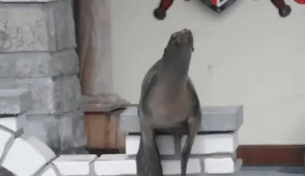
NEW EBOARD!!! (FALL 2023-SPRING 2024)
Shajan Hamza - VP of Operations
Sriram Batchu - VP of Communications
Ouwen Dai - Secretary

Slide 10
Thoughts on Spring 2023 Events?
Notes:
Daniel

Slide 11
T-SHIRT RAFFLE TIME!!!!!
Notes:
Helen

Slide 12
Jackbox Games!
Try to survive a horror hotel and play trivia along the way! (15-25 mins)

Slide 13
THANKS FOR COMING!
SEE YOU IN THE FALL!

