Slide 1
Small but Effective Steps to Improve an Organization's Security Posture
Information Systems Security Association
and
Women in Cyber Security
October 19, 2020

Slide 2
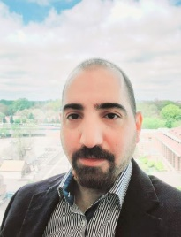
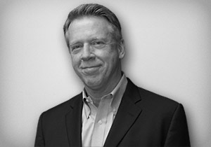
Our Background
Moe Alsubu
Bob Rosecrans
Director, Technology Infrastructure and Desktop Services, ASHP
Prior experiences:
Enterprise Computing Manager, CNSI
Senior System Administrator, CNSI
IT Helpdesk, CNSI
Degrees:
MS, HRM; BS, MIS
Certifications:
ITIL Foundation Certificate
Microsoft Certified Solutions Associate, Office 365
Project Management Professional (PMP)
AWS Certified Solutions Architect and Certified SysOps Administrator
Chief Information Officer, Vice President, Office of Information Technology, ASHP
Prior Experiences:
CIO/CISO, Blue Cross Blue Shield Association
CIO/CISO, Graduate Management Admission Council
Multiple positions, Verizon
Degrees:
MBA; BS, Economics; BS, Business Administration
Certifications:
ITIL Foundation Certificate

Slide 3
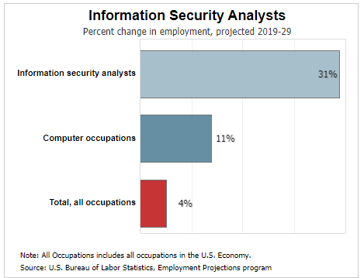
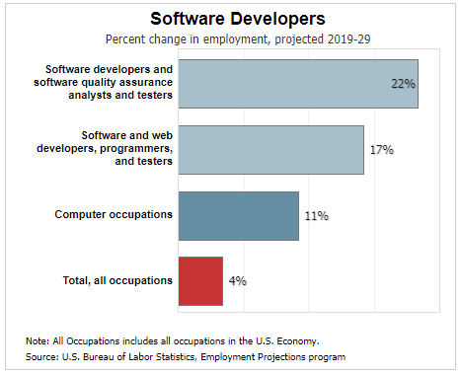
Wonderful Career Opportunities
Examples per the United States Bureau of Labor Statistics
www.bls.gov

Slide 4
One CIO’s Reflections on the Evolution of Cyber Security
2000
2010
2020
Very little recognition of Cyber Security as a threat within Boardrooms
Full time cyber security jobs were rare
Castle and Moat approach
Concern with lost laptop replacement cost rather than data loss
Y2K = Armageddon
Security reporting to Boards increasing
Security jobs proliferating
Increasing reliance on independent 3rd party assessments
Some movement to cloud data centers
Increasing focus on employees as a security risk
Boards adding cyber security expertise
Formal security roles common place
3rd party security firms have proliferated
Little hesitation to utilize cloud hosting arrangements
Cyber security solution set has proliferated
Cyber security insurance
Ever present employee awareness and training

Slide 5
Security is an ongoing process
We are only scratching the service in this presentation.
We are sharing steps that we believe added value to our IT security posture

Slide 6
Understand your environment
Threats
Vulnerabilities
usershe

Slide 7
Small but Effective Steps
Access Review
Endpoints review
Security Awareness
Who has access to your systems?
Do you know what’s on your network?
Cybersecurity is everyone's responsibility!

Slide 8
Access/Accounts Review
Review existing accounts
Configure password expiration policy
Configure lockout policies
Avoid using shared accounts
Limit the number of admin accounts
Change default systems passwords

Slide 9
Endpoints review/Asset management
Know your IT assets!
Patching
Backups
Endpoint Protection
Image baseline
Monitoring
Logs

Slide 10
Understand your environment
Threats
Vulnerabilities
usershe

Slide 11
Security Awareness and Behavioral Training
Focuses on importance of security for the organization as a whole and each employee's responsibilities
Organization–wide
Should be comprehensive
Can be tailored for specific groups
i.e. phishing campaigns and DLP

Slide 12
We are happy to answer any Questions
Thank you!

