Slide 1
Mechanical Engineering S-STEM Scholarship Program at UMBC
Liang Zhu, PhD
Director, ME S-STEM Program
Department of Mechanical Engineering
University of Maryland Baltimore County
Notes:
1

Slide 2
Outline
ME S-STEM Program at UMBC
Welcome New Scholars and Their Mentors
Activities Sponsored by our Program
Expectations
Action Items
Notes:
2

Slide 3
Mechanical Engineering S-STEM Scholarship Program at UMBC
The ME S-STEM Scholarship Program” is an NSF funded multiple year scholarship program starting in 2010. We have gotten two renewals from NSF to continue the program for the next five years.
The S-STEM program will provide scholarships and educational opportunities to economically disadvantaged and academically talented undergraduate students in the ME program at UMBC.
Scholarship amount is based on financial need (indicated in the FASFA form) and academic performance.
Eligible expenses include tuition, fees, books, supplies, housing, and equipment.
The scholarship goal is to improve student retention and increase their career prospects, with special emphasis on diversity.

Slide 4
Eligibility
The scholarship is aimed at graduating high school seniors, community college transfer students, and current UMBC students in Mechanical Engineering.
The applicants must be a US citizen and permanent resident.
The student should intend to enroll in the Mechanical Engineering major at UMBC and maintains a full time student status.
A minimum GPA of 2.75 is required.
The applicants should demonstrate financial need based on the FASFA form.
Scholarship renewals are based on academic performance and participations in all required S-STEM program activities.

Slide 5
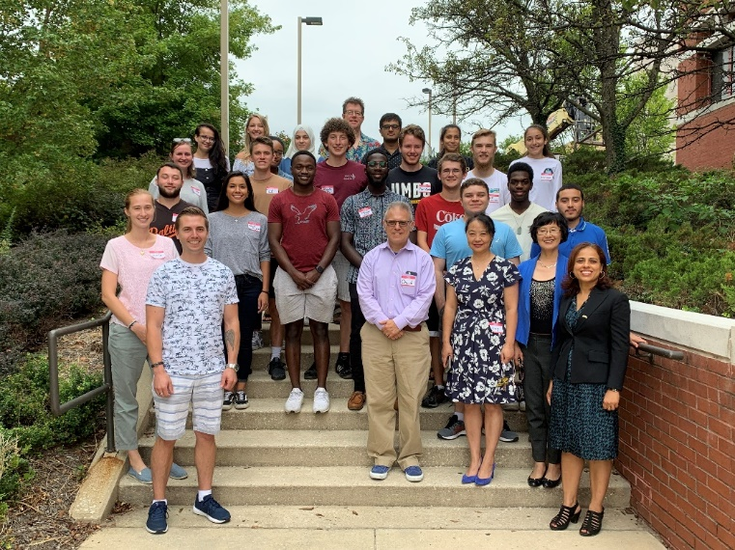
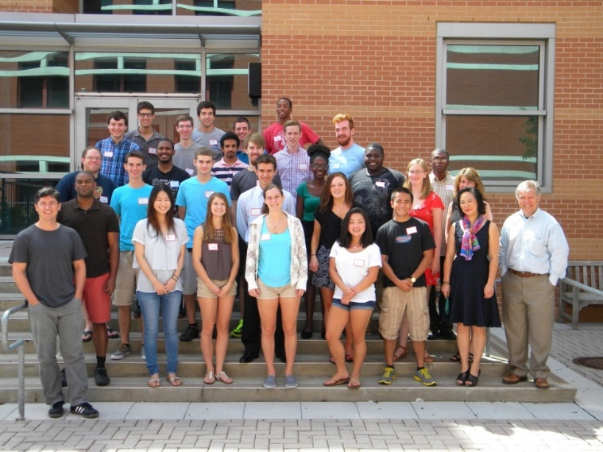
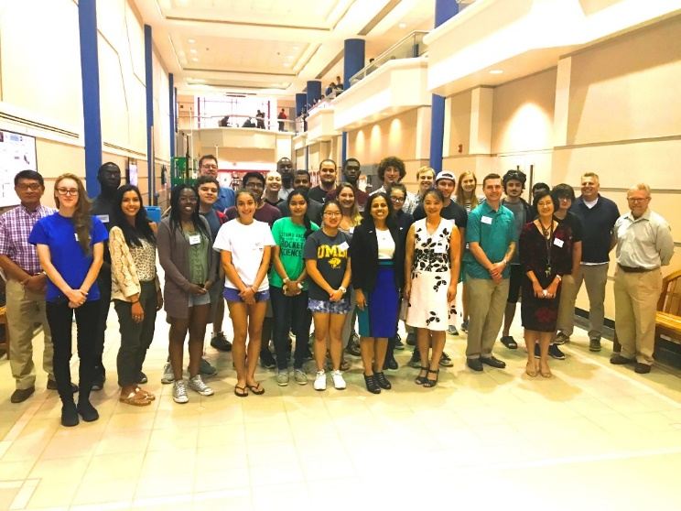
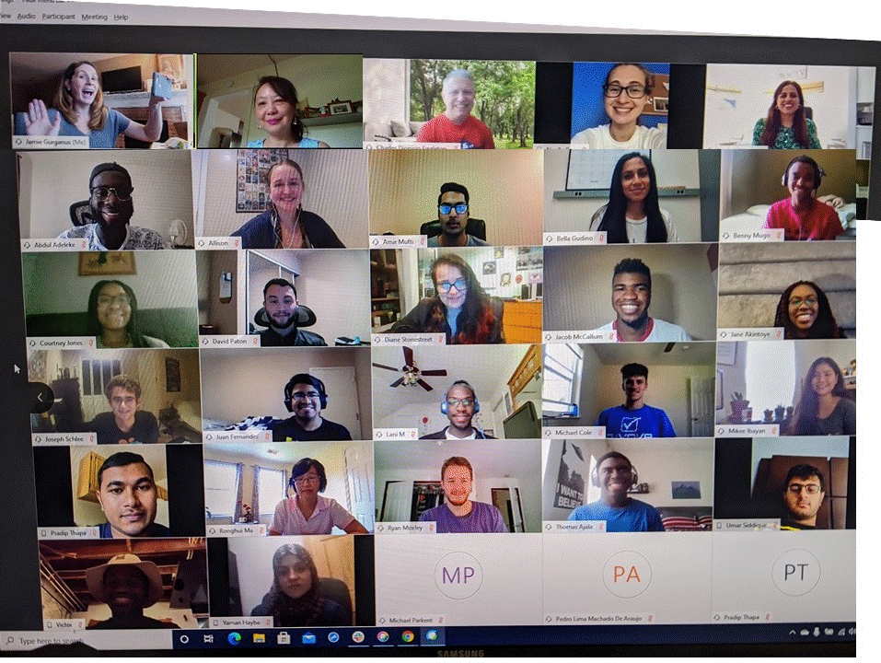
Our scholars in the past

Slide 6
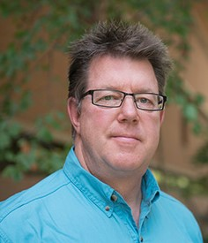
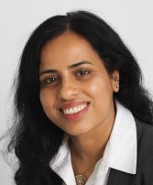
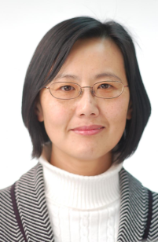
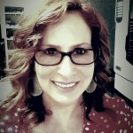
Management Team
Dr. L. Zhu Dr. T. Topoleski Dr. C. Eggleton Dr. D. Madan Dr. R. Ma
Peer mentoring program
Evaluator
Dr. Jamie Gurganus
Dr. Karen Peterman

Slide 7
Activities Sponsored by the ME S-STEM Program
Annual retreat with professional development workshop*
Three research seminars per year*
Mid-semester lunch with faculty/professional development workshop*
One-to-one faculty mentoring*
Peer mentoring program* (with the ME department)
ME Lab visits*
Provide financial support to cover lab expenses
Feature scholars’ research/internship on our website
Support ME S-STEM scholars attending conferences
* Mandatory participation

Slide 8
Industry Experience or Internship
Internship opportunities are available to most juniors and seniors in the department.
UMBC Career Center coordinates internship and provides other career development programs on campus.
20% of the Mechanical Engineering students had internships in local industry and were often hired by the company after their graduation.
41% of the ME S-STEM scholars had at least one internship over their S-STEM experience.

Slide 9
Integration of Research and Education
Bioengineering seminar series
One-semester or one summer research experience for the S-STEM scholars
58% of the ME S-STEM scholars had at least one semester/summer research experience in labs.
UMBC MARC U*STAR Program
UMBC undergraduate research awards
REU summer programs at UMBC or other universities
McNair Scholars Program

Slide 10
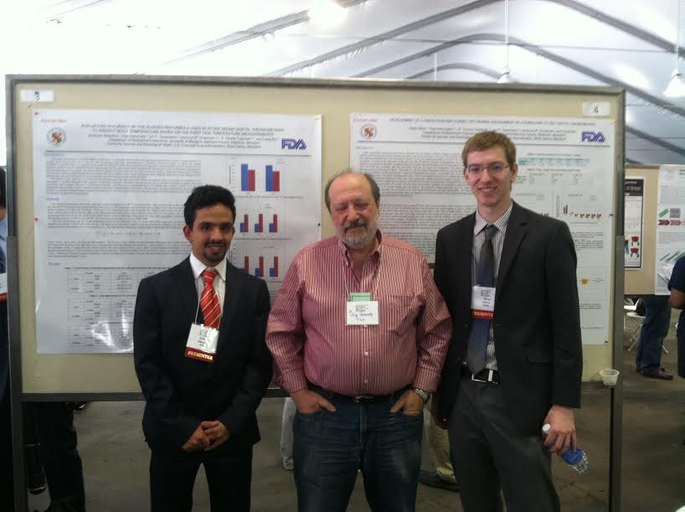
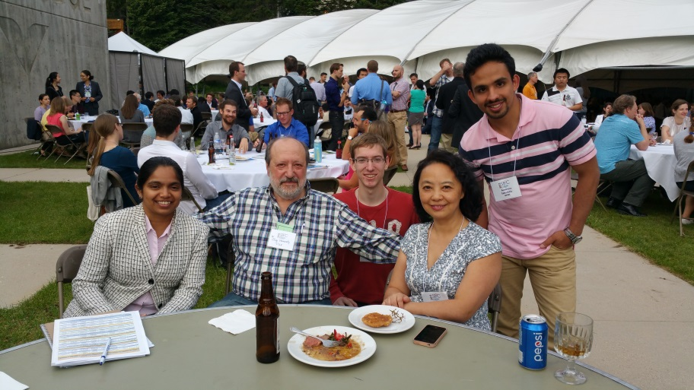
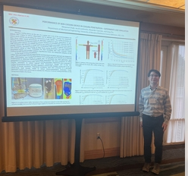
The ME S-STEM program has funds to support scholars’ travel to scientific conference and to cover their lab supply expenses. Contact the program if needed.

Slide 11
Career Counseling and Job Placement
Industrial opportunity
Faculty mentoring
Internship
UMBC Career Service Center
Graduate school
Mechanical Engineering BS/MS program
Research seminars and research experience
Graduate application process (UMBC Summer Horizon Program) and professional development workshops

Slide 12
Recent S-STEM Scholars Graduated from Our Program
2021 – 2022 --- Congratulations to our S-STEM scholars who graduated during the 2nd COVID year. They are Allison Dietz (Raytheon Technologies, Maryland), Amir Mufti (US Army Corps of Engineers), Dai Nguyen (Johnson and Johnson Consumer, PA), David Paton (Middle River Aerostructure systems, MD), Pedro Lima Machado De Araujo, Diane Stonestreet (Graduate School, Cornell University), Ryan Moxley, Yaman Hayba, Troy Baker (Graduate School, Imperial College of London).
2020 – 2021 — Congratulations to our S-STEM who graduated during the difficult COVID year. They are Maria Lee (Kite Pharm, CA), Adeleke Abdul-Raheem, Isabella Gudino (UMBC research lab), Michael Parkent (Air Force Materiel Command at Hill AFB, UT), Pradip Thapa (Engineering Associate, MD), Juan Fernandez (JHU APL, MD), Akintoye Jane (Graduate School, JHU), Mikee Ibayan (Fabpro Technologies in MD)
2019 - 2020 -- Congratulations to our S-STEM scholars who graduated this year. They are Josie Aquino (Mechanical Engineering Teaching Fellow, UMBC), Randy Deinlein (NAVSEA Warfare Centers, Bethesda, MD), Luke Spafford, Hector Flores (Navy Research, Washington DC), Micah Nissly (Johns Hopkins University Applied Physics Lab, MD), and Mariana Bueno (Graduate School, UMBC)
2018 – 2019 Several ME S-STEM scholars graduated from our program this year. They are Shiyani Patel (General Dynamics Robotic Systems, MD), Adnan Shaikh (Graduate School, UMBC), Noelle Ray (Graduate School, UMBC), Alliana Warner (Night Vision Electronics and Sensor, ARL, Virginia), Emily Duan (Graduate School, North Carolina State University), Olaoluwa Akinsola (Ohio State University), Ricardo Cardoza (Graduate School, U Pitt), Poojan Shah (Northrop Grumman + Graduate School JHU), Mamadou Diallo (Regal Beloit, MD), and Jonathan Shelly (Graduate School, UMBC)
2017 – 2018 — Eight ME S-STEM scholars graduated from our program this year. They are Jenette Phillips (U. Pitt, Graduate School), James Carl (Walmart, MD), Nathan Trentini (Introlox, MD), Levi Johnson (UMBC, Graduate School), Jordan Bendler (G3 Technologies, MD), Trevor Evans (Graduate School, Ohio State University), Marc Francis (Clemson University, Graduate School), Juliette Mason (Oceaneering, MD).
2016 – 2017 — Congratulations to our S-STEM scholars who graduated this year. Jezron Basbas (Unitec Electronics, MD), Ben Cherry (Aberdeen Proving Grounds), Christian Ingham (Graduate School, Carnegie Mellon University, PA), Anthony Lucernoni (Department of Justice), Angela Bartolomeo (Navel Research Lab, DC), Kyle Glazier (Walmart), Keith Purvis (William Technology, Michgan).
2015 – 2016 — Congratulations to 9 S-STEM scholars who graduated this year: Michael Roberts (ARL, MD), Louis Vasiliades (Stanley Black and Decker, MD), Nicole Dementride (APL), Amirreza Saharkhiz (Graduate School, UMBC), Nichole Forrester (NSA), Caroline Zellhofer (Graduate School, University of Maryland College Park), Qin Liu (Meridian Medical Technologies, MD), Amanda Crofoot (BAE Systems, MD), Avraham Feldman (Parsons Brinkerhoff and VP Engineering).
2014 – 2015 — Seven ME S-STEM scholars graduated from our program this year. They are Khalid Lamaafi (KK Engineering LLC, MD), Chris Mullen (UMBC Graduate School), Jeremiah Hess (UMBC Graduate School), Matt Wold (Northrop Grumman, MD), Peter Dillon (Northrop Grumman, MD), and Jonathan Wilson (EPA Assessment Center, Washington DC).
2013 – 2014 — This year we have more than 9 S-STEM scholars graduated from our program. They are Owen Abe (NAVSEA Command), Alfred Irungu (Stanley Black and Decker, MD), Yasas Katumuluwa (Johnson Marminran Thomson, MD), Vincent Di Salvo (Mueller Associate), Julian Gomez-Jordan (Northrop Grumman, MD), Steven Lavenstein (Johns Hopkins Graduate School), Matthew Parks (ICI Services, Washington DC), Irvin Rodriguez (Siemens, MD), David Morrison, Kabish Shah (Whiting Turner, MD),
2012 – 2013 – Congratulations to our S-STEM scholars who graduated in the past December 2012 and May 2013. Hiren Balsara and Randy Huber will continue to pursue their graduate degrees in Mechanical Engineering at UMBC, while Maleshia Jones will be a graduate student at U. Penn. Other scholar are working in STEM industry, including WR Grace (Sean Brady), W.L. Gore & Associates (Israel Ilufoye), HGL Dynamics (Sarah Kopytko), Lockheed Martin (Hannah Piper), JMT (Sarah Seering), Army Evaluation Center (Christopher Wooten), Henry Adams LLC (David Moskowitz) and Siemens (James Yee).
2011 – 2012 – Congratulations to our S-STEM scholars who Graduated from our program and working in industry or pursuing graduate career: Jason Dunthorn (UMBC Graduate School), Andrew Horton (US Patent Office), Chao Hou (UMBC Graduate School), Vikesh Patel (GE Aviation), Chelsea Stinson (John Deere), Luke Roberts (UMCP Graduate School), and Phillip Sinex (Gannon University Graduate School).
2010 – 2011 – Congratulations to our S-STEM scholars who graduated from the Mechanical Engineering Program: Mr. Mariano Mumpower (Key Technologies), and Mr. Binh Tran (Simens).

Slide 14
Expectations
Update your email contact information and check your emails regularly
Respond right away to email requests from the program team and survey
Schedule at least one meeting with your mentor each semester
Attend all required activities (surveys, research seminars, retreat, lunch with faculty/workshop, lab visit, etc)
Finish online surveys requested by the evaluator and management team.

Slide 15
Checklist for Scholars
Show up for our group photo today.
Email Dr. Zhu today which faculty in our team you want to be your mentor (only for new scholars).
Submit the survey when you receive an email from our external evaluator (only for new scholars)
Have you applied for the peer-mentoring program?
Have you enrolled in TRS201 (some transfer students) or ENES101Y (only for new UMBC students)?
Check your emails regularly.
Email me a paragraph of you recent research or internship and a photo for me to post it on our website. We need good news from you!
Contact Dr. Zhu if you need funds to attend conferences.
Please let Dr. Zhu know whether you need any research supply if you work in a research lab at UMBC.
Feel free to use the ME Tutoring room (E229B).

