Slide 1
Mechanical Engineering S-STEM Scholarship Program at UMBC
Liang Zhu
Director, ME S-STEM Program
Department of Mechanical Engineering
University of Maryland Baltimore County
Notes:
1

Slide 2
Outline
ME S-STEM Program at UMBC
Eligibility
Program Features
Introduction of New Scholars
ME S-STEM Mentors
Expectations
Notes:
2

Slide 3
Mechanical Engineering S-STEM Scholarship Program at UMBC
The ME S-STEM Scholarship Program” is an NSF funded four year scholarship program starting in 2010. We recently got the renewal from NSF to continue the program for the next four years.
The S-STEM program will provide scholarships and educational opportunities to 16 economically disadvantaged and academically talented undergraduate students in the ME program at UMBC.
Scholarship amount is based on financial need (indicated in the FASFA form) and academic performance, with an average amount of $7500 per year per student.

Slide 4
Mechanical Engineering S-STEM Scholarship Program at UMBC
(continued)
Eligible expenses include tuition, fees, books, supplies, housing, and equipment.
The scholarship goal is to improve student retention and increase their career prospects, with special emphasis on diversity.

Slide 5
Eligibility
The scholarship is aimed at graduating high school seniors, community college transfer students, and current UMBC students in Mechanical Engineering.
The applicants must be a US citizen and permanent resident.
The student should intend to enroll in the Mechanical Engineering major at UMBC and maintains a full time student status.
A minimum GPA of 2.75 is required.
The applicants should demonstrate financial need based on the FASFA form.
Scholarship renewals are based on academic performance and participations in S-STEM program activities.

Slide 6
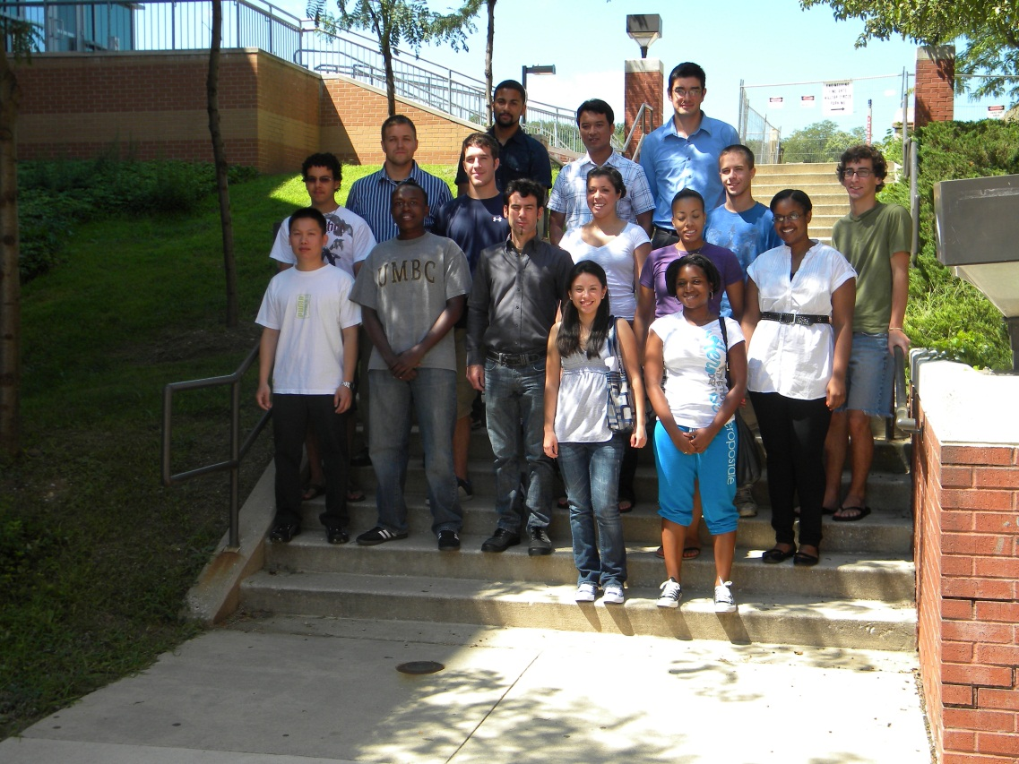
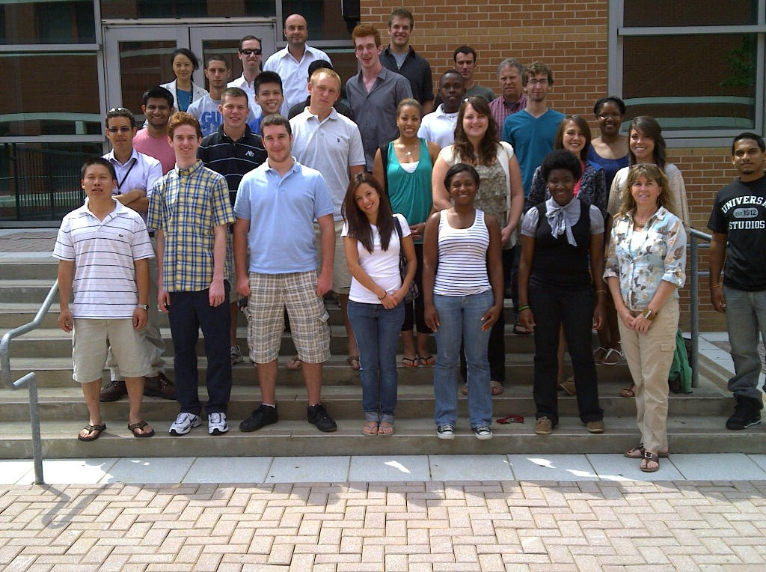
Our Scholars in the Past

Slide 7
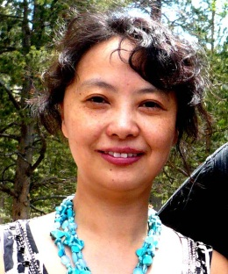



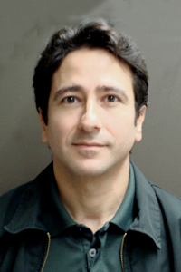
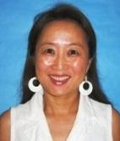
Management Team
At UMBC
Dr. L. Zhu Dr. D. Arola Dr. C. Eggleton Dr. A. Spence Dr. C. Romero-Talamas
At MCC
Dr. W. He

Slide 8
Special Features
What will we do DIFFERENTLY from other S-STEM programs?

Slide 9
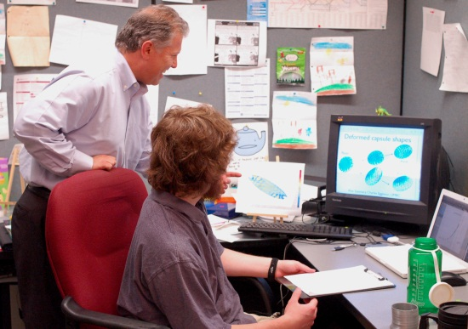
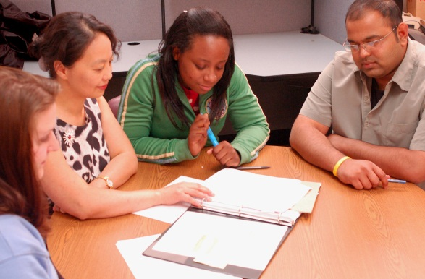
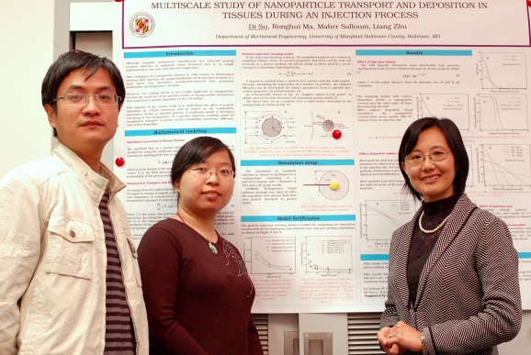
Mentoring
One-to-one mentoring by faculty in the department.
Regular interaction with the mentor
Different mentoring strategies for students at various stages.

Slide 10
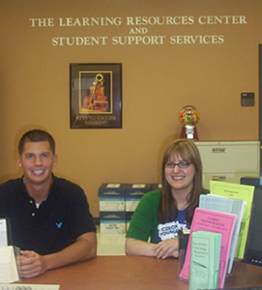
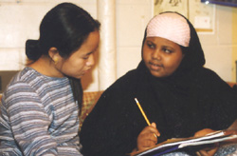
Academic Support Services
Tutoring service by the ME S-STEM program
  Mr. Hiren Balsara
  ME Tutoring Room: E229B
Study groups
Workshops
Peer mentoring

Slide 11
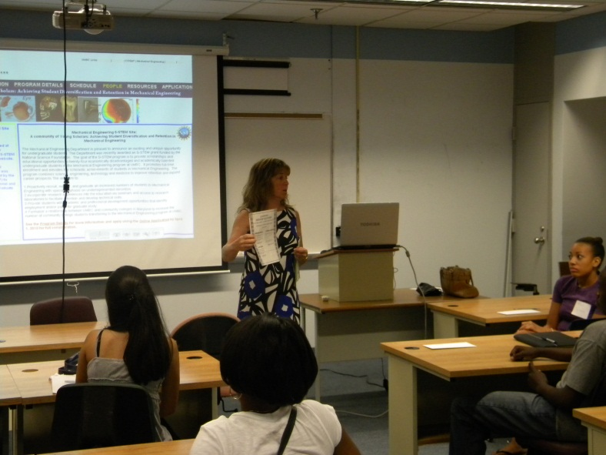
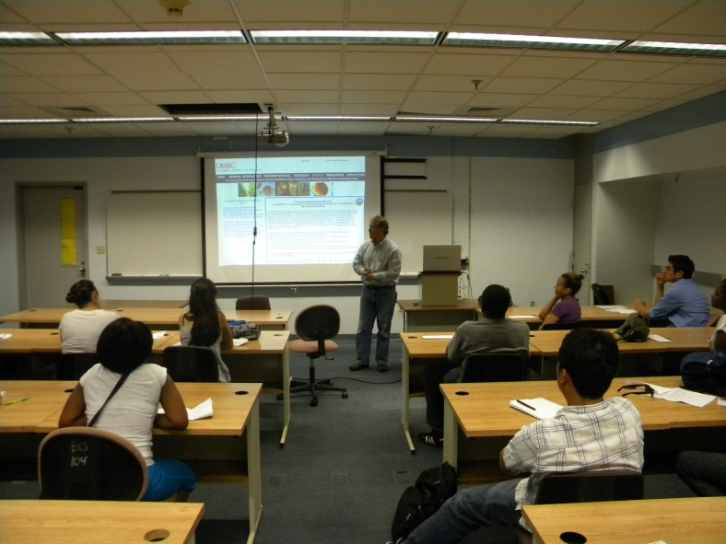
Community Building
August retreat
Participate in various academic activities on campus
A designated room for the ME S-STEM Scholarship Program
Social events

Slide 12
Industry Experience or Internship
Internship opportunities are available to most juniors and seniors in the department.
UMBC Shriver Center coordinates internship and provides other career development programs on campus.
20% of the Mechanical Engineering students had internships in local industry and were often hired by the company after their graduation.
The ME S-STEM scholars had an average of 1.2 internships and/or research experiences over their S-STEM experience.

Slide 13
Integration of Research and Education
Bioengineering seminar series
One-semester or one summer research experience for the S-STEM scholars
61% of the ME S-STEM scholars had at least one internship and/or research opportunity.
UMBC MARC U*STAR Program
UMBC undergraduate research awards
REU summer programs on campus
McNair Scholars Program

Slide 14
Career Counseling and Job Placement
Industrial opportunity
  Faculty mentoring
  Internship
  UMBC Career Service Center
Graduate school
  Mechanical Engineering BS/MS program
  Research seminars and research experience
  Graduate application process (UMBC Summer Horizon Program)

Slide 15
Recent S-STEM Scholars Graduated from Our Program
2013 – 2014 — Owen Abe (NAVSEA Command), Alfred Irungu (Stanley Black and Decker, MD), Yasas Katumuluwa (Johnson Marminran Thomson, MD), Vincent Di Salvo, Julian Gomez-Jordan, Steven Lavenstein (Johns Hopkins), Matthew Parks, Irvin Rodriguez, Kabish Shah (Whiting Turner),
2012 – 2013 – Hiren Balsara and Randy Huber (UMBC), Maleshia Jones (U. Penn), WR Grace (Sean Brady), W.L. Gore & Associates (Israel LIfoye), HGL Dynamics (Sarah Kopytko), Lockheed Martin (Hannah Piper), JMT (Sarah Seering), Army Evaluation Center (Christopher Wooten), Henry Adams LLC (David Moskowitz) and Siemens (James Yee).
2011 – 2012 –Jason Dunthorn and Chao Hou (UMBC Graduate School), Andrew Horton (US Patent Office), Vikesh Patel (GE Aviation), Chelsea Stinson (John Deere), Luke Roberts (UMCP), and Phillip Sinex (Gannon University).
2010 – 2011 – Mariano Mumpower (Conveyor Handling Company), Binh Tran (Simens).

Slide 16
Current Scholars and New Scholars
We have 12 scholars from the NSF 2010 grant.
17 new ME S-STEM scholars will join us this fall.

Slide 17
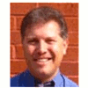
Meet the ME S-STEM Mentors
Dr. C. Eggleton
Department Chair
Speaks fluent Spanish
Has the potential to be a hacker since he is good at writing sophisticated computer codes for CFD research

Slide 18
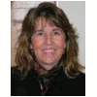
Dr. A. Spence
Undergraduate Coordinator in ME
Knows how to fly a helicopter
Likes wine

Slide 19
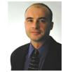
Dr. D. Arola
Currently at University of Washington
Likes motorcycles
Is a very good hunter

Slide 20
Dr. C. Romero-Talamas
He is allergic to cats
He is from a city by the ocean
His research involves the so-called fourth state of matter.

Slide 21
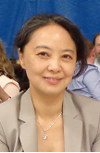
Dr. L. Zhu
She got a C in her Calculus II course in her college.
She worked until the day before her baby was born.
She can lift a 50 Ib bag over her head.

Slide 22
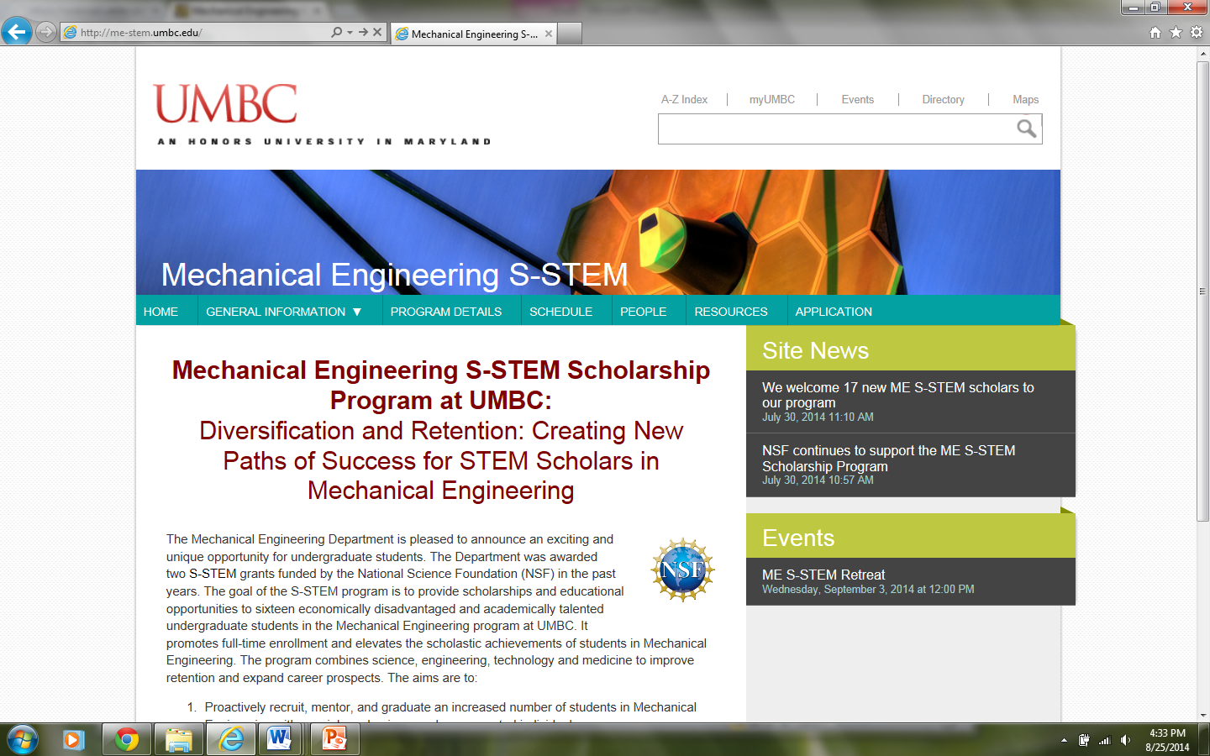

Slide 23
Expectations
Update your email contact information and check your emails regularly
Respond to email requests from the program
Schedule regular meetings with your mentor
Attend all required research seminars
Contact us if you need help
See the tutor regularly if you have difficulties in courses
Use the student support services on campus
  Learning Resource Center, Office of Undergraduate Education, Student Support Services, The Shriver Center, Career Center, UMBC Graduate School

Slide 24
Action Items for Scholars
Don’t forget the sign up sheet.
Select your mentor (new scholars) and email Dr. Zhu before this coming Friday.
Submit the survey (new scholars) today
Know where room E229B is.
Check your emails regularly
Schedule at least one meeting with your mentor this semester
Attend the S-STEM research seminars
Enjoy the scholarship and buy yourself something fun.

