Slide 1
Mechanical Engineering S-STEM Scholarship Program at UMBC
Liang Zhu
Director, ME S-STEM Scholarship Program
Professor of Mechanical Engineering
Department of Mechanical Engineering
University of Maryland Baltimore County
Notes:
1

Slide 2
Outline
ME S-STEM Program at UMBC
Program Features
Program Outcomes
Notes:
2

Slide 3
Mechanical Engineering S-STEM Scholarship Program at UMBC
The ME S-STEM Scholarship Program” is an NSF funded four year scholarship program starting in 2010. We got the renewal from NSF in 2014 to continue the program for the next four years.
The S-STEM program will provide scholarships and educational opportunities to 16-24 economically disadvantaged and academically talented undergraduate students in the ME program at UMBC.
Scholarship amount is based on financial need (indicated in the FASFA form) and academic performance, with an average amount of $7500 per year per student.

Slide 4
Mechanical Engineering S-STEM Scholarship Program Objectives
Proactively recruit, enroll, and graduate an increased number of students in Mechanical Engineering with special emphasis on underrepresented minorities and women.
Incorporate research experiences into the education curriculum via research seminars and access to research laboratories in bioengineering as a vehicle to facilitate the participant’s retention and to supplement their skills base.
Provide students with academic and professional development opportunities that identify potential industrial employers and/or successful paths for graduate study.
Formalize cooperative relationships between UMBC and local community colleges to increase the number of students transferring to the 4-year ME program at UMBC.

Slide 5
Approaches
Mentoring
  One-to-one mentoring by faculty in the department with regular interaction.
Community Building
  August retreat
  Participate in various academic activities on campus
  A designated room for the ME S-STEM Scholarship Program
Incorporating Research into Education
  Bioengineering seminar series
  One-semester or one summer research experience for the S-STEM scholars
  Financing students’ participating in research conferences
Enhancing collaborations with Community Colleges
  Visiting community colleges
  Sending scholars back to their community colleges to describe the program
  Establishing regular contacts and intense interaction with community college faculty and staff members

Slide 6
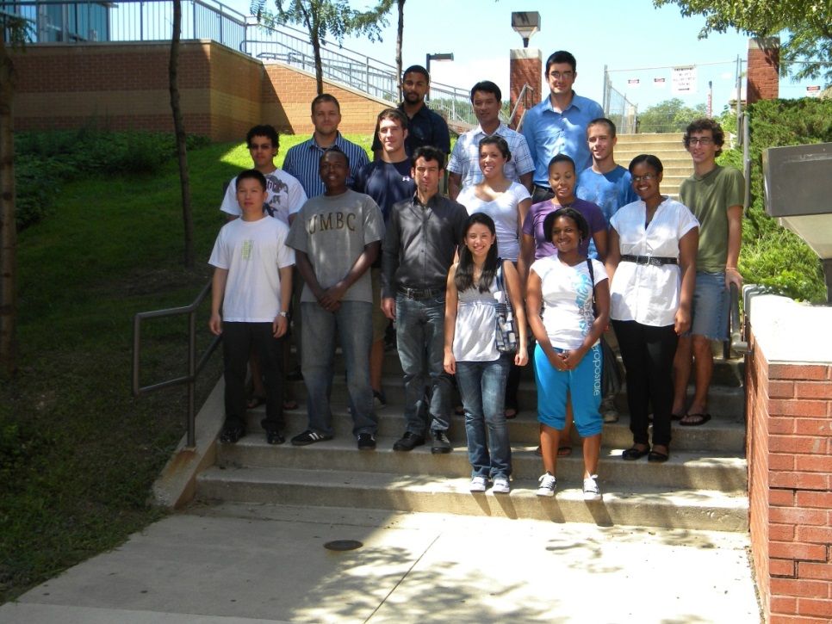
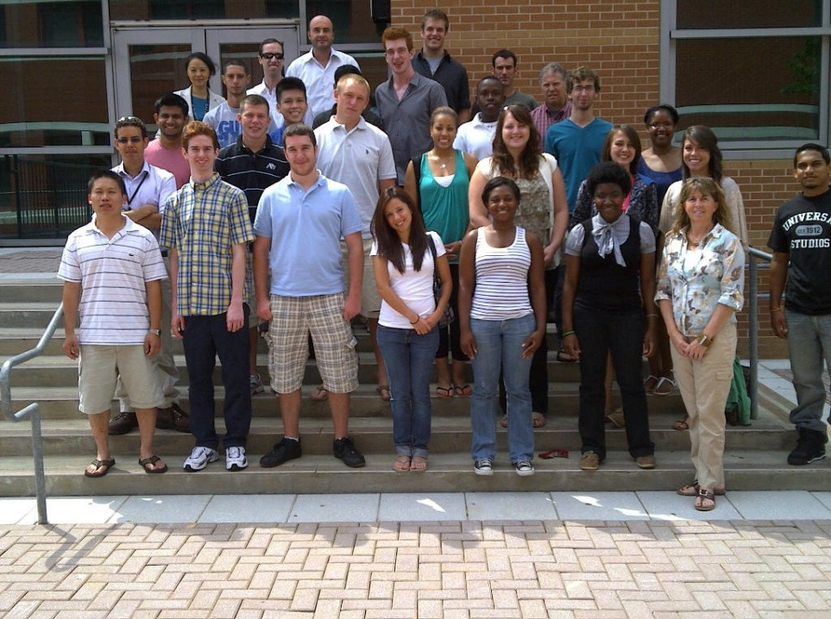
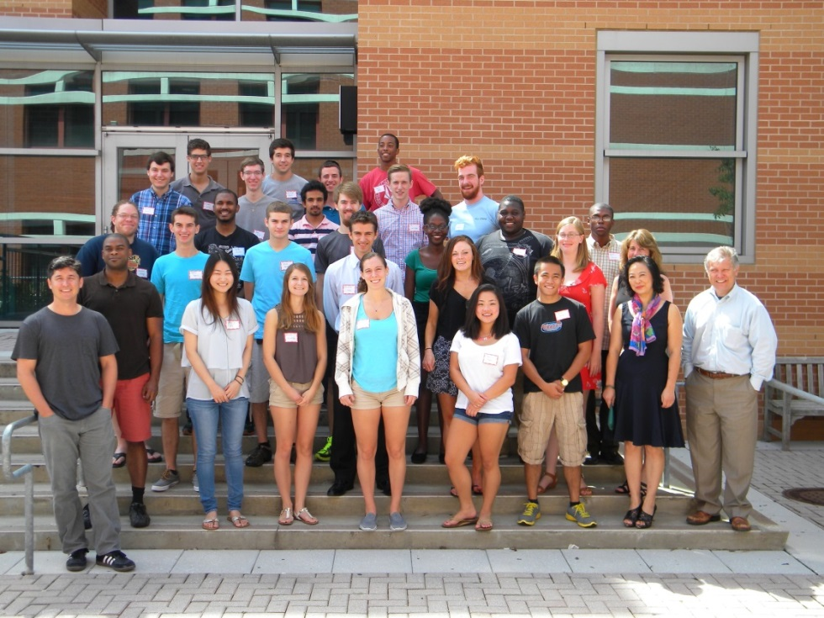
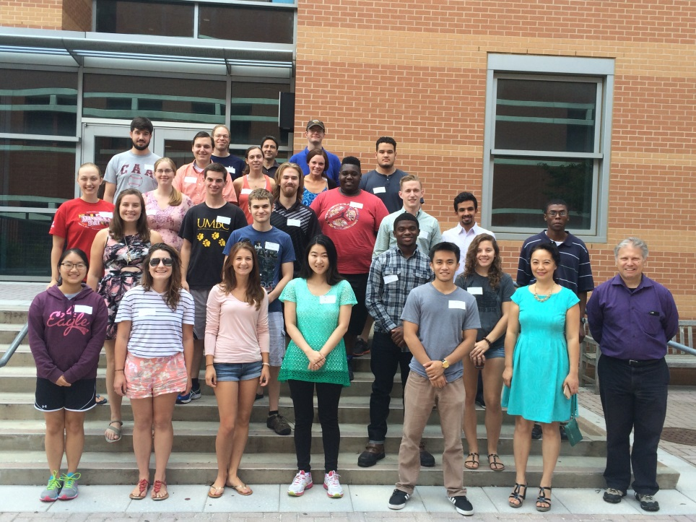
Our scholars

Slide 7
We supported 49 scholars over 4 years

Slide 8
Scholars’ attendance rate for various activities

Slide 9
Scholars’ satisfaction to the events

Slide 10
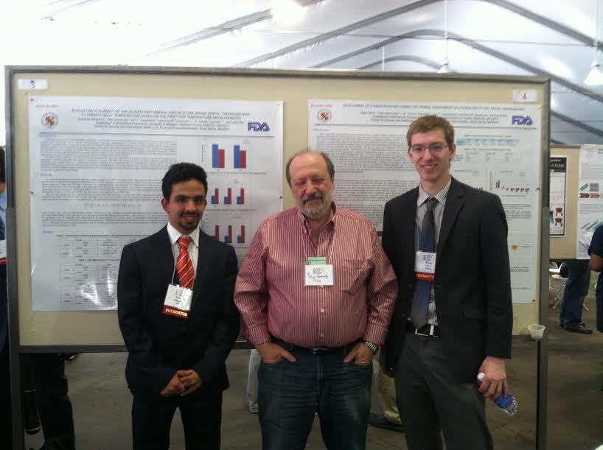
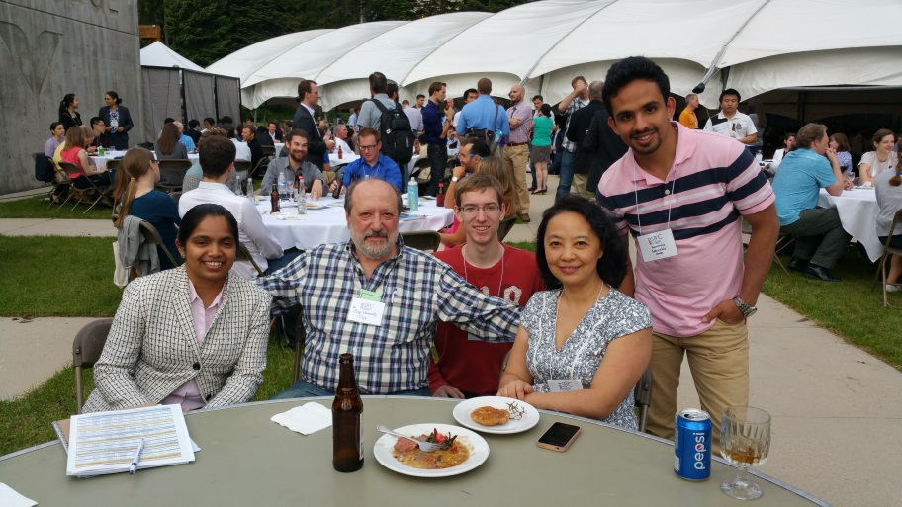
The ME S-STEM program has funds to support scholars’ travel to scientific conference and their lab supplies.

Slide 11
Among the 49 scholars, 7 of them were not renewed due to poor academic performance. None of them dropped out of school.

Slide 12
35 scholars graduated from our BS program with an average GPA of 3.5/4.0.

Slide 13
Recent S-STEM Scholars Graduated from Our Program
2014 – 2015 —Khalid Lamaafi (KK Engineering LLC, MD), Chris Mullen (UMBC Graduate School), Jeremiah Hess (UMBC Graduate School), Matt Wold (Northrop Grumman, MD), and Peter Dillon (Northrop Grumman, MD).
2013 – 2014 —They are Owen Abe (NAVSEA Command), Alfred Irungu (Stanley Black and Decker, MD), Yasas Katumuluwa (Johnson Marminran Thomson, MD), Vincent Di Salvo (Mueller Associate), Julian Gomez-Jordan, Steven Lavenstein (Johns Hopkins Graduate School), Matthew Parks (ICI Services, Washington DC), Irvin Rodriguez (Siemens, MD), David Morrison, Kabish Shah (Whiting Turner, MD),
2012 – 2013 –Hiren Balsara and Randy Huber will continue to pursue their graduate degrees in Mechanical Engineering at UMBC, while Maleshia Jones will be a graduate student at U. Penn. Other scholar are working in STEM industry, including WR Grace (Sean Brady), W.L. Gore & Associates (Israel Ilufoye), HGL Dynamics (Sarah Kopytko), Lockheed Martin (Hannah Piper), JMT (Sarah Seering), Army Evaluation Center (Christopher Wooten), Henry Adams LLC (David Moskowitz) and Siemens (James Yee).
2011 – 2012 –Jason Dunthorn (UMBC Graduate School), Andrew Horton (US Patent Office), Chao Hou (UMBC Graduate School), Vikesh Patel (GE Aviation), Chelsea Stinson (John Deere), Luke Roberts (UMCP Graduate School), and Phillip Sinex (Gannon University Graduate School).
2010 – 2011 -Mariano Mumpower (Key Technologies), and Binh Tran (Simens).

Slide 14
Conclusions:
The NSF supported S-STEM scholarship program has supported 49 scholars at UMBC with scholarships and opportunities to improve students’ retention and placement after their graduation.
Strong connection and collaboration with local community colleges have resulted in a high percentage of transfer students in the program and their success in retention and graduation.
The program has achieved high participating rates (>87%) and high satisfaction rates (>90%) to the S-STEM sponsored activities.
The annual retention rates are higher than 85%. Among the seven students who did not get renewal, none of them were community transfer students.
Implementation of research activities and encouragement of industrial internships have helped identify potential industrial employers and/or successful paths for graduate study.
95% of the scholars who graduated from our BS program either found a position in industrial or admitted to a graduate school.

