Slide 1


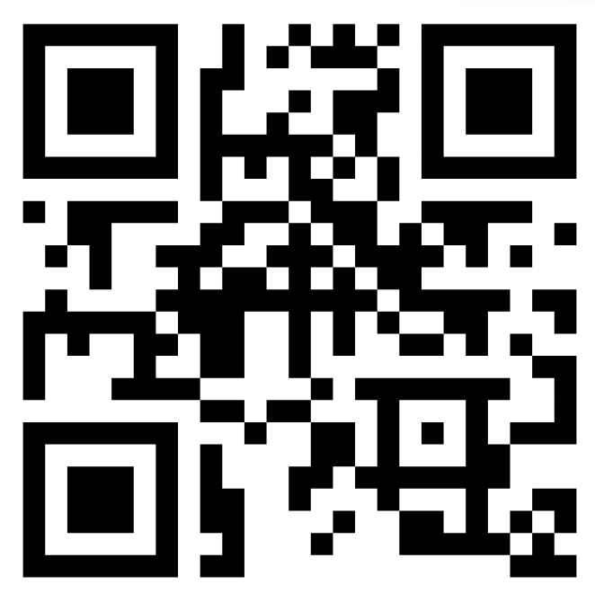
Center for Integrated Mathematical and
Biological sciences Research and Eduation
CIMBRE
Student Research Award
Are you strong in Math or Stat and interested on Biological applications or
focused on Biology research but have some background in
Math or Stat and an interest in mathematical modeling??
Then this program may be for you!
Paid Spring research opportunity!!
Check out the announcement at this QR code
Or website cimbre.umbc.edu/news/cimbre-undergraduate-student-award/

