Slide 1
Nigerian Graduate Student Association
The NGSA is committed to the intellectual success of all Nigerian graduate students at UMBC. It is devoted to providing professional, social interactions and support among Nigerian graduate students.
Provide opportunity to interact with each other as well as build a strong support system for each other and share job opportunities and resources with each other.
NGSA will provides support for newly admitted graduate students moving to the US from Nigeria and assist in making their transition as comfortable and enjoyable as possible. This would involve officials of the NGSA and its members attending orientations to speak to and welcome new Nigerian graduate students
Providing opportunities and support, as well as fostering a sense of community for Nigerian Graduate Students through events, collaborative projects within and outside the association.
The NGSA will collaborate with the GSA, BSO, the other African Students and any organization interested in inter-cultural exchange to effectively pursue and achieve its goals.
Collaborating with the GSA, BSO and related student organization on events that foster academic and social events in which Nigerian graduate students feel represented and recognized.
Work closely with our faculty advisor Gloria Chuku, Professor and Chair of Africana Studies to achieve these goals

Slide 2
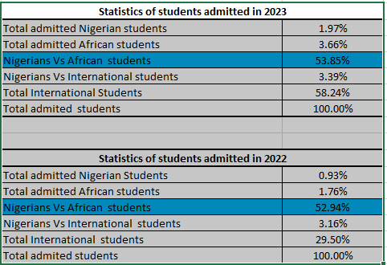

Slide 3
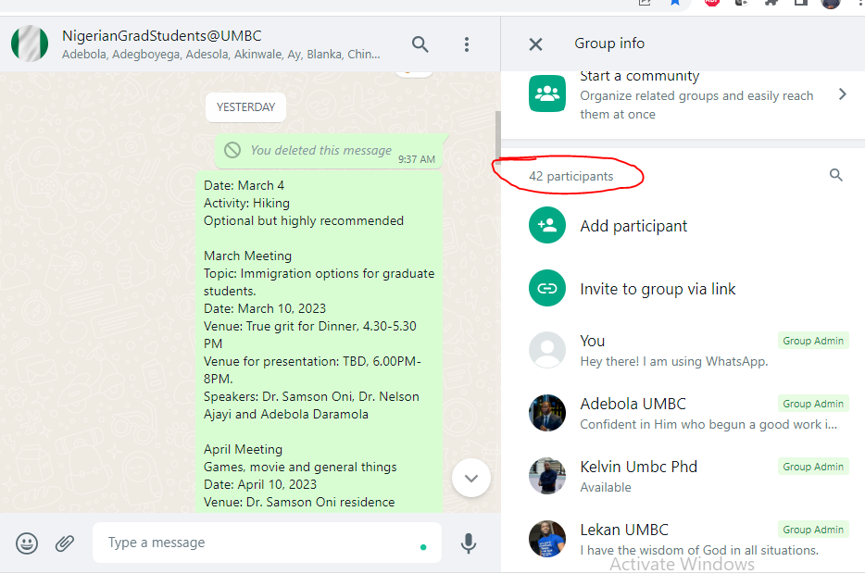
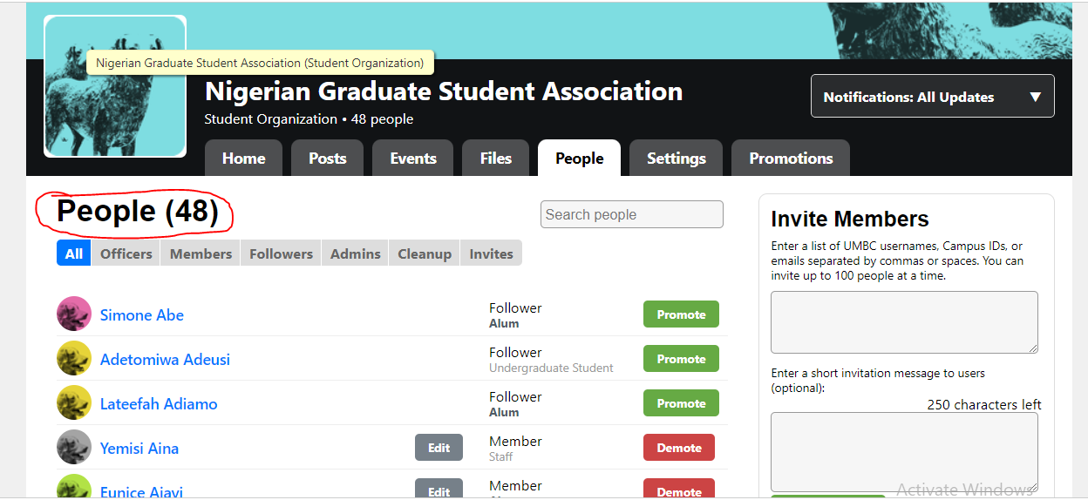

Slide 4
