Slide 1
TIHAR: THE FESTIVAL OF LIGHTS
Rashmita Bajracharya
Jyotsna Karkee

Slide 2
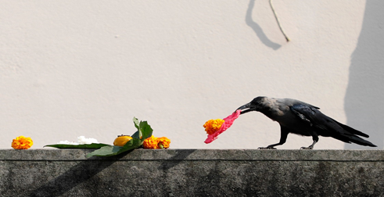
DAY 1: KAAG (Crow) TIHAR
Notes:
First day of the festival
Crows are worshipped for good luck
Crows are regarded as messengers of Yamaraja, the god of death
People normally leave rice grains, fruits, and sweet on their balconies for the crows to eat.

Slide 3
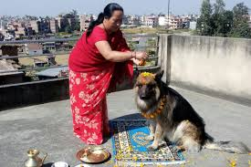
DAY 2: KUKKUR (dog) TIHAR
Notes:
Celebration of dogs
People offer garlands, tikka and food to dogs
Symbolizes the admirable relationship between dogs and humans
In Hindu mythology, dogs were protectors of households; every household owned a dog.

Slide 4
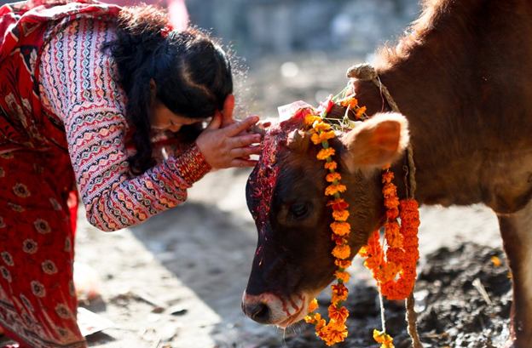
DAY 3: GAI (cow) TIHAR AND LAXMI POOJA
Notes:
Worship cows (In Hinduism, cows signify prosperity and wealth)
They are worshipped by putting flower garlands on their neck and feeding them grass.
For Laxmi pooja, people clean their houses and decorate with flowers and lights
The goddess laxmi, known as the goddess of wealth, is worshipped to thank her for the wealth and prosperity bestowed upon the family
At night, people go from house to house singing deusi bhailo (homeowners, in return, give them money, fruits, sweets etc.)
Cow is regarded as mother in Hindu religion as we grow up drinking its milk. So they are regarded as life givers.

Slide 5
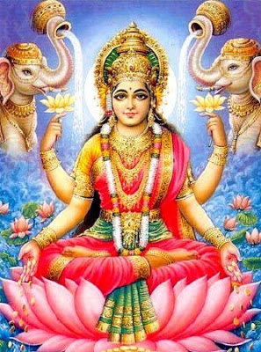
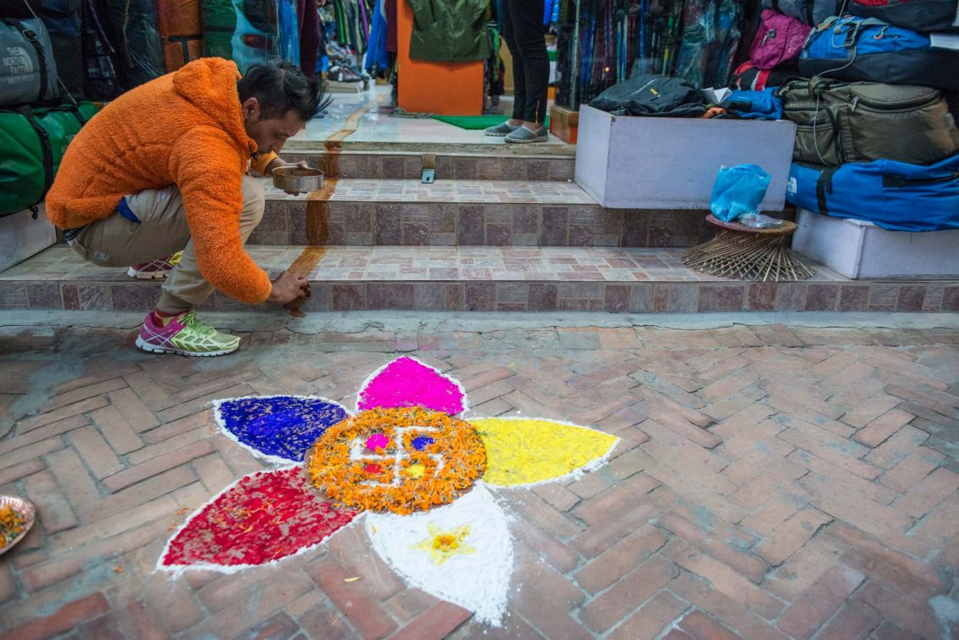
DAY 3: GAI TIHAR AND LAXMI POOJA

Slide 6
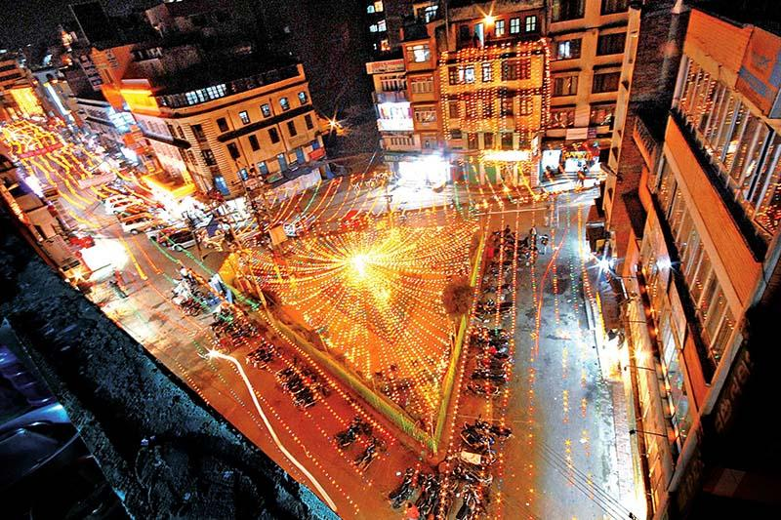
DAY 3: GAI TIHAR AND LAXMI POOJA

Slide 7
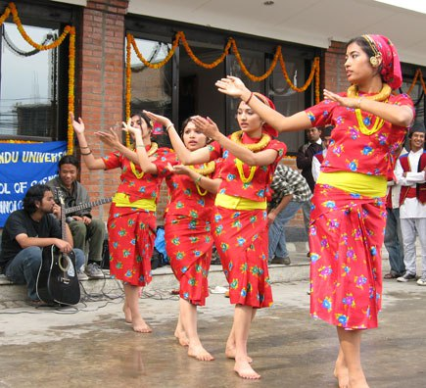
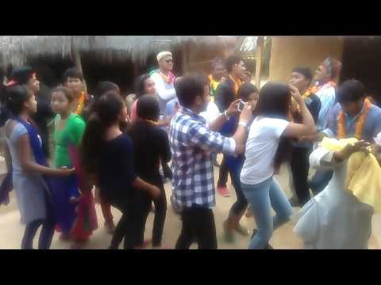
DAY 3: GAI TIHAR AND LAXMI POOJA
https://www.youtube.com/watch?v=SI0MQzESyFY

Slide 8
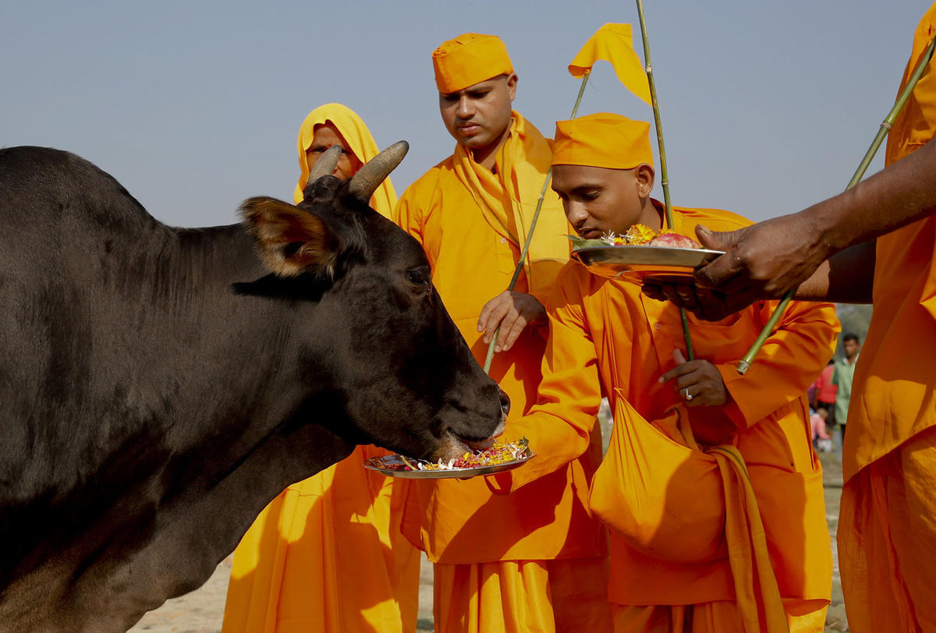
DAY 4: GOVARDHAN POOJA
Notes:
Ox is worshipped on the fourth day
Also known as goru tihar
Cow dung is used during the worship
Marks the beginning of the new Nepal calendar year.
We worship oxen thanking him for his hard work on the field.

Slide 9
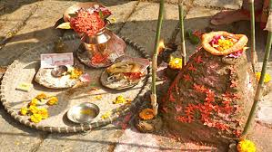

Slide 10
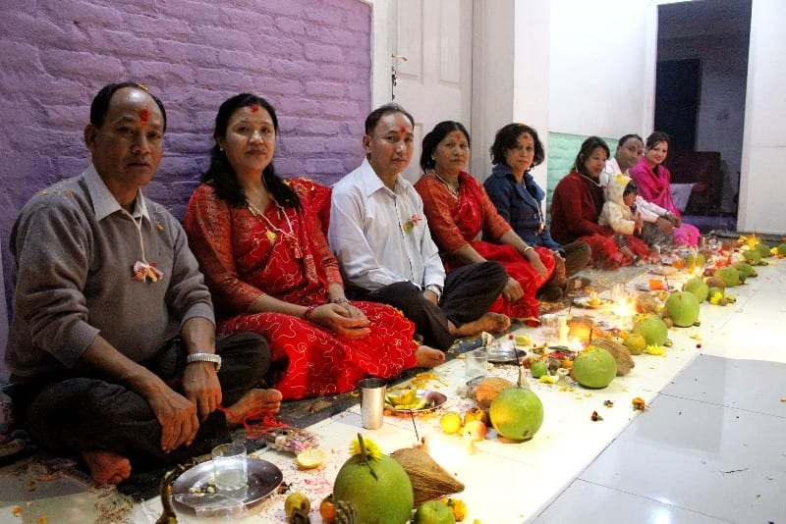
DAY 4: MHA (Self) POOJA

Slide 11
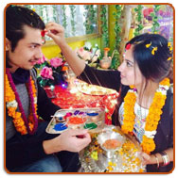
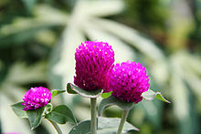
DAY 5: BHAI (brother)TIKA
Notes:
Sisters worship their brothers and vice versa
Sisters apply tika to their brothers foreheads to ensure long life
Garlands are put around their neck. This symbolizes the sister’s prayer for her brother’s long life

Slide 12

THANK YOU!

Slide 13
https://www.youtube.com/watch?v=lODAb-HmC4Q

