Slide 1

National Society of Black Engineers

Slide 2
Mission Statement
The mission of the National Society of Black Engineers is "to increase the number of culturally responsible Black Engineers who excel academically, succeed professionally and positively impact the community."

Slide 3
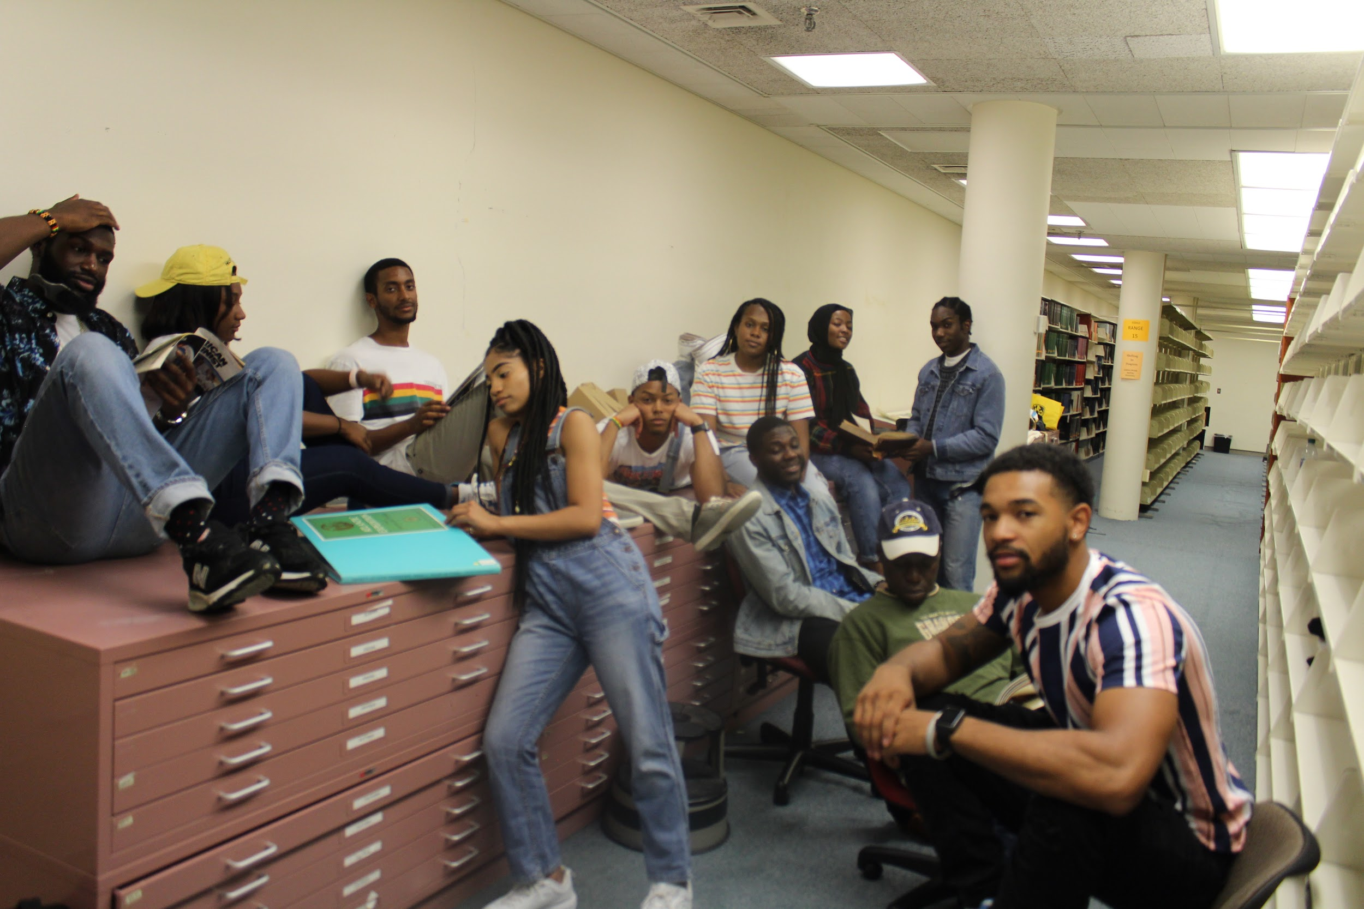
What We Do?
Cultural/Professional organization
Host networking events and workshops
Attend Regional and National conferences
Provide mentoring and academic support
Throw social events
Volunteer Opportunities (Ex. Assist our local NSBE Jr. Chapter)
Bi-weekly general body meetings (Every other Monday starting Sept. 14th)
We Stay 2 Hype!!

Slide 4
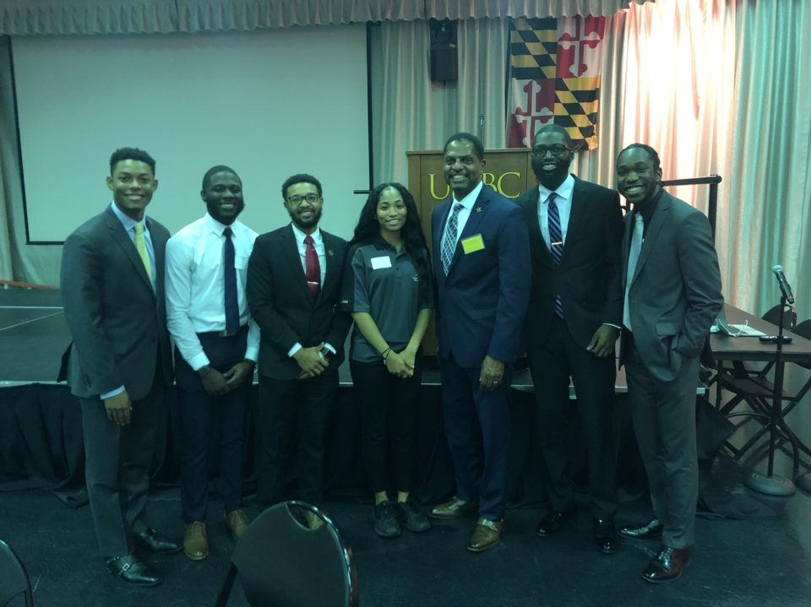
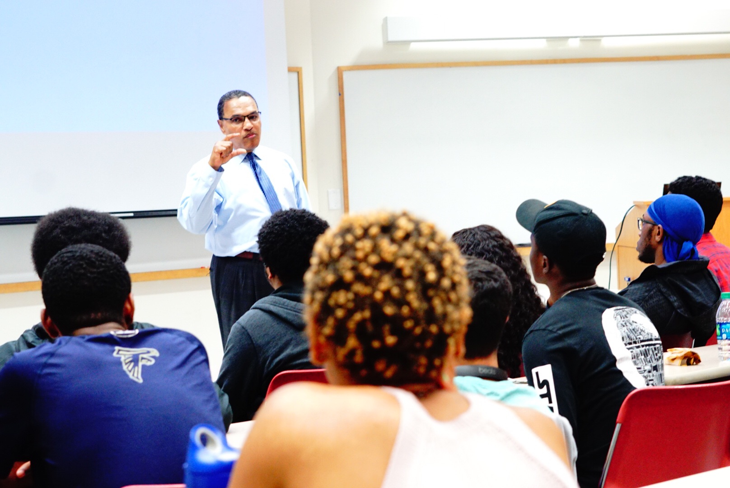
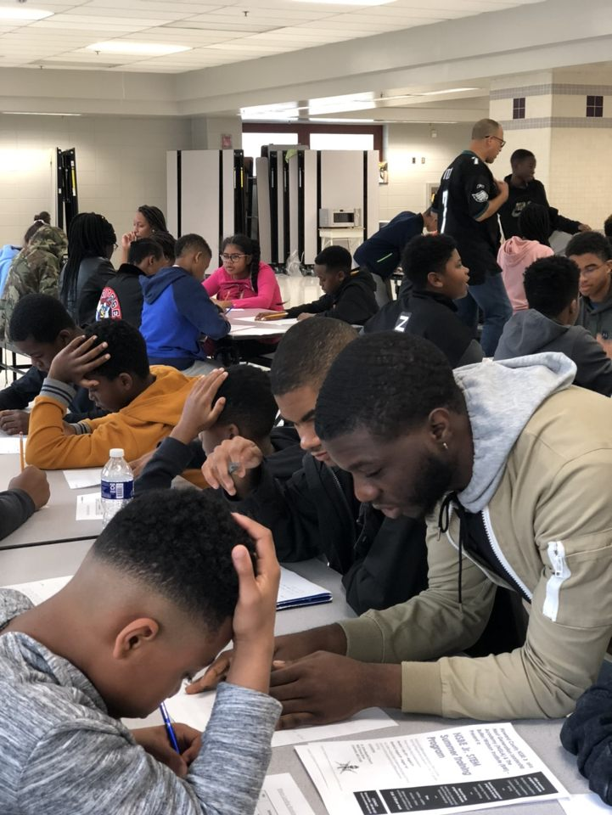
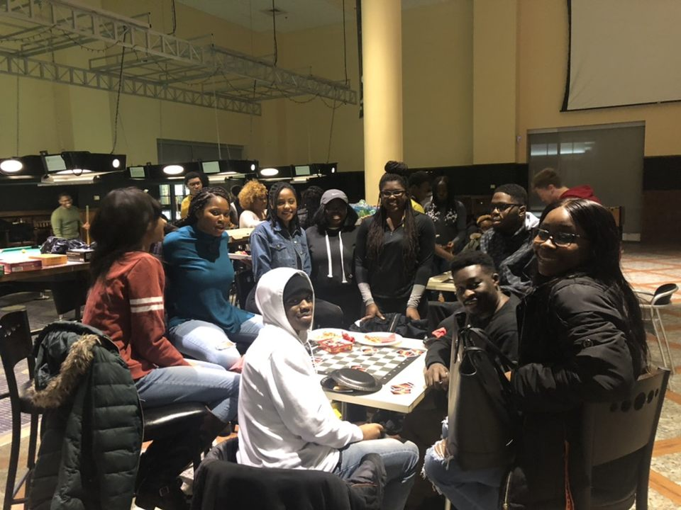
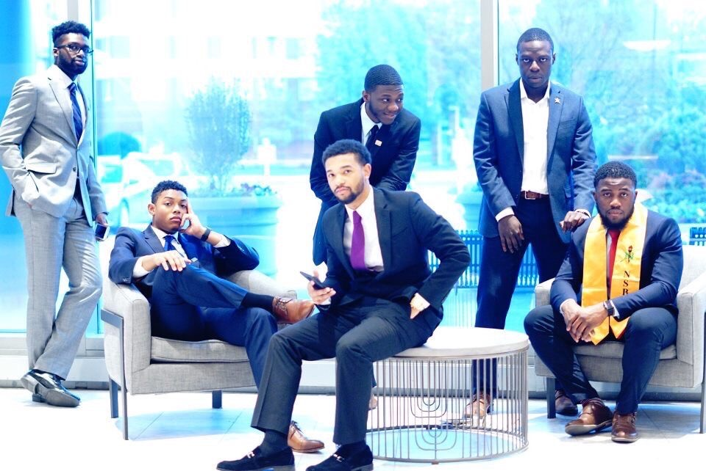
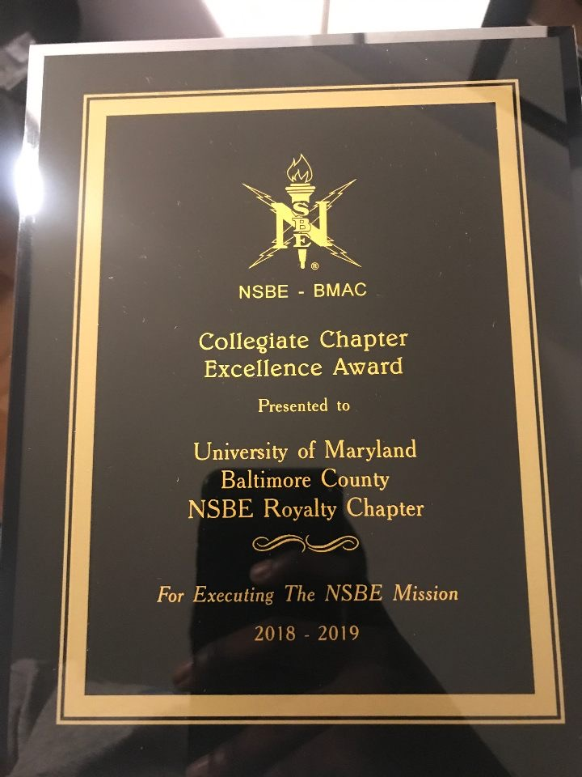

Slide 5
Executive Board
President - Howard Nicholson III, Major: Chemical Engineering, biotechnology track, Minor: music, Contact: hnicho1@umbc.edu
Vice President - Jason Pentsil, Major: Mechanical Engineering, Contact: jpen1@umbc.edu
Treasurer - Basit Sanni, Major: Mechanical Engineering, Contact: basan1@umbc.edu
Secretary - Jane Akintoye, Major: Mechanical Engineering, Contact: ak35@umbc.edu
Conference Planning Chair - Jordan Troutman, Major: Computer science & Mathematics, Contact: trout1@umbc.edu
Finance Chair - Vlad Stewart, Major: Information Systems, Contact: stewvla1@umbc.edu

Slide 6
Executive Board
Senator - Jameka Wiggins, Major: Chemical Engineering, Contact: jameka2@umbc.edu
Senator - Jonathan Amao, Major: Mechanical Engineering, Minor: Math, Contact: jon33@umbc.edu
Public Relations - Makayla Headley, Major: Chemical Engineering, Contact: headl1@umbc.edu
Parliamentarian - Nomso Ashiogwu, Major: Computer Engineering, Contact: cashiog1@umbc.edu
Programs Chair - Jarod Mendoza-Tingem, Major: Mechanical Engineering, Contact: jmendoz2@umbc.edu
Pre-Collegiate Initiative (PCI) Chair - Ryan Mbagna-Nanko, Major: Mechanical Engineering, Contact: mbagna1@umbc.edu

Slide 7
Committees
NSBE Jr. (Next Generation Leadership Academy) - Ryan Mbagna-Nanko, Major: Mechanical Engineering, Contact: mbagna1@umbc.edu
Volunteer Committee - Nicole Attram, Major: Mechanical Engineering, Contact: nicolea1@umbc.edu
Pageant Committee - Makayla Headley, Major: Chemical Engineering, Contact: headl1@umbc.edu

