Slide 1
Sponsored Projects Manual Payroll Request
New DocuSign Form

Slide 2
Background
Payroll is entered into the PeopleSoft HR module
If there is a need for a payroll cost transfer, it is submitted through the retro process, which updates the PeopleSoft HR module
When a manual payroll adjustment is submitted, that is processed through a journal entry, which updates the PeopleSoft Finance module, not the HR module

Slide 3
Background
PeopleSoft Effort Reporting is updated from the HR module only. Transactions from sources other than HR do not update the effort.
Effort report certification is mandated by the federal gov’t regulations and all transactions must be reflected in order to provide after the fact distribution of effort on sponsored awards.
Manual salary journal entries should be rare exception and documented within the Effort certification process.
  Discussion: What are reasons for submitting manual payroll journals?

Slide 4
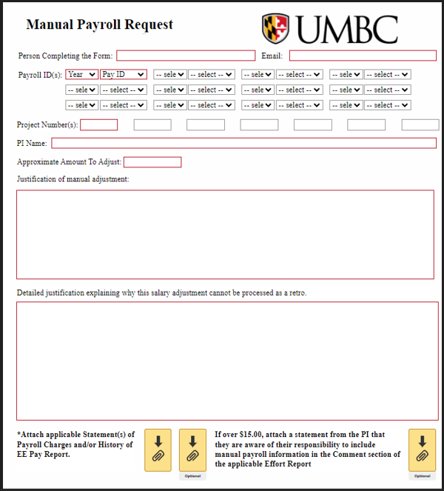
Sponsored Projects Manual Payroll Request Form

Slide 5
Manual Payroll Request Form Instructions
Start the process by completing and submitting the Manual Payroll Request DocuSign form, including applicable attachments.
Name and email of person completing the form
Payroll ID of the payroll(s) affected, ex: 2025006
Project numbers
Name of the PI
Approximate amount to adjust, this can be exact or rounded

Slide 6
Manual Payroll Request Form Instructions
Justification of manual adjustment.
  Remember a payroll adjustment that affects sponsored funds is a cost transfer and must adhere to Cost Transfer Policy requirements
  Ex: A manual payroll adjustment is needed because we received an extension with a new PO therefore
  an additional project was created and funds are moving from Project #1 to Project #2
Detailed justification explaining why the salary adjustment cannot be processed as a retro.
  Ex: A retro is not able to be processed due to system constraints per Justin Hopkins.
8. Attach applicable Statement of Payroll Charges and/or History of EE Pay Report
If over $15.00, attach a statement from the PI that they are aware of their
responsibility to include manual payroll information in the Comment section of the
applicable Effort Report.

Slide 7
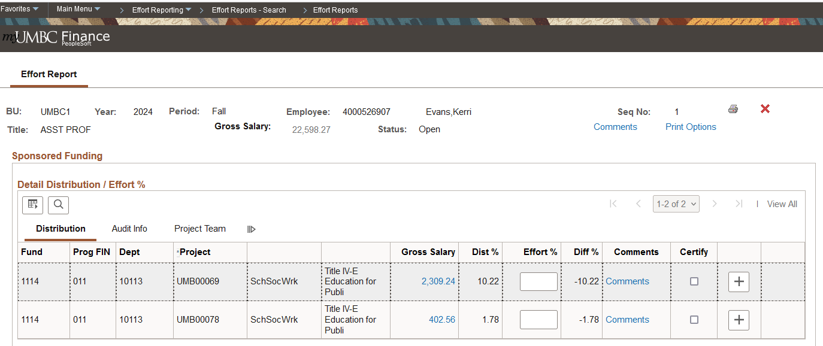
PI responsibility: Comment section of the applicable Effort Report
Click on ‘Comments’ in the Effort report of each employee affected, selecting the appropriate project.

Slide 8
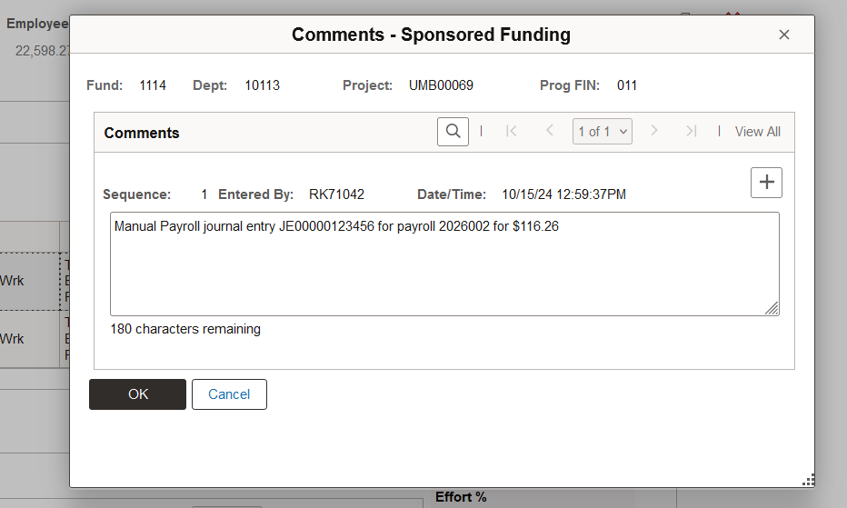
PI responsibility: Comment section of the applicable Effort Report
A pop-up box will appear where the PI will type in the amount of the manual payroll entry. This will be viewable to auditors, as needed.

Slide 9
When to use the form
Salary adjustments should be processed through a retro (payroll cost transfer).
The use of the manual payroll journal for sponsored funds, in lieu of a retro, will only be approved on rare occasions. They may include:
  PeopleSoft not allowing a retro to process due to system constraints
  A salary only award which requires an adjustment under $15.00

Slide 10
Authorization
The DocuSign form will route from
the Requestor to
the PI(s) listed to
the Assistant Director for Cost Accounting and Analysis (Amy Steinly-Marks).

Slide 11
Next Steps
Once the form is fully authorized,
  Create the manual payroll journal entry
  Attach the approved manual payroll request form to the journal entry
  Submit the journal entry as normal with required attachments related to cost transfers

