Slide 1
How to Advocate for Yourself
Online Learning Edition
September 14th, 2020
This event will be recorded and posted on our myUMBC page.
These slides will also be available to you on myUMBC.
Please make sure your mic is turned off (muted) for the beginning of the presentation.

Slide 2
This is a Brave Space
What is a Brave space?
Community members engage in critical dialogue through conscious questioning and active listening. While all are expected to make their best effort to be respectful, there is an understanding that someone may say something that results in unintentional offense and hurt feelings for those around. A primary assumption of brave space is that everyone speaks with the positive intent of seeking greater knowledge and understanding.
- challenge yourself
- respect others
- cultivate community learning

Slide 3
Introductions

Slide 4
Self - Advocacy is about three things
a self-advocate has personal power – understanding our own rights and how to make decisions is key
when self-advocates come together working as a group and supporting one another their voices are amplified
working together and with others to make change happens by advocating for inclusion

Slide 5
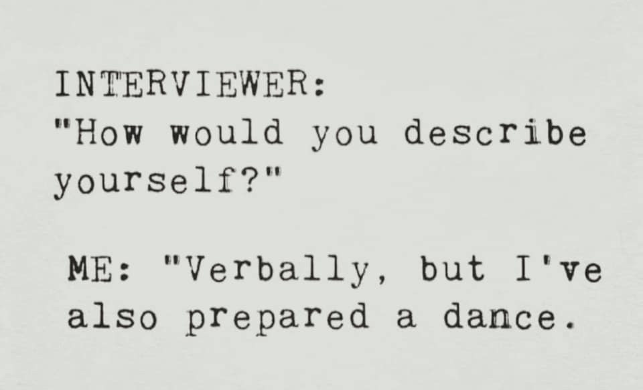
Who are you?
What words would you use to describe yourself ?
Student, Parent, first-generation college student, veteran, woman, learning impairment, survivor, etc.

Slide 6
Who are you?
What words would you use to describe yourself ?
Now think about the things you need as the individual you are
What are some of your needs?
How have your needs changed during this time?
What makes you and your needs unique?
Notes:
Can anyone think why I asked you to describe yourself and what your needs are?
You know you best! My knowing yourself helps you to know what you so that you can be the best advocate for you.

Slide 7
Advocacy and Technology
Technology Literacy
Dealing Multiple Platforms
Communication or Lack thereof
Being Proactive
UMBC’s Academic Success Center

Slide 8
Technology Literacy
Identify the platforms or programs that you will be using
Take time to get to know and also become familiar with the platforms you are using. ( ie. Check Camera and Mics are working before a video call)
Build and Share your knowledge with your classmates
Don’t be afraid to ask for help. Also, we often learn best when teaching others.

Slide 9
Communication or Lack thereof
Best Practices for reaching out to a Professors
Email netiquette
Check your syllabus
Ask your professor the best way to get in contact with
Turnaround time policy
Best Practices for reaching out to other campus partners or other individuals
Check their website
Phone calls or emails and ask them what’s the best way to get in contact
Groupme, Facebook, Google Chat

Slide 10
The Academic Success Center
The Academic Success Center provides centralized support services to all undergraduate students at UMBC. Through a coordinated approach and an unwavering commitment to student success, the Academic Success Center fosters a welcoming environment that provides a one-stop opportunity through Academic Policy, Academic Learning Resources, and Academic Advocacy for students to achieve their academic goals and claim their future with a UMBC degree.
https://lrc.umbc.edu/online_learning/

Slide 11
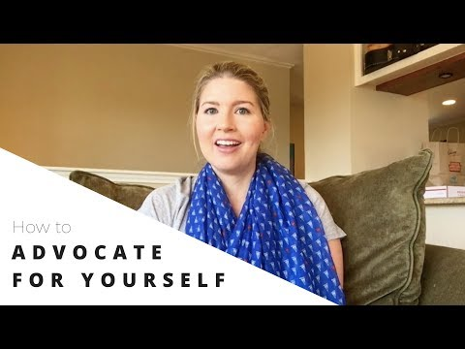
What happens when we do not know what we need, want or deserve?
Notes:
Courtney Clark , resilience author and speaker
Content based motivation using research and inspiration
At age 26, I beat cancer. But five years later, doctors told me that a routine scan of my brain showed an aneurysm that was about to rupture.
I had a series of three brain surgeries in 2011 to remove the aneurysm. During those months I spent lying in bed, in pain so intense I wanted to die, I realized I had a choice for how I could move forward. Now I teach others how to make that same choice.

Slide 12
Things to remember ….
Know yourself
Believe in Yourself
Believe you deserve what you’re asking for
Know your rights
Decide what you want or need
Planning strategy
Gather support if needed
Express yourself clearly
Assert yourself calmly
Be firm and persistent

