Slide 1
Navigating UMBC
Online
2021
Notes:
DO NOT CHANGE THIS SLIDE ** Unless there is misspelling**
Emiley

Slide 2
Follow us on myUMBC to know when the next Workshop is coming out
Notes:
DO NOT CHANGE THIS SLIDE ** Unless there is misspelling**
Asiyah

Slide 3
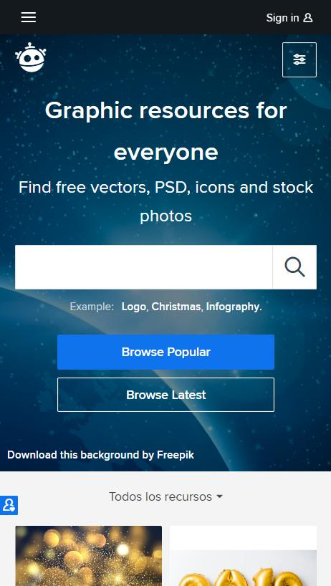
DISCORD
https://discord.gg/suXAD2b6vu
Notes:
Emiley

Slide 4
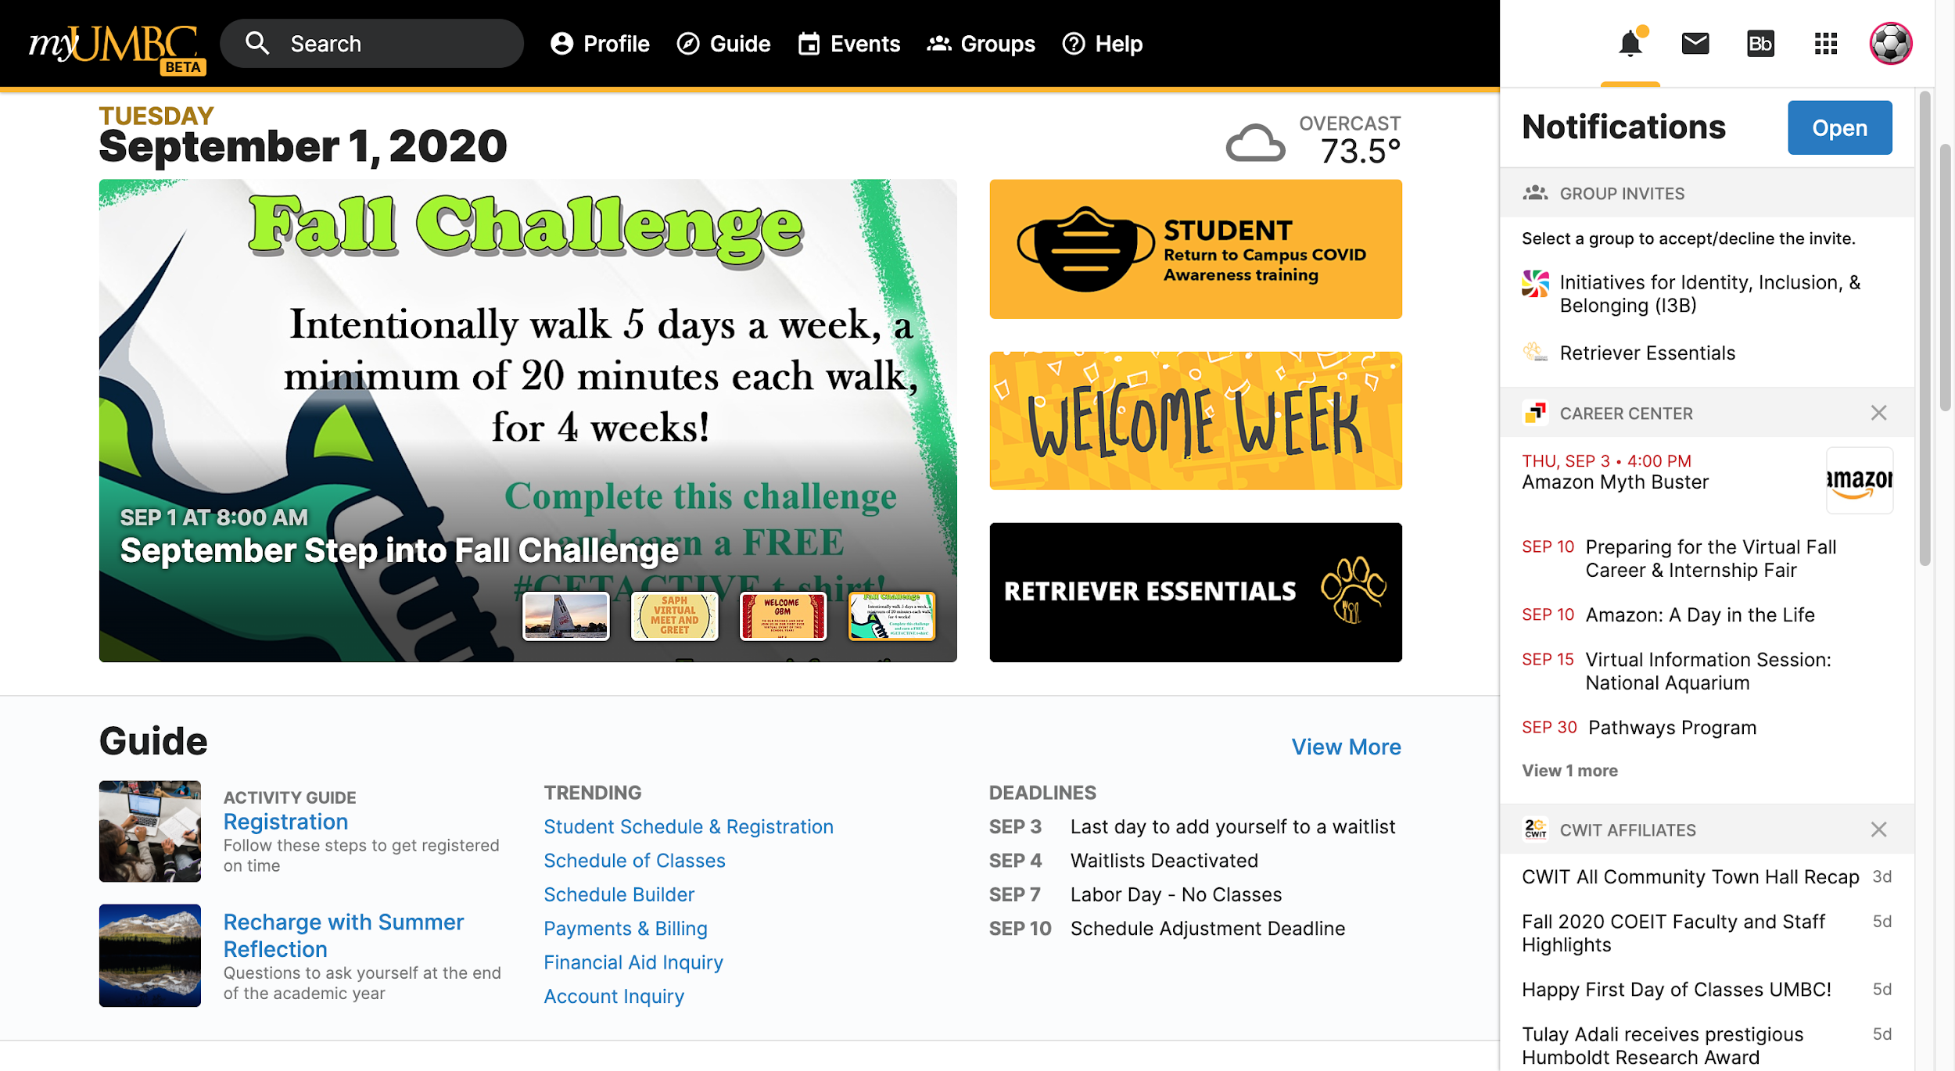
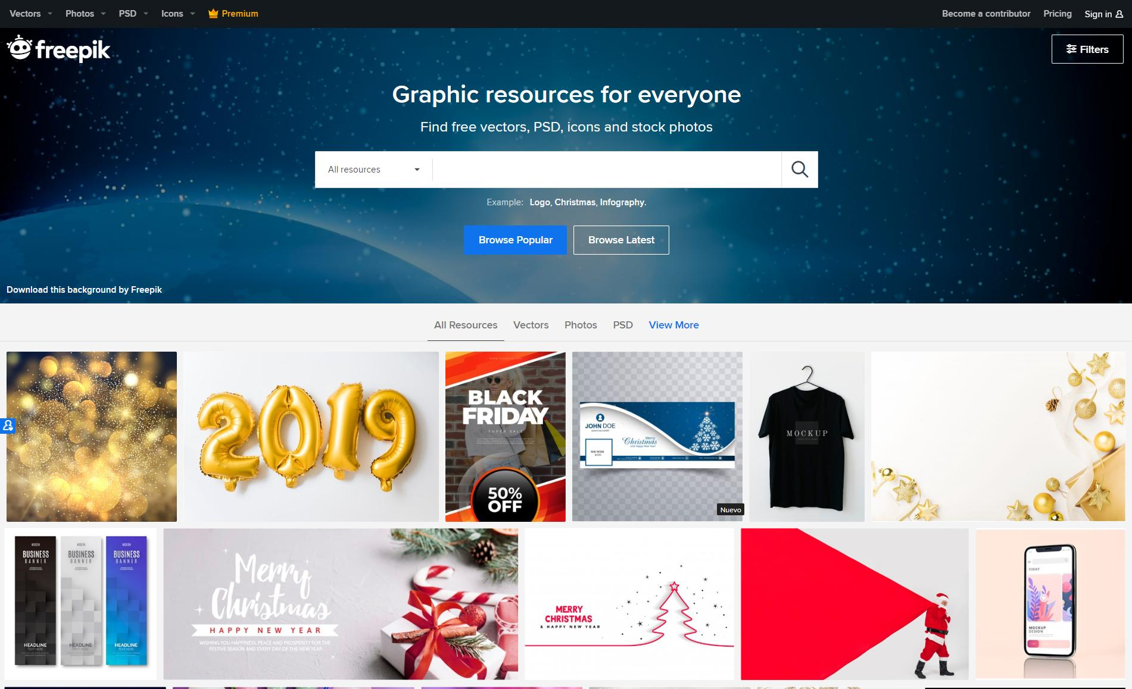
MYUMBC
Introduce MYUMBC
Notes:
My UMBC
Emeka
Profile - Where you find your degree audit, know if you’re allowed to come on campus, view your GPA, you can see if you have any bills, view your campus card
Guide - Place to find general UMBC links
Events - Find what events are happening
Groups - You can join different groups and get emails about their events, you should join OCSS’s group to get our updates
Help - FAQ questions, resources, and search up, if you can’t find what you’re looking for you can put in a ticket

Slide 5
MYUMBC:
This is essentially the hub for anything related to UMBC
Navigate to classes ( Blackboard )
Find class schedule
Financial aid
Degree audit → The Doughnut
Transfer Credit Report
Transcript
Bb
Notes:
Emeka

Slide 6
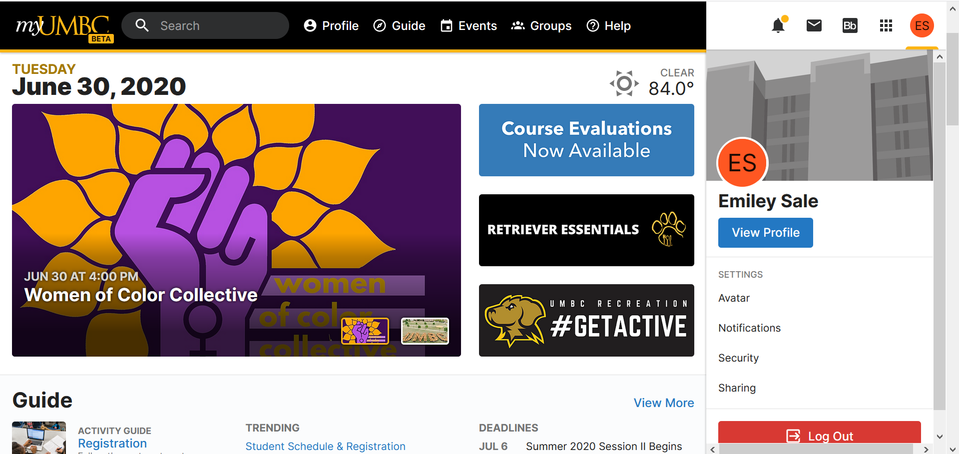
myUMBC Homepage
Home Page
Guide:
Profile
Campus Resources
Events:
Student Events
Webinars
Groups:
Student Organizations
Clubs
Discussion Groups

Slide 7
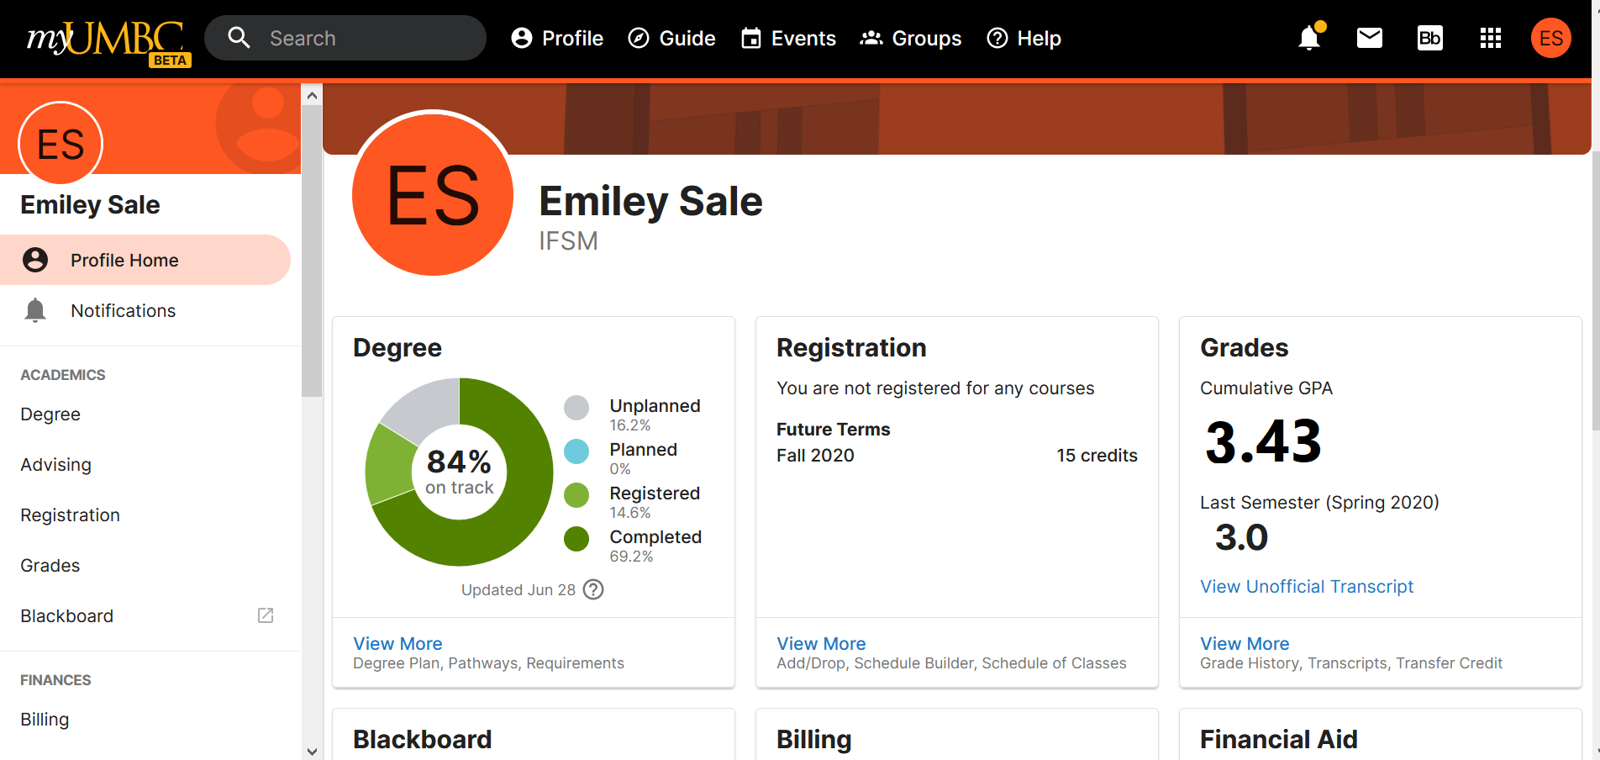
myUMBC Profile
Degree progress:
Degree audit(see later slides)
Registration: See class title, section, location, time, professor
Grades for each semester
View unofficial transcript

Slide 8
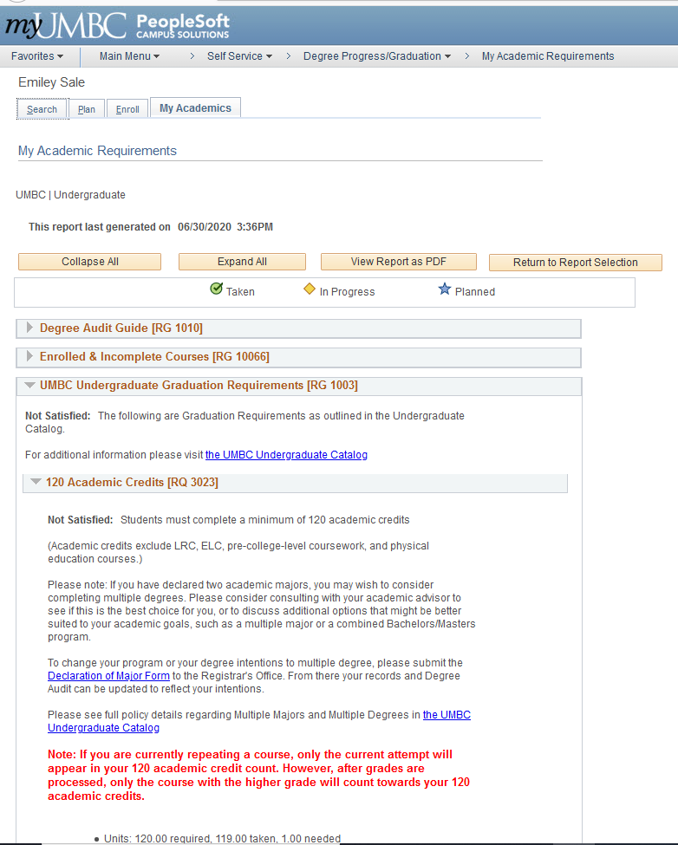
Degree Audit
Degree: progress
Degree Audit: See what you are missing from your degree, what classes transferred, etc.
What-If Degree Audit: Try out a different major, add a minor or certificate
To Access: Profile, Degree, Degree Audit

Slide 9
MYUMBC → BLACKBOARD
Blackboard is where all classes are located
The syllabus can be found for most classes in the syllabus tab
Books that are looped into your tuition can be found in Course Materials
Some Organizations this year will use the organization tab on blackboard
Breakdown of grades can be found in grades → If you have quizzes many times teachers will release the answers after it closes, you can check them when you click on your quiz grade in grades.
Notes:
Emiley

Slide 10
What’s going on in the WEB
What websites are we using
How do you use them & access them
Notes:
DO NOT CHANGE THIS SLIDE ** Unless there is misspelling**
Emiley

Slide 11
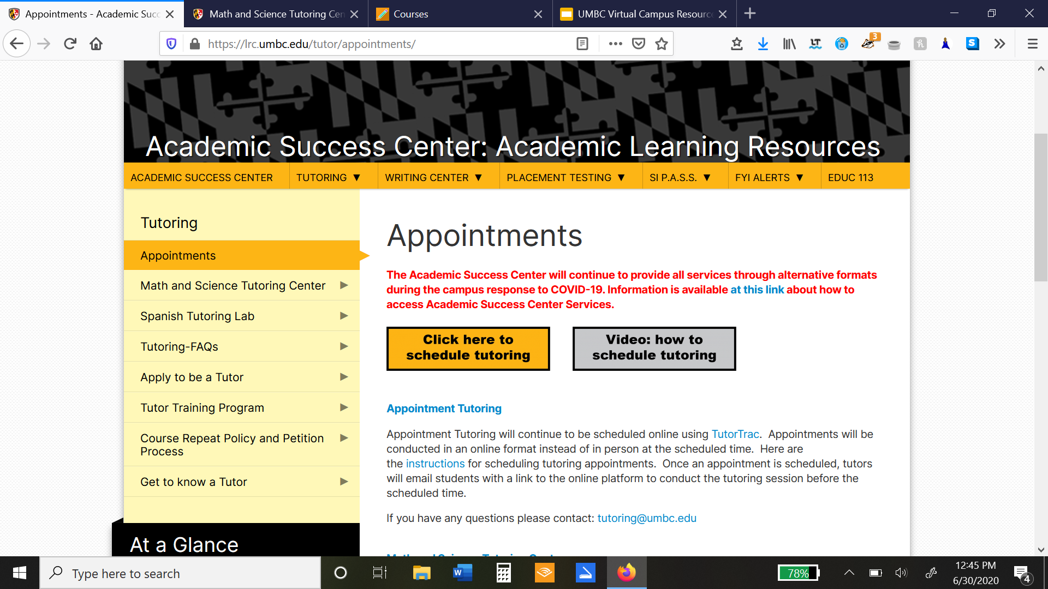
Tutoring
https://lrc.umbc.edu/tutor/appointments/
Math/Science walk-ins
Spanish tutoring
Appointment tutoring: by specific class
Writing review
S.I.P.A.S.S - built in tutoring

Slide 12

Retriever Essentials
Pickup Locations:
True Grits, Campus Police Station
Food Pantries Around UMBC:
Catonsville Emergency Assistance
Southwest Emergency Services
Elkridge Food Pantry

Slide 13
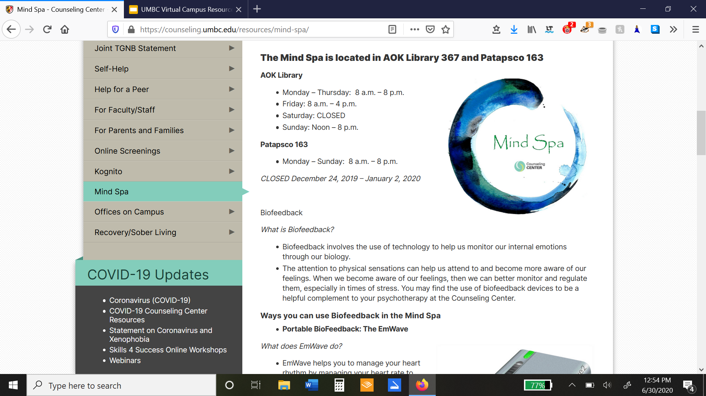
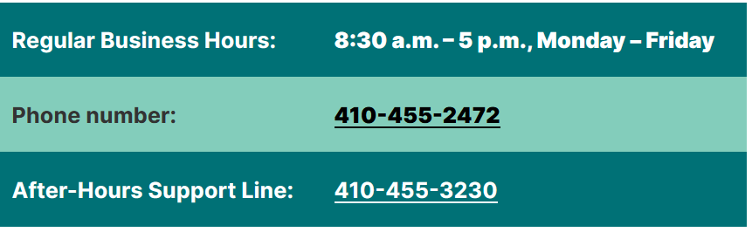
Counseling Center
Who is eligible for services?
All currently registered UMBC students (undergraduate and graduate) are eligible for an initial appointment. During that appointment, you and your counselor will determine the most appropriate services. This may include individual or group counseling at the Counseling Center, self-help resources, or referral to a community provider. There is no charge for services provided at the Counseling Center.
How do I make an appointment?
You may call the Counseling Center (410-455-2472)
Webinars available on a variety of mental health topics

Slide 14
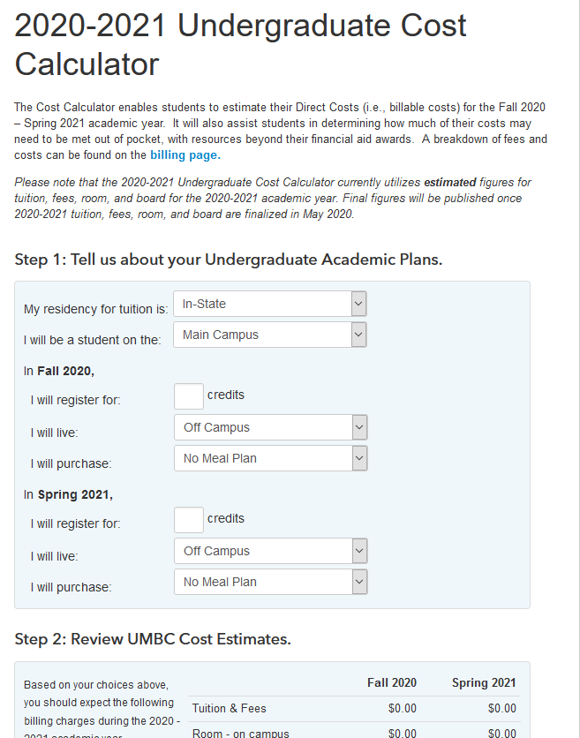

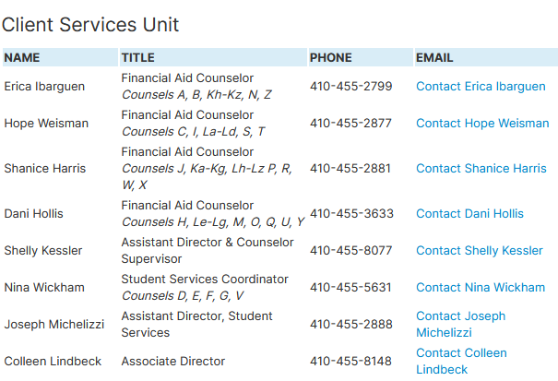
Financial Aid
FAFSA School Name: UMBC
FAFSA School Code: 002105
Financial aid can come in the form of grants, work, student loans,
parent loans, scholarships and other awards.

Slide 15
IMPORTANT WEBSITES THIS SEMESTER
UMBC Library Database
WEBEX/BB COLAB
LOCKDOWN/ BB EXAMS
UMBC has a database of free papers, books, and journals for students. This is a great resource to write papers, research, or just read up. on.
Webex is where a lot of organizations are hosting events, like the one you’re at right now. Bb colab is where a lot of teachers are having class, if your teacher records class the recordings will be located here.
Lockdown browser is fairly new -- It won’t allow you to use new tabs or open new windows ( from what we know ) Some professors make you turn on your webcam too. Blackboard Exams are through blackboard which are different, there are no restrictions.
Notes:
Emiley

Slide 16
UMBCworks
All about getting a job on campus, off campus, and after graduation

Slide 17
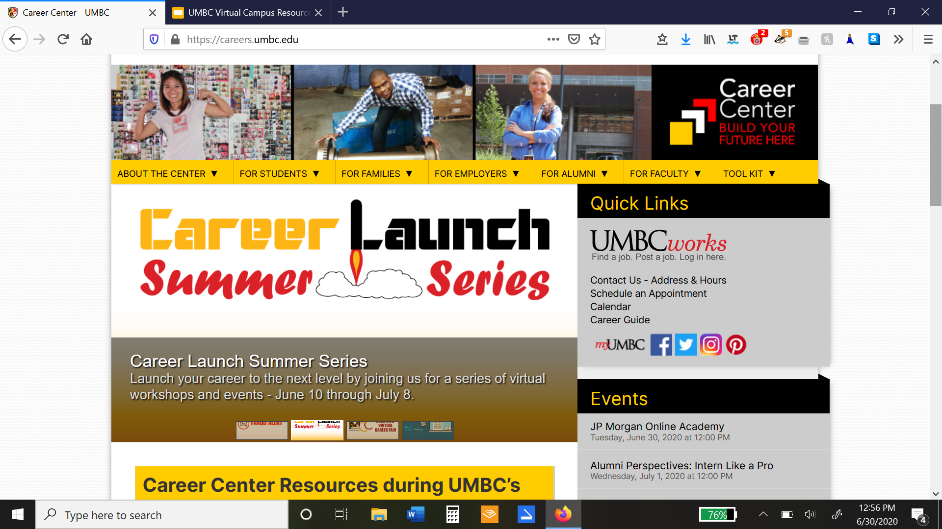
What does the Career Center offer?
Resume Review
Practice Interviews
Personality Tests, Workshops, and more!
In 15 minutes, you can get your resume reviewed and approved for job hunting
Interview anxiety? Try a practice interview to ace those hard questions
Myers Briggs, career talks, and more are available free for students

Slide 18
How to Sign up for UMBCworks
1.
2.
3.
Go to http://careers.umbc.edu/umbcworks/
Sign in and fill out the profile and job criteria you are looking for
Start applying!

Slide 19
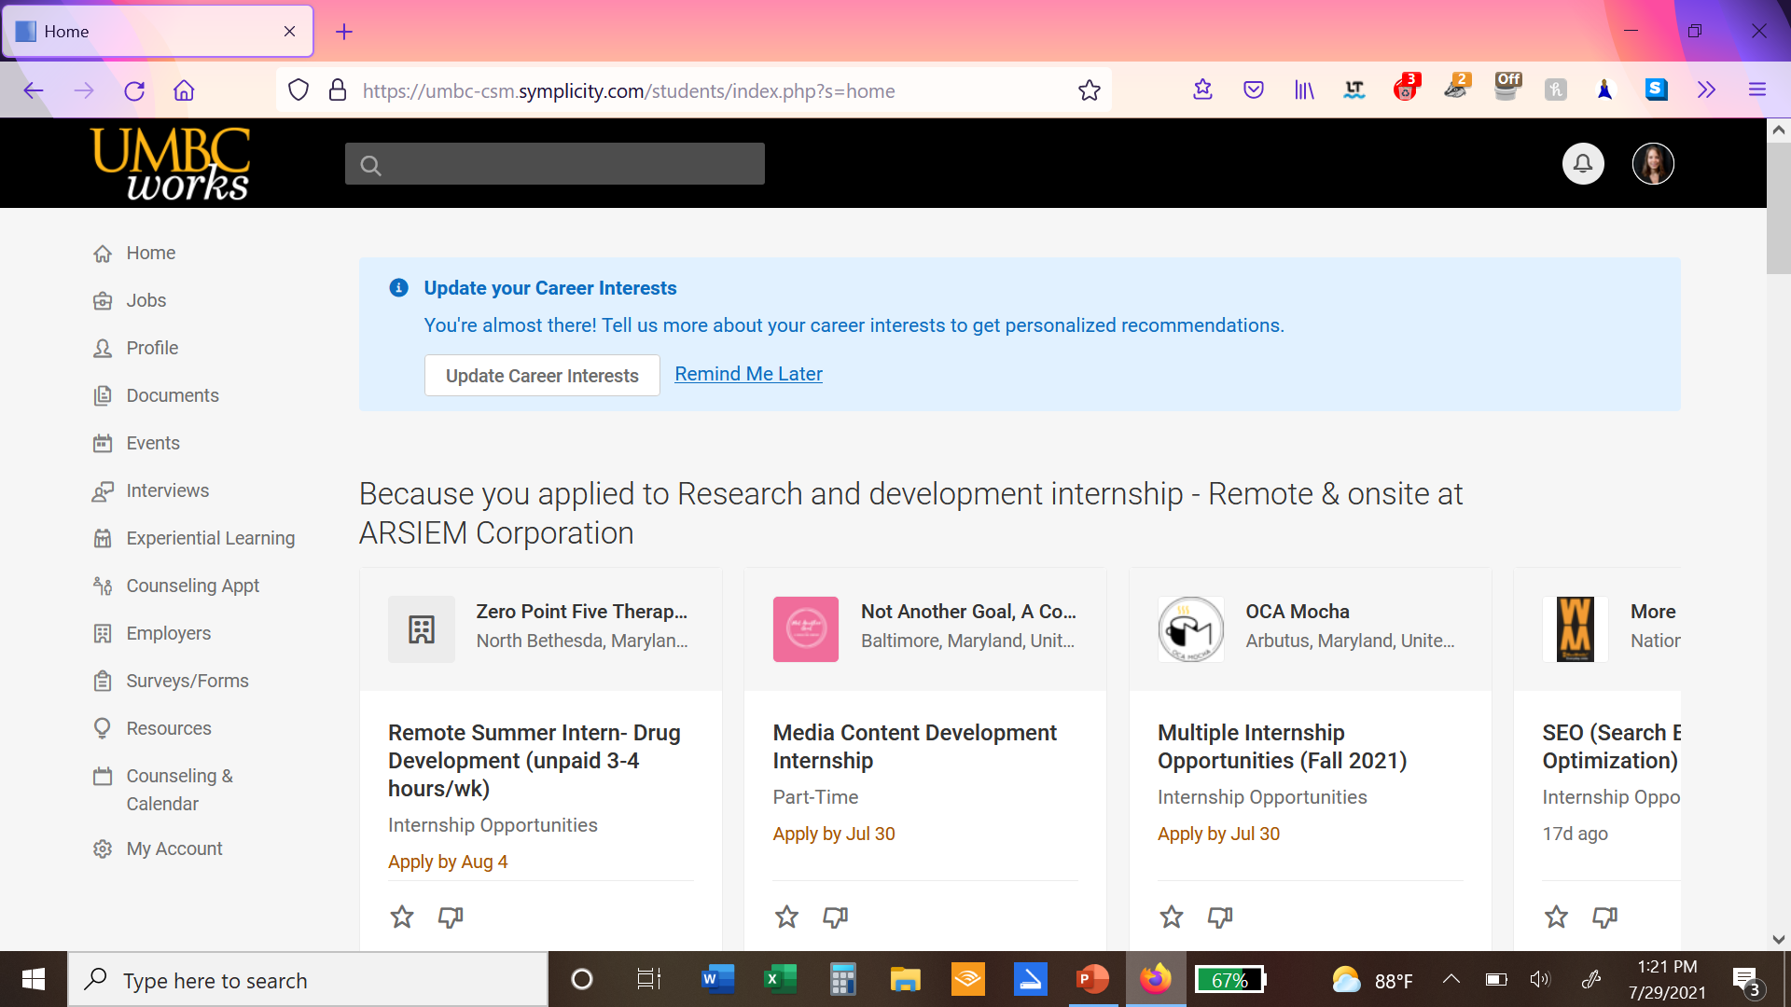
Planning out your time at UMBC
Make sure to check your doughnut
Stay organized
If you know you might need something for next semester. Make sure to save your notes
To know what classes you have left check your doughnut
At UMBC every semester you must meet with your advisor before the next semester
If you’re unsure of what to do next, ask.
Do your best, and you’ll be on the right path to graduation
Plan with your advisor
Ask questions
Graduate!
Notes:
Emeka

