Slide 1
Test Prep and Next Steps
Tips for Success

Slide 2
Table of Contents
Common Questions
Websites
Tips
Socials

Slide 3
Finals are coming up, what should I do to prep?
We all know to study for finals, but it’s just as important to know the basics to prepare.
Know the weight of the exam- is one worth 40% and another 25%?
Is it cumulative? Or is it select chapters?
When is the exam?
Once you get an idea what you need to study, you can get into the prep.

Slide 4
WHOA!
What do I do if I have 3 exams in the same day? Or if I have two exams at the same time?

Slide 5
Policy on Daily Student Exam Load Faculty Senate policy states that students should not be required to take more than two final exams in one calendar day, and where conflicts arise, faculty should work with students to make necessary arrangements to avoid the conflict.

Slide 6
Where can I find when my exam is?
Here!
UMBC has common finals, where students in the same class take the final at the same time. Use the calendar to see when your class test would be.
https://registrar.umbc.edu/calendars/final-exams/

Slide 7
01
Tips for Success
Common ways to ace your exams

Slide 8
Where to Get help in classes
Tutoring
It’s the biggest planet in the Solar System and the fourth-brightest object in the sky
S.I. P.A.S.S
Students
Mars is a cold place. It’s full of iron oxide dust, which gives the planet its reddish cast
Yes, this is the ringed one. It’s a gas giant, composed mostly of hydrogen and helium

Slide 9
Top tips from students
Office Hours
Search the Web
Go to office hours or make appoinments with your professor to get tips on exams
There’s a lot of useful tools and websites if you’re willing to look ( we add some of our favorites at the end)
Tutoring
Study Groups
Tutoring before the exam just makes sure you know the material well and gives you a chance to ask someone who has already been there
Join Discord or group chats for your class to get help from other students

Slide 10
How should you Study?
Set a timer
Silence
Try Pomodoros or just set a timer to give yourself breaks
Unless you need your phone, put messages and distractions on mute
Well Rested
Breathe
Make sure your not trying to study (or take the exam) when your sleep deprived
Research shows that stress makes it harder to learn and to retain information. Try taking deep breaths to relax

Slide 11
Setting up your Study Spot
Space
Music
Snacks
You need a place that’s comfortable without being so relaxing that you end up falling asleep
Noise-canceling headphones and quiet music instead of loud tunes
Go for snacks that will power your brain and keep you alert. Steer clear of items that are high in sugar, fat and processed carbs
Methods
Summarize
Flashcards
Mindlessly reading through your notes or textbooks isn’t an effective method of studying. Instead, you should use a proven study strategy
Summarize points and chapters to make sure you understand key themes
Can’t go wrong with hand written, typed, or virtual flashcards to learn definitions or key points

Slide 12
Other Study Tips
Associate words or concepts with tunes, mnemonics, or pictures
Make your own study sheet from material or what the Prof gives you
Learning from fun videos or lectures is a great way to get another perspective
Bite
Size
Be the
Teacher
Association
Study
Sheet
youtube
Studies show we are better at memorizing information in smaller chunks
Teaching others is a great way to learn the material and make sure you truly understand it

Slide 13

Helpful Websites for studying

Slide 14
Websites
Khan Academy
Mathway
Chegg
Almost every subject is covered and can add another layer of understanding to any topic
Need math help? Type in or snap a photo of the problem for the answer
Internships, job questions, and of course practice problems

Slide 15
To Summarize…
Night Before
Sleep well
Weeks Before
Days Before
Gather Materials
Study periodically
Day Of
Ace the exam!

Slide 16
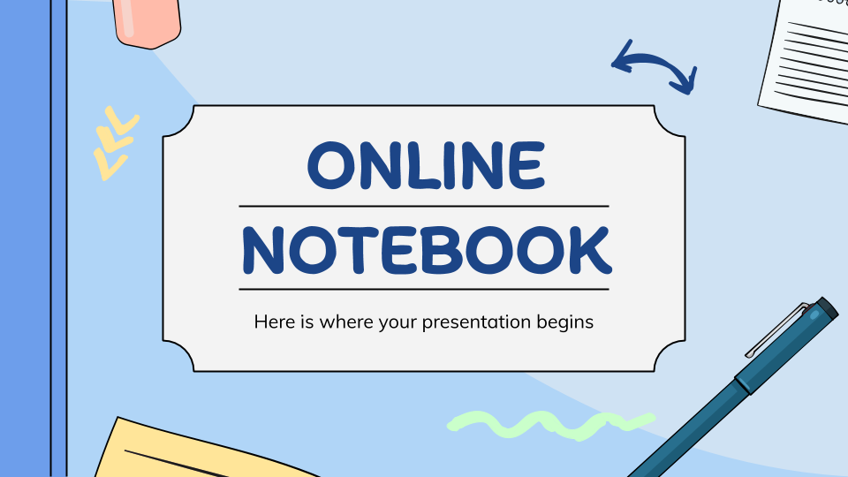
myUMBC
Follow us on myUMBC to stay up to date on workshops, panels, and programming geared toward students.

Slide 17
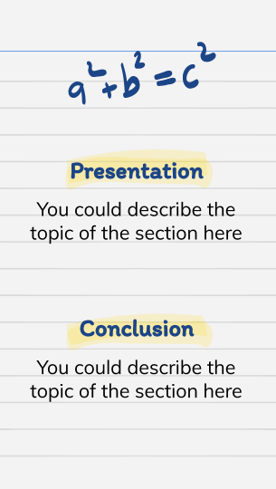
Instagram
Check out out Instagram to get connected and see what the team at OCSS is up to for students.

Slide 18
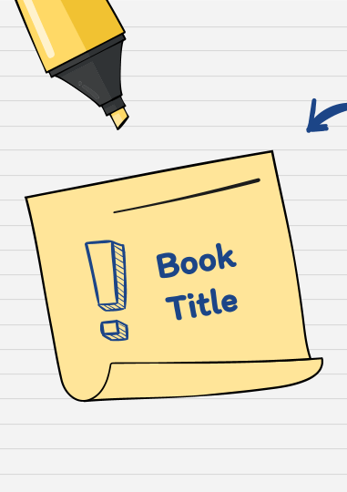
Discord
Connect with other students in your major, play games and win points towards gear.

Slide 19
Thanks!
Do you have any questions?
transfers@umbc.edu
commuters@umbc.edu
Please keep this slide for attribution.

