Slide 1
Software & Cloud Services Procurement
DoIT's role as the first step in the process
Jason Paluck (paluck@umbc.edu)
Associate Vice President for Information Technology · DoIT

Slide 2
Where DoIT fits in the process
1
2
3
4
5
Requestor
DoIT review
Procurement
Legal/Contracts
Purchase & use
identifies a need, talks to a vendor
licensing, security, accessibility, data, privacy
sourcing, purchase mechanics, contractual terms
terms negotiated, advising on risk acceptance
onboarding, support, renewal
DoIT is not Procurement and not Legal, and we do not speak for either.
We are the first stop, and we stay involved with both offices for the life of the request. Engaging us early is what keeps the later steps short.

Slide 3
What counts as software/Cloud Service?
Part 1

Slide 4
"It's only software if I install it." No!
What people think
What it actually includes
Something I download and install on a computer
A license key or a box
"It's just a subscription"
"It's free, so it doesn't count"
"It's just a website"
SaaS and web-based subscriptions
Mobile apps and browser extensions
Hosted services: web hosting, cloud storage, databases
APIs, plug-ins, and add-ons to tools we already own
"Free" tiers and trials that touch university data
Quick test: if the vendor's servers went dark tomorrow, would you lose access or data? Then it's software, and it goes through review.

Slide 5
What DoIT reviews, and why
Part 2

Slide 6
Six things we check on every request
1
Enterprise license check
2
Digital accessibility
3
Data protection
Is there already a licensed or supported product that does this? Fiscal responsibility to the state and taxpayers.
ADA and Section 508. We review the VPAT/ACR. A tool some students can't use is a tool we can't buy.
Student data (FERPA), research data under sponsor or export-control terms, employee and health data.
4
Privacy
5
Security & integration
6
Contract terms
What the vendor collects, retains, shares, and — increasingly — trains on.
Single sign-on, vendor security posture, how it connects to systems we already run.
We flag what Procurement and Legal will need to negotiate before the request reaches them.

Slide 7
The HECVAT: how we actually evaluate a vendor
Higher Education Community Vendor Assessment Toolkit: a standardized questionnaire vendors complete covering cybersecurity, privacy, IT accessibility, and compliance in one place. Built by higher ed for higher ed with EDUCAUSE, Internet2, and REN-ISAC. Current version: HECVAT 4 (4.1.6), which added privacy and AI questions.
Why it is our biggest delay
How you can expedite the review
We can't finish the security, privacy, or accessibility review without it
Chasing vendors: finding the right contact, explaining what it is, waiting on their security team routinely adds weeks
You are already talking to the vendor. We are not.
Ask the vendor for their completed HECVAT 4 (and VPAT) before your request
Any vendor that regularly sells to higher ed has one on file
If they have never heard of it, that tells us something too
Send them the link: educause.edu/higher-education-community-vendor-assessment-toolkit
Say this: "Our IT division requires a completed HECVAT 4 and a VPAT as part of procurement review. Can you send the most recent versions?"

Slide 8
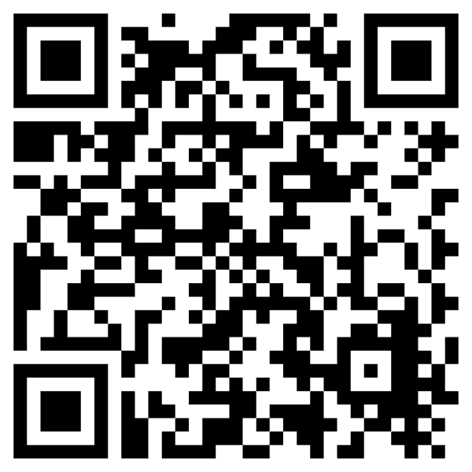
How to find the HECVAT
https://www.educause.edu/higher-education-community-vendor-assessment-toolkit

Slide 9
The "I want my own" problem
Part 3

Slide 10
We already offer it. Buying your own adds risk.
The pattern we see
Separate terms
No central governance
Cloud storage
A department buys Dropbox or similar while UMBC already provides multiple supported cloud storage options.
Web hosting
A unit buys WordPress hosting while DoIT already runs a substantial WordPress footprint for all our web properties.
The reasons are almost always the same: wanting complete control over the product, or simply liking their choice better.
Small purchases get no leverage; the vendor's terms are usually non-negotiable.
No security monitoring, backup, or access management behind it.
Another contract
Orphaned data
One more agreement to track, renew, and eventually offboard.
When the owner leaves, the data and the account leave with them.

Slide 11
Before you write a requisition
Check the UMBC Software Catalog first
softwarecatalog.umbc.edu
Licensed, supported, and already reviewed, with the terms, security, and accessibility work done.
1
If it's there
2
If something similar is there
3
If it's genuinely not there
Use it! Context matters so a review is still required, but this will streamline your request.
Talk to DoIT before buying. Often the gap is a feature we can enable, not a new product.
Engage DoIT early (before a quote), and ask the vendor for the HECVAT while you're at it.

Slide 12
AI purchases
Part 4

Slide 13
No negotiated terms means public information only
UMBC has no negotiated terms and conditions with Anthropic or OpenAI today. Without them, there are no data or privacy protections we can rely on. These tools may only be used with public information.
Public information = anything you'd be comfortable posting on a public web page with no login.
Fine to use
Not fine — even if it feels harmless
Published course catalog text, public web content
Drafting general-purpose writing, brainstorming
Code and documents with nothing confidential in them
Student records or anything covered by FERPA
Research data under a sponsor or export-control agreement
Employee records, health data, anything internal-only

Slide 14
The AI Attestation form
1
2
3
4
Request submitted
DocuSign routed
End user attests
Review continues
Any purchase that is primarily generative AI triggers the attestation
DoIT sends the attestation as part of the procurement workflow
The person who will actually use the tool signs attesting public information only
Procurement and Legal proceed with the attestation on file
The attestation must be signed by the actual user of the product.
Not the business manager or administrative staff who submitted the request on their behalf. It is a personal commitment about how the tool will be used, and it only means something if the person using the tool is the one making it.

Slide 15
"Not yet" is not "no"
Internet2 NET+ enterprise contract
University System of Maryland AI policy
I sit on the NET+ legal and contracting committee. We have been negotiating an enterprise agreement with Anthropic for over a year.
When it lands: Claude purchases get real data and privacy protections, and the public-information restriction can be lifted for that product.
Why it is slow: Anthropic's growth and IPO preparation. Higher ed is negotiating with a company that is changing shape month to month.
Still in draft. It will extensively shape how AI can be used across the system.
Every USM institution is holding off on wholesale AI adoption until it is final. Nobody wants to roll out broadly and then walk it back.
What that means for you: expect the current constraints to hold for now, and expect them to change when the policy does.

Slide 16
Four asks
1
Check the Software Catalog first
softwarecatalog.umbc.edu — before a quote, before a requisition
2
Engage DoIT early
Before a quote, not after. Early questions are short; late ones are expensive
3
Ask your vendor for the HECVAT up front
Include the VPAT. It is the fastest way to shorten our review
4
Expect the AI attestation
Public information only, signed by the actual user, not the requester
Questions before you buy? Reach out to DoIT! That conversation is always shorter than the one after.

