Slide 1
UMBC BUSINESS SERVICES
Accounts Payable PAW TRAINING
Presenter
Jalen Perkins,
Business Services
Help & Documentation
https://businessservices.umbc.edu/employee-help/
Notes:
Good morning everyone, I am Jalen Perkins from UMBC Accounts Payable. Before we get started if you have a question that can’t be answered today, please put in an RT ticket from the link below.

Slide 2
Sections
SECTION 01
Creating Invoices
SECTION 02
Creating Receipts
SECTION 03
Creating Credit Memos
Notes:
Today we will cover 3 important sections, the first will be creating invoices, the second will be creating receipts, the third and final will be creating credit memos

Slide 3
Creating Invoices
Notes:
Since we talked about Invoices, Receipts, now we are going to cover credit memos

Slide 4
Pre Checks Before Creating An Invoice
Invoice Precheck
CHECK 01
Do you have a Contract or Purchase Order (PO)?
CHECK 02
Is it the final Invoice?
CHECK 03
Is the invoice final amount greater than the PO?
Notes:
The first pre-check is determine whether you have a contract or Purchase order
You can’t submit a invoice without a contract or PO
Another Precheck is determine if you have the final invoice
We do not pay for Quotes or Pro Forma Invoices
If the invoice amount is greater than PO amount, you must submit a written approval from your department head and Procurement or you must get an amend invoice?
Next we will cover necessary information required on the invoices to be approved

Slide 5
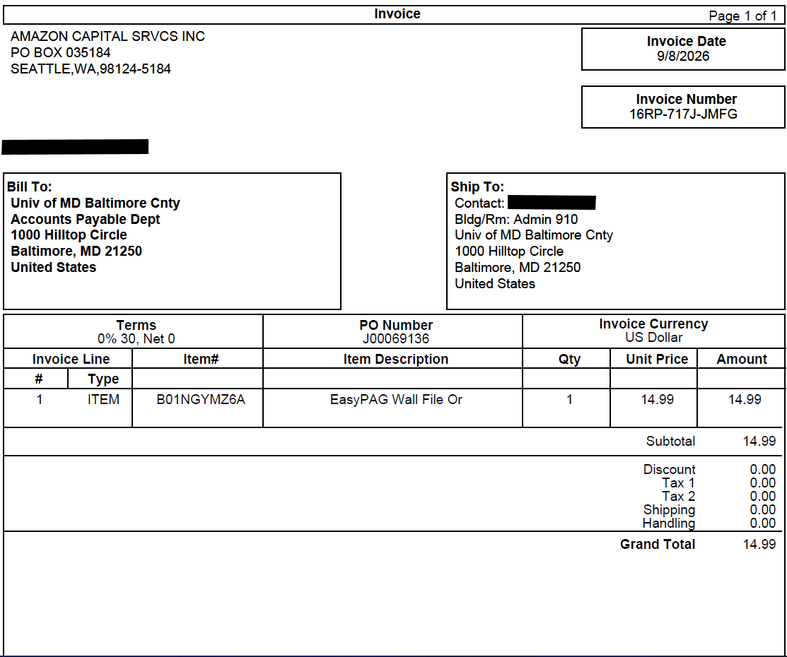
Invoice Precheck
Pre-Invoice Checklist
Please ensure all invoices meet the following requirements to avoid processing delays:
PO or Contract Number
Make sure the Purchase Order (PO) Number or Contract Number is clearly visible on the invoice.
Supplier Name & Remit Address
Invoices must include the supplier's name and remit address. Note: These must match the PO and PAW details exactly.
Billed to UMBC
Invoices must be billed to UMBC or affiliated UMBC organizations and include our complete official address.
Required Invoice Details
The invoice number, invoice date, and a detailed, itemized description of the goods or services must be present.
Notes:
This will cover the prechecks required for Invoices to be approved
The following is an example invoice that shows the requirements need for an invoice to be approved

Slide 6
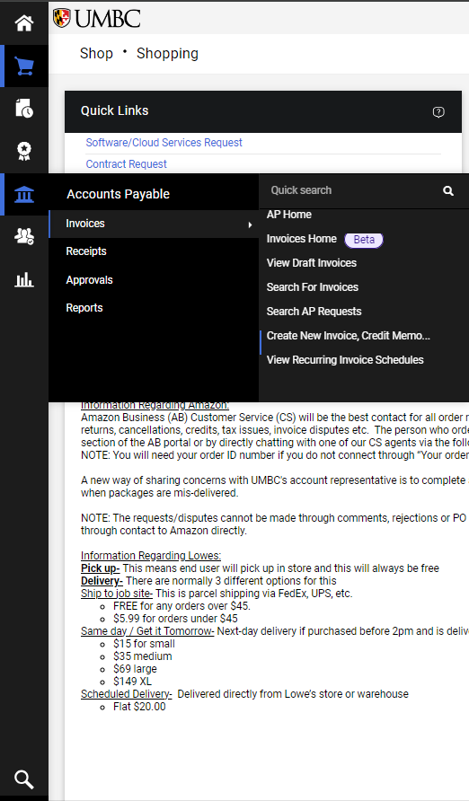
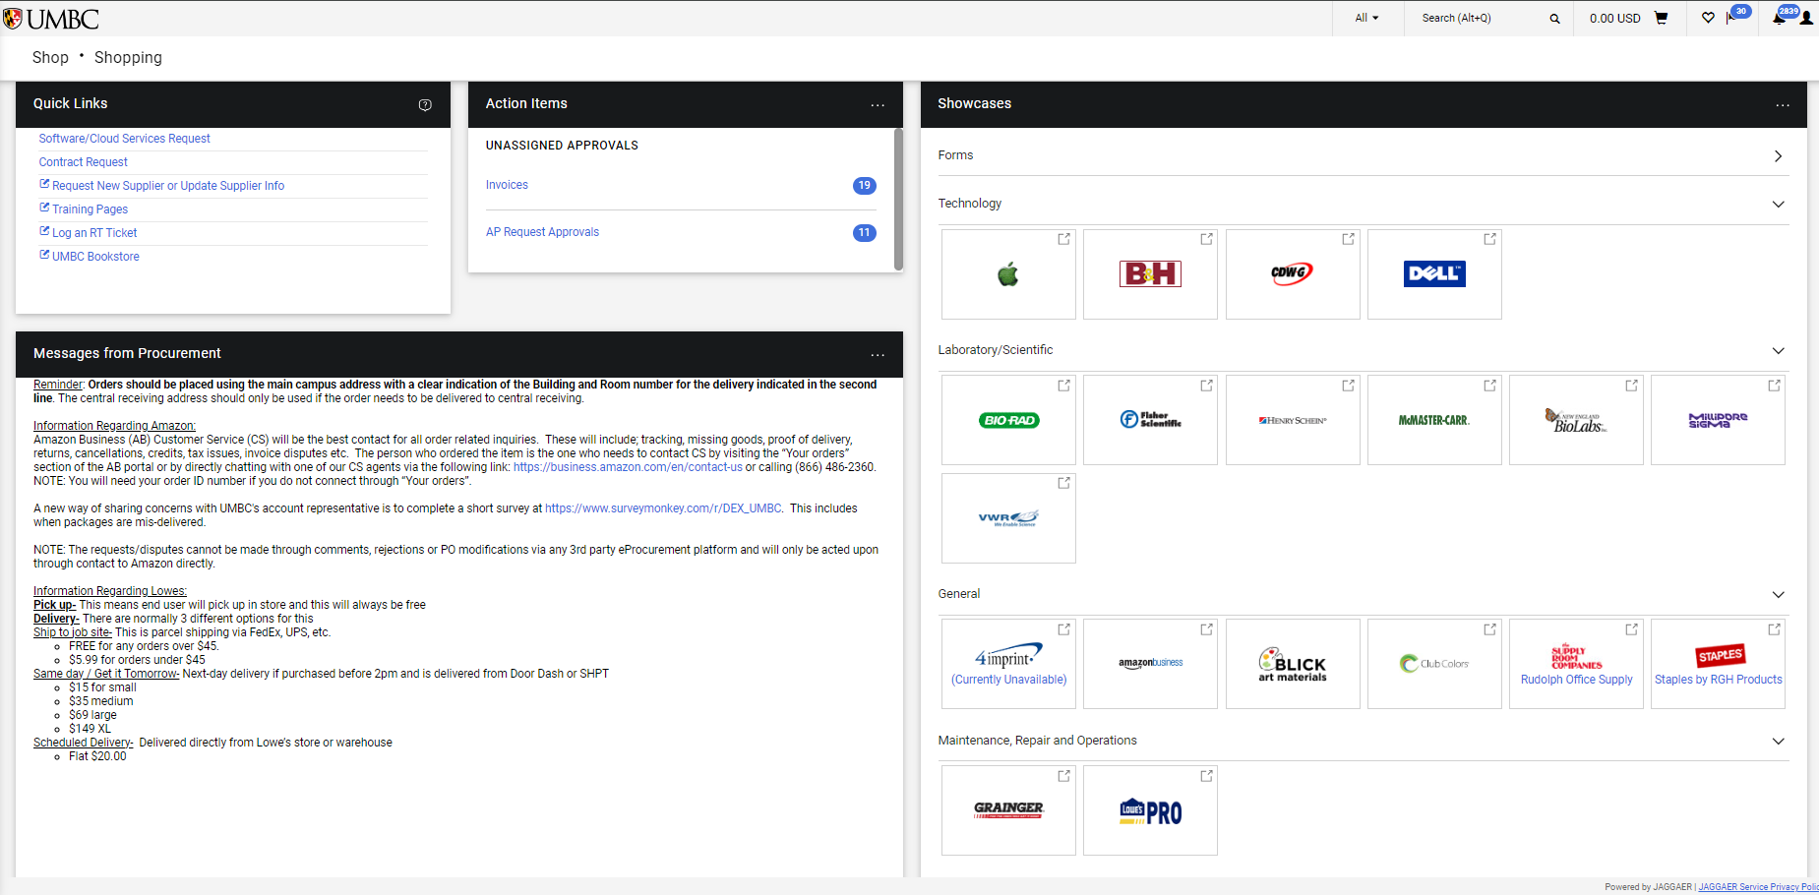
Creating Invoices in PAW
Punch Out Invoices
Punch out suppliers upload their own invoices directly into the system, requiring no manual entry.
Non-Punch Out Invoices
Non-Punchout Suppliers will require a manual upload of invoices within the PAW portal.
Notes:
Here we cover the types supplier categories
Punchout Suppliers
NonPunchout Suppliers
Punchout Suppliers are all the suppliers that you would find on the initial screen of PAW. (For example Amazon, Apple, Grainger, and BH)
Vendors that do not fall into the Punchout category are classified as Non-Punchout Suppliers

Slide 7
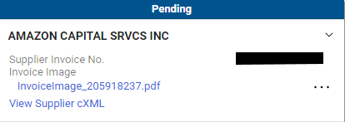
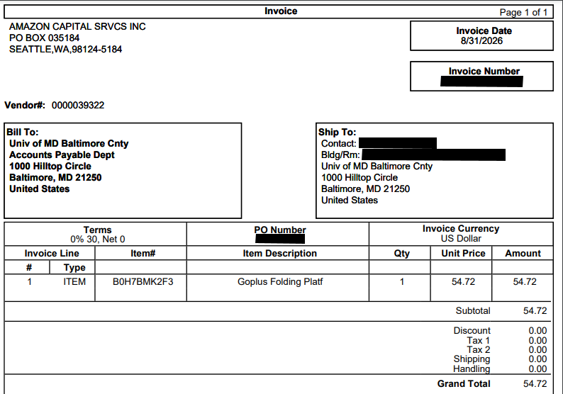
Creating Invoices in PAW, Cont.
Punch Out Invoices
Supplier-Generated Invoice
Punch Out vendors will generate an invoice into PAW when an item is bought.
Notes:
When you purchase an item from a Punchout Supplier, they will automatically upload an invoice.
These automatic invoice will look like the image on the bottom left and be called an invoice image.
Invoice images are only allowed for Punchout Suppliers
Next we will cover Non-Punchout Invoices

Slide 8
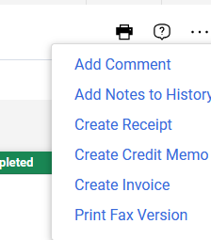
Creating Invoices in PAW, Cont.
Non-Punchout Invoices
1
Go to your PO
Navigate to the specific Purchase Order (PO) related to your invoice within the PAW portal.
2
Open Action Menu
Click the three vertical dots (ellipsis icon) located in the upper right-hand corner of the page.
3
Create Invoice
Select "Create Invoice" from the drop-down menu options to begin.
Notes:
For Non punchout invoices it requires a multiple steps.
He we will cover the initial steps, which is opening up the create invoice section whether in the PO itself

Slide 9
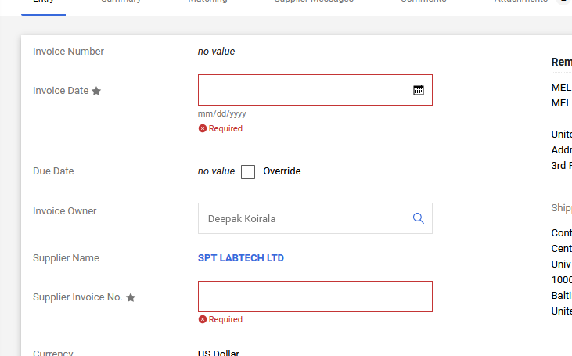

Creating Invoices in PAW, Cont.
Non-Punchout Invoices
5
Upload Attachments
Click on the "Attachments" tab to upload the required supplier invoices and backup documentation.
Make sure you verify that the correct files have been attached before finalized submission.
Invoice Entry Form Overview
Notes:
From there you will Enter the Invoice Date and Supplier Invoice # and Upload a PDF of the invoice by clicking on the Attachment Tab and Add Internal Attachment

Slide 10

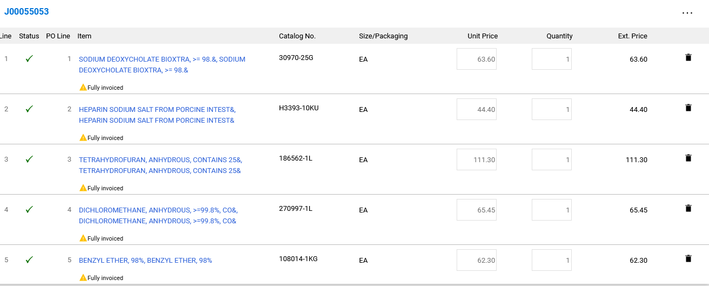


Creating Invoices in PAW, Cont.
Non-Punchout Invoices
PAW will warn you if the items have been invoiced already
Notes:
If there are multiple line items in the PO, you will be prompted to click for all lines, or to choose individual PO lines.
If the invoice does not include all line items, be sure and delete those lines not included!

Slide 11
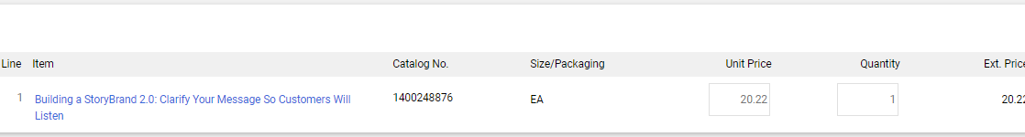
Creating Invoices in PAW, Cont.
Non-Punchout Invoices
warning
Important Adjustment Rule
If the invoiced amount is less than the quoted amount on the PO, adjust the UNIT Price for the item that is lower in PAW.
Notes:
Finally you will fill in the unit price box by entering the unit price from the invoice.
Important!! If the invoiced amount is less than the quoted amount on the PO adjust the UNIT Price for the item that is lower in PAW

Slide 12
Creating Receipts
Notes:
Since we talked about Invoices, Receipts, now we are going to cover credit memos

Slide 13
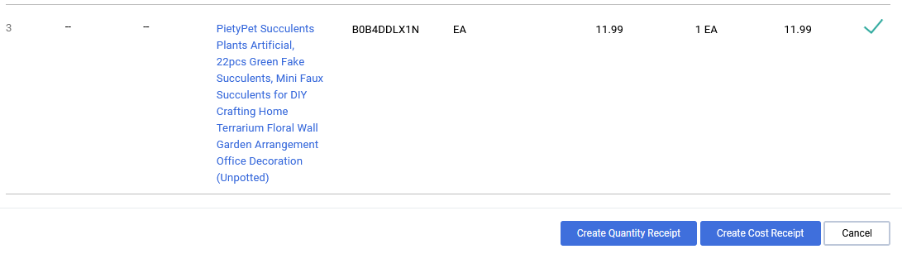
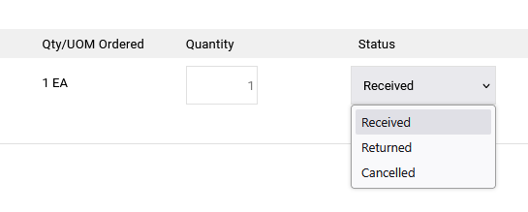
Receipts
What are Receipts?
Receipt Types
Receipts can be classified into two primary types depending on purchase requirements: Cost and Quantity.
Receipt Statuses
Track processing stages with standard statuses: Received, Returned, and Cancelled.
Notes:
What are Receipts.
Receipts are used to track the process of the items
They can be classified in two types, Cost and Quantity Receipts
They can be further broken down into 2-3 statuses, Cancelled, return and received

Slide 14
Receipts
Must Do’s When Entering Receipts
CRITICAL INSTRUCTION:
Enter a received receipt IMMEDIATELY upon receiving a shipment related to a purchase order (PO) so that we can pay the invoice.
MUST
DO NOT
REASSIGN
We MUST pay all invoices ASAP
Do NOT request that Procurement close a PO that has outstanding invoices or credit memos.
When a PO owner leaves UMBC or the position, REASSIGN the duty to monitor the PO.
Notes:
PLEASE Enter a received receipt upon receiving the item
This is to avoid credit-holds and issues with the State of Maryland.
WE STILL OWE THE INVOICE
Especially with STUDENTS!!

Slide 15
Quantity vs. Cost Receipt
What kind of received receipt do I enter? Quantity or Cost?
?
?
Notes:
Speaking of Receipts Lets get into the different types of Receipts
Quantity and Cost Receipt

Slide 16
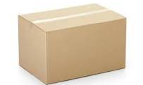
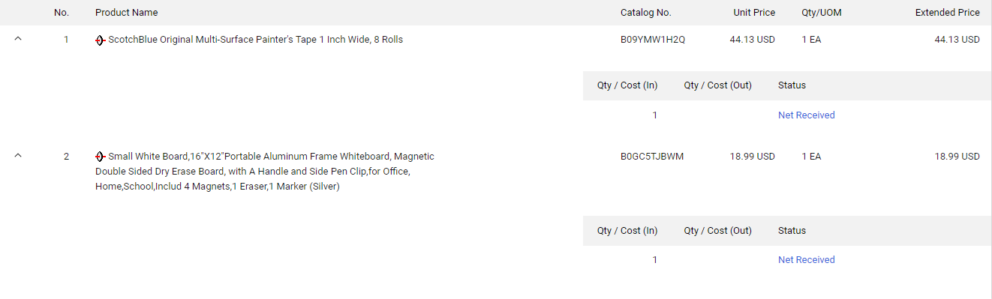
Quantity vs. Cost Receipt
PHYSICAL
MULTIPLE
Can the item be physically returned?
Is it multiple items?
Multiple line items may require individual line-by-line verification before entering receipts.
Notes:
When do we determine to use a quantity receipt?
Can the item that you ordered be physically returned?
Is there multiple of the same items being ordered?
Then you should use a quantity receipt.

Slide 17

Quantity vs. Cost Receipt (Cont.)
SUBSCRIPTION
TECHNOLOGY
Is it a subscription?
Is it technology or non-physical?.
Notes:
Now onto a cost receipt?
Is this a subscription item?
Is this an technology item or a no physical item like a hotel room
Then you should use a cost receipt.

Slide 18
Status Types
Receipts
Three key status types used for receipts:
STATUS 01
Received
STATUS 02
Return
STATUS 03
Cancelled
Notes:
With covering the different types of receipts now we will talk about the different status those types can fall under
There are three status types for Receipts
Received, Return, Cancelled
The received status:
Applies to Quantity and Cost Receipt
Indicates that the department has obtained the item
The Return status:
Applies ONLY to Quantity Receipts
Department has sent the item back to the vendor
The Cancelled status:
Applies to Quantity and Cost Receipts
Indicates the Department has never obtained the item

Slide 19
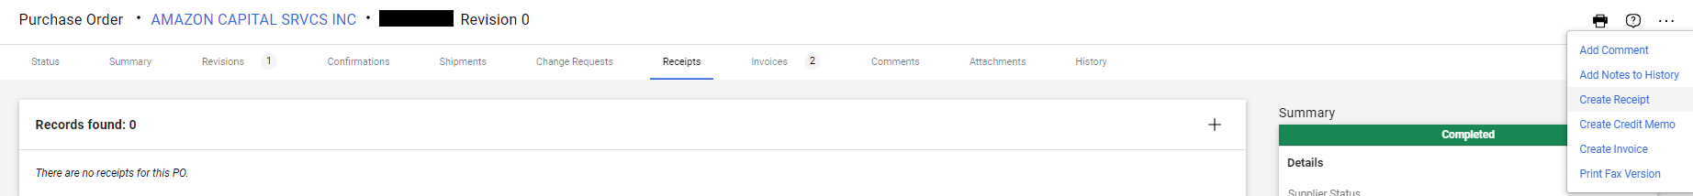
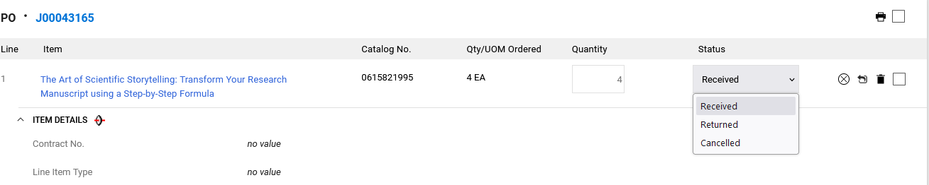

Entering Receipts Into PAW
Click Complete in the upper right corner.
Notes:
When you select your relevant receipt to your item.
PAW will default to a quantity amount of Zero and the status of Received
Make sure you change the quantity amount to 1, or in this scenario 4 since we received 4 items on delivery. And change the status to the approiate status, in this case it will be received because we have obtained the item.
If we were returning an item then we would change it to the return status, if we never received the item from the vendor then we would put in the cancelled status.

Slide 20
Creating Credit Memos
Notes:
Since we talked about Invoices, Receipts, now we are going to cover credit memos

Slide 21
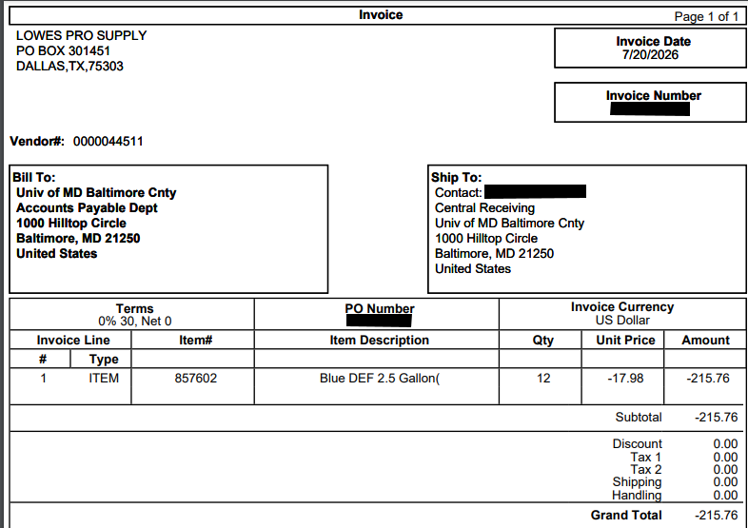
What is a Credit Memo (CM)?
Understanding Credit Memos
A credit memo is an official document or invoice from a supplier that indicates a negative balance adjustment.
Issued when goods are returned, damaged, or when a shipment is cancelled.
Acts as a negative invoice to reduce the total balance owed to the vendor.
Helps maintain accurate financial records and balance tracking in PAW.
Notes:
What is a Credit Memo?
Credit memos are issued by the supplier when you return an item, or if you never received the item and you contact them for the credit.
Credit memos from most Punchout suppliers (i.e., Amazon, Dell, Apple, etc.) are entered into the PAW system by the supplier. You do not upload it yourself.
If you get a credit memo from a non-punchout supplier, you need to “create” the CM in PAW.

Slide 22
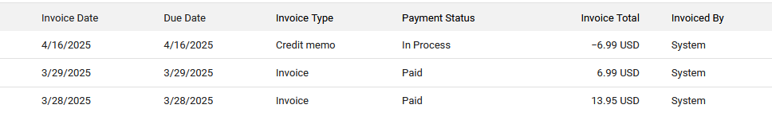
Punchout Supplier Credit Memo
When a supplier accepts a return or cancels a shipment, they will issue a credit memo (CM) – a negative invoice to adjust the balance.
info
Notes:
Credit memos from most Punchout suppliers (i.e., Amazon, Dell, Apple, etc.) are typically atomically entered into the PAW system by the supplier and you do not upload it yourself.
In order to process them:
AP needs to see a received receipt and returned receipt, if the item was received and then returned.
If the item was never received, we need to see a cancelled receipt.

Slide 23
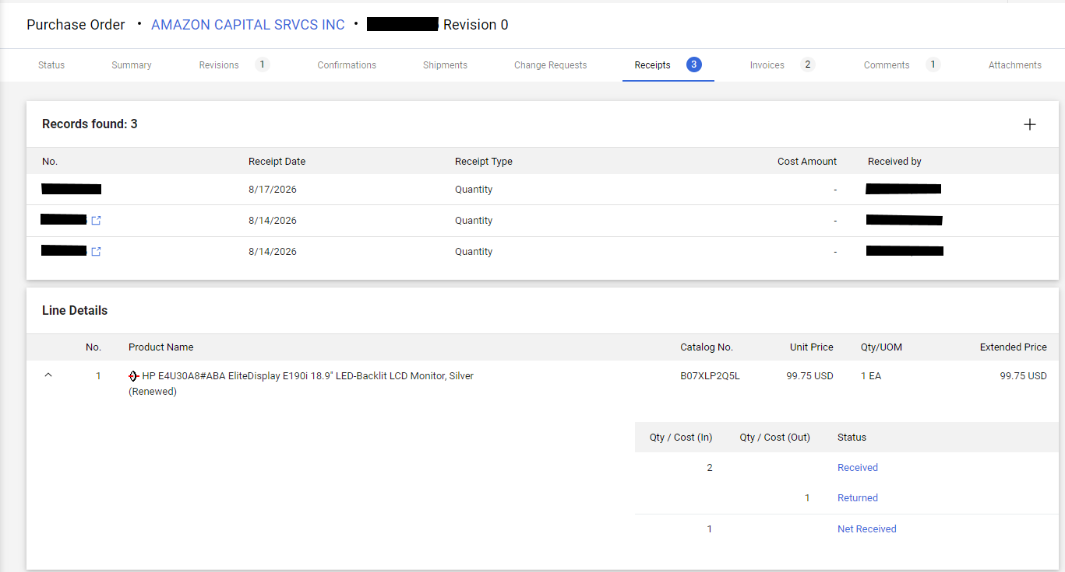
Punchout Supplier Credit Memo, Cont.
Scenario
Notes:
Lets look at this example
We can tell that a credit memo was issued because the department entered a received receipt, indicating that they have obtained the item.
Then a returned receipted showing that the item was returned back to Amazon.
If the Department never received an item then they would have entered a quantity receipt with status of cancelled

Slide 24

Non Punchout Supplier
Notes:
What do we if we have an Non Punchout Supplier with a credit memo?

Slide 25
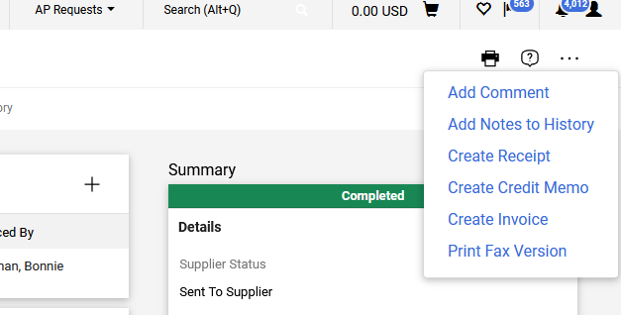
How to create a credit memo for a Non-Punchout Supplier
01
Access PO Options
Go to the 3 horizontal dots at the top right of the PO and choose “Create Credit Memo.”
Notes:
Because the nonpunchout suppliers do not automatically upload directly to the system, you will have to manually upload it to the PO.
This can be done by first going to the PO and clicking the 3 dots in the top right corner and selecting the create credit memo option

Slide 26
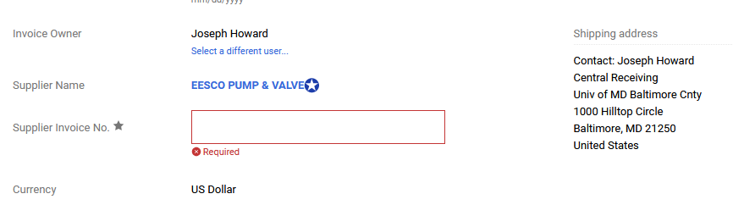
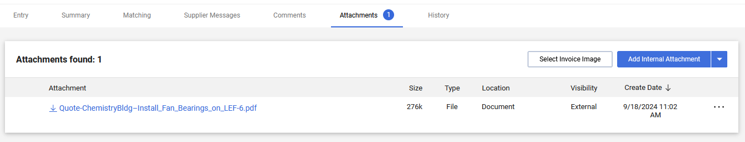
How to create an credit memo for a Non-Punchout Supplier
Notes:
From there you fill in the documentation like a normal invoice and attached the credit memo in PAW.

Slide 27
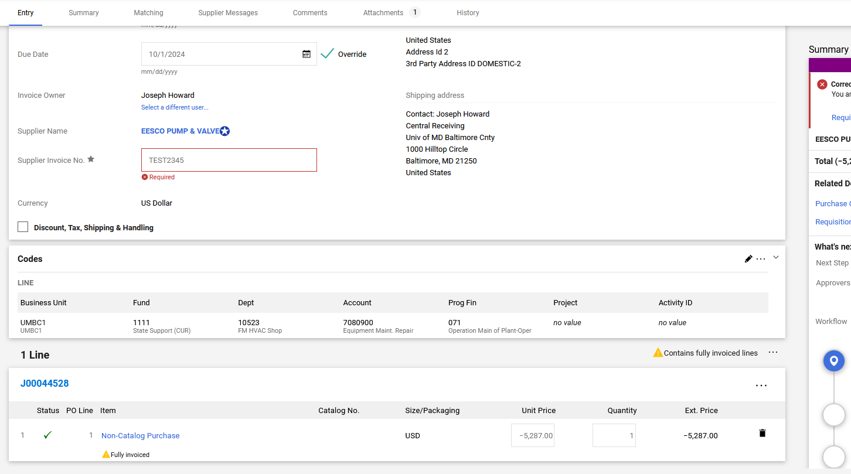
How to create an credit memo for a Non-Punchout Supplier
Notes:
When filling out the Line items, make sure that the Unit Price is Negative, and that the Quantity amount is NOT ZERO.
The credit memo will not process if either of theses are incorrect

Slide 28
What to do if the PO is closed?
RT Ticket
If the PO is closed, please submit an RT ticket in the Procurement queue and request that it be reopened.
AP cannot re-open a PO.
https://procurement.umbc.edu/umbc-staff-request/
Notes:
AP cannot process an invoice or credit memo if the PO is closed. Do not request that Procurement close a PO if there is an outstanding invoice or CM. Also, you cannot create a CM or enter receipts if the PO is closed.

Slide 29

Thank you!
Any Questions?
https://businessservices.umbc.edu/employee-help/
Notes:
Thank you for your time, I am unsure if we have additional time for questions, but if you have any very specific questions please put an RT ticket

