Slide 1
Is Law School for You?

Slide 2
Who?
Why?
What?
How?
When?
Where?

Slide 3
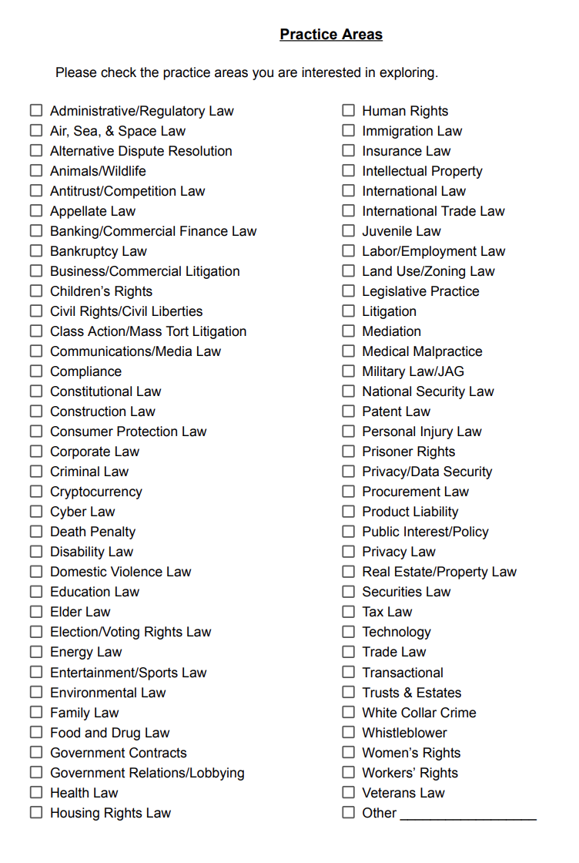
True Assessment . . .
who are
YOU
why
LAW SCHOOL
(what is of interest to you)

Slide 4
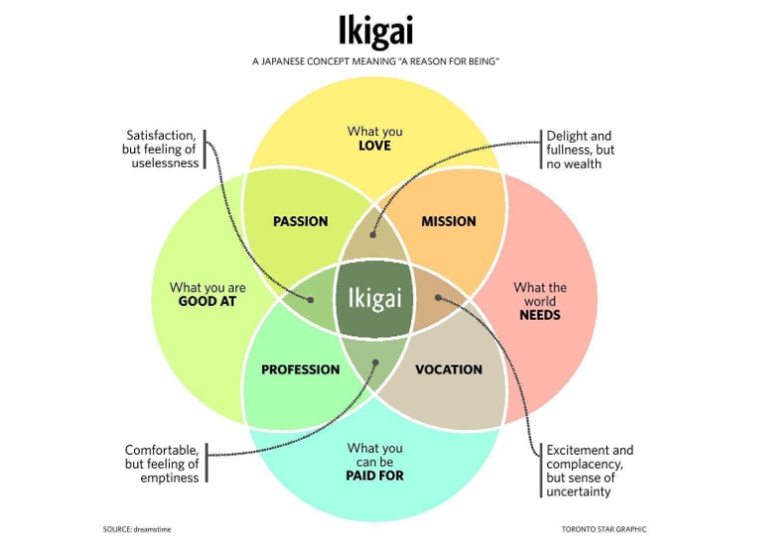
The
Goal:

Slide 5
Who?
Why?
What?
How?
When?
Where?

Slide 6
Research
Register via LSAC
Prepare/Take LSAT
Apply to law school
Choose your school
Pay for law school
HOW, WHEN, and WHERE
TO BECOME A LAWYER . . .
BEGIN
THE PROCESS
lsac.org

Slide 7
Why Catholic Law?
(beyond our first-rate legal education!)
Location in the nation’s capital
Values-based and mission-driven foundation
Unparalleled collegial and supportive community

Slide 8
Eligibility
https://www.law.edu/admissions/overview/apply-now/index.html
Available Programs
JD Programs
Full Time/Day (3 years)
Part Time/Evening (4 years)
Special Programs (3x3 or Flex)
Joint Degree Programs
LLM
MLS

Slide 9
FALL 2023 ENTERING J.D. CLASS PROFILE
Class Size: 114
Gender Distribution: 52% women 48% men
Diversity Representation: 25%
Average Age: 25
Percentiles:
LSAT
161
159
155
GPA
3.75
3.63
3.41
75th
Median
25th

Slide 10
CERTIFICATE PROGRAMS
Law and Public Policy Program
Comparative and International Law Institute
Compliance, Investigations, and Corporate Responsibility
Law and Technology Institute
Securities Law Program

Slide 11
J.D. INSTITUTES, CENTERS, AND SPECIAL PROGRAMS
Religious Liberty/First Amendment Initiatives
Center for the Human Person
Constitutional Originalism and the Catholic Intellectual Tradition
Summer Abroad Programs (Rome, Poland/EU)

Slide 12
PATHWAYS
Civil Litigation
Criminal Litigation
Family Law
Intellectual Property
Labor and Employment
Securities Regulation

Slide 13
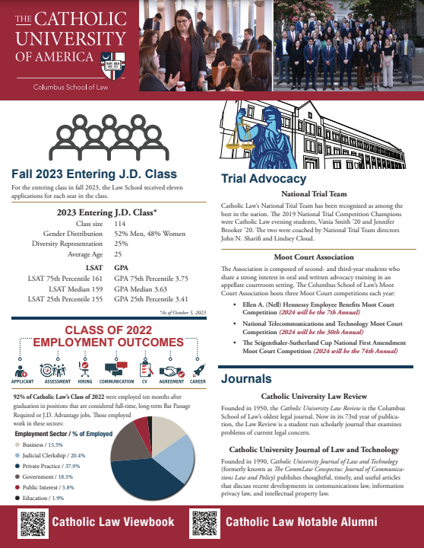
visit us at
law.edu

Slide 14
PAYING FOR LAW SCHOOL
accesslex.org
Financial Aid/Scholarship from Catholic Law

Slide 15
QUESTIONS
&
TIPS

Slide 16
Susan Smith Newell, JD/MA
Assistant Dean for Admissions &
Dean of Students for First-Year Students
Contact us at: admissions@law.edu

