Slide 1
Pre-Rx Success!
Albert Truong, Christine Tran, Khiem Han, Jessica Lai, Sofia Yousufzai
Notes:
Christine

Slide 2
Overview
Intro- Who we are
About VCU SOP
Stats
Overview of the curriculum
Programs at VCU
Getting into Pharmacy School
Pre- Reqs @ VCU
Application Requirements
Timeline
General Tips and Advice
Q&A?
Notes:
Christine

Slide 3
Christine
Undergraduate Experience
University of Virginia, Class of 2020
Major: Biological Sciences
Why pharmacy?
Unique career opportunities
Career Interests
Clinical pharmacy - currently interested in transplant, oncology, and infectious diseases!
Also interested in working/doing research for big pharma/pharmaceutical companies
Notes:
Christine

Slide 4
Albert
Undergrad Institution and Major
University of California, Los Angeles (UCLA)
Biochemistry B.S.
Pharmacy Experience Prior
Nothing!
Why pharmacy?
Versatility
Public Health
Career Interests
Industry
Postdoc fellowships
Non-traditional routes

Slide 5
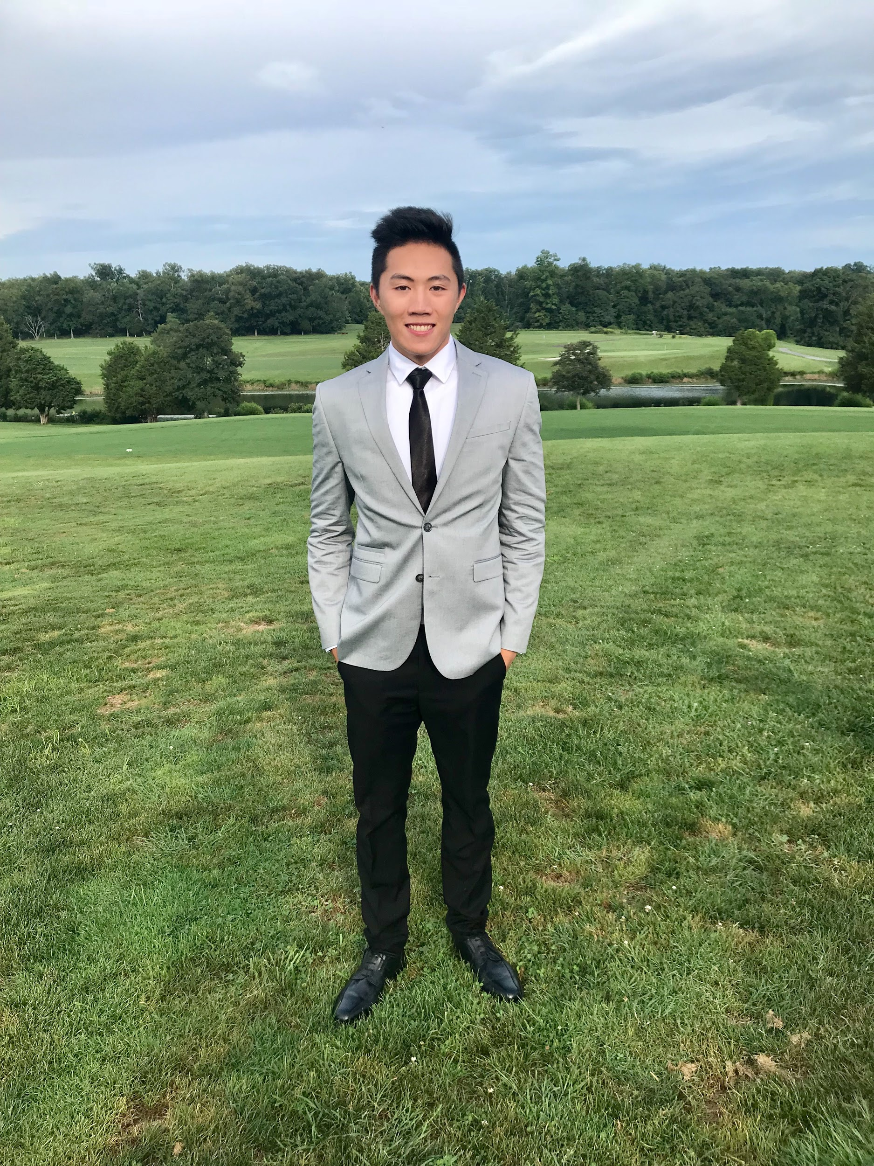
Khiem
Undergraduate
UMBC Class of 2020
Biological Sciences and Psychology
GPA 3.96
Why pharmacy?
Flexibility in Career Opportunities
Most Accessible Healthcare Professional
Career Interests
Nuclear pharmacy
Hospital pharmacy
Anything work from home 🙏

Slide 6
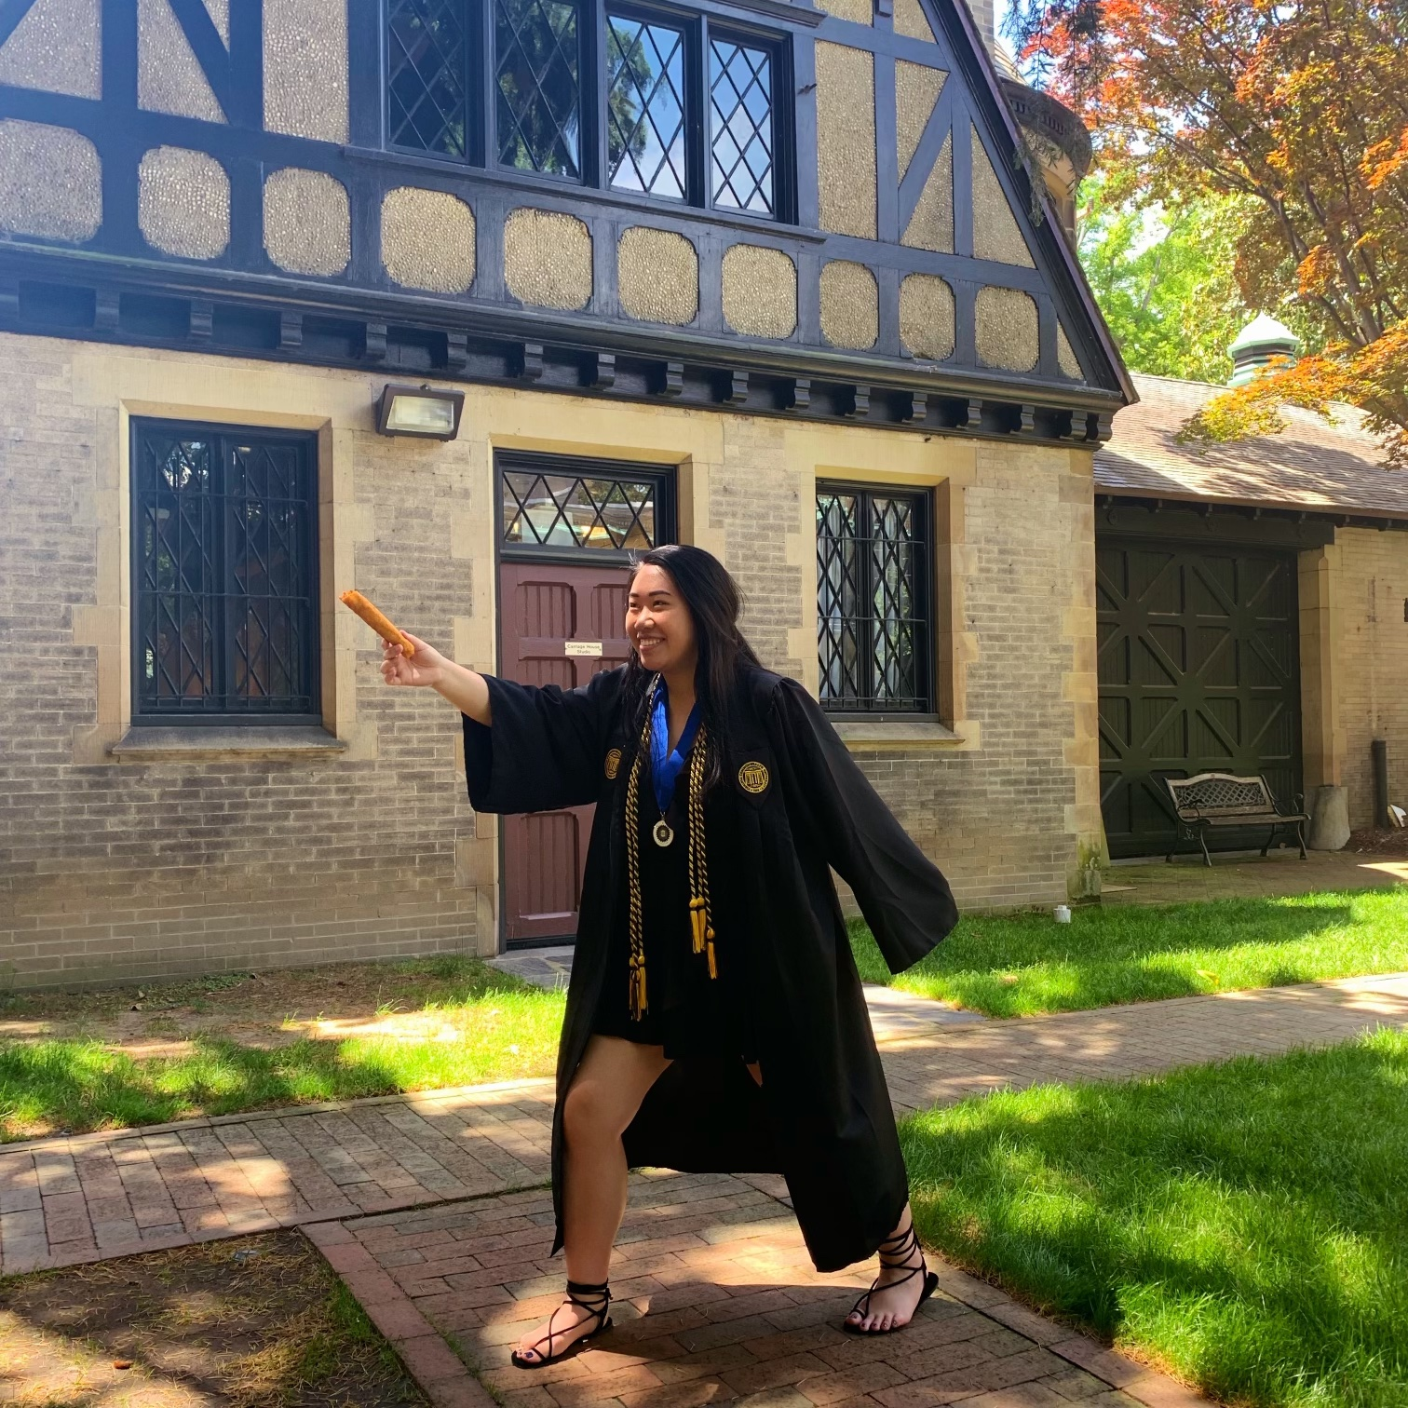
Jessica
Undergrad: VCU (2016-2019)
Major: biology, minor in chemistry
GPA: 4.0
PCAT: 89th percentile
some pharmacy schools don’t require (check!)
studied for 1 month, but rec. 2 months
Pharmacy Experience
CVS pharmacy technician (“senior year,” gap year)
transitioned to pharmacy intern in P1 fall
most schools do not require pharmacy experience but it is very helpful for when you start P1 year
Why Pharmacy?
unique patient interaction
many different careers in pharmacy profession
Career Interests
nuclear pharmacy
compounding pharmacy
hospital pharmacy

Slide 7
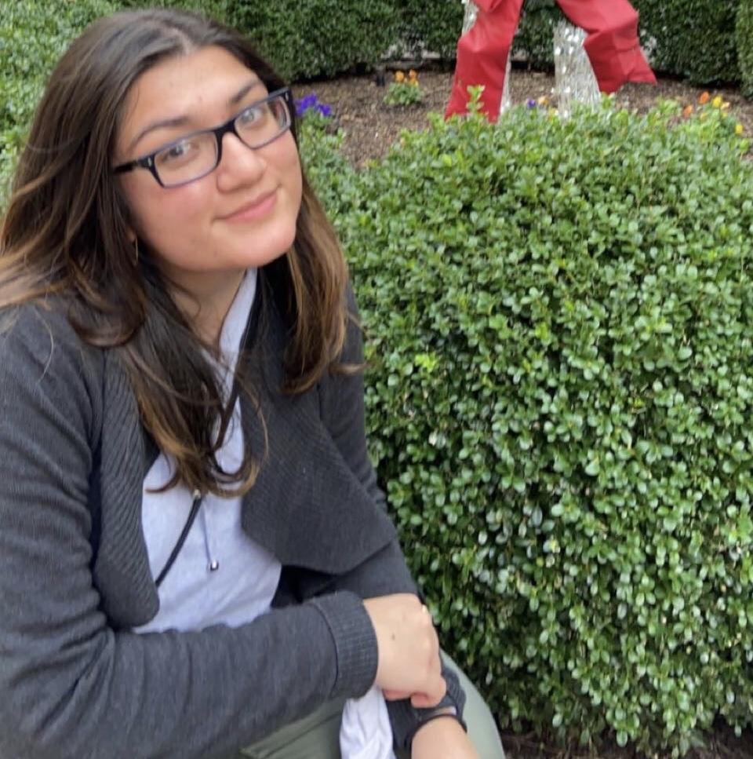
Sofia
Undergraduate
VCU class of 2019
Major in biology and minor in chemistry
GPA: 3.3
Why pharmacy?
Diverse career choices→ took an intro to pharmacy class during undergrad
Work experience→ worked at Walgreens during my gap year
Overall, want to provide patients tools to make sure that they can be their best healthy selves
Career interests
Geriatric and consultant pharmacy
Ambulatory care pharmacy
Managed care pharmacy

Slide 8
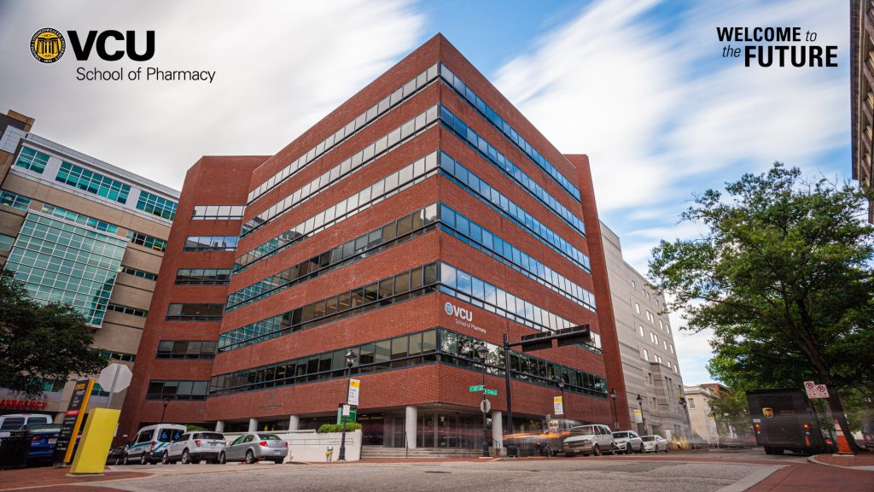
VCU SoP Stats
Notes:
Sofia

Slide 9
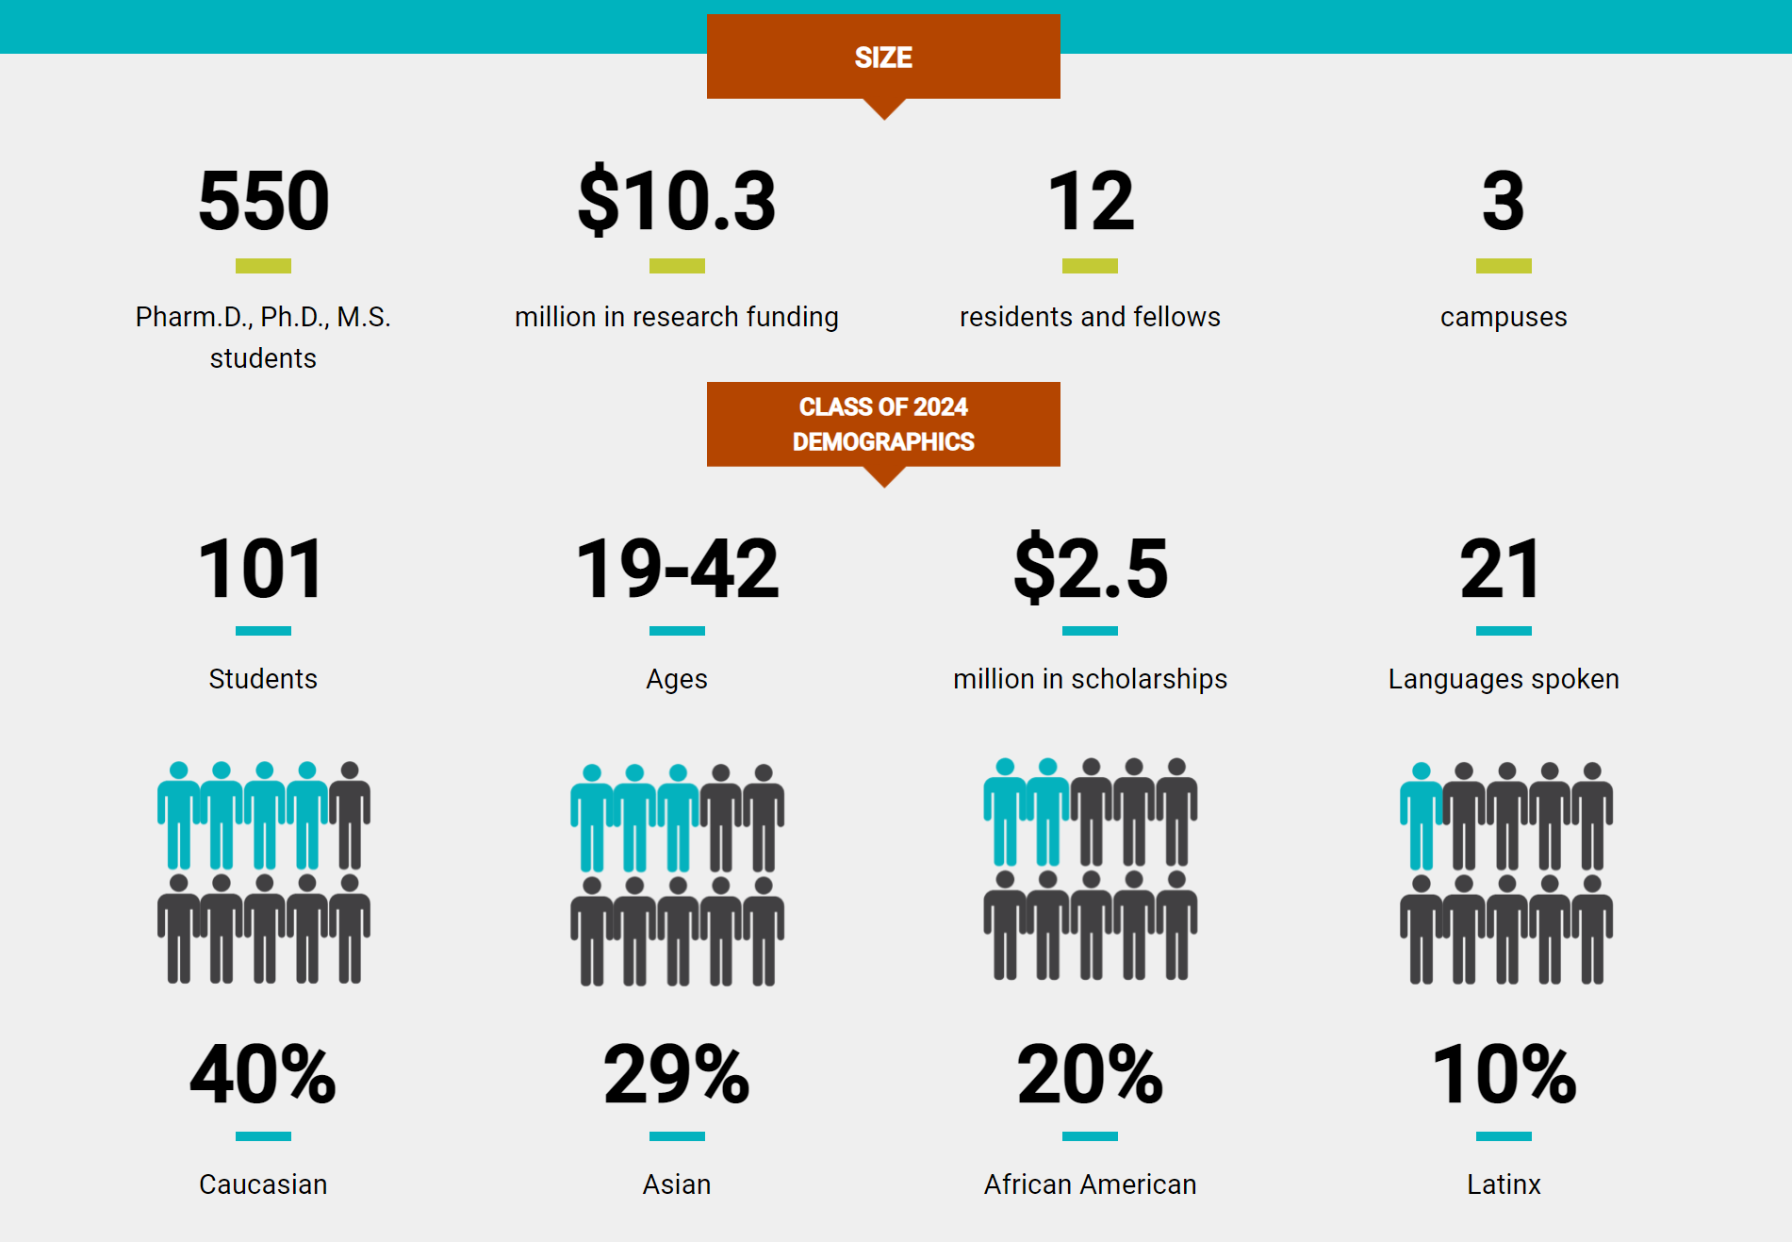
Notes:
Sofia

Slide 10
Overview of Curriculum
Four- year program
P1- P3 years are didactic - classroom
P1 - Foundational classes - Fall: 10 classes - Spring: 9 classes - Summer: community pharmacy Introductory Pharmacy Practice Experiences (IPPE)
P2 & P3
Therapy Modules & Electives
P2 Summer: hospital pharmacy IPPE
P3 Summer: start 4th year rotations
P4 year
Rotations year round
Notes:
khiem

Slide 11
Programs Offered by VCU
Combined Dual Degree Programs
PharmD/ PhD
PharmD/ MBA
PharmD/ MPH
Satellite Campuses
Default - MCV (Richmond)
INOVA (Northern Virginia)
UVA (Charlottesville)
Lots of student organizations!
Professional Organizations
Fraternities
Notes:
Khiem

Slide 12
School during COVID?
VCU offers hybrid in-person and online
Skills lab is in-person (compounding, dispensing, competencies)
Lecture you can choose to be in-person or online - designation is for whole semester however
Exams
Proctored through Examplify and secondary device on Zoom (recorded)
Organization meetings are through Zoom during our designated lunch hour
HOPEFULLY, pharmacy school will be “normal” by the time you start
Notes:
Jessica

Slide 13
What’s next?
How do I get in?
Notes:
Jessica

Slide 14
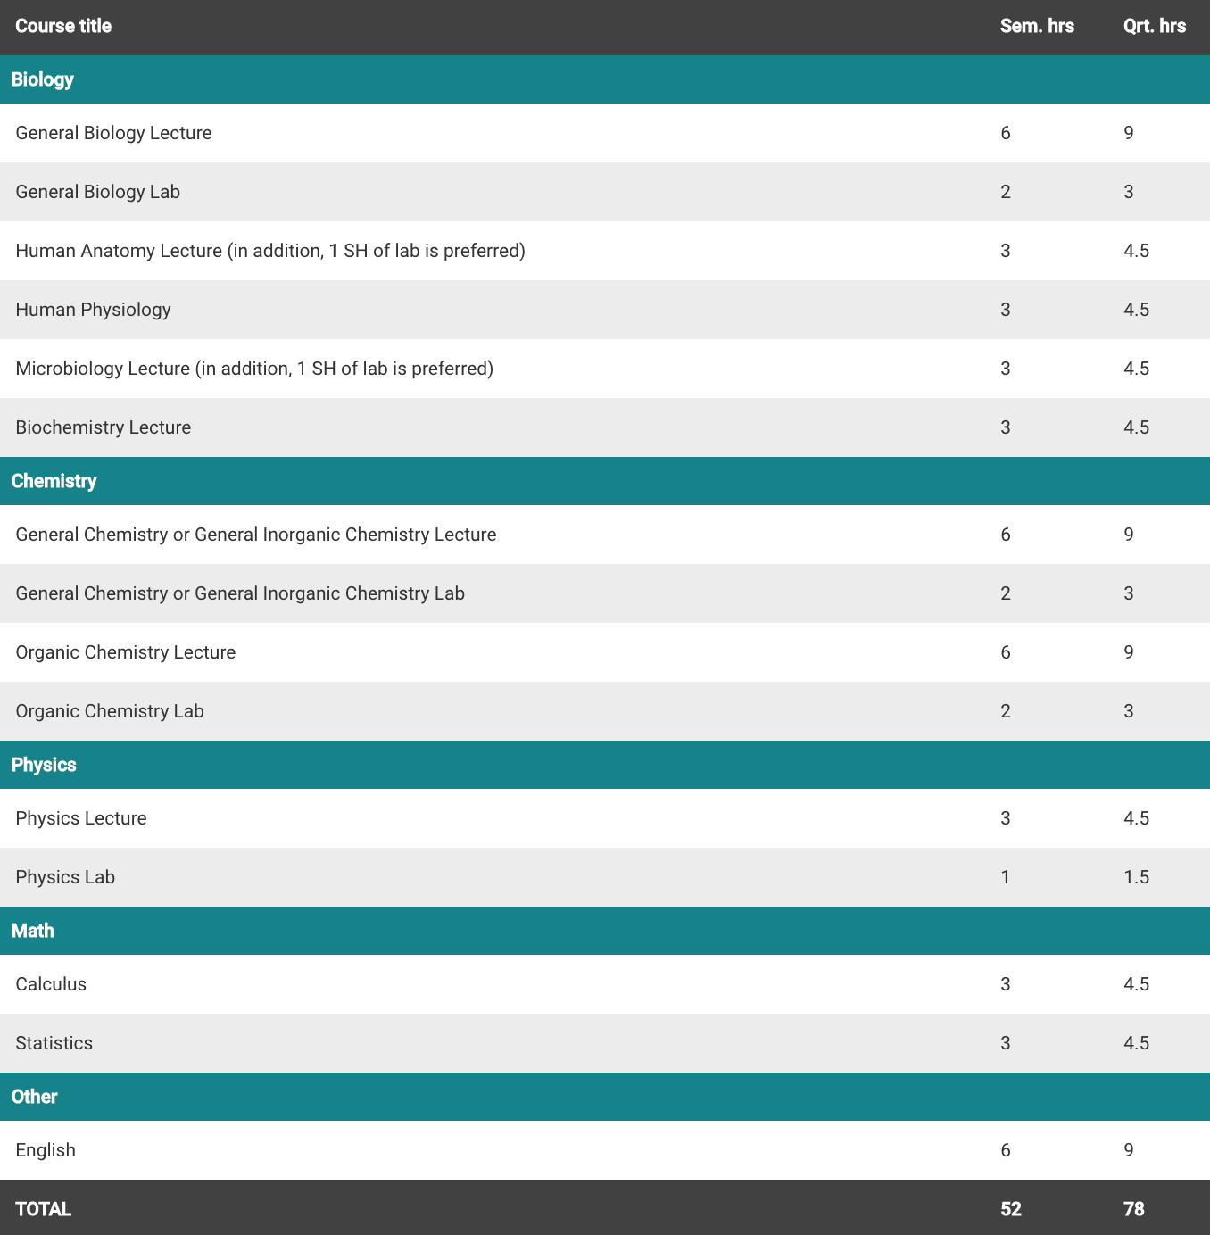
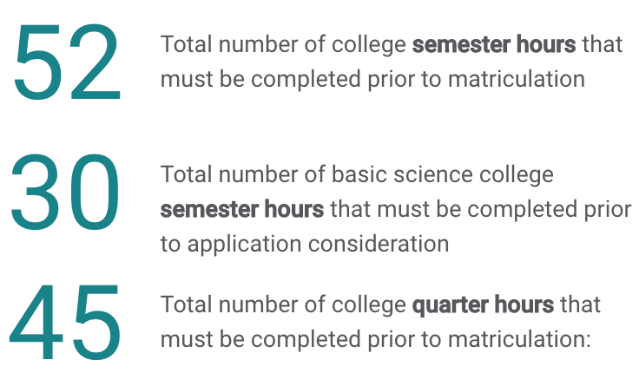
Pre- Reqs
Notes:
Jessica

Slide 15
Application Requirements
Complete the PharmCAS application online with the following information -
Official Transcript(s)
Personal Statement
Three letters of recommendation
Faculty member, employer, health care professional (or another faculty member/volunteer coordinator)
Pharmacy College Admissions Test (PCAT)
Optional for the 2021-2022 cycle!
Encouraged to take if..
GPA <3.0
Pre-reqs completed 5+ years ago
< 50 credit hours at the time of application submission
Downward trend in academic history
Notes:
Jessica

Slide 16
Application Timeline
**Timeline begins the year (~12 - 18 months) before starting pharmacy school**
October - May-
Plan to take PCAT
Start drafting personal statement & resume
Think about who you’ll ask letters of rec from
July - PharmCAS opens up
ask for LoR at least 1 month before you plan to submit application
if planning to take PCAT, give Pearson 1-2 months to send official scores
send application earlier than later (but check individual schools for early decision--binding decision)
September
Interview Prep
Interviews begin
April
Finalize decisions
Notes:
Christine

Slide 17
Tips for Applying into Pharmacy School
Start early & stay organized
Ask early (enough) for letters of rec
Don’t forget about transcripts!
Keep track of application deadlines
Work Experience
Technician experience can only help
GPA (VCU SoP average GPA 3.4)
Shadowing
Research
Get involved!
Join organizations
Volunteer
Leadership positions
Notes:
Christine

Slide 18
Things to Think About When Applying
Interests
Faculty at each prospective school
Academic Environment
Location
Scholarship Opportunities
Match Rates
NAPLEX (licensure board exam) Pass Rate
Postdoc interest
Notes:
Albert

Slide 19
Questions?

Slide 20
Contact Information
Christine Tran - tranc14@vcu.edu
Albert Truong - truongam3@vcu.edu
Jessica Lai - laijm@vcu.edu
Khiem Han - hank5@vcu.edu
Sofia Yousufzai - yousufzais@vcu.edu

