Slide 1
School Psychology
Improving the Lives and Learning of Children and Youth

Slide 2
What Do you Want in a career?
Positively impact teachers, children, and their families?
Work with children and adolescents?
Work in a school?
Enact change within schools and the community?
Advocate for marginalized groups?

Slide 3
What do you want In Your Job?
Plenty of job openings across the country
Diverse roles and responsibilities
A competitive salary with great benefits
Job flexibility and stability

Slide 4
Why I became a school psychologist:
The best part of being a school psychologist:
The most challenging aspect of being a school psychologist:

Slide 5
So who are school psychologists?
Experts in learning, behavior, mental health, and school systems
Work in schools and other educational and clinical settings
Provide psychological and educational services to diverse students
Support student achievement and wellbeing, and school-family-community partnerships

Slide 6
What do school psychologists do?
Assessment
Conduct psychological assessments
Counseling
Provide individual and group counseling and other mental health and behavioral supports
Consultation
Consult with teachers and families to help support students' behavioral and academic needs
Crisis Intervention
Prevent and respond to various types of crises
Diversity
Provide culturally competent services to diverse learners

Slide 7
This may look like supporting students with...
Learning difficulties
Behavior and attention concerns
Interpersonal problems (bullying, social isolation)
Depression, anxiety, and other mental health issues
Coping with crisis and trauma (natural disasters, war, school violence, abuse, etc.)
Poverty, homelessness, foster youth
Family problems (divorce, death, substance abuse, violence, military deployment)

Slide 8
Where Do school psychologists work?
86%
Public Schools
10%
Colleges & Universities
8%
Private Schools
7%
Private Practice
6.7%
Faith-Based Schools
1.6%
Department of Education
1.5%
Clinics & Hospitals
Walcott, Charvat, McNamara, & Hyson (2015)

Slide 9
Who are today's school psychologists?
gender
83%
Women
16%
Men

Slide 10
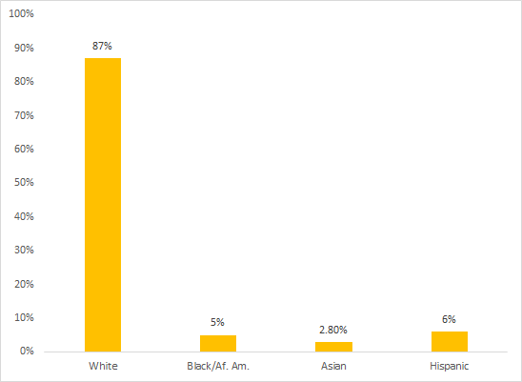
Race/ Ethnicity
Who are today's school psychologists?
2014
Walcott, Charvat, McNamara, & Hyson (2015)

Slide 11
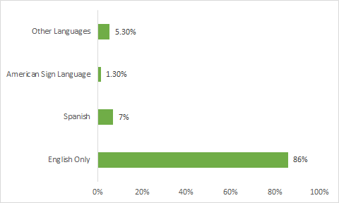
Linguistic Diversity
Who are today's school psychologists?
Other Languages includes 27 different languages
Walcott, Charvat, McNamara, & Hyson (2015)

Slide 12
The school psychology field is calling for...
Males
Individuals from non-White backgrounds
Bilingual individuals

Slide 13
Salary by Region
WEST
SOUTHWEST
MIDWEST
SOUTHEAST
NORTHEAST
ALASKA & HAWAII
(Walcott & Hyson, 2018)

Slide 14
So Maybe now you want to be a school psychologist...
How do you get there?

Slide 15
Undergraduate Degree & Pre-Graduate school Experiences
1.
Bachelor's Degree:
Psychology
Child Development
Sociology
Education or related field
Volunteer or Work Experience with Children:
Mentorships/tutoring
Camp counselor
Daycare/preschool
Behavior technician
Kennedy Krieger Institute
Local ABA Therapy organizations
Some programs (like Towson) may have prerequisite courses you need to take during undergrad—or need to complete before starting the program

Slide 16
Undergraduate Degree & Pre-Graduate school Experiences
sdfs
1.
Research:
Join a professor's research lab that aligns with your interests
Working with school-age individuals or on research relating to children and adolescents could be a plus
Explore undergraduate research opportunities
Thesis?
Undergraduate research exhibitions?
Apply to work in research labs post-graduation

Slide 17
Graduate school Preparation
sdfs
2.
Specialist (EdS, CAS, CAGS)
> 60 graduate credit hours
3+ years, including one-year full-time internship
Allows you to work in schools
In MD: can apply to be a Psychology Associate and work in private practice under supervision
In MD: can take extra counseling courses to become LCPC
Doctoral (PhD, PsyD)
> 90 graduate credit hours
5-6+ years, including one-year full-time internship
Allows you to work in schools, academia, research
Opportunities to work independently in private practice

Slide 18
To go nasp-approved or not
sdfs
2.5
NASP-Approved Program
Like APA-approved, follows a rigorous training model
Regularly approved to become recertified—checking to make sure the program still meets national standards
You can more easily apply to become an NCSP, Nationally Certified School Psychologist
NASP-Approved or not?
A NASP-approved program ensures that your program hits all important aspects of school psychology
You can still become an NCSP without attending a NASP-approved program, but it may not be as stream-lined
NCSPs are nationally recognized, allowing for increased job flexibility
Some districts may offer additional pay if you have an NCSP

Slide 19
Graduate Application
sdfs
3.
NASP-Approved Maryland Schools:
Towson University (Specialist-Level)
Bowie State University (Specialist-Level)
University of Maryland, College Park (Doctoral-Level)
Applying:
Doctoral programs usually have earlier deadlines
Update your CV
Write and edit your personal statement
Need three letters of recommendation
Transcripts
DO NOT WAIT TO FILL OUT YOUR APPLICATION; BE PROACTIVE
Interviews (if invited after submitting your paper application)

Slide 20
4. Graduate coursework
Prevention and Intervention for Students and Families
Assessment
Academic/learning interventions
Mental and behavioral health interventions
Counseling techniques
Instructional support
Special education services
Crisis preparedness, response, and recovery
Family-school-community collaboration
Cultural competence

Slide 21
4. Graduate coursework
Foundations of Services Needed in Schools
Data collection and analysis
Resilience and risk factors
Consultation and collaboration
Diversity in development and learning
Research and program evaluation
Professional ethics
Education law

Slide 22
Getting a job
sdfs
5.
Must hold a current, valid state credential to practice
Holding an NCSP is one path to work in some states (like MD)
Link to NASP's database of state credentialing requirements: State School Psychology Credentialing Requirements (nasponline.org)
Independent practice may require an additional credential

Slide 23
Job outlook
Ranked #2 Best Social Services Jobs, #18 Best STEM Jobs
Federal education laws include provisions for school psychological services
High demand across the nation—national shortage
Need for professionals from culturally and linguistically diverse backgrounds

Slide 24
Questions?
To learn more about school psychology, visit www.nasponline.org
To view a comprehensive list of doctoral and specialist-level school psychology programs, visit Approved Programs (nasponline.org)

Slide 25
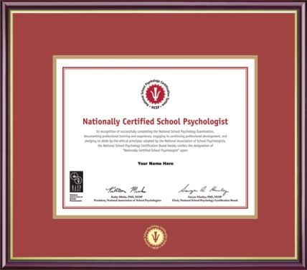
Learn about school psychology and school psychology graduate programs in the area.
**Presented by the Maryland School Psychologists’ Association**

