Slide 1
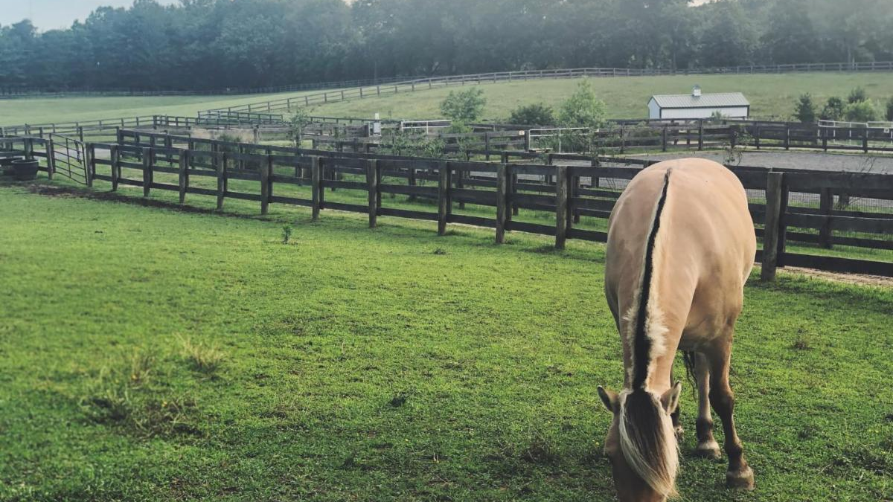
Equine Assisted Services
Katie Streett, MS, LGPC
Program Manager
PATH Intl. Advanced Certified Therapeutic Riding Instructor
EAGALA Certified Mental Health Professional & Equine Specialist

Slide 2
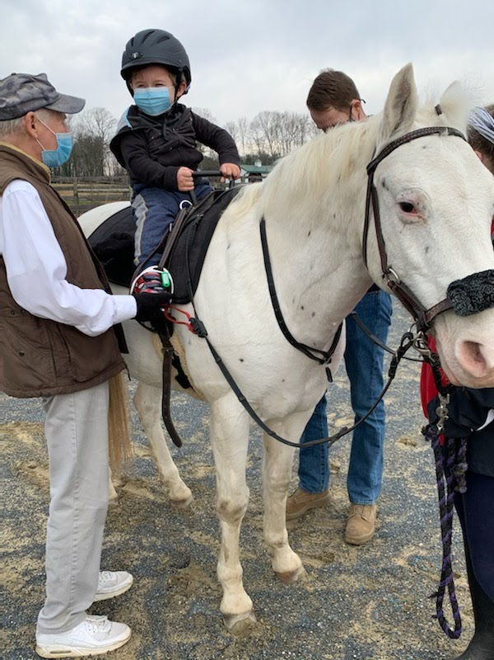
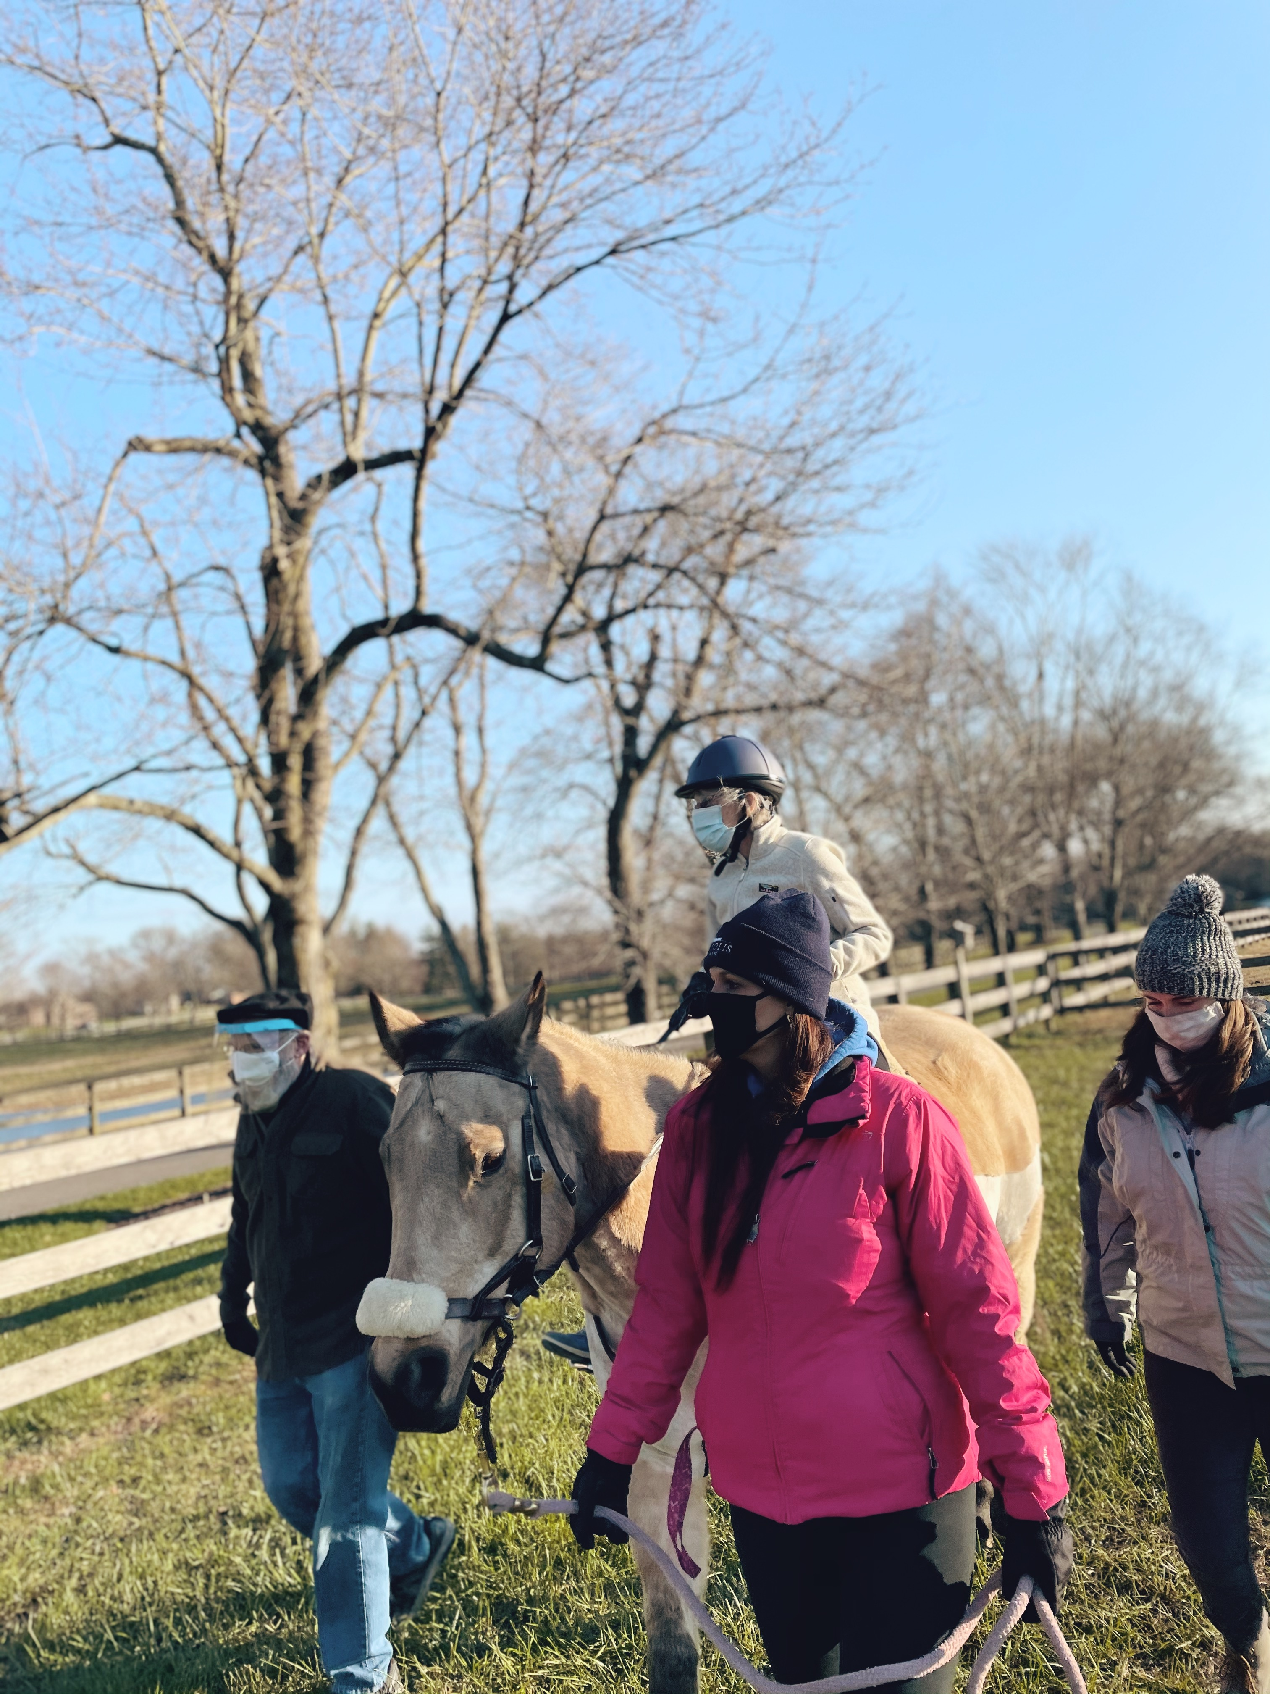
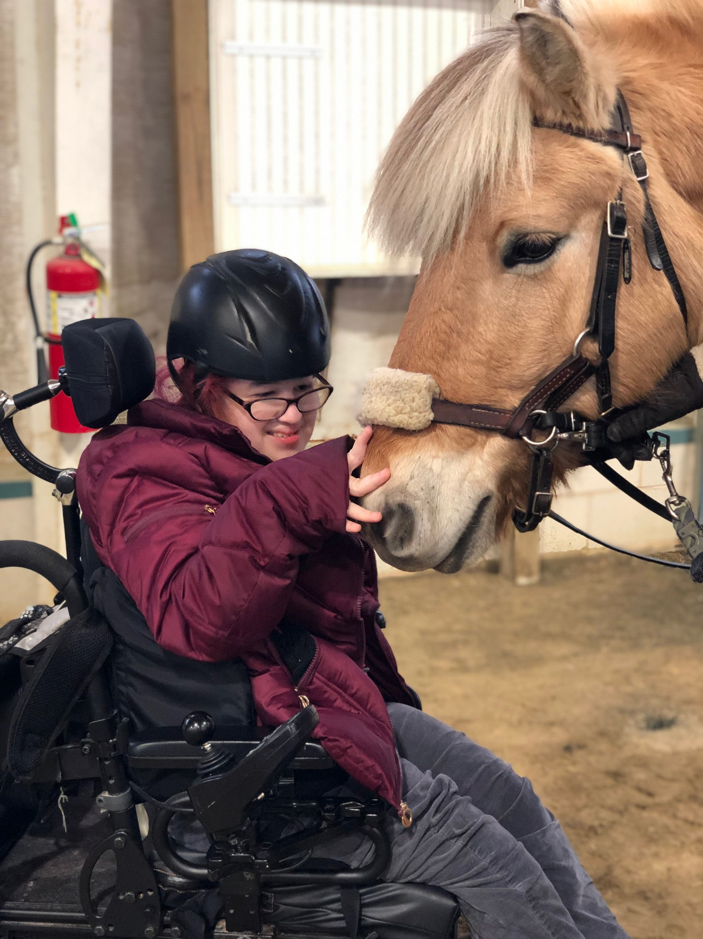
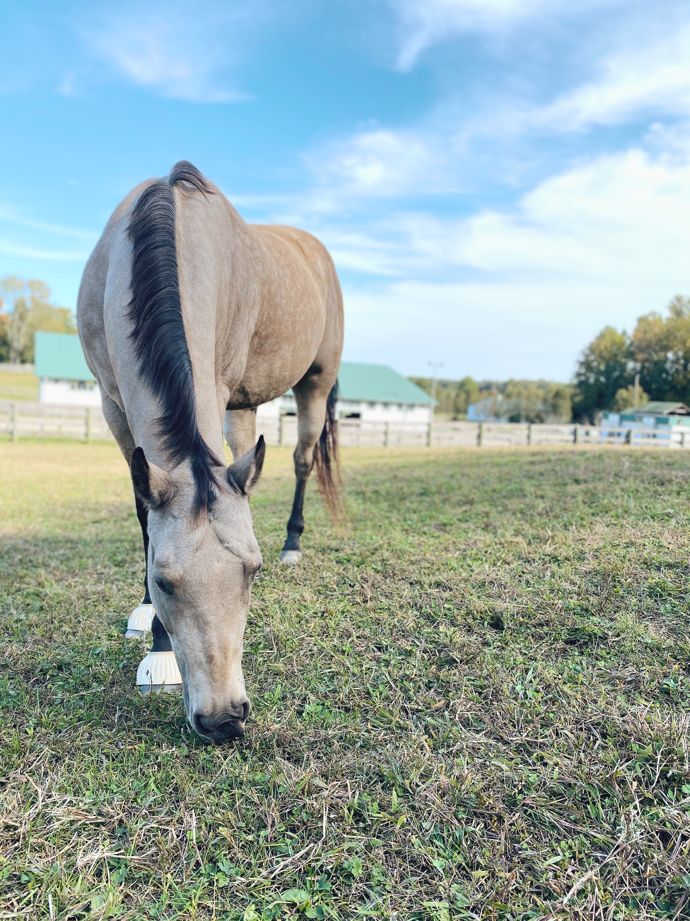
MTR Programs and Services
Therapeutic or Adaptive Riding
Hippotherapy
Speech and Language Therapy
Physical Therapy
Occupational Therapy
Equine Facilitated Psychotherapy
Equine Learning
Instructor in Training Program
Intern Program
Mental Health Partnerships
MTR on the Road
Pony Partners
Volunteer Program
Notes:
MTR Programs and Services (High level highlights, include discussion of definition of service, benefits to participants, professionals who provide service-credentials, training, certifications, etc.) Katie
TR
Interns
IIT
EL
HPOT
Mental Health
EFP
Partnerships
Facility Usage -Nicole
Equine assisted services-use new terminology
All programs designed to enhance and support the wellbeing of our community. We specialize in support for (populations). Our providers (credentials). The policies and procedures at every aspect of operation, from administrative to program and service specific, are guided by standards of excellance to provide the highest quality, effective and safe services that we can.
Amount of services in 2020
COVID impact
Expansion: Riding for Wellness
Nia rider survey response

Slide 3
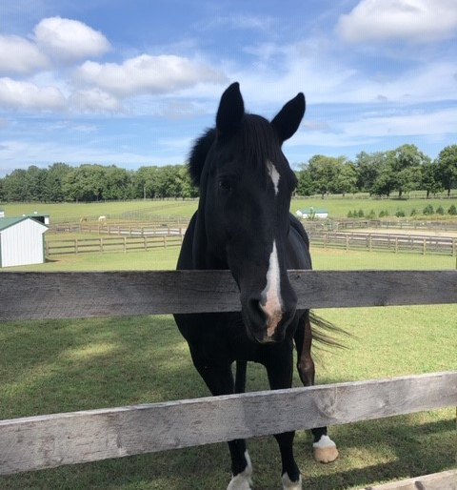
Equine Assisted Psychotherapy
Team Aproach
Ground-based
Solution-Oriented
Externalizing, the power of story
Experiential
Why Horses?
Social herd structure
Resilience and persistence
Large and powerful size
Prey animal, sensitivity to environment and non-verbal communcation
Notes:
# of horses and how horse needs have changed-Nicole
Pony Partners- Nicole

Slide 4
Road to practicing Equine Assisted Therapy
Complete requirements for licensure in the state where you plan to practice. CACREP (The Council for Accreditation of Counseling & Related Educational Programs) Accredited program.
Obtain licensure as a mental health provider.
Certification Options:
EAGALA, Equine Assisted Growth and Learning Association
PATH Intl, Professional Association of Therapeutic Horsemanship International
Natural Lifemanship, Trauma Focused
Notes:
Setting Foundation: Purpose of the Meeting-Kelly
Strategic Goal 1: Establish an Inspiring Culture that Reflects a Collaborative Team Working Towards Standards of Excellence
Our community is our strongest asset. We will dive deeper into the fundamental beliefs of this community by codifying, communicating, and living the core values that represent who we are. MTR leadership will champion a culture of transparency, consistency, and trust that nurtures and inspires our staff and stakeholders.
Review of changes in the Industry in 2020.
Brief discussion of recommendations for terms used.-Katie
Review of Changes in the Community in 2020.
COVID-Kelly
Mental health- Katie
How do we define ourselves in a more accurate way? -Katie

Slide 5
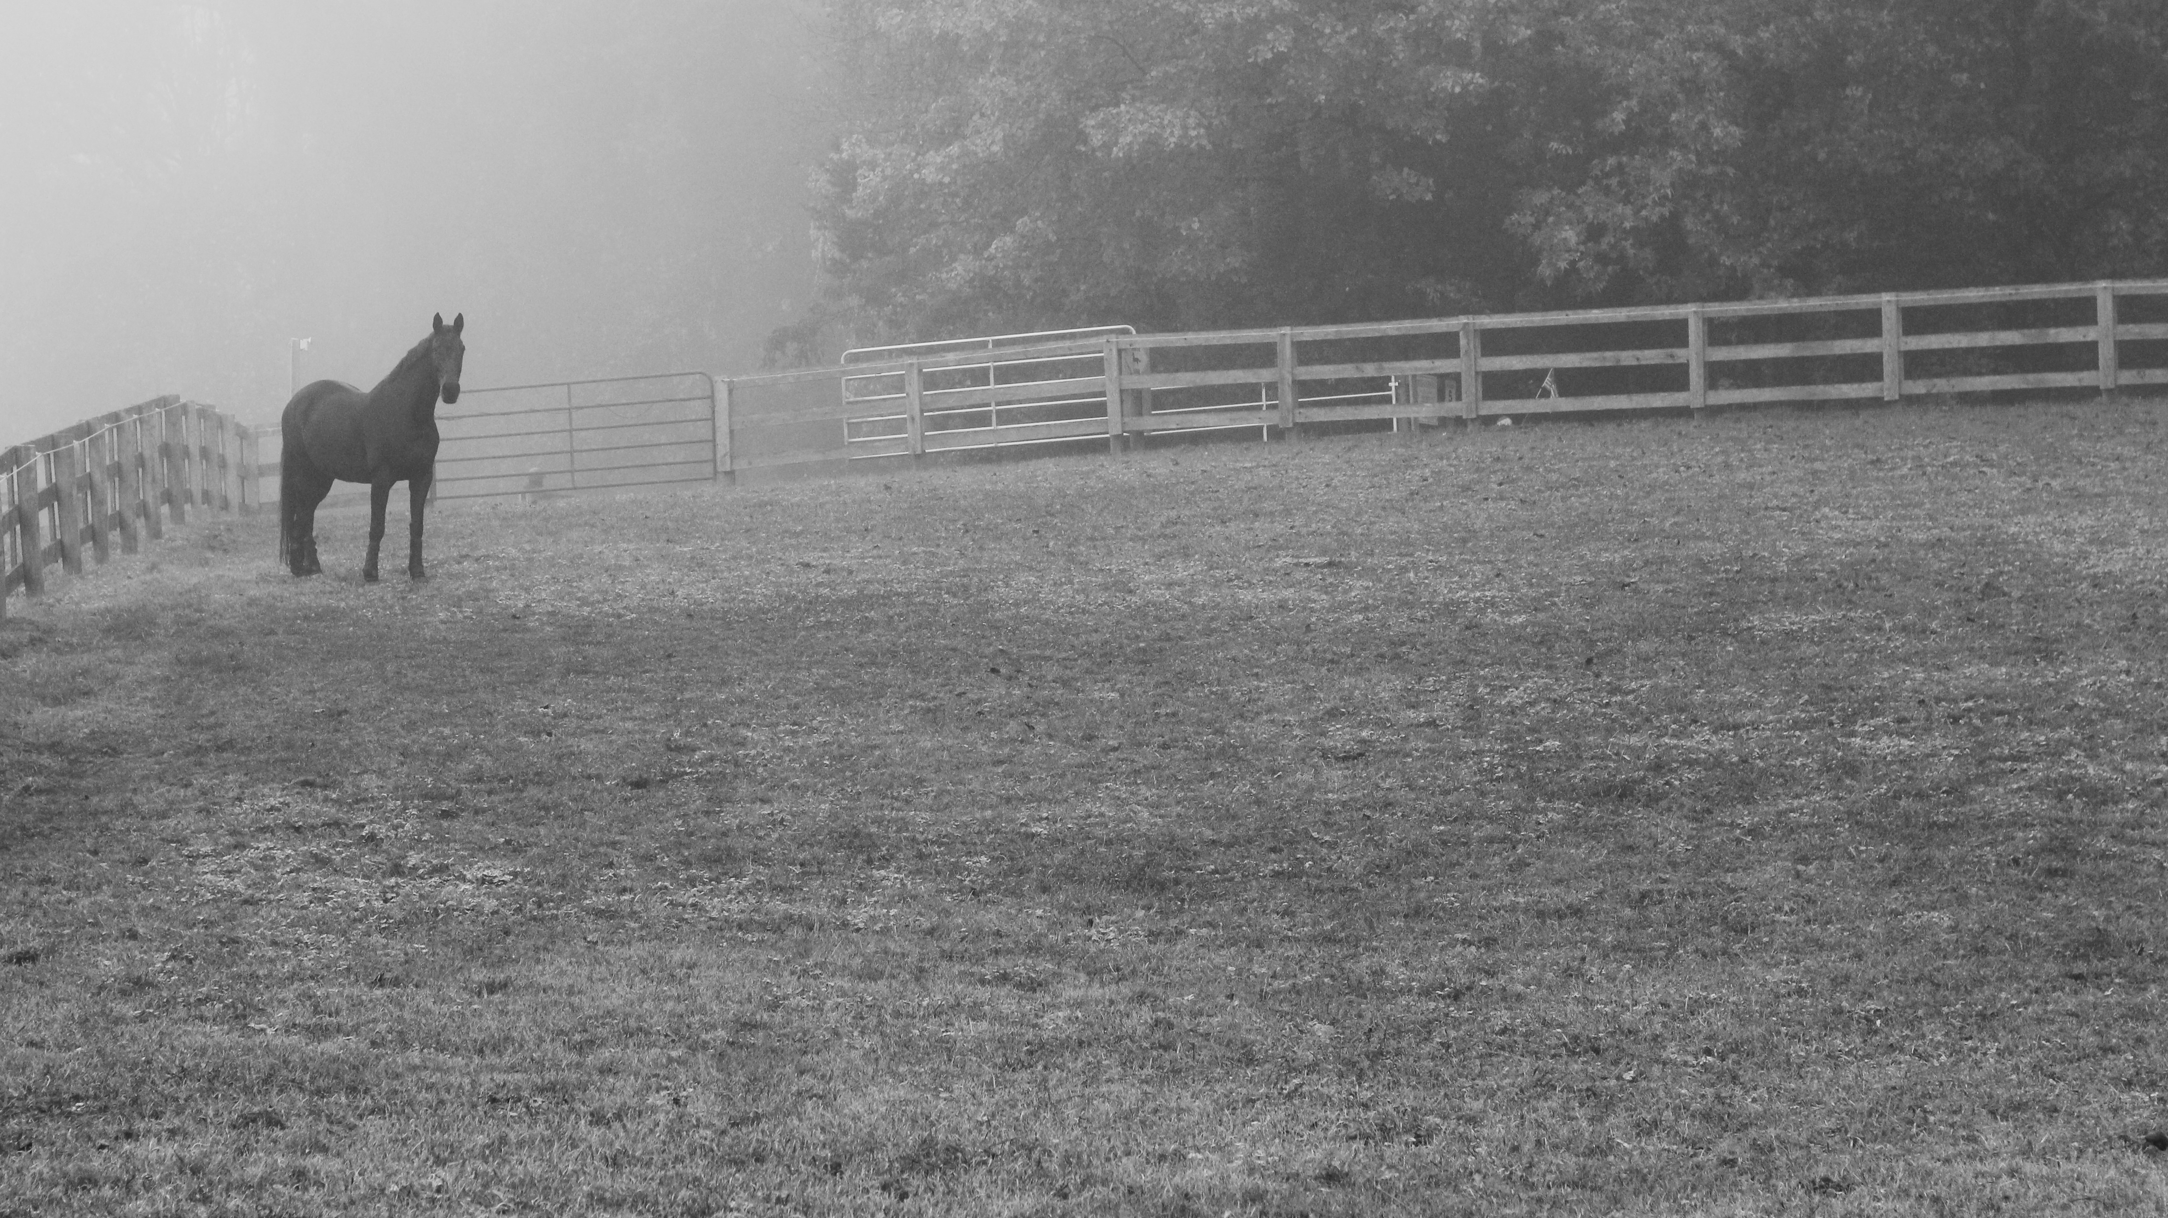
Questions?
Katie@mtrinc.org
Katiestreett@tentencounseling.com
443-494-3018
www.horsesthatheal.org
https://www.tentencounseling.com/
www.eagala.org
www.pathintl.org
https://naturallifemanship.com/

