Slide 1
The Field of I/O Psychology Elliot D. Lasson, Ph.D., SHRM-SCP Graduate Program Director, UMBC’s Masters of I/O Psychology Program Presented to UMBC PSI CHI November 17, 2021

Slide 2
What is I/O Psychology?
Scientific Study of Workplace Behavior
Theoretical and Empirical Bases
Talent Acquisition and Management
Organizational Behavior and Development
Interventions and Consultative

Slide 3
Employment Sectors for I/O’s
Public/Government
Corporate/Private
Consulting
Nonprofit
Higher Education
Research firms

Slide 4
One Coin, Two Sides
Some Actual Job Titles for Each
I/O Psychology
Human Resources
Personnel Psychologist
Human Capital Consultant
Senior Director, Talent Management Analytics and Solutions
Management Analyst
Professor, Instructor, etc.
Research Scientist
Partner, Talent and Rewards
Director of HR
VP of Talent Acquisition
Chief Customer Experience Officer (CXO)
Chief Human Resources Officer
HR Specialist/Manager

Slide 5
UMBC Masters of I/O Psychology Program Overview
Our Courses and Faculty

Slide 6
Program Highlights
Applied program
Designed for working adults
evening classes
meet once a week
Academic components
core and specialty courses
allows for choice of curriculum based on student career interests
Experiential components
Advisory Board mentorship program
Capstone Experience (PSYC 698)
Practicum (PSYC 690)
Consulting projects with faculty
Professional organizations
SIOP, PTC, SHRM

Slide 7
I/O Psychology Program Details
Master of Professional Studies:
Industrial/Organizational Psychology
10 courses (3 Credits each)
30 credits
Course Requirements:
5 Core Courses
4 Specialty Courses
1 Capstone Course

Slide 8
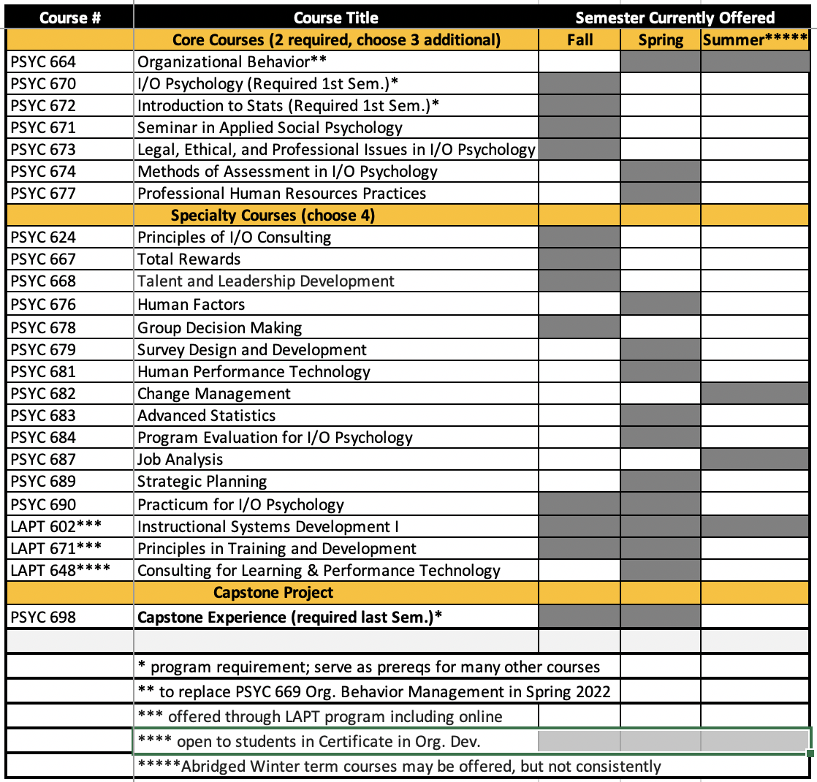
Current Course Offerings

Slide 9
Where Some of Our Alumni Work
U.S. Department of Defense
Research Psychologist, Management Analyst
Wells Fargo
Selection and Assessment Specialist
Norwegian Labour and Welfare Administration
Inclusive Workplace Advisor
FINRA
HR Sr. Associate, Training & Development
American Humane Society
HR and Legal Coordinator
NIH
Chief/Consultant

Slide 10
John D’Amore
Management and Program Analyst: U.S. Secret Service
Barb Blau
Workforce Strategy and Analytics Manager: National Institutes of Health
Nikeya Elliott
Manager, Talent Acquisition: KIPP Foundation
Elizabeth Winters
HR Leadership Development Specialist: Office of Personnel Management
Emilie Llenado
Asset Management Senior: Freddie Mac
Some Recent Representative Alumni

Slide 11
Program Alumni Quotable
“All of my bosses at have been very proud of my educational background and it naturally incorporates itself into my daily tasks and projects. I design onboarding kits for new hires in my team, am the lead facilitator for a corporate wide women’s resource group, and assist in departmental training and community service planning initiatives for our corporate scorecard. I also work regularly in data analytics for seasoned Multifamily loans, and departmental responses on morale/well being surveys.
While the backbone of my position is performing seasoned loan reviews - and assessing risk ratings for loans in our portfolio, I’m very fortunate to pursue and maximize on my I/O passions. My leadership recognizes these strengths and gladly incorporates them into my role.”
--Emilie Llenado, Asset Management, Senior for Freddie Mac

Slide 12
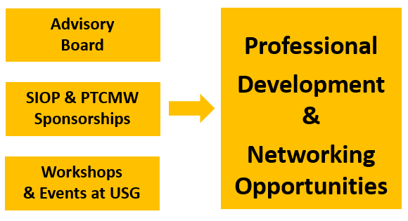
Mentorship >> Experience >> Partnerships

Slide 13
Fall 2022 Deadline: May 15, 2022
Review Admission Requirements
Apply Online at
umbc.edu/gradschool
Submit All Required Materials
Stay Tuned for Admission Decision

Slide 14
Your Resources
Application/Admissions Information
sgprofessionalprograms@umbc.edu
Program Information
Dr. Elliot Lasson
elasson@umbc.edu
Dr. Elissa Abod
eabod@umbc.edu
umbc.edu/io

Slide 15
The Psychology of Interviewing

Slide 16
An employment interview is:
A communication process between two parties, with a predetermined purpose to exchange behavior, which involves the asking and answering of questions
A technique of obtaining information from a set of candidates that will allow the interviewer to differentiate among them and make an informed selection decision
Verbal
Non-verbal
Tool which is part of larger selection process
Notes:
we can view an interview as a process with a purpose, with two parties involved, and questions are asked and answered; there are many types of interviews; fin the context of employment, the interview can be used at different points in the selection process in order to find out relevant information about the applicant
sometimes they are formal; sometimes, they are informal; for example, if you follow up with someone on the phone after receiving a letter of interest in a position, you can get a sense of who the person is and whether there is a good enough fit to move ahead
in any employment interview, both the IER and IEE can clarify their positions and determine whether there still is a fit
in the interview, there is what is said and how it is said
depending on the situation, the interview may be the first check-point in the hiring process, or it may be the last; there may be other forms of assessment taking place (for example, a test or background investigation)

Slide 17
Organizations use interviews to:
Select the best person for the position
Find the best place in the organization for the individual
Sell the organization to the candidate
See who is out there even if they have no intention of hiring (“tire kicking”)
Notes:
there are a variety of short-term and long-term organizational objectives accomplished, in part, by the interview
some are selection issues, in hiring the very best person for the job and some are placement issues, of placing the person in the part of the organization which can benefit most
sometimes interviews are used for PR and other times, they are just to test the waters of who is out there in the labor market

Slide 18
Interview Formats
Traditional, one-on-one
unstructured
structured
Panel (more than one interviewer)
Technology platforms
Phone, Conference Call
Zoom, Google Meets
Notes:
the interviews we are most familiar with vary along the continuum of structure
on one end, there is the unstructured interview; on the other end, is the highly structured and standardized interview; here, the exact same questions are used for each applicant without any deviation from this protocol
for the most part, this all is a matter of degree, where almost all interviews have a minimal shell of questions which will be asked; the question is whether the IER is diligent in making sure that each applicant is asked these same questions
another type of interview which has gained popularity recently is called the “panel interview”; here, there are multiple interviewers for a single candidate; a main benefit is pragmatic, in that within an hour’s time, several people can observe the applicant and evaluate hs/her responses
however, the panel interview is non-traditional and poses different dynamics for both parties involved (explore)
other forms of non-traditional interviews involve the lack of face-to-face interaction between the two parties; the telephone is quite commonly used for an initial conversation with the applicant (done for pragmatic, scheduling purposes); with the telephone and the others, each party is not able to see the other (good for preventing bias, but goes against our psychological comfort tendencies)
exit interviews are used to gain information on the circumstances associated with people leaving an organization

Slide 19
Drawbacks of Interviews
Costly
opportunity costs of time and resources
Poorly trained interviewers, susceptible to bias (e.g., physical attractiveness)
Interviewers lack clarity as to what they are looking for
Interviewees are often unprepared or distort information
Interviewers are inconsistent in the questions they ask applicants
Notes:
we can all appreciate some of the down-sides associated with interviews as a technique
consider a situation where there are five candidates for a position, each of whom will be interviewed by 2 people in the first round; that’s 10 hours; it could be that 2 or 3 are called back for a second interview, which is another 4 or 6 hours; and this does not include preparation or evaluation/deliberation time; the point is that this is time which is “down time” for those involved in the process (which needs to be justified)
people have biases
interviewers have not objectively determined the qualifications for the position
from the interviewee’s perspective, some are seasoned and know what to do or say in order to make themselves more desirable
interviewers will not get the same types of information from each applicant; so, they may be comparing apples and oranges

Slide 20
Interviewer Biases and Stereotypes
Negative Information
Contrast
First Impressions
Race
Gender
Physical Appearance
Disability
Similarity
Halo
positive
negative
Notes:
negative information- negative information which surfaces in the interview tends to get one’s attention and heavily influence the impression of the applicant (as we will see, you may need to seek out “contrary evidence”)
contrast-during an interview, interviewers may subconsciously compare candidate with those coming before him/her
first impressions- some people say that they can figure out a person after speaking with him/her for five minutes; the rest of the interview is spent confirming that impression rather than asking questions in an objective way
race/gender- people have pro and anti- biases of all sorts
attractiveness- interviewers may favor the candidate who is the most physically attractive (all other factors being equal or not)
disability- people may have stigmas associated with the disabled applicant
similarity- interviewers may tend to prefer candidates like themselves (political views, social views, same alma mater)

Slide 21
So, why are they so popular?
Managers who do interviews believe they are amateur psychologists
“Implicit Personality Theory”
Can be used for just about any position
Allow a direct look at appearance, nonverbal behavior, verbal skills
Allow for an evaluation of applicant’s spontaneous answers to questions
Notes:
implicit personality theory- those who conduct interviews are quite confident in their ability to assess others and would not feel comfortable making a decision on someone sight-unseen
interviews can be used for any position and are
interviews allow us to get a picture of how people “carry” themselves
interviews allow for observation of applicant reactions

Slide 22
Common Interview Questions
Why should I hire you?
What do you see yourself doing 5 years from now?
What do you consider to be your greatest strengths and weaknesses?
How would you describe yourself?
What college subjects did you like best? least?
What do you know about our company?
Why did you decide to seek a position with our company?

Slide 23
More Common Interview Questions
What do you really want to do in life?
Describe your ideal job.
Do you consider yourself an over-achiever or under-achiever?
If I spoke with you supervisor, what would he/she say would be your strengths? weaknesses?
What do you do for fun?
What sort of salary expectations do you have? (this question actually has a place in an interview or phone screen)

Slide 24
Legal Concerns
Base interview questions on job-related Issues
ADA
Unlawful questions
Notes:
since we operate within a legal system, we have to be aware of the types of questions we can and cannot ask; a general rule-of -thumb is that if you stick to questions that are directly job-related and competency-related, you are OK
now, there are inquiries that interviewers believe to be job-related in an indirect way which are unlawful; questions ; for example “how will you be getting to work on a daly basis?” would be an unlawful question because the answer should be secondary to the person being able to make it there
once you start asking about personal situations, past or present, this is where people can get in trouble
the ADA brings up a new twist to interviewing those who are challenged; the best thing to do is to focus on their ability to do the essential functions of the job
keep the questions neutral and ask the same of each applicant, regardless of an apparent impairment

Slide 25
Unlawful Questions
Maiden name
Pregnancy
If rent or own home
Direct question of age
About sexual preference
U.S. citizenship*
* for many government jobs, OK
Marital status
Questions about spouse
Treatment for mental illness
Notes:
specifically, these are areas which are off-limits

Slide 26
More Potentially Unlawful Questions
Ask to submit a photo
If applicant has a disability
About arrests
About military service
reserve duty obligations
nature of discharge
service for another country

Slide 27
Parts of a Typical Interview
Opening
establish rapport
introduction
scheduling
Body
questions
maintain rapport
Closing
information about position/organization
offer to answer questions
next steps
Notes:
we can divide any employment interview into three parts: the opening, body, and closing
while we will be spending some time today on the body, the opening will set the stage for what will take place and the closing will impact the future
for the opening, rapport is key
for the closing, a smooth and honest conclusion is needed

Slide 28
Interview Question Categories
Job knowledge
Informational
education
experience
pragmatics
availability to start
working conditions
Behavioral
Situational

Slide 29
Behavioral and Situational Questions
Behavioral
based on from job description/analysis
set up questions with a statement about the job
“Can you tell me about a time when....”
follow-up probes for details
scoring guide to evaluate answers
Situational
also based on job description/analysis
a “dilemma”
set up questions with a situation which poses a dilemma
“Let’s say you were confronted with [situation x]. What would you do?”
scoring guide to evaluate answers
Notes:
we know about the two question formats; I would recommend a combination of both behavioral and situational questions
keep in mind that situational questions are asking about ba future, perhaps hypothetical, situation; behavioral questions ask for a specific time in one’s past when something happened
combining these two questions in the same question is confusing and makes evaluation difficult; for example, “Let’s say you had two employees physically fighting with one another. Has there ever been a time when you had to deal with this situation?”; the first part of the question was situational and the second behavioral; one needs to stay within a single question type

Slide 30
Behavioral Question Example
“One of the functions that the person in this position will perform is the writing of grant proposals. Can you tell me about a recent time when you wrote such a proposal? What were the circumstances? How did you go about doing it? What was the outcome?”
Notes:
one of the best ways to begin a behavioral question is with a statement; this sets the stage by clearly identifying what the IER is talking about
when developing behavioral questions, keep in mind that not everyone will necessarily have had experience with an event in the past that you are asking about; for example, someone right out of college may have limited managerial experience
so, if you are really trying to assess delegation and organization skills, ask the question in a generic way, about delegation skills, so that he/she can draw from relevant nonwork experiences; so, if the candidate had leadership experience by holding responsibility in an extra-curricular group, he/she would be able to draw from that experience
for some KSAO’s , however, where one really really should have direct experience with something, you can phrase it in a specific way (e.g., the grant proposal writing question; the second question could be re-phrased to read “counseling others”, if “counseling individuals with developmetal disabilities” is not an absolute requirement)

Slide 31
Situational Question Example
“Let’s say you are dealing with a client one-on-one who becomes belligerent and starts to physically assault you. What would you do?”

Slide 32
Closing and Beyond
Interviewer
Offer to answer questions
Additional information about the job and organization
Next steps
be honest
Interviewee
Be gracious for the opportunity
recap
additional information
‘Thank You’ email within one business day
Follow-up as appropriate to find out status

