Slide 1

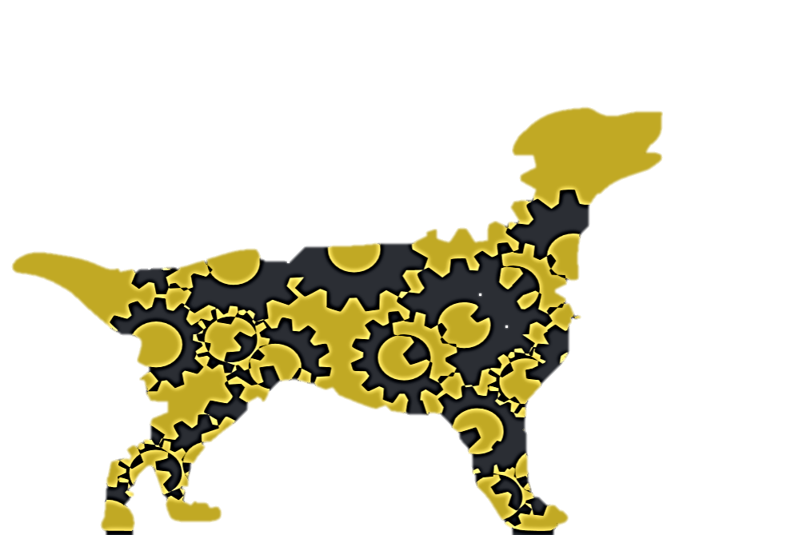
9/4/2014 GBM
Shelby Coppolino

Slide 2
Agenda
Corny Ice Breaker
RREB and general member updates
What is Retriever Robotics?
Being an RR member
Projects
Service
Fundraising
GBM dates

Slide 3

What is RR?
Retriever Robotics = RR
Public colors: yellow, black, red, and white
Internal colors and print: pink and zebra print
Logo

Slide 4
Mission Statement
Retriever Robotics (RR) has been established for the purpose of enhancing learning of robotics, encouraging competitive spirit, promoting fellowship and bonding within multidisciplinary fields, and motivating others to engage in STEM fields.

Slide 5
Achieving our mission statement
Competitions and robotics projects
Professional Development
Service
Socials

Slide 6
Becoming a member
Must attend 3 RR meetings
I’m a member… now what?
  GroupMe!
  Join our myUMBC group
Member benefits

Slide 7
Projects
VEX U
  https://www.youtube.com/watch?v=PJ-5H3JVtPs
RoboSub
Working with IEEE on copters

Slide 8
Battle O’Baltimore
Sept. 20th
9 AM – 5 PM
Stay tuned for more details and registration link!
If necessary, car pooling may be arranged

Slide 9
Fundraising
Smash Bros
  Tentatively Sept. 26
  Tentatively Nov. 21
3D printed ornaments
  Taking orders starting Nov. 21 or 24 through Dec. 5
  Distributing ornaments Dec. 6-17

Slide 10
GBM Dates
9/19
10/3
10/17
10/31 (Halloween! Boo!)
11/14
11/21

Slide 11
RREB Contact Information
President: Shelby Coppolino
  shelbyc1@umbc.edu
VP: Nate Lebedda
  lebedda2@umbc.edu
Treasurer: Max Knutsen
  mknutse1@umbc.edu
Secretary: Abbie Minor
  abminor1@umbc.edu

Slide 12
Existing RR members…
Come see Shelby after meeting!

