Slide 1


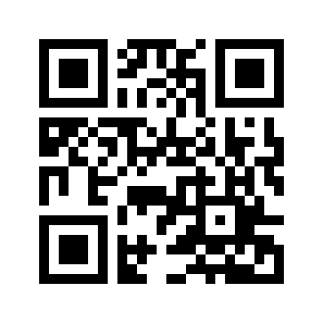
1/30/15 GBM
Shelby Coppolino
Sign In!
http://goo.gl/forms/ezXupKZu07

Slide 2
Agenda
Ice Breaker
Welcome to RR
President
  Professional Development
  Service
VP
  VEX U
  RoboSub
Treasurer
  Smash Bros Fundraisers
  Committee Sign-Up
Secretary
Sign In!
http://goo.gl/forms/ezXupKZu07

Slide 3
Ice Breaker
Name
Major
World’s Worst Superhero Ideas
Sign In!
http://goo.gl/forms/ezXupKZu07

Slide 4
Welcome to Retriever Robotics [RR]!
“Welcome, please leave any remnants of sanity outside.” – Mathew Ridge, Semester 0

Slide 5
What is RR?
Retriever Robotics (RR) has been established for the purpose of enhancing learning of robotics, encouraging competitive spirit, promoting fellowship and bonding within multidisciplinary fields, and motivating others to engage in STEM fields.
In other words… Our purpose is to create a community of people who are passionate about robotics.

Slide 6
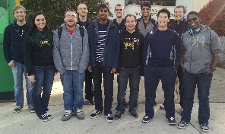
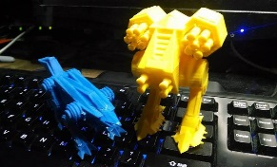
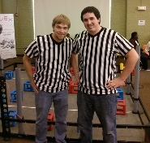

How do we do it?
Hands-on Robotics
Professional Development
Service
Socials

Slide 7
Organizational Structure
President
(Leader)
Outreach
Professional Development
Decides direction of org
VP
(Technical)
Treasurer
($)
Secretary
(Documentation)
Oversees all technical projects
Allocation of funds
Fundraising
Sponsorship
GBM and RREB meeting minutes
Membership
Historian
Socials
Note: This is a general idea of what RREB positions do, but is not an all encompassing list. RREB members also have the right delegate to appointed positions.

Slide 8
Organizational Structure w/ Committees
President
(Leader)
Outreach & Professional Development
VP
(Technical)
Treasurer
($)
Secretary
(Documentation)
Big Bot
As needed
Fundraising
As needed
Little Bot
Note: This is a general idea of what RREB positions do, but is not an all encompassing list. RREB members also have the right delegate to appointed positions.

Slide 9
Meetings
General Body Meetings (GBMs)
  1/30, 2/13, 2/27, 3/13, 3/27, 4/10, 4/24, 5/8
  4/10: Call for elections.
  4/24: Elections
Committee meetings scheduled as needed

Slide 10
President
Shelby Coppolino, Founder (shelbyc1@umbc.edu)

Slide 11
Professional Development
Max Morawski strikes again!
Talking to companies
Contact Shelby if you have any other suggestions. (shelbyc1@umbc.edu)

Slide 12

Outreach
Let’s Get Techy
  Thursday, Feb. 26th
  10-3 (tentative)
  On campus
FLL (see picture)
  Saturday, Feb. 28th
  Volunteer here
  Let Shelby know if you sign up
Look out for service poll

Slide 13
Professional Development and Outreach Committees
Contact Shelby (shelbyc1@umbc.edu) if you want to be part of either committee
Committee poll
  Fill out after GBM
  Emails with poll will be sent for those who did not attend

Slide 14
VP
Jonathan Shulgach, Semester 1 (shulgac1@umbc.edu)

Slide 15
VEX U
Big Bot
Little Bot
Competition = Feb. 6th
  See Jonathan for Absence Forms, if needed
Training dates TBD

Slide 16
RoboSub
Finishing testing this week
Fill out poll if you are interested in working on RoboSub
  Will be working with a CompE capstone group

Slide 17
Treasurer
Max Knutsen, Semester 0 (mknutse1@umbc.edu)

Slide 18
Fundraising Updates
Smash Bros Tournament
  Feb. 20th
  Details TBD
Join fundraising committee!

Slide 19
Secretary
Abbie Minor, Semester 0 (abminor1@umbc.edu)

Slide 20
Secretary
2 socials
  On Campus
    Options: board game/video game/pizza night
  Off Campus
    Options: Food, movie, laser tag, bowling
Email for suggestions/favorite options!

Slide 21
Eboard Contact Information
President: Shelby Coppolino, Founder
  shelbyc1@umbc.edu
VP: Jonathan Shulgach, Semester 1
  shulgac1@umbc.edu
Treasurer: Max Knutsen, Semester 0
  mknutse1@umbc.edu
Secretary: Abbie Minor, Semester 0
  abminor1@umbc.edu

