Slide 1



Slide 2

APPLIED BEHAVIOR ANALYSIS

Slide 3
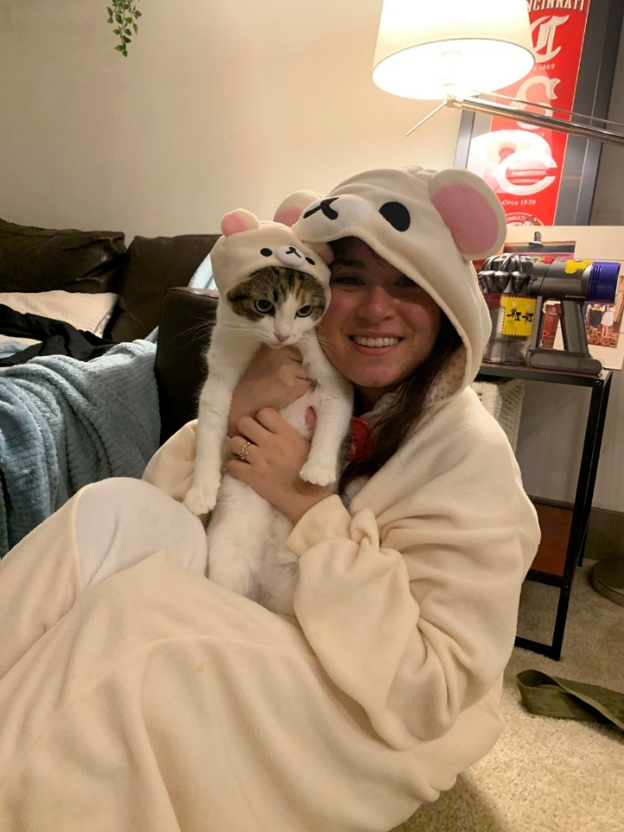
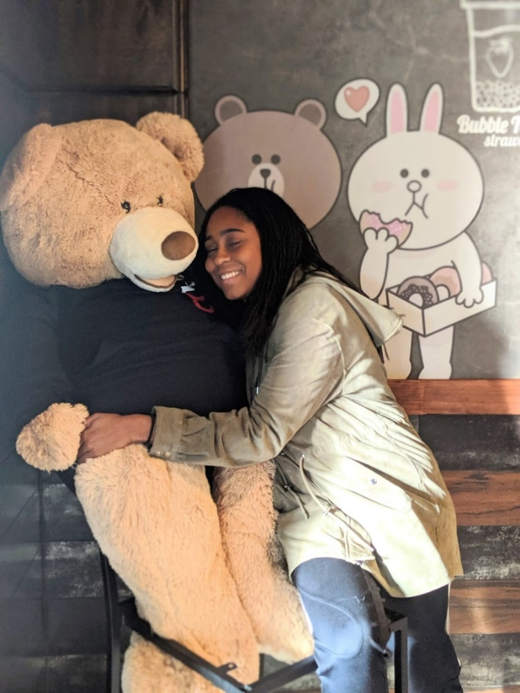
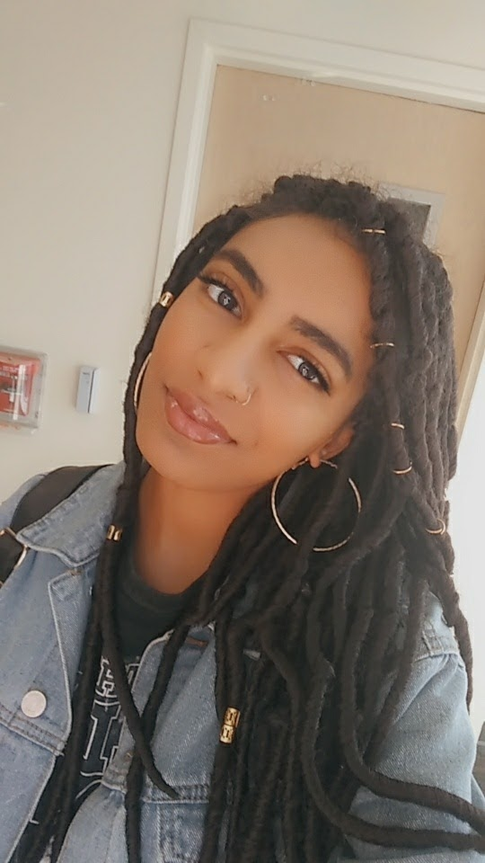
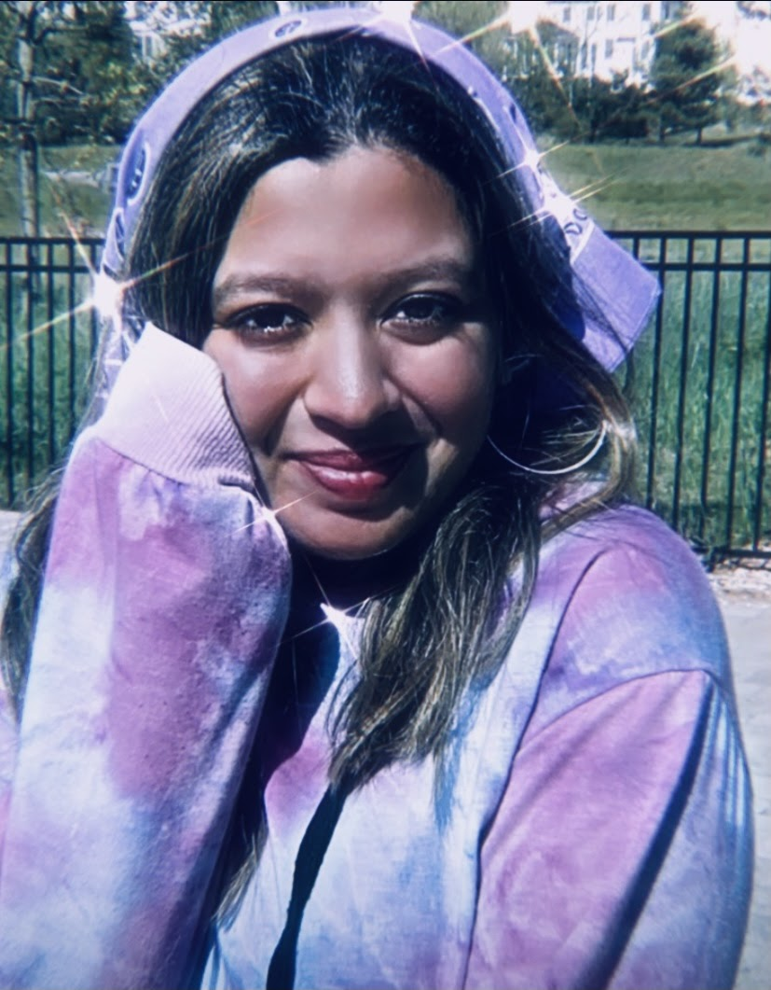

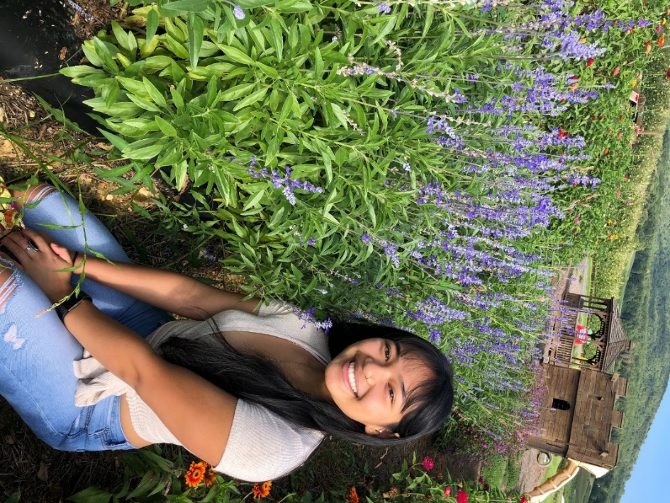
SABAS 2020-2021 Officers
Meghan Sonja Ceribo Ann Jeanette Santos Courtney Arrington Shannon Bissondial Zohaa Awan Claire McCaulley
President Vice-President Secretary Treasurer Event Coordinator Public Relations

Slide 4
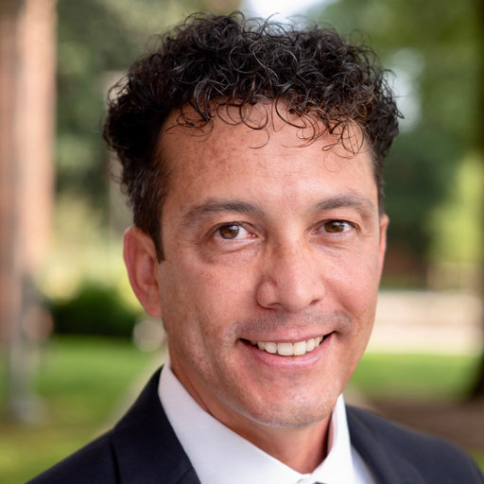
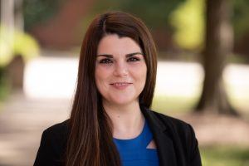
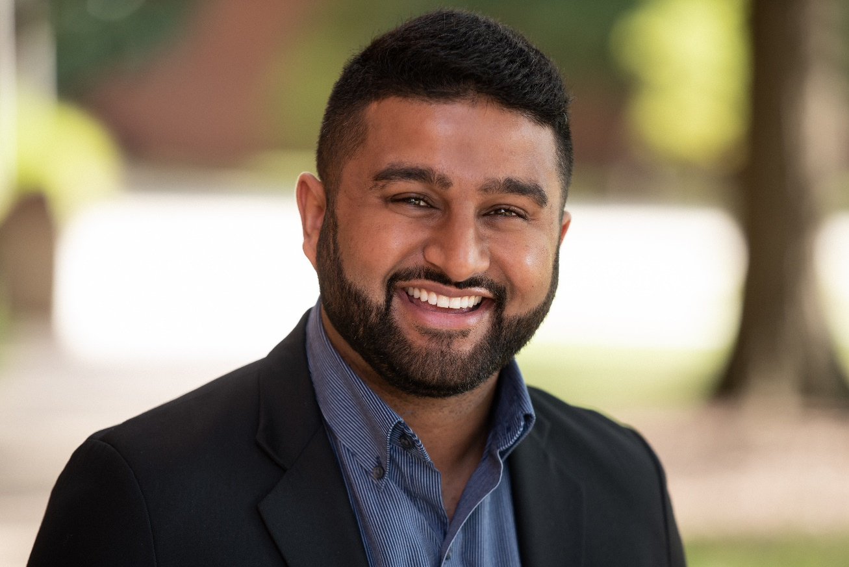
ABA FACULTY
Dr. John Borrero Dr. Mirela Cengher Dr. Adithyan Rajaraman
Associate Professor Assistant Professor Assistant Professor

Slide 5
UPCOMING SABAS EVENTS
Our LAST event of the semester!
The SABAS team would like to host something fun and interactive with our newfound community, so please keep an eye out for an announcement nearing the end of the semester!

Slide 6
Grad School & Resume and Curriculum Vitae Workshop
Application requirements
Type of program
What do YOU want from a program?
Notes:
So tonight I’m briefly going to touch on application requirements – keep in mind that each school has some differences, however overall there will be some similar requirements
We will talk about the different types of programs available to you
And finally what you personally want to get out of a program and your experience there

Slide 7
Application Requirements
Minimum GPA
Baccalaureate degree
GRE scores (not required for most programs this year)
Letters of recommendation
Specific coursework
Transcripts
Resume or Curriculum Vitae (CV)
Personal statement
Notes:
So we are going to go over the most common application requirements, that you will typically see across all programs:
All programs have a minimum GPA requirement – keep in mind, this is just the minimum to be eligible to apply, it does not necessarily mean that the applicants are at this minimum…usually those who are admitted will be above the minimum requirements
All master’s programs are going to require that you have a BA degree – however, the specific major may vary…some programs may require that you have a BA in psychology or special education…and others have no restrictions
The GRE…so this is a source of stress for many of you I know, but it is just something you have to get through and get done – so again, each program has different requirements for this…some programs require a specific score, some a percentile that your scores fall in, and some do a z-score of GRE and GPA ()…so you can make up for a deficit in one if the other is strong
Letters of recommendation – typically need 3, you will want at least 2 of these to be academic letters, preferable from professors you have taken classes from or worked with in lab
Specific coursework – all programs have specific coursework and this varies from program to program…make sure to CHECK THIS well in advance!! The worst thing that can happen is that you go to apply and you have 1 class not taken that prevents you from applying to that program
Transcripts – do this in advance!!! DO NOT wait until the last minute to order your transcripts…most programs you will need to submit 2 sets (one to the university and one to the specific program you are applying to)…and it can take up to 6 weeks for them to make it to the program
Submitting and CV vs a resume – again this will be according to the preference of the program
Personal statement – start working on this early! This is your opportunity to state not only why you are a good fit for the program, but also why the program is a good fit for you…you want to address both of these aspects…keep in mind that the personal statement is still a professional documents – you want it to be personal…but not too personal – have A LOT of people go over it!

Slide 8
Type of Program
Research vs practitioner focused
Is a thesis required?
Length of program
Advisor to student ratio or size of cohort
Notes:
Different programs are going to focus on different things – when looking at programs you are applying to, keep in mind what it is you want out of your graduate school experience, make sure the program fits what you want!
Research versus practitioner focuses – do you want a research heavy experience? (if you are planning on going to a PhD program or becoming a professor)…do you want a practitioner focused experience? This is going to assist you in your career and clinical future
Is a thesis required? – some programs do not require this…a more practitioner focused program will typically not require…some schools have a thesis option (you will apply to a lab once you get there – if accepted into the lab you will do a thesis, if not a thesis won’t be required)
Length of the program – this will largely depend on whether or not a thesis is required, a typical length will be between 2-3 years (approximately 2 years of classes, 1 year of thesis)
Advisor to student ratio – some cohorts are very small, others are larger…sometimes you apply directly to a lab, like Sac State, and others you are accepted into the cohort but apply to labs after your first year…some programs you will be largely supervised by PhD students rather than having frequent direct contact with the professor

Slide 9
What YOU Should Look for….
Advisor to student ratio
Professional growth opportunities
BCBA supervision
Research interests of faculty
Specific coursework offered
Notes:
What YOU want to look for in a program – to ensure you come out of this experience with all the tools necessary for you to succeed after graduate school
Again that advisor to student ratio is very important to consider – keep in mind, a school that take 30 students a year is going to give you a much different experience with professor contact than a school that takes 6
Professional growth opportunities – will you have a chance to present, what will your internship opportunity look like (will you have to find your own internship site, or does the university set this up for you?)
BCBA supervision provided – in order to sit for the BCBA exam you have to have1500 supervised hours, this should be provided to you while you are in the program (some schools provide this, some require that you pay for your supervision – this will come out of your paycheck wherever you work)…BCaBA hours do not roll over to cover BCBA hours
Research interests of faculty – you are going to be doing their research for 2-3 years…if you hate it, your life will be much harder than it needs to be…make sure you are AWARE of the research being done in the lab you are applying to and that you want to conduct that research – because you will be…don’t assume that the advisor will let you do something they are not currently studying
Look at the coursework offered – some programs will be 100% ABA courses, but other programs are not (may be a mix of psyc/ABA classes, or special education classes, etc.)

Slide 10
UMBC ABA Program
Consistently one of the highest passing rates on the BACB exam!
Program Focus:
  Prepares students to practice as M.A. level BCBAs
  Prepares students to enter Ph.D. programs in applied behavior analysis and experimental analysis of behavior
Research Mentors:
  Dr. Carrie Borrero BCBA-D
  Dr. John Borrero BCBA-D
  Dr. Mirela Cengher BCBA-D
  Dr. Dithu Rajaraman (Dr. Raj) BCBA-D
  Dr. Griffin Rooker, BCBA-D
Notes:
Our program is a research-practitioner model (you are going to get a rounded experience involving both aspects)
Research labs:
Dr. C. Borrero – assessment and treatment of pediatric feeding disorders
Dr. J. Borrero--Basic behavioral processes responsible for common behavioral interventions. The programming of effective learning environments in early childhood education.
Dr. Cengher- language acquisition and concept formation
Dr. Raj- assessment and treatment of dangerous problem behavior with an emphasis on investigating trauma informed approaches
Dr. Rooker- assessment and treatment of problem behavior; SIB, precursors to problem behavior, durability of treatment effects

Slide 11
UMBC Psychology Department Admission Requirements
Minimum cumulative undergraduate GPA of 3
GRE (not required this year)
Undergraduate degree in Psychology and ABA preferred (PSYC 210, PSYC 365, PSYC 397, PSYC 393, PSYC 411)
UMBC undergraduate students who apply to grad school at UMBC receive a $1,000 check
Notes:
Sac State requires a minimum GPA of 2.5 – again, keep in mind this is a minimum requirement, but typically strong candidates will have a higher GPA than this
GRE – the general GRE is required, along with the writing portion
An undergrad degree in psychology is preferred – however, we have had students admitted from other programs (such as child development) but they had taken ABA courses
2 upper division statistics/research methods are required – PSYC121, and PSYC102…however, PSYC102 is technically not required to get into the grad program – it will not prevent you from getting accepted into the program, but you will still have to take it as a graduate student – I HIGHLY recommend doing this as an undergraduate…talk to any grad students who took 102 with their other grad classes and no one will recommend this
The application program is a 2 step process!! - you are applying to both the Psychology Program, and the University Graduate studies (2 applications, 2 sets of transcripts)…this will be the same for all CSU schools, UOP is also this way)

Slide 12
ABA Requirements
  A personal statement
  A list of faculty with whom you would like to work and why
  A resume or CV
  Three letters of recommendation (2 from former professors recommended)
Notes:
ABA specific requirements include
A personal statement – this should be maximum of 2 pages double spaced – this is an exercise in clear concise writing! Start working on this early, make sure you address any deficits you may have and put a positive spin on them! And highlight your strengths, talk about why YOU are a good fit for the program and why the program is a good fit for YOU!
A list of the faculty you want to work with and why – we are different in that you will be applying to work with a specific advisor and you will be working in that lab and conducting their research…so make sure your interests align with theirs!
A resume or CV – be sure to include any relevant classes (ABA courses) and research experience, and any other experiences that will help you stand out!
3 letters of recommendation – 2 are required to be from former professors

Slide 13
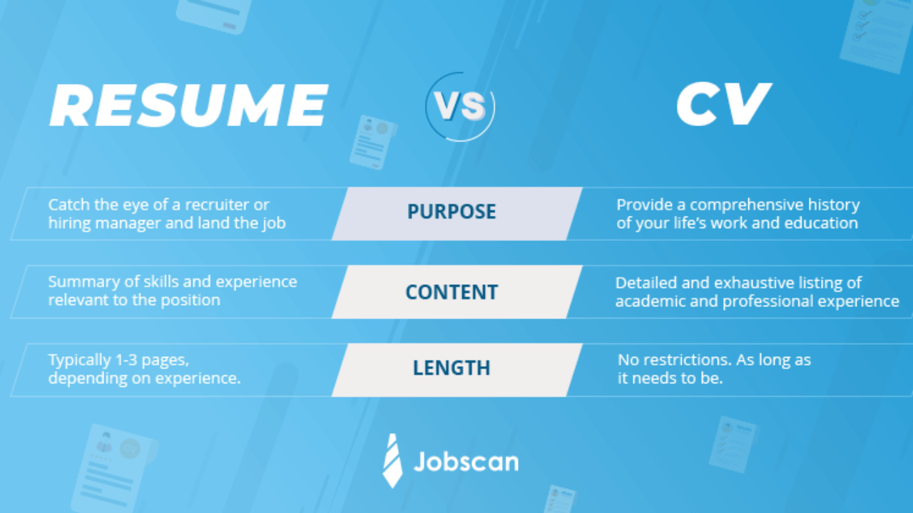
Resume versus CV

Slide 14
Resume versus CV
  Check the application requirements for each program to see if they prefer one versus the other
  It is better to prepare and submit a CV rather than a resume when applying to graduate school

Slide 15
Personal Statement
  A way for the admissions committee to get to know you!
  Should include:
    An introductory paragraph
    An overview of academic and clinical experiences that make you competitive
    Address potential shortcomings
    Career goals and how they relate to this specific Master’s program
  Write it ahead of time and ask mentors for feedback!
  No longer than 1-2 pages, unless otherwise specified
  Make sure it is aligned with the application requirements

Slide 16
ABA Programs
University of the Pacific
University of Nevada, Reno
Columbia University
Queens College, CUNY
Hunter College, CUNY
Caldwell University
University of South Florida
Western Michigan University
West Virginia University
University of Kansas
University of North Texas
Florida Institute of Technology
Western New England University
University of Florida

Slide 17


