Slide 1

Applicant Tracking System

Slide 2


Slide 3


Slide 4
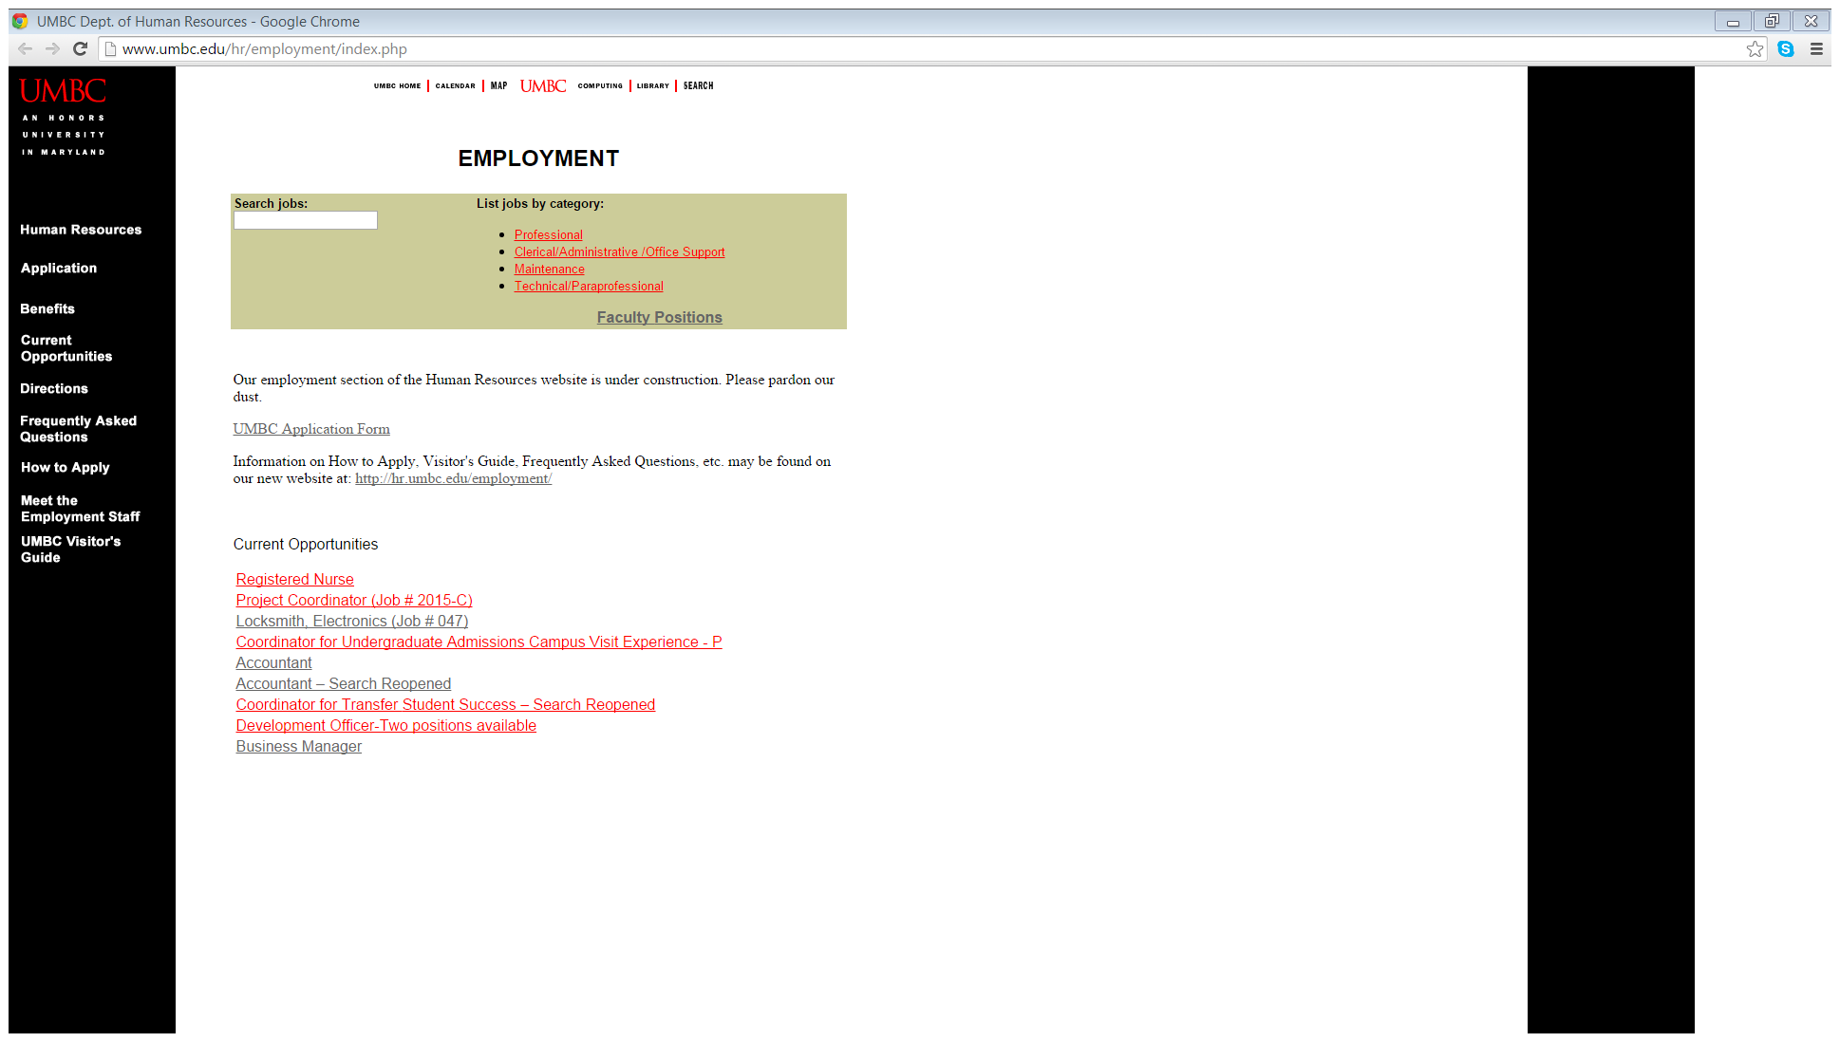
Current HR Job Postings

Slide 5
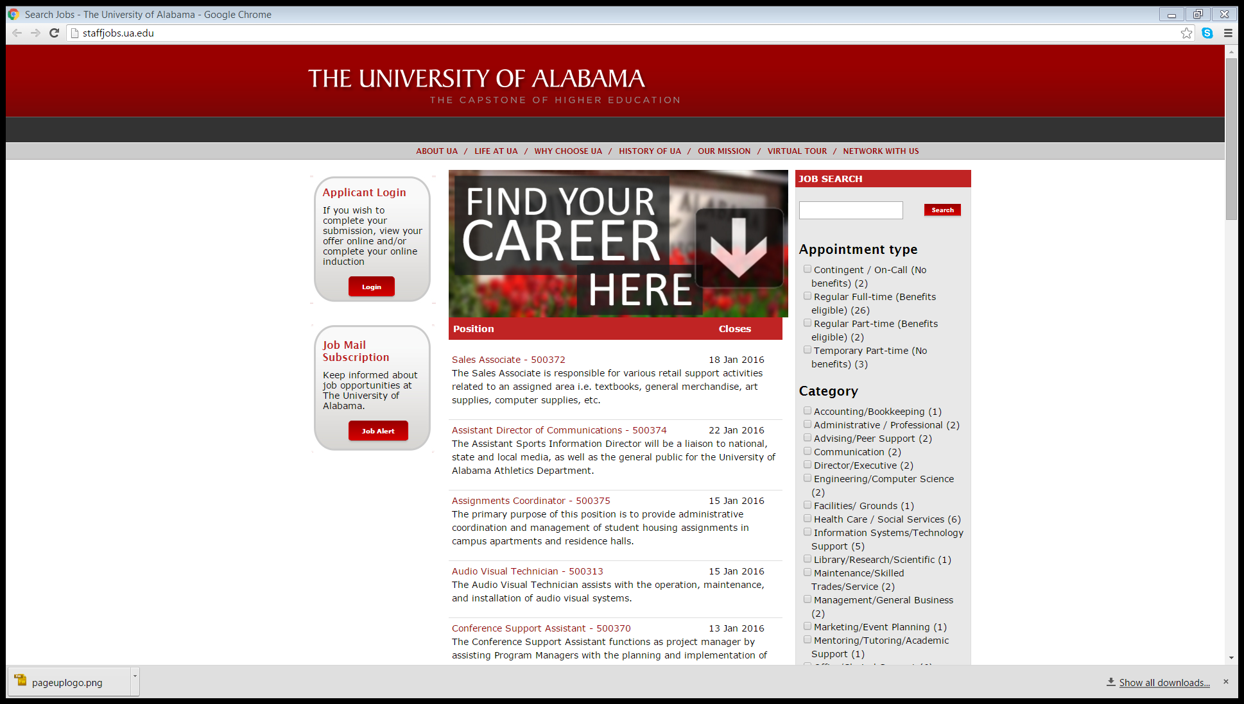
Sample Job Posting Web Page
University of Alabama

Slide 6
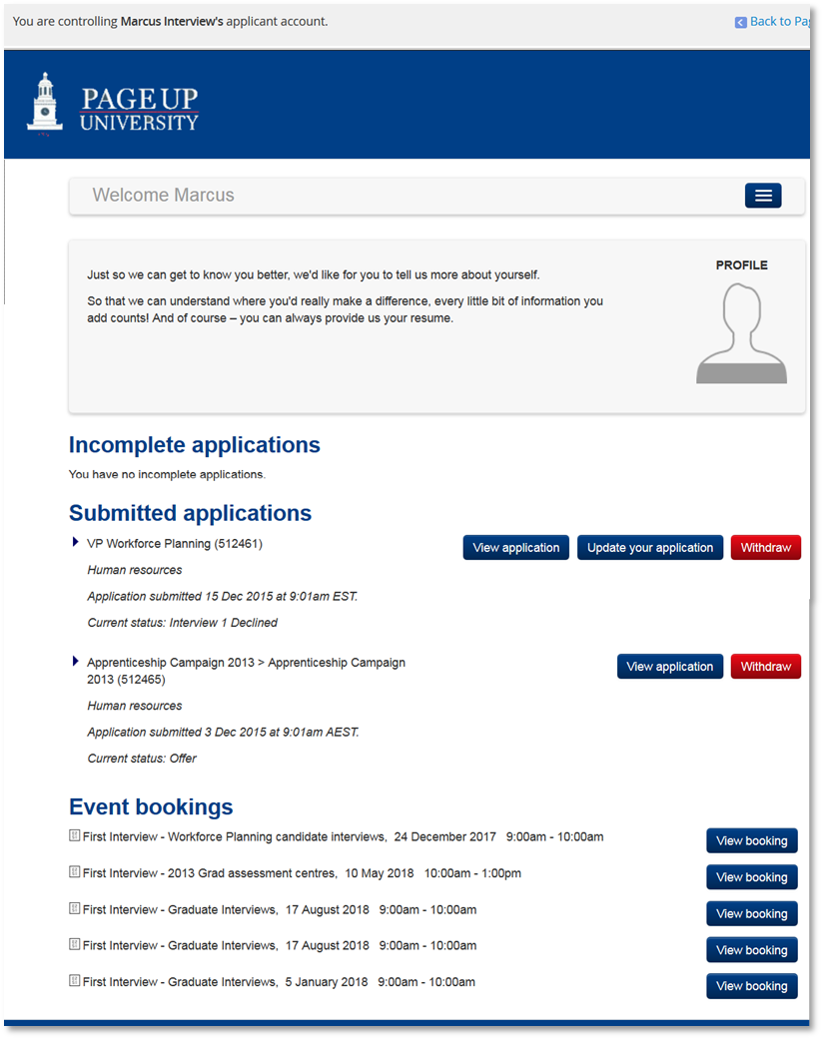
Applicant Portal
View Status

Slide 7
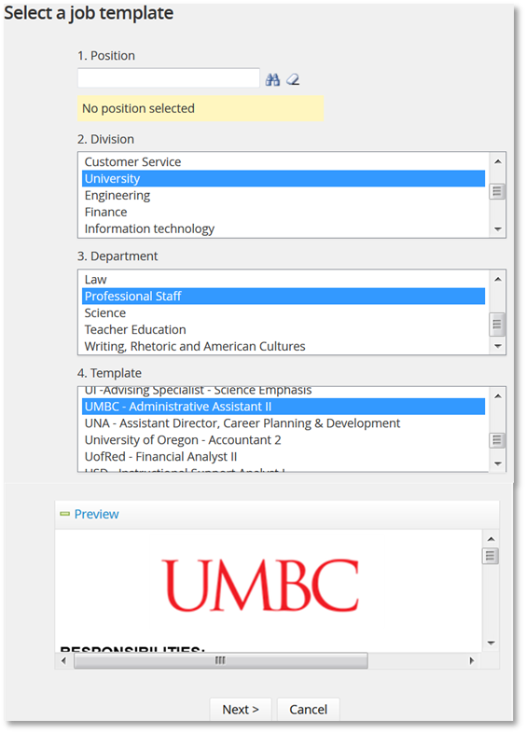
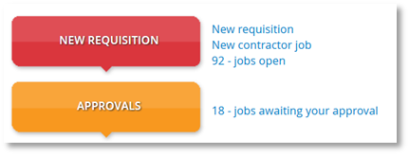
Creation of the Requisition

Slide 8
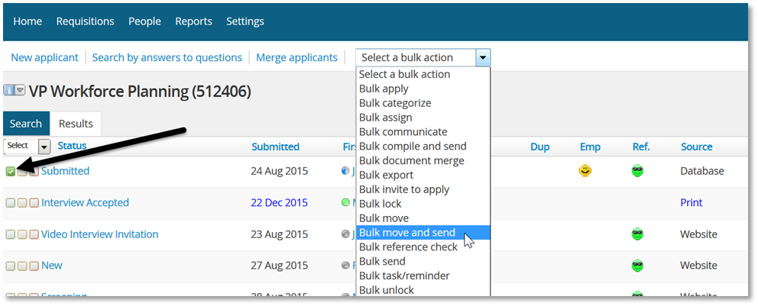
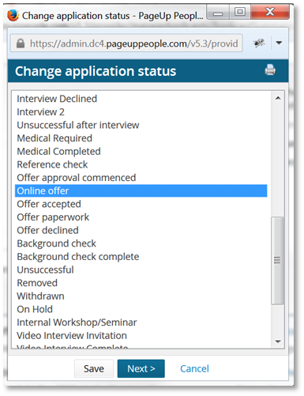
Bulk Actions

Slide 9
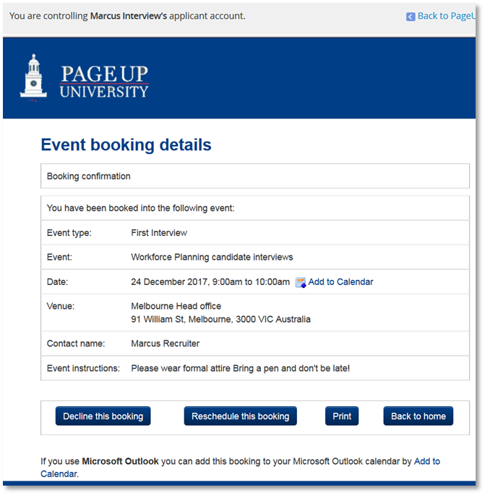
Interview Scheduling

Slide 10
Hiring manager selects status

Slide 11
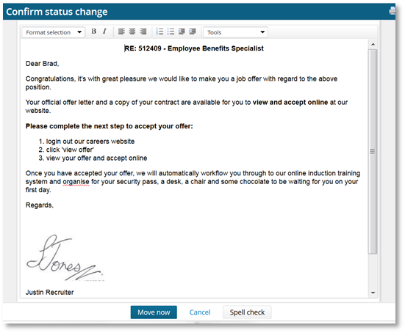
Email notifying the candidate that the offer is on career site

Slide 12
Mass Contract Update Process
Streamlining the Change PAR was a top priority by the Shared Service Centers initiative
Contract renewals are high volume but simple PS transaction
Pilot available for current Payroll Service Centers
They have already had a preview of the new process & training will occur in May
Process is for the following employee classifications:
  Graduate Assistants
  Faculty Contractual
  Contingent I
  Contingent II

Slide 13
Overview of Current Process
Preparer receives updated contract
Preparer completes a Change PAR for each contract which involves individual:
  Data Entry
  Department Approval
  Human Resources Approval (Contingent I & II)
Review by Payroll or HRIS staff
Entry by Human Resources
New Job Row Takes Effect

Slide 14
CURRENT PROCESS:
Individual Transactions
New Contract
Preparer creates change PAR and signs
Change PAR gets entered into PeopleSoft
Approver: Review information and approves
Change PAR gets delivered to HR
Change PARs get sorted and reviewed by HR
New Contract
Preparer creates change PAR and signs
Change PAR gets entered into PeopleSoft
Approver: Review information and approves
Change PAR gets delivered to HR
Change PARs get sorted and reviewed by HR
New Contract
Preparer creates change PAR and signs
Change PAR gets entered into PeopleSoft
Approver: Review information and approves
Change PAR gets delivered to HR
Change PARs get sorted and reviewed by HR

Slide 15
NEW PROCESS: Mass Transactions
Preparer: Selects employees for renewal
Approver: Reviews information and approves
HR Approval:
Reviews and approves renewals (ONLY CI & CII)
Batch Job runs to load into PeopleSoft (replaces manual data entry)
Updated contract appears in the employee job record
New Contract
New Contract
New Contract
New Contract
New Contract
New Contract
New Contract
New Contract
New Contract
New Contract
Notes:
Comments throughout the screens
Almost instant approval and submission to HR
Job loads prior to pay cycle to ensure other transactions can occur

Slide 16
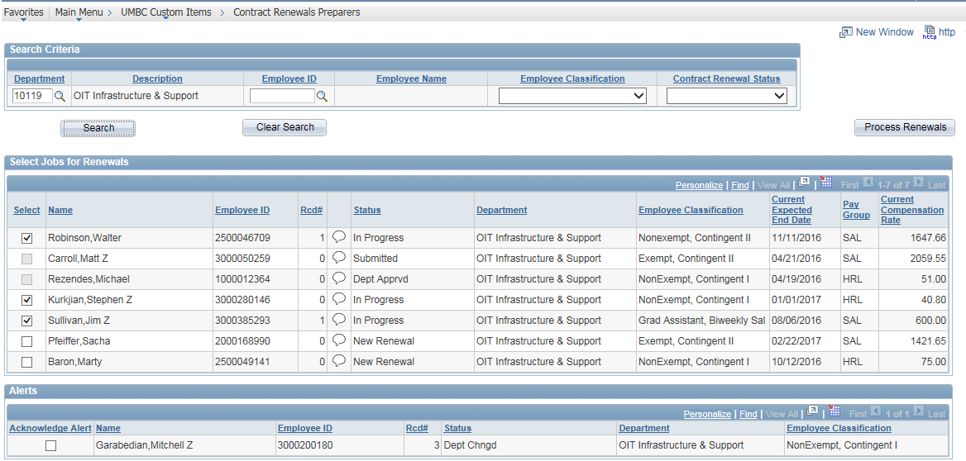
NEW PROCESS: Selection Screen

Slide 17
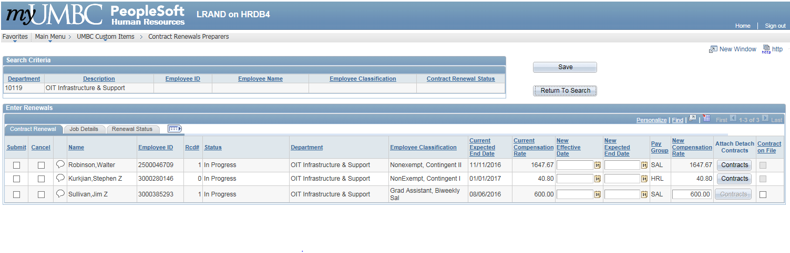
NEW PROCESS: Selection Screen

