Slide 1
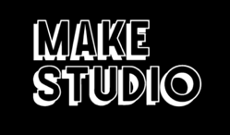
Radically Connected in Baltimore
Make Studio & Progressive Arts Practices
Jill Scheibler, PhD, LCPAT, ATR-BC

Slide 2
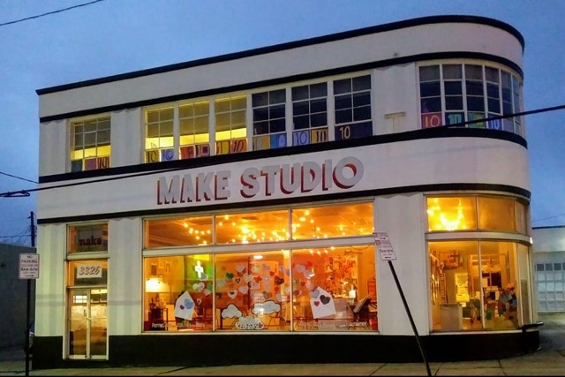
NPO founded in 2010, currently located in Hampden
Professional studio program + Outreach/inclusive community activities + gallery
Artists who self-identify as PWD or as disabled (e.g., autism, Down syndrome, TBI, CP, psychiatric)*
37 studio artists + youth programs
Artists work in the studio weekly and earn 70% of all sales
Not art therapy, but…
Make Studio empowers artists with disabilities to grow as professionals with visibility and voice in their communities. We create opportunities for everyone to connect through art.

Slide 3
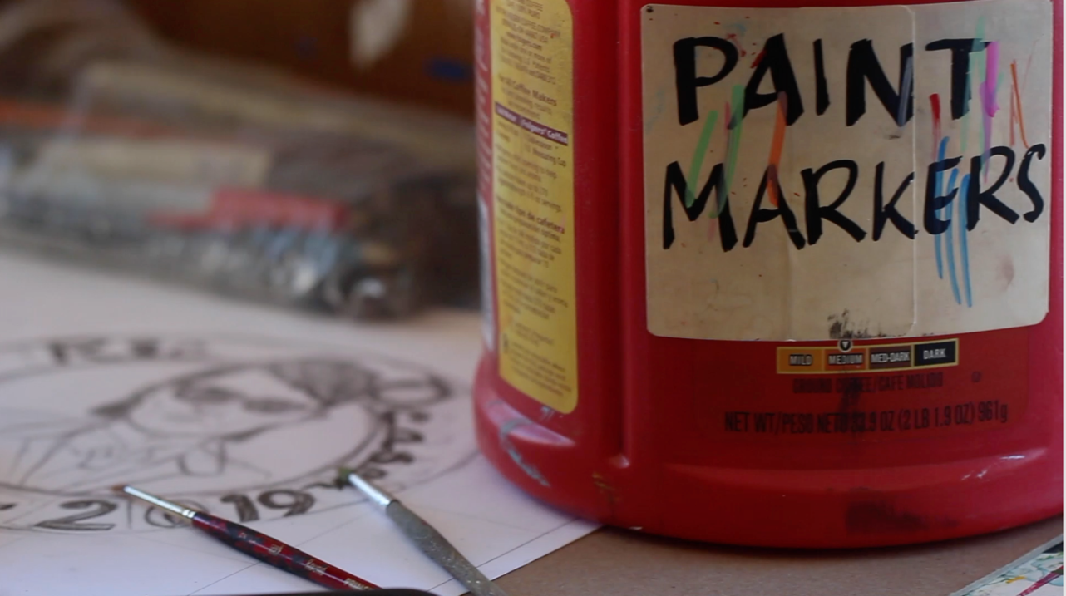
FULL VIDEO AVAILABLE HERE: https://youtu.be/fVOAeT2_UAk

Slide 4
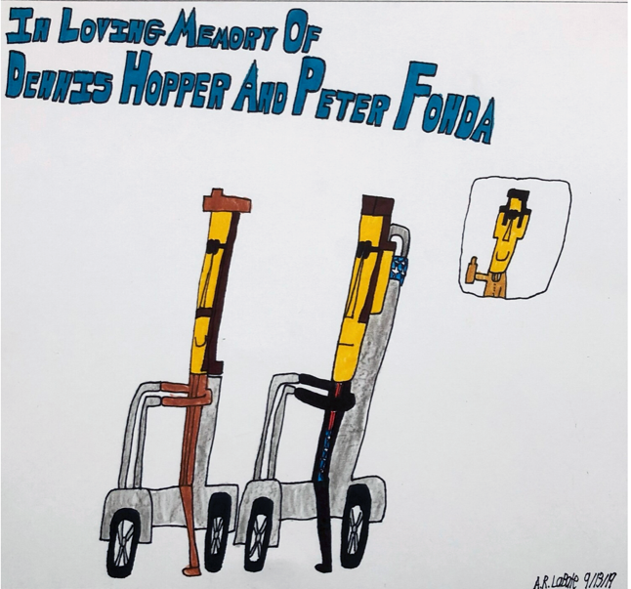
“I started to become intrigued by the question of why was there so much wonderful work coming out of these three art centers and was there something they had in common, some kind of methodology that was bringing forth such wonderful art…
that these centers be connected to the art world, that there be a gallery connected to the studio, that there be not teachers but facilitators…and that there would be a sales element.
It’s interesting that the first of these centers was created at exactly the same moment of Roger Cardinal’s famous Outsider Art definition of outsider artists being cut off from the world and these centers were radically connected to the world...”
Lawrence Rinder,
Director of the Berkeley Art Museum and Pacific Film Archive

Slide 5
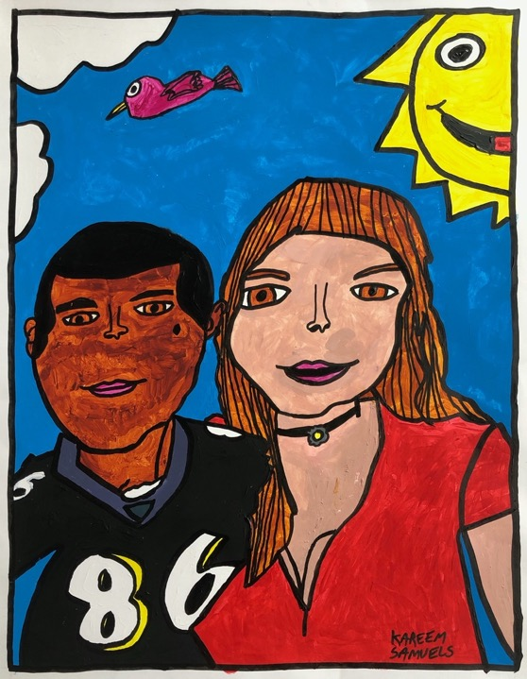
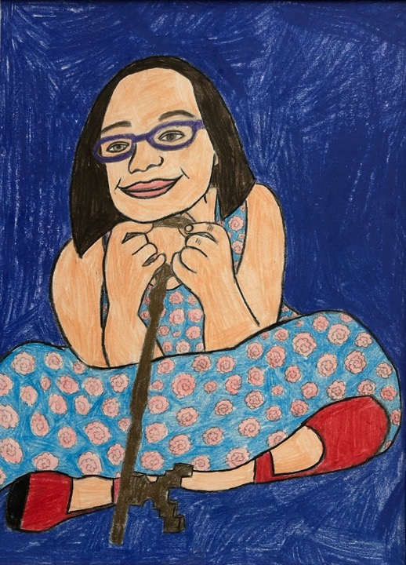

Slide 6
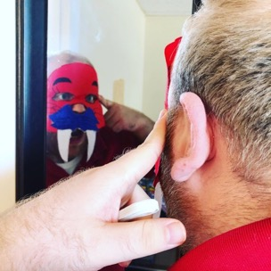
Why Radical?
Affecting fundamental nature of something
Both studio and artists are radically connected
Connection and the disabilities community
  Society is not set up for differences; uniquely at the mercy of our systems and keenly aware of that
  Intersection of disability and artist (and other) identities → Sensorily engaging with the world and attuned to culture
  Empathy → Perhaps more empathic (certainly not less) and eager to relate and share perspectives
  Disability is not in itself marginalizing; spectrum/lifespan
  Interdependence
Modeling what can be when a prevailing system turned on its head; changes the narrative
Everyone needs “to have another individual simultaneously experience a state of mind similar to our own.”
Daniel Siegel

Slide 7
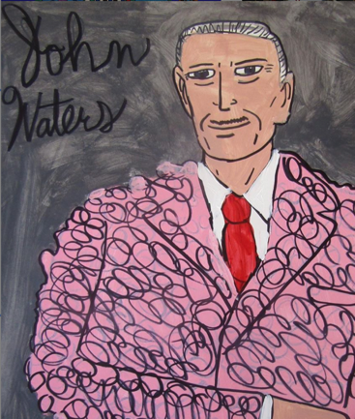
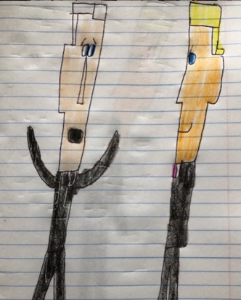
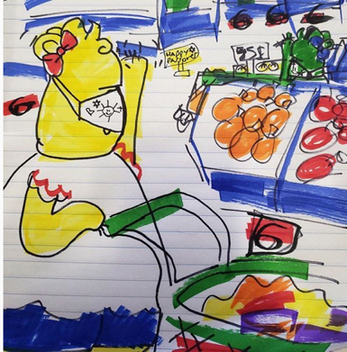

Slide 8
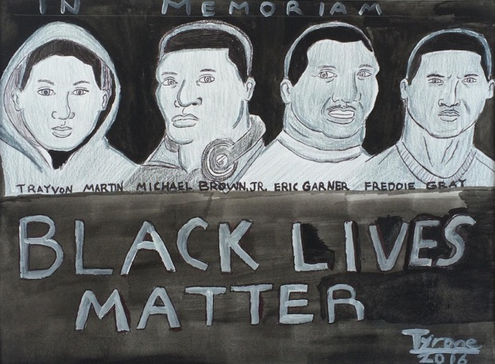
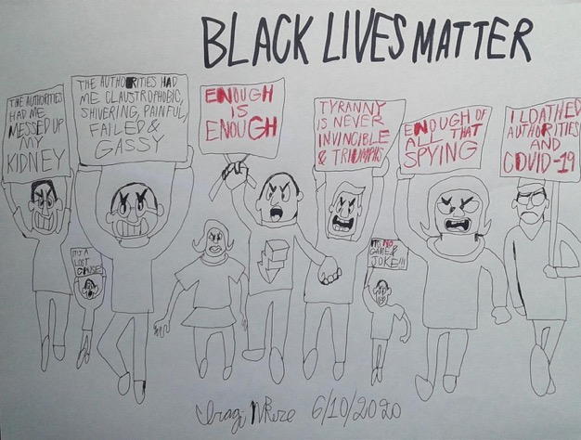

Slide 9
Progressive Studios
Outsider/Naïve/Visionary/Art Brut
  Celebrates idiosyncracy, talents of “outsiders”
  Ahistorical, decontextualized, presumes isolation, conditional (who’s in vs. who’s out)
Post-institutionalization and Disability Rights world
”Art centers for persons with developmental disabilities”
  Katz and Ludins-Katz, late 70s-80s, Bay Area
Several dozen in the U.S. and internationally; varied approaches
“A fine art studio environment where adults with disabilities can pursue and maintain lives or careers as artists.” (Ortiz)

Slide 10
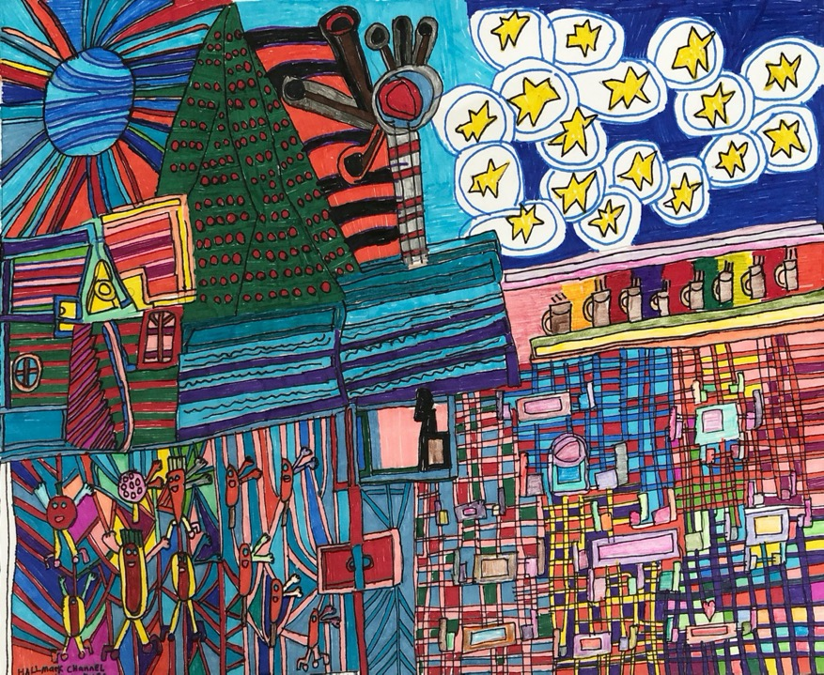

Slide 11
Why Progressive?
Variation on “day habilitation” or “supported employment” program models, which often mimic or provide a workplace environment and provides training in occupational and daily living skills. Focus on simple, short-term work that often has nothing to do with participants’ interests.
Rather than completing training tasks devised by others, participants are facilitated by fellow artists to tap a studio environment for productive creative work of their own choosing. Studio structures enable artists to create complex, higher value works of fine and decorative art.
Art as a form of work is more than a sellable product --> Process, communication, connection
“Rather than attempting to simplify tasks that are counter-intuitive to an individual, the progressive art studio strives to empower one to become productive using the working practices that are intuitive to them already - an acceptance model, rather than an assimilation model. . .[the artists] take ownership of artwork of their own devising through incredible diligence, commitment, and true brilliance.” Tim Ortiz & Andrea Donohue, Disparate Minds

Slide 12
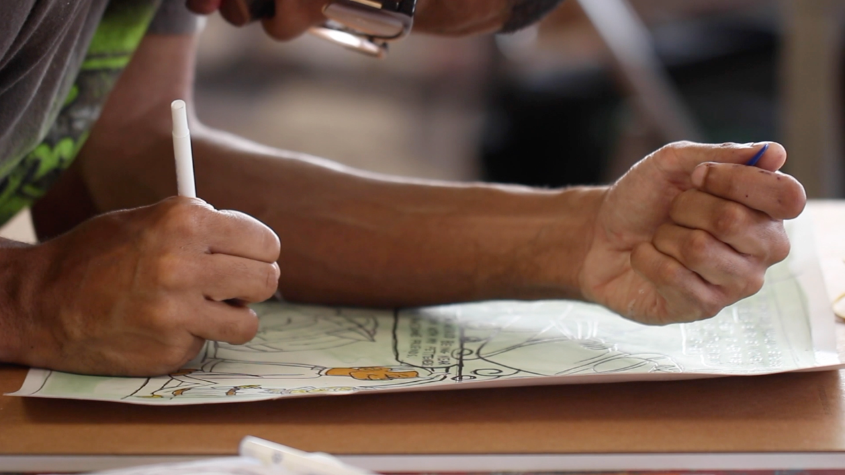
FULL VIDEO AVAILABLE HERE: https://youtu.be/fVOAeT2_UAk

Slide 13
Progressive Practices
“Radically connected to the world in contrast with traditional services for people with developmental disabilities.” (Ortiz)
Thinking differently about integration and inclusion
  Over the past few decades, integrated services have long been the goal and has worked in schools; in everyday adult life, integration and inclusion are more complex. How to integrate without further marginalizing?
  Support from a progressive environment that prioritizes the neurodivergent/disabilities perspective OVER the neurotypical/abled one can propel artists into competitive, visible, influential positions in other less accepting environments.
  Acknowledge and engage with the tensions. (Norms and standards of agencies, workplaces, fine arts institutions, etc.)
Personal investment in practices of art-making at every program level, supporting all relationships in the studio being artist-peer ones
Dedicated time to making
Ownership of the space
Gallery and sales element (valorization)

Slide 14
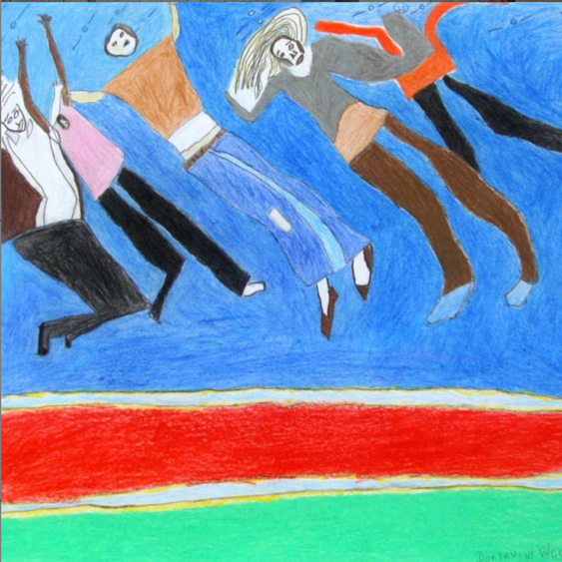
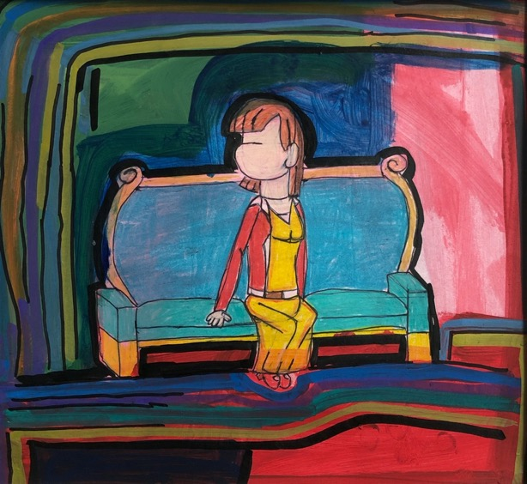

Slide 15
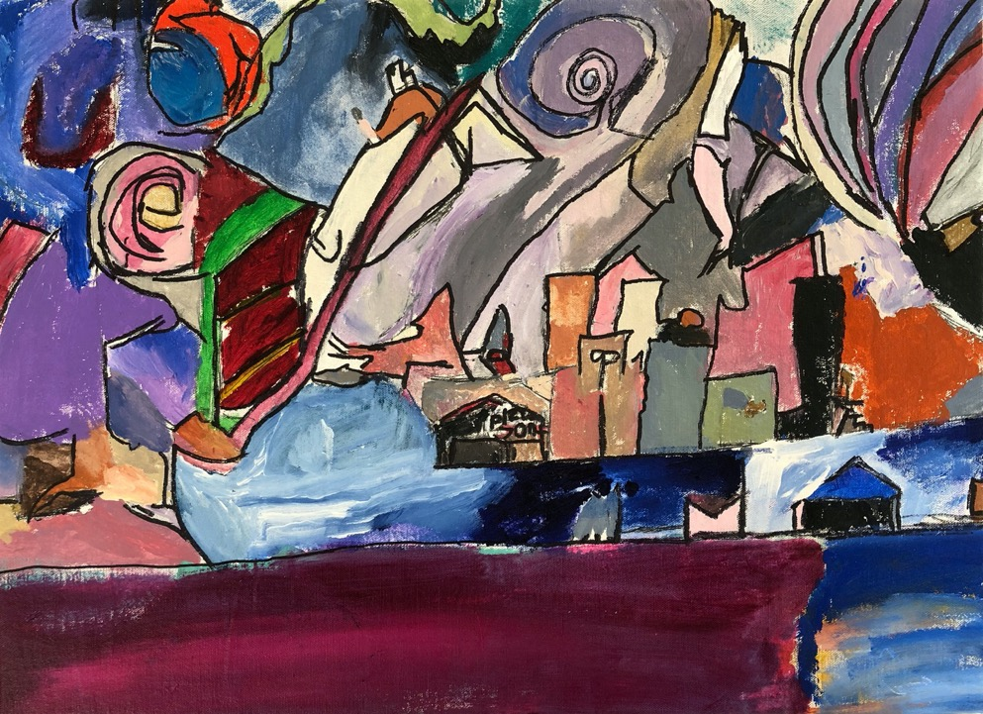

Slide 16
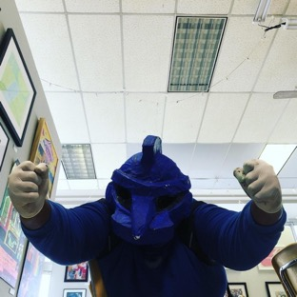
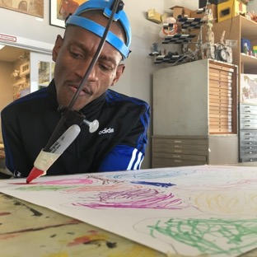
Acceptance & Inclusion
Proactive creation of “least restrictive” environs; moving beyond assimilation and accessibility/accommodation
Assimilation methods depends on working to produce a prescribed result (e.g., contrived means to alter a way of being; “best practices” for being ”professional” or “appropriate”). Acceptance methods begin with perceived potential and an open-ended concept of success, which is particularly suited to the creative types!
Accessibility (often focused on the physical) is a starting point and not the end goal of inclusion.
Inclusion where setting is co-constructed by the artists invites in and models acceptance to all (including “typicals”), reverses norms of neurodivergent folks assimilating to be include in a neurotypical dominant space.
Frequent 1:1s and group meetings; agree to disagree; save your faves

Slide 17
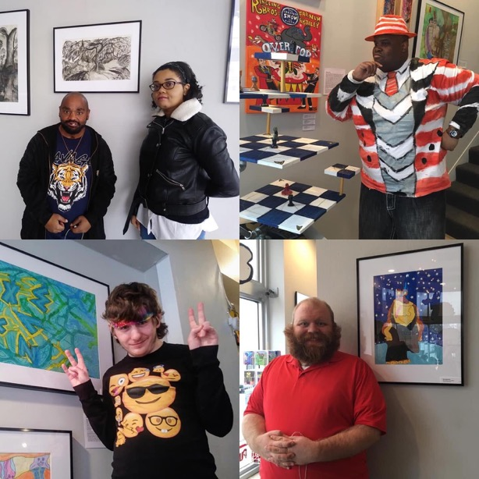
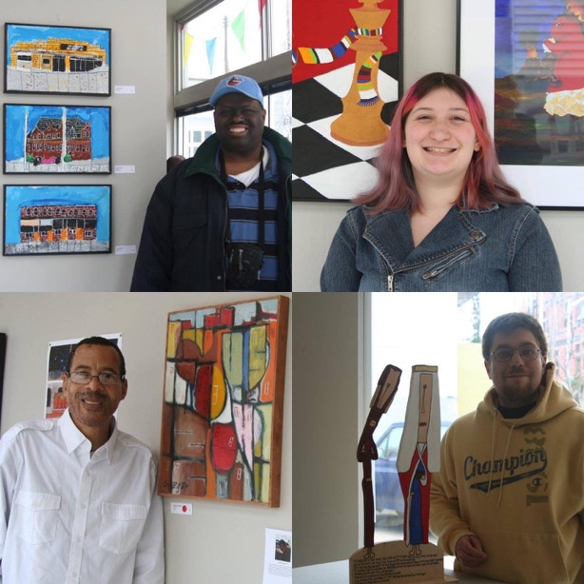

Slide 18
Art Hives & Make Studio’s Values
What is an art hive? (Chainey & Timm-Bottos)
Small and regenerative community arts studios
  Welcomes everyone as an artist and believes art-making is a human behavior.
  Celebrates the strengths and creative capacities of individuals and communities.
  Fosters self-directed experiences of creativity, learning, and skill sharing.
  Encourages emerging grass roots leaders of all ages.
A form of arts-based social inclusion (Barraket; Hutzel)
Mutual learning and professional development opportunities; narratives; “stretch goals”
10 values: inclusivity, self-expression, self-discovery, fun, opportunity, social justice, mutual respect, fidelity, visibility

Slide 19
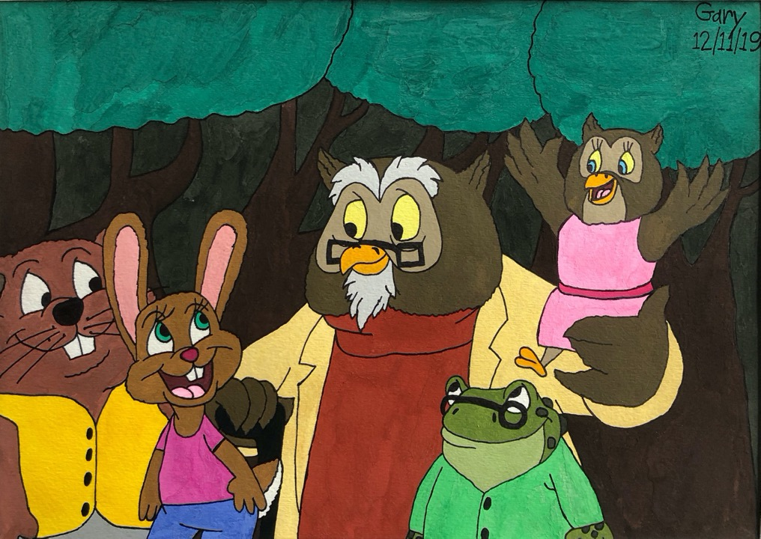

Slide 20
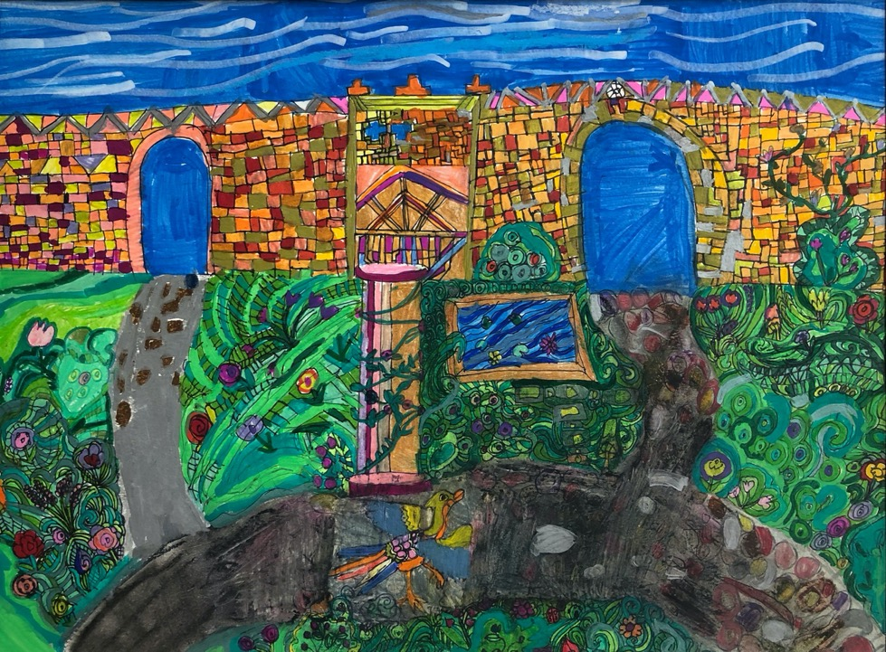

Slide 21
How Does Make Studio Work?
(Theory → PSOC, empowerment, social roles in community arts)
Teaching and presentation opportunities
Exhibitions, competitions, sales, and publicity
Collaborations and consultations with other artists and groups
Planned and organic social experiences that aim to level the playing field
Weaving in traditional services mandates and art world norms as relevant and appropriate
Staff take a back seat and serve as co-conspirators (with, not to or for)

Slide 22
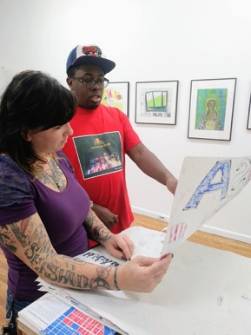
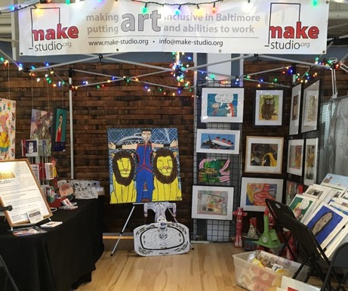
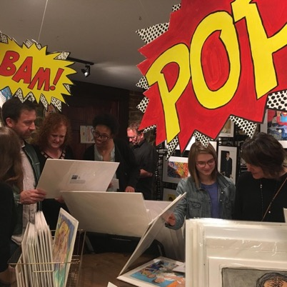
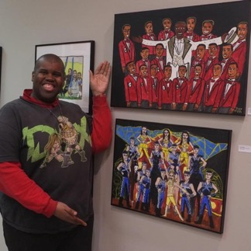
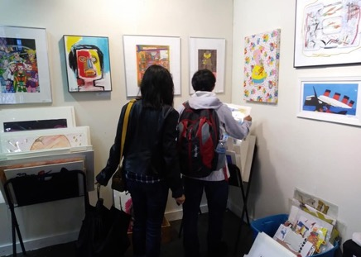
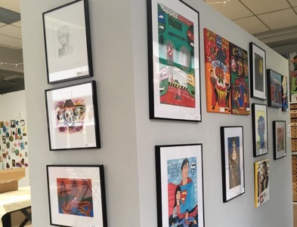

Slide 23
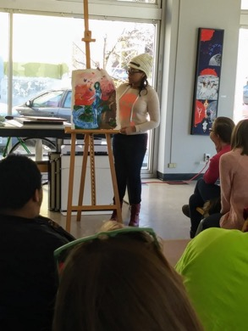
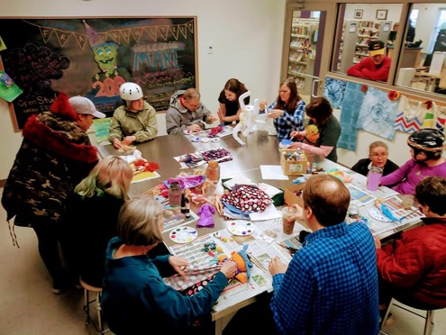
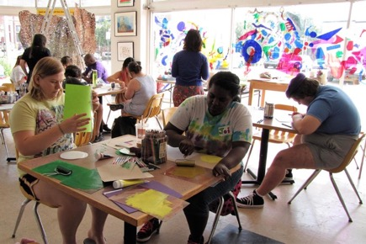
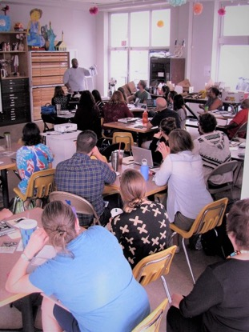
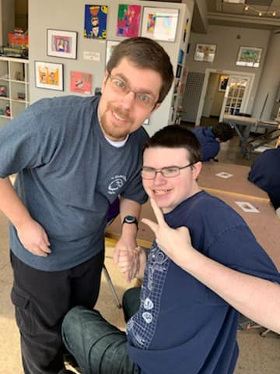
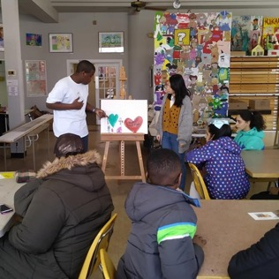
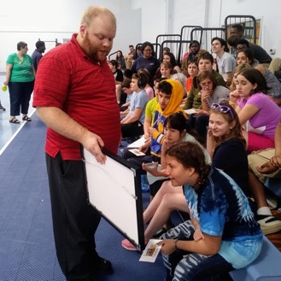

Slide 24
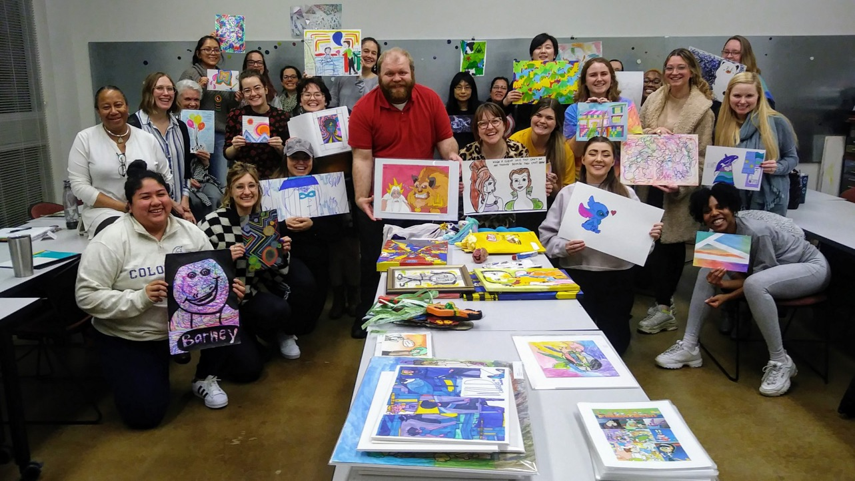

Slide 25
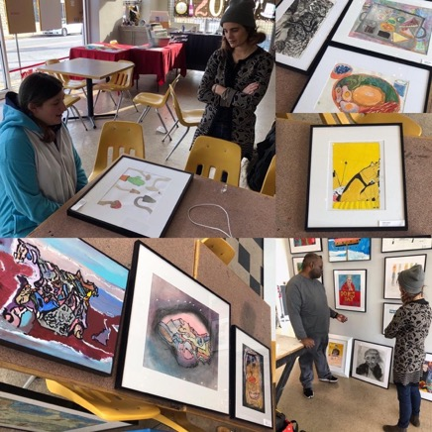
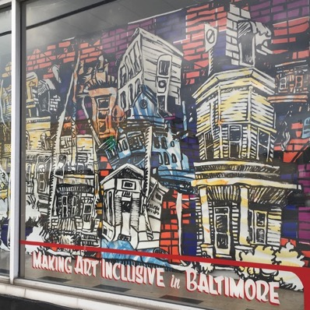
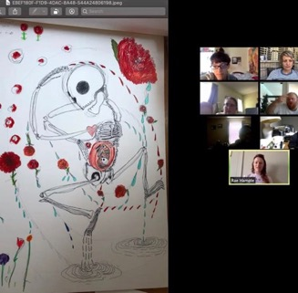
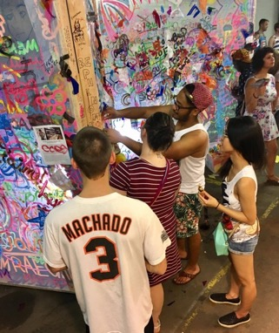
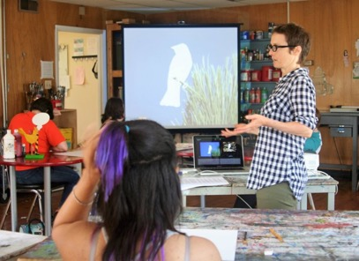
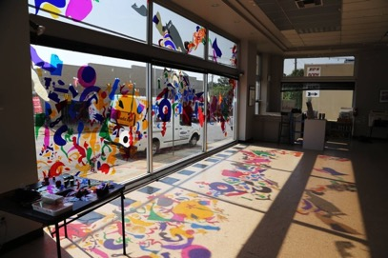

Slide 26
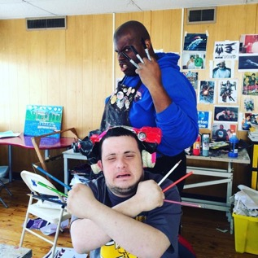
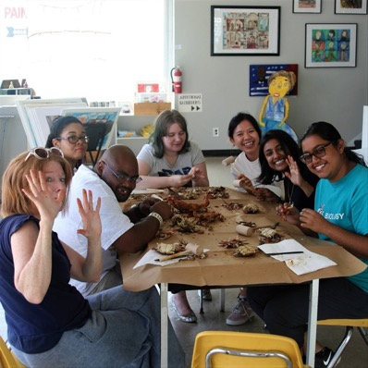
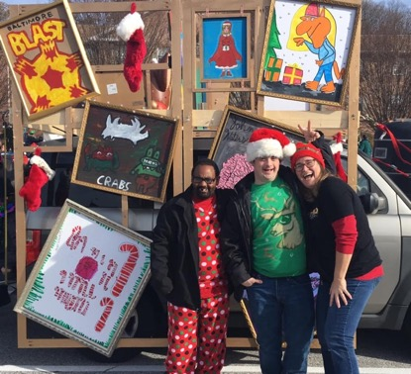
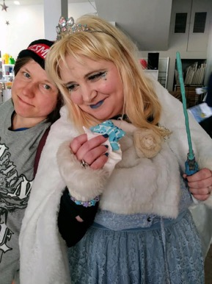
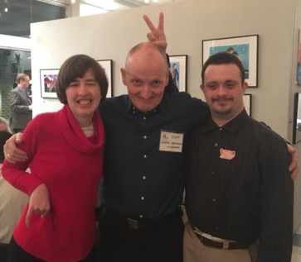
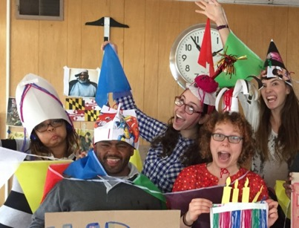

Slide 27
Where Do Progressive Practices Fit?
What’s your version of “everyone an artist”?
What overt and covert assimilation methods (for non-dominant identities) are at play? How can they be counterbalanced by acceptance?
Are there voices that haven’t been included and/or elevated?
When decisions need to be made, is consensus being built or are some opinions being squashed?
Bring in inclusion evaluation and organizational culture assessment
Always strive to do better! Systems and ’isms are entrenched and the work takes time. Know limits. Only one part of someone’s life.

Slide 28
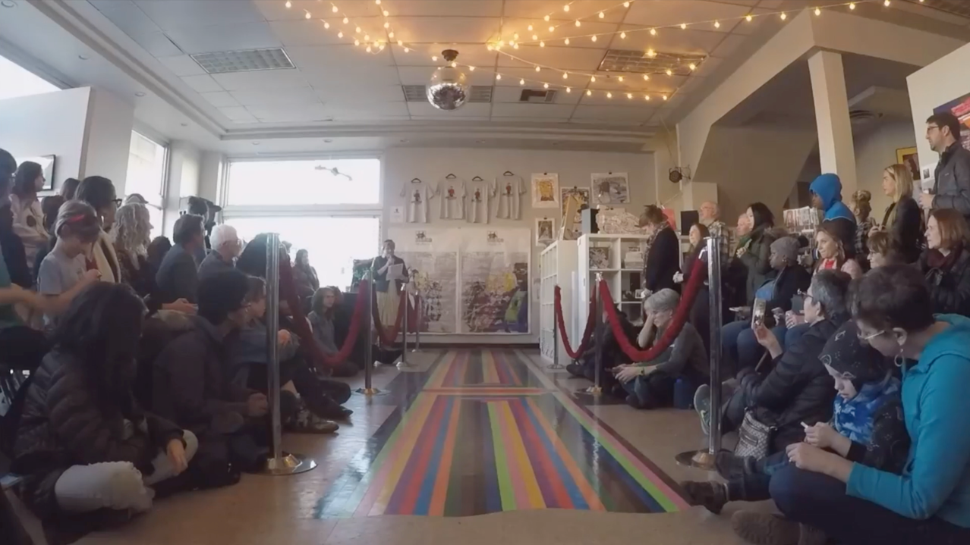
CLIPS AVAILABLE HERE: https://youtu.be/WM7wjGFN7c8 or in full: https://tinyurl.com/y6dglf36

Slide 29


The Studio & COVID-19
Physical space is (mostly) closed; phased reopening plan
Intensive surveying, risk and benefit assessment, artist choice
Virtual studio that parallels ”usual” studio but works with what folks have at home
Ensuring tech and materials access
”Field trips”, visitors, collabs, projects
Online exhibitions and experiences for the public
It’s difficult

Slide 30


Slide 31




Slide 32

For further info
saveyourfaves.org
disparateminds.org
“The Big 3”
  creativegrowth.org
  niadart.org
  creativityexplored.org
arthives.org
inciter.io/evaluating-accessibility-and-inclusion/
marylandarttherapy.org

Slide 33



Questions?
Jill Scheibler
jill@make-studio.org
www.make-studio.org
/MakeStudioBaltimore/
/makestudiobmore/

