Slide 1
Welcome Back to SWE!
February 5th, 2020

Slide 2
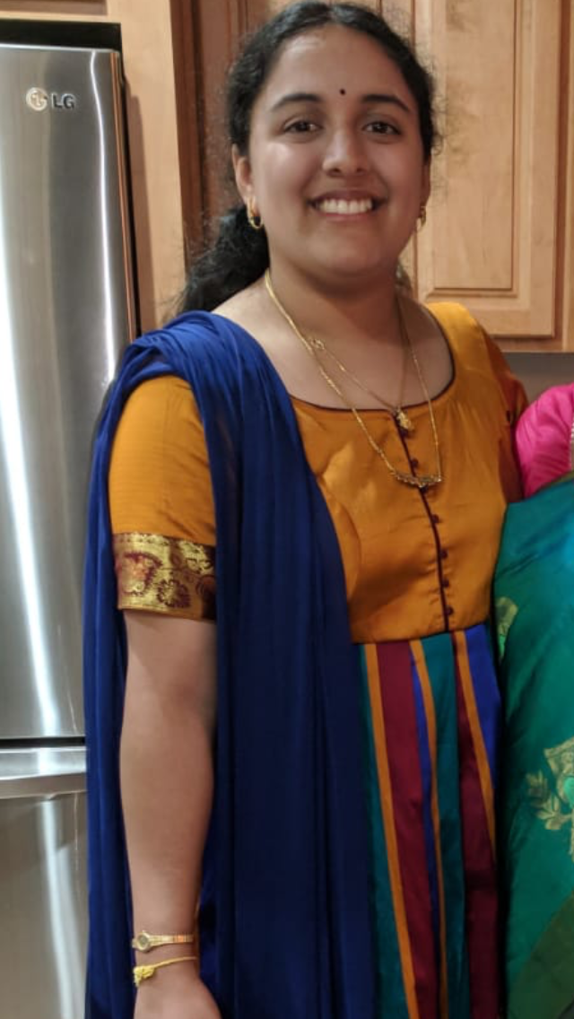
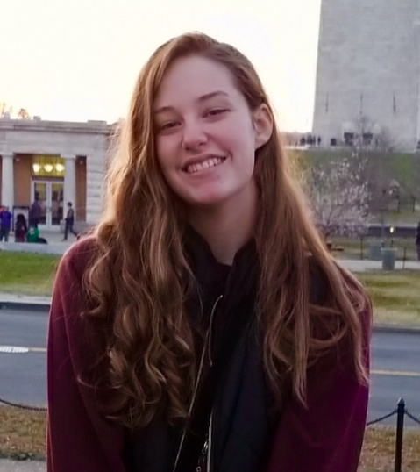
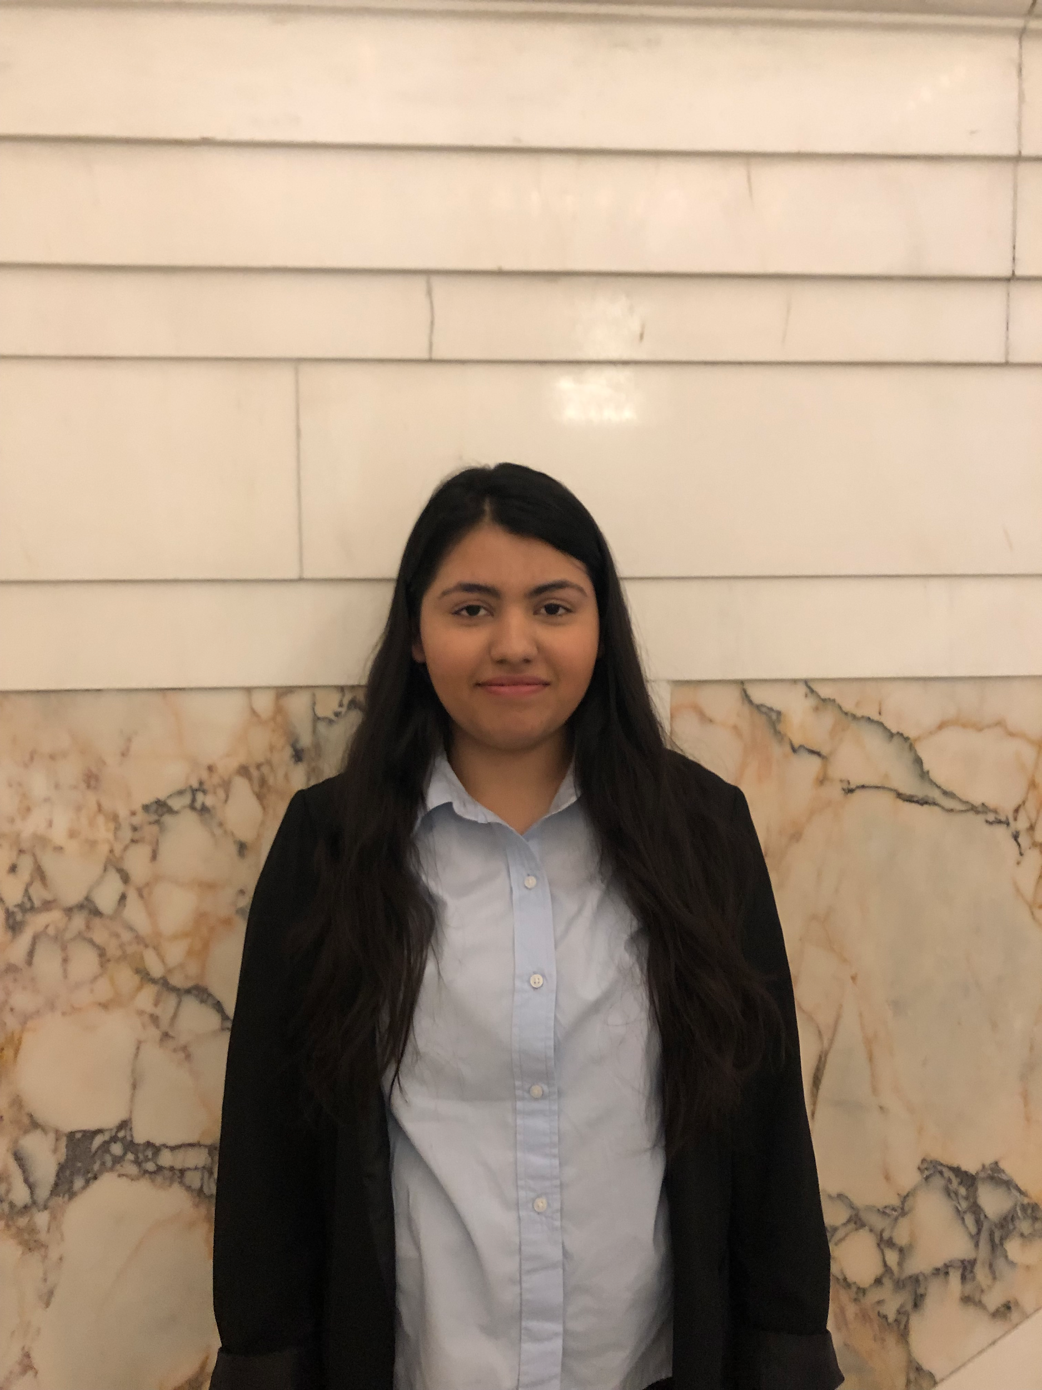
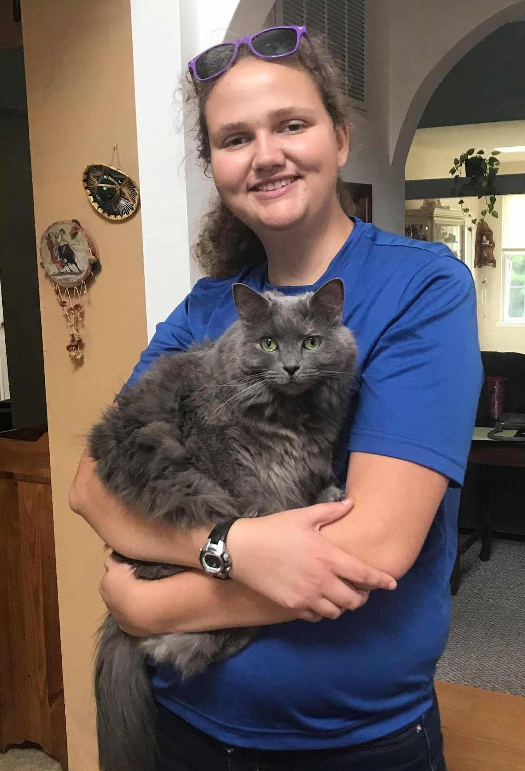
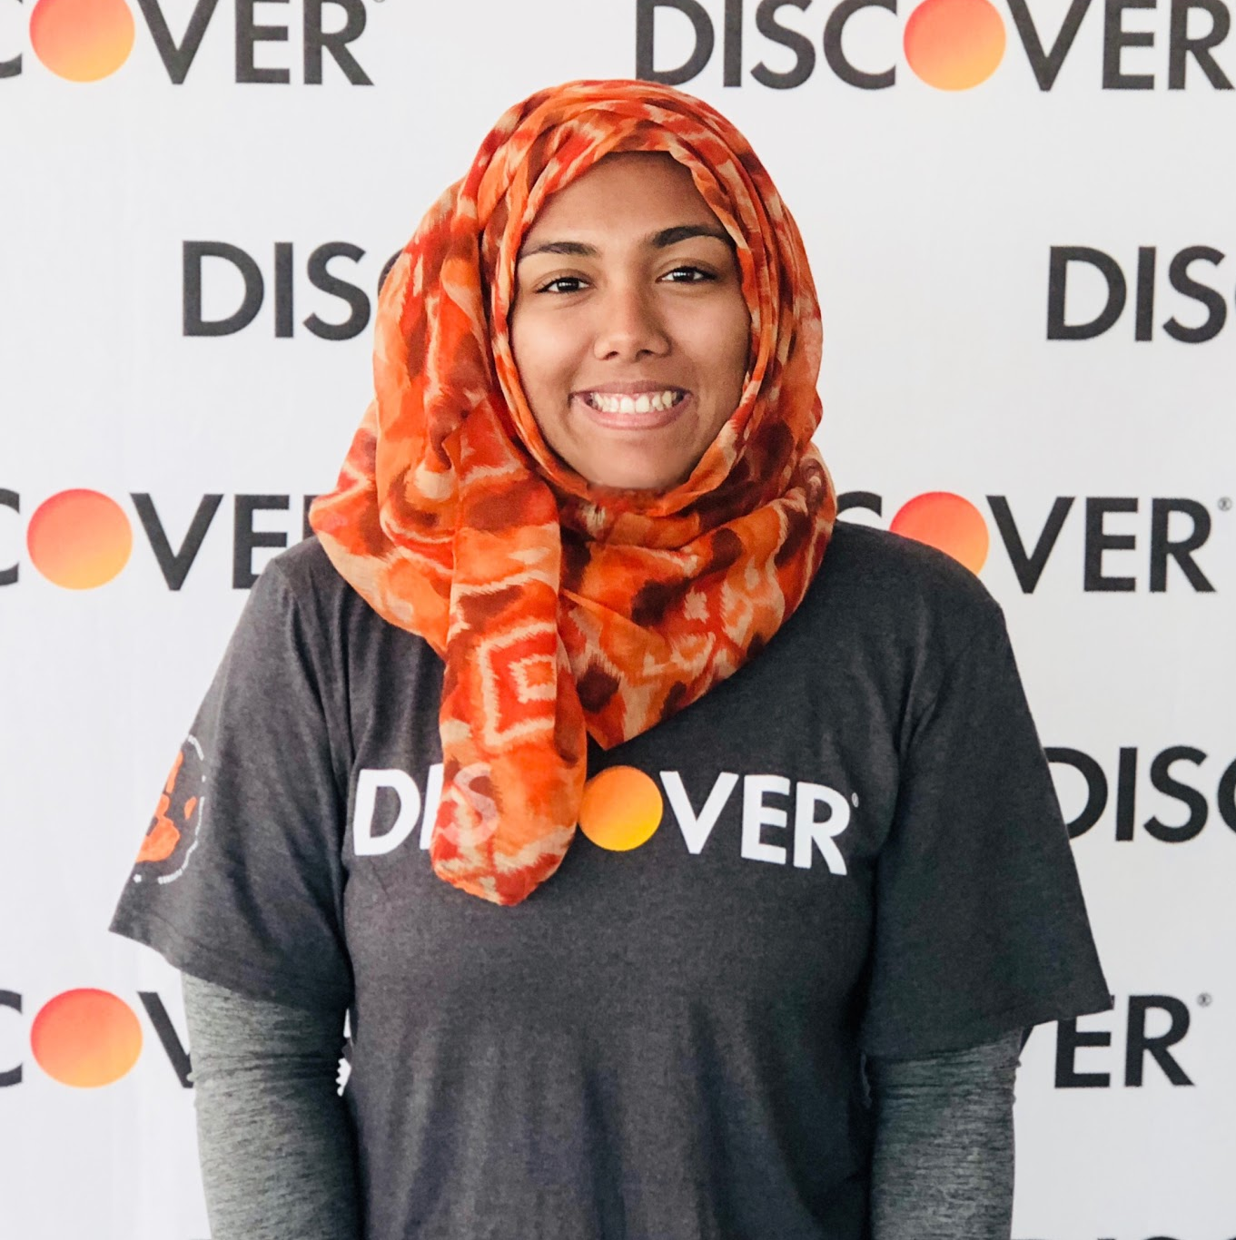
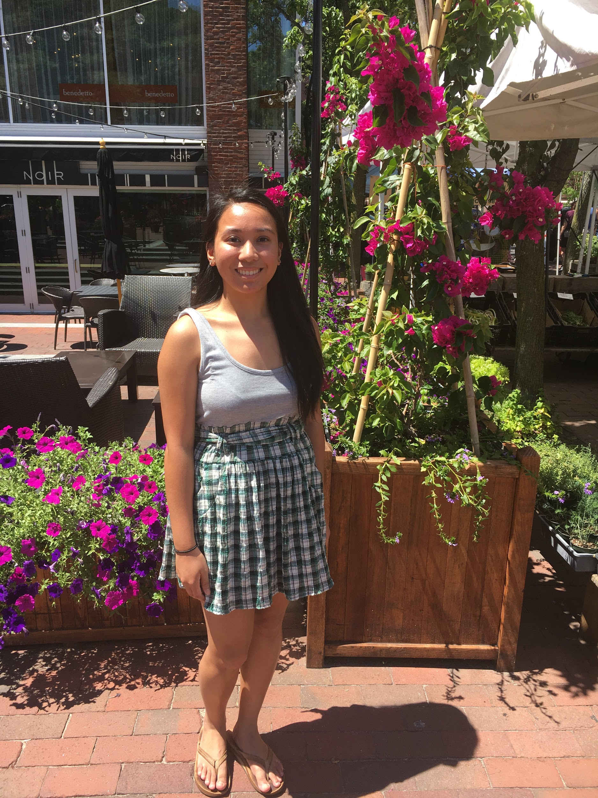
Officer Introductions
President- Lily
VP- Kulsoom
Treasurer- Sumana
Event Coordinator- Kaitlynn
PR Chair - Reda
Freshman Rep - Cindy

Slide 3
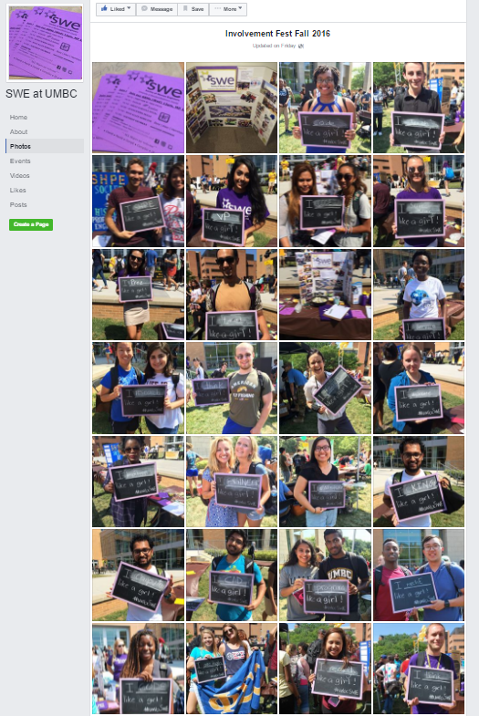
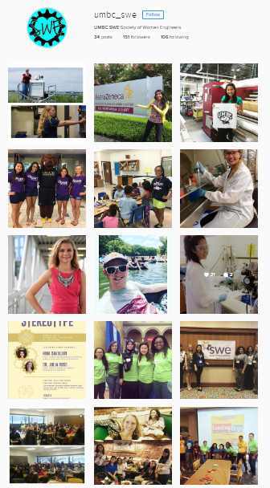
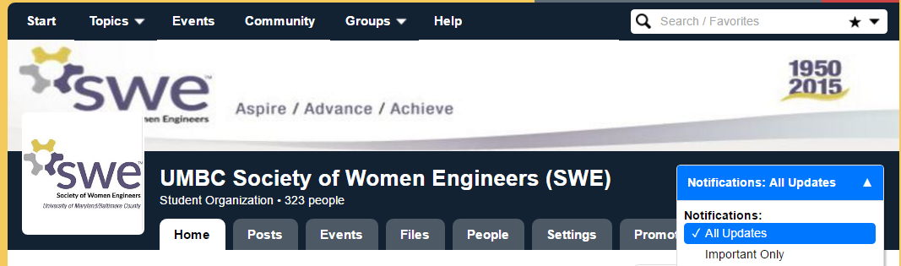
FOLLOW US!!!
myUMBC: http://my.umbc.edu/groups/swe
Facebook: SWE at UMBC
Instagram: @umbc_swe

Slide 4
Upcoming Dates
2/7 - UMBC Spring Career Fair
2/12 - Games w/ SWE
2/19 - WR Grace
2/20 - SWE’s Cocoa Networking Bar (EWEEK Event)

Slide 5
Membership Points
1 point is given for meeting attendance, sharing us on social media
2 points are given for volunteering and tabling events
3 points means you are a full member. You can vote in elections, run for spring elections, and can put us on your resume.
5 points gets you a shirt!

