Slide 1
Meet SWE’s Executive Board

Slide 2
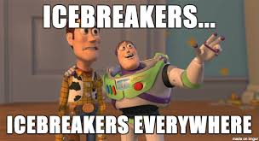
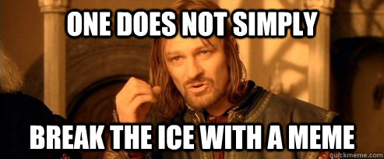

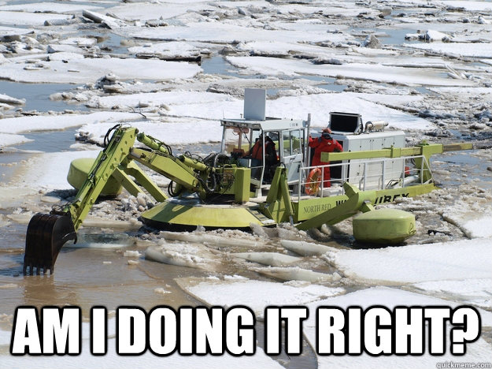
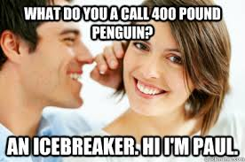
But First…ICEBREAKER!

Slide 3
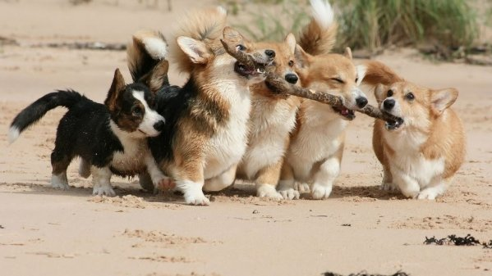
The Best Team
Describe the best team you’ve ever been on and why it was the best.

Slide 4
QUALITIES OF THE DREAM TEAM
Similar schedule
Good work ethic
Same interest
Focused
Organized
Aware of eachother’s strengths and weaknesses
  Accommodating of each other’s talents
Team members pull their own weight
Good communication
Be preeeeepaaaaared!
having fun isn’t hard when you’ve got a library card
Getting along with others

Slide 5
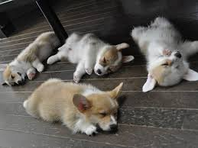
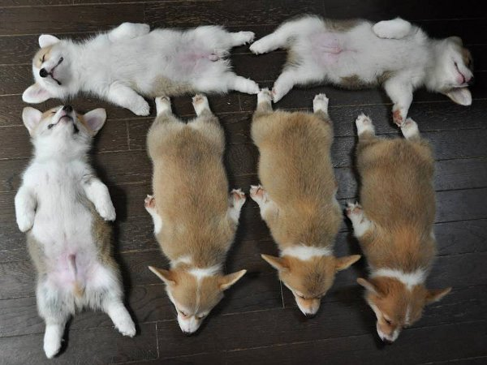
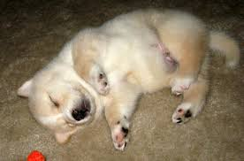
Introducing OUR (current) dream team…..

Slide 6
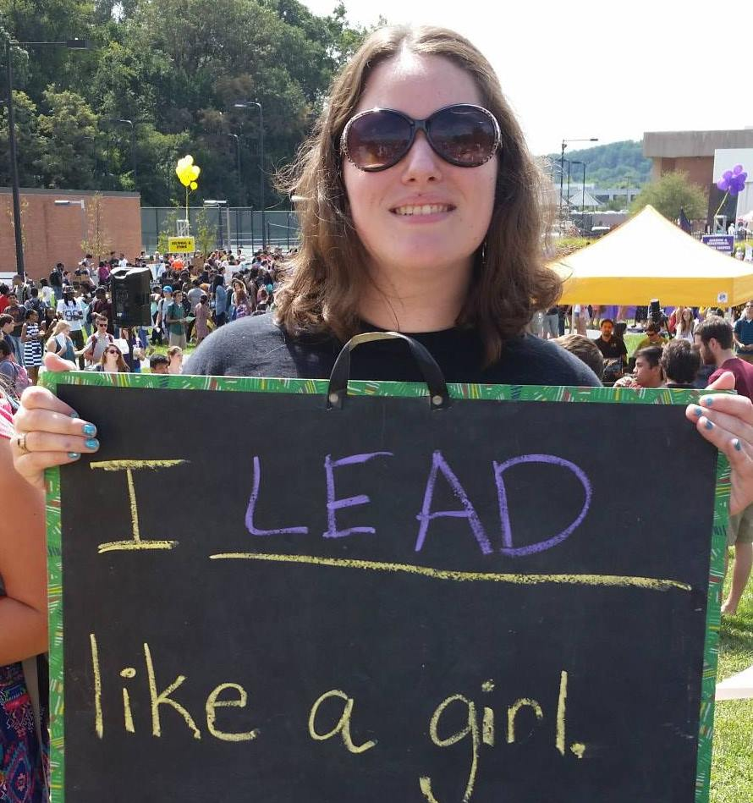
President - Shelby Coppolino
Communicate with our advisor(s), SWE Region E, and SWE National
Attend Annual and Regional SWE conferences
Push the chapter to new heights
Aid SWE board members
Oversee planning of semester events
Book GBM room
Organize EBMs
Get to know the SWEethearts
President: Must have held a position on E-board

Slide 7
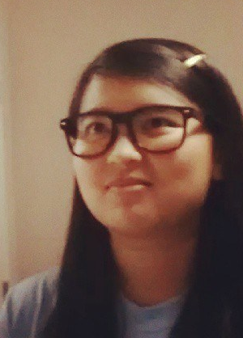
Vice President - Stacy Sumedi
Assist President in overseeing other officers
Fill in where other board members need help
Plan some bigger scale events
Help plan GBMs and socials
Organize Big/Little SWEet Mentoring Program
Promote SWE to freshmen class and transfers
Fill freshman representative position
Purchase organization t-shirts

Slide 8
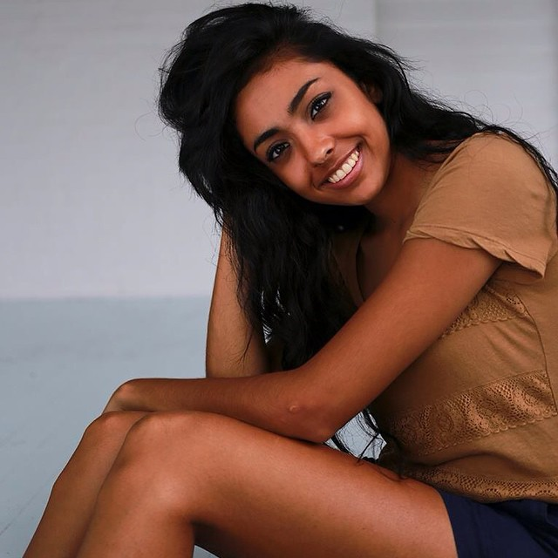
Secretary - Mona Patel
Manage the myUMBC website
Take and post pictures of SWE events (managing the Flickr account)
Reminders for upcoming events
Set up spotlights on the main myUMBC page
Add/invite new members to the website.
Keep track of attendance and manage membership points
Type up everyone’s report at the E-board meeting
Setup the alum Facebook Page

Slide 9
Treasurer - Katie Yu
Manage and organize budget for the semester
Coordinate fundraising
  Partial funding for National and Regional Conference for SWE Members
  SWE Givecorp accounts for fundraising
Complete end of the semester Fiscal Year (FY) Reports and authorize RESGAF & Reimbursement forms
Update Advisor information on National SWE account
Plan fun and creative fundraising events, GBMs, and socials.
Providing assistance to other E-board members when needed

Slide 10
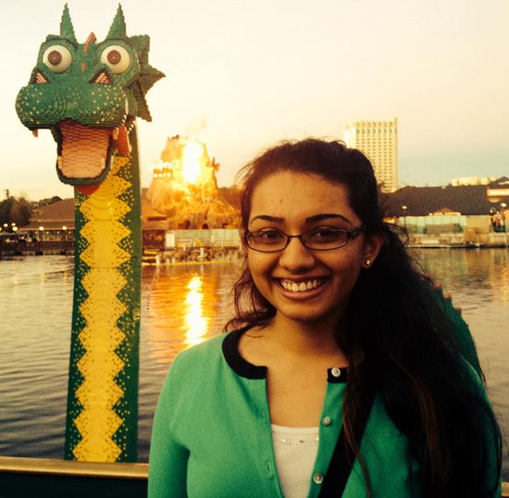
Service Chair - Tulsi Shukla
Plan out SWE involvement in outreach events, such as Girl Power and Let’s Get Techy
Invite younger girls to our school or go to them to build interest of girls in engineering fields
Coordinate a service event with local SWE chapter (ie Baltimore/Washington DC SWE)
Facilitate in Engineer’s Week

Slide 11
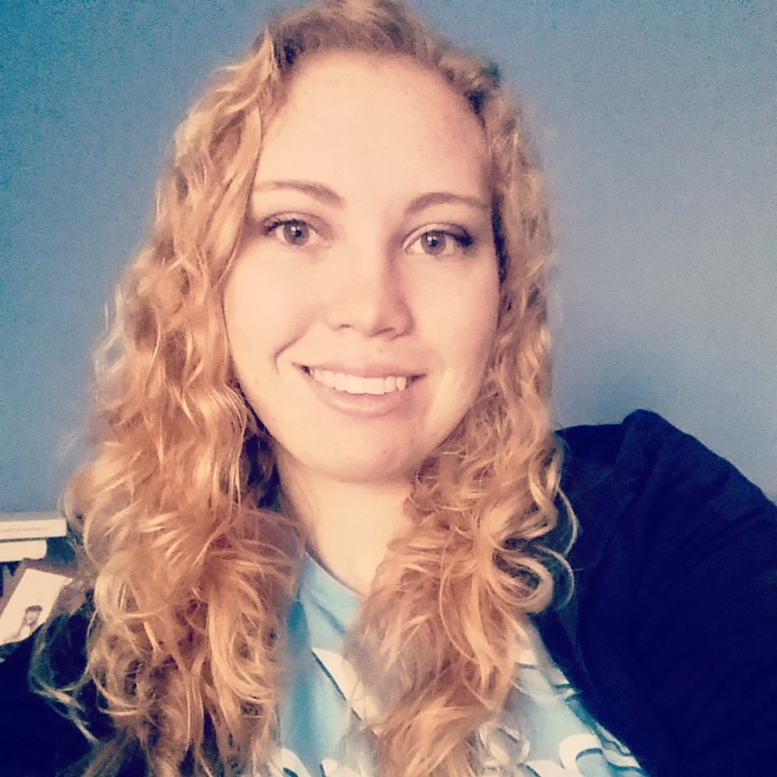
Freshman Representative - Shelbi Tippett
Liason between freshman/transfer members and SWEboard.
Assist the Service Chair with activities/planning
Shadow existing E-Board members
Complete any designated responsibilities
Freshman Representative: Incoming Freshman class is elected (So dis don’t apply to you bruh. 4 Class of 2019)

Slide 12
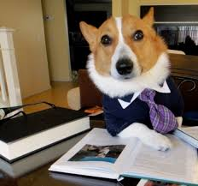
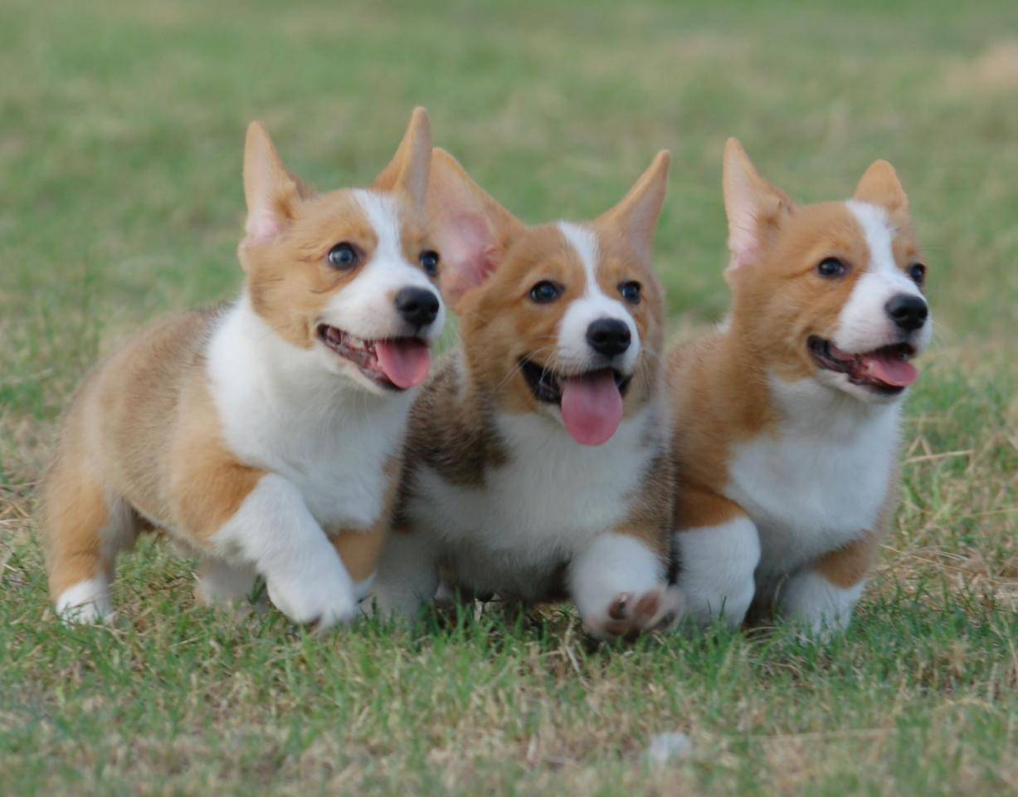
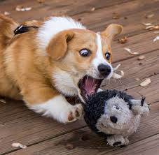
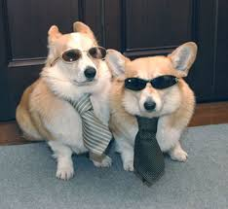
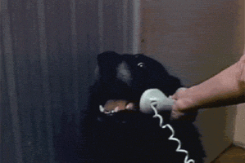
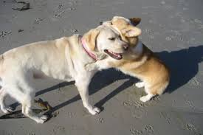
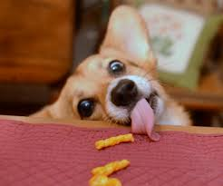
What We Are Looking For
A Team Player
A Multi-Tasker
A Go-Getter
Good communicator
Like to Eat Chipotle
A great support
Calm, Cool and
Collected

Slide 13
How to Apply?
Make a powerpoint slide promoting yourself for the election presentation and add to designated SWE google slides.
Prepare a 2 minute speech telling us why you should be elected, what qualifies you, and what are some fun interesting things you plan to do with your position if elected?
ELECTION DAY: Wednesday, April 22

Slide 14
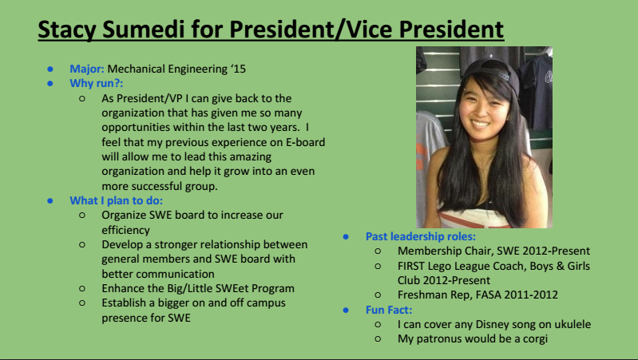
Example

Slide 15
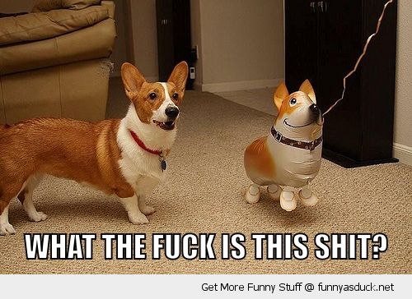
Questions?
Questions too personal/embarrassing/hilarious? Email: Stacy Sumedi at ssumedi2@umbc.edu for any other questions or concerns! ← Shes da Real MVP, She will gladly listen to your poop stories.

