Slide 1
SWE Executive Board Elections 2015-2016

Slide 2
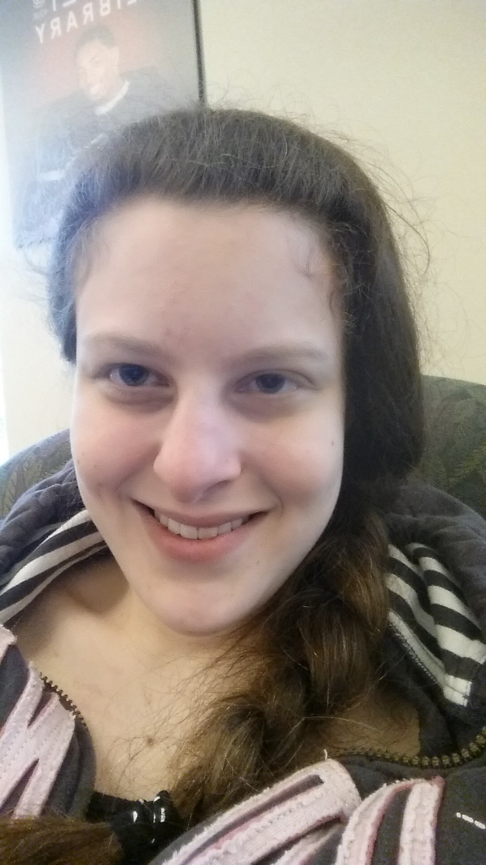
Liz Blasdell for Service Chair
Major: Chemical Engineering: bio track, Minor: Biology
Why run?
  help increase the number of women in the STEM fields
  spark an interest in the STEM fields for young women
  share my passion for science and engineering while inspiring others
  I love planning outreach events
What I plan to do:
  Increase the number of outreach events at local schools
  work with the other engineering societies to co-host events
  Work with nearby SWE chapters to co-host larger events in the area
  Work with the other STEM departments to host events
Fun Facts:
Doctor Who is my favorite show (but I love anything Sci-Fi) and I have have a cat that is scared of hamsters, rabbits, etc
Past Leadership Roles:
PR,Service Chair,President/Treasurer- HCC Vowlunteers
Founding Member/Secretary-HCC Math Club

Slide 3
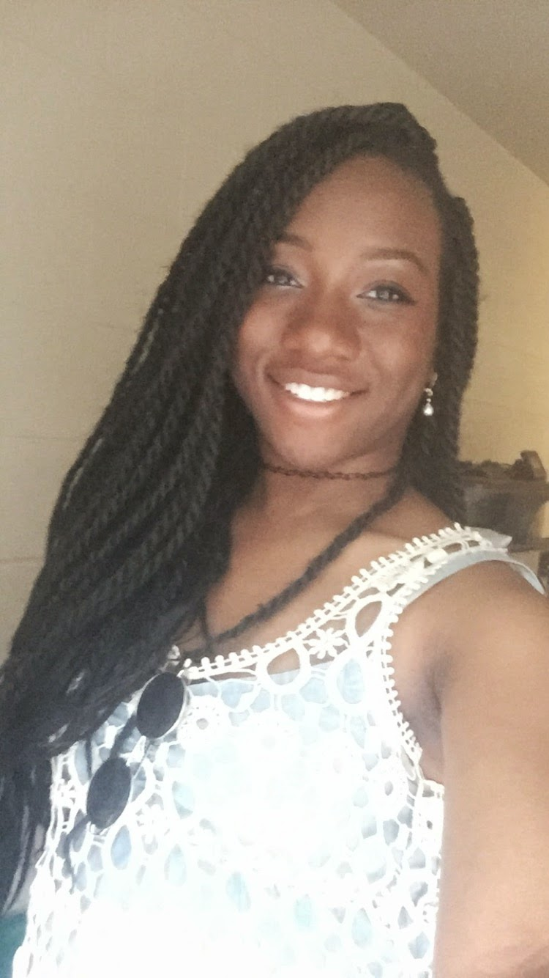
Demi Owoeye for Service Chair
Major: Mechanical Engineering ‘17
Why?
As last’s year’s Service Chair at HCC’s chapter of SWE, I learned how to effectively plan and organize events that spread awareness about our goal and mission.
One of my joys is service and my life long goal is to teach young, disadvantaged girls about STEM.
I will give all the time and effort I can into the position and connect with professional advisors and other colleges for our chapter’s benefit.
What I plan to do?
Connect to other colleges and professionals to organize events that would bring together of a community of like-minded and goal-orientated women.
Fun facts: I’m a huge nerd (ask me about it later) and a member of Phi Sigma Sigma.

Slide 4
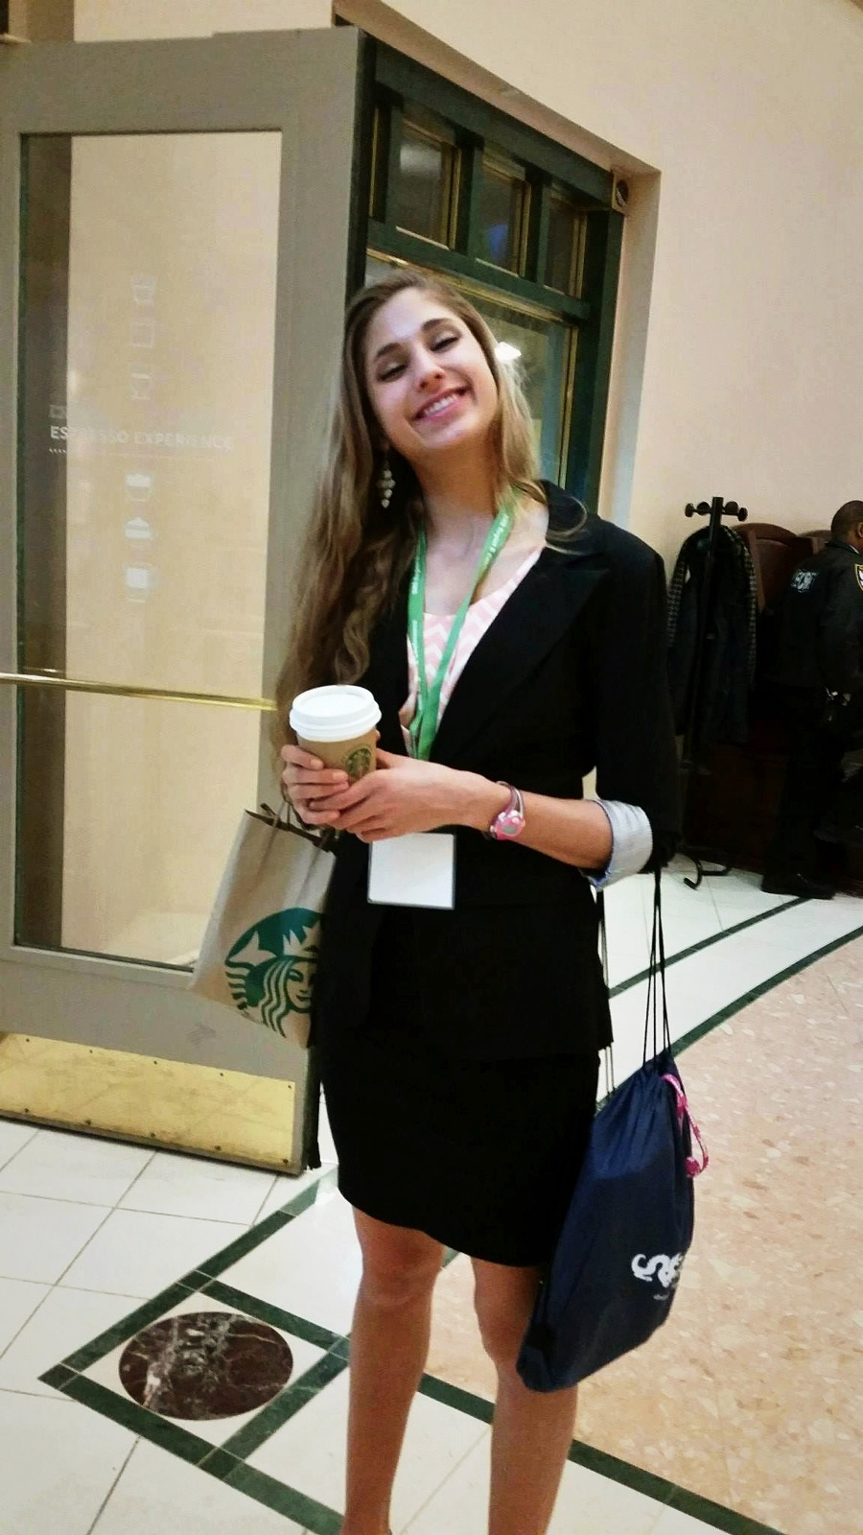
Savannah Steinly for Service Chair!
Major- Chemical Engineering, Environmental Track
Minor- English, Creative Writing Track
(Honors College Certificate)
What I plan to do-
I will effectively organize priorly executed outreach events in the coming year
I value creativity and will contribute fresh ideas for service and outreach events as well
I want to connect SWE with other organizations that I am involved with in order to plan events together
I also want to reach out to professors, departments, orgs, etc. that have not previously known of or collaborated with SWE
Why Run?
Science and tech are my passions, and I hope to spread this enthusiasm to others, especially younger students
I am a good communicator
I am already highly involved in a number of organizations that share a similar mission (CWIT Scholar, AiChe…)
I want to get more involved in SWE. This year I’ve learned what a valuable resource it is and want to make others aware
Past Leadership-
XC Team Captain
President of the Leo Club (HS)
National Science Honor Society VP (HS)
Volunteer at Catholic Charities Homeless Shelter
Fun Facts-
I am obsessed with Starbucks and all things coffee
I sing and write creatively for fun
I’m a twin

Slide 5
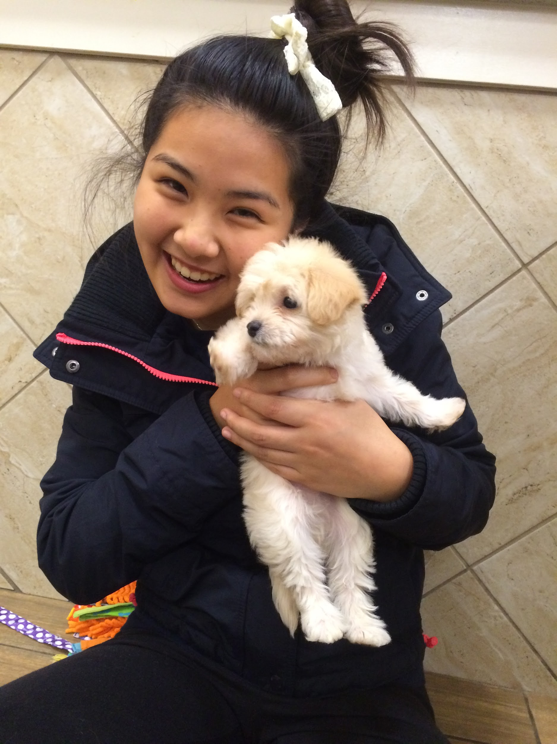
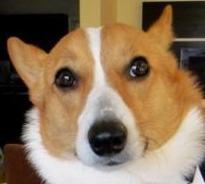
Elizabeth Tan for Secretary
Major: Chemical Engineering ‘17
Why run?
I want to be more involved with a club that I am really passionate about. I have enjoyed being active within SWE for the past two years. Also, I can see the potential that this club has in helping so many more people ranging from the young children to the alums.
What I plan to do?
- Increase member participation/recruitment
- Promote SWE more around campus
- Continue the Alum page on facebook; more networking events
- Partner up with more UMBC STEM orgs
- Have meeting minutes
- Record attendance
Past leaderships:
- Volunteered Arbutus Middle Schoolers (Spring 2014)
- I am a Desk staffer (Fall 2014-Present)
Fun Facts:
- I became a US Citizen on Aug. 20, 2014
- I love to play field hockey
- I <3 Corgis

Slide 6
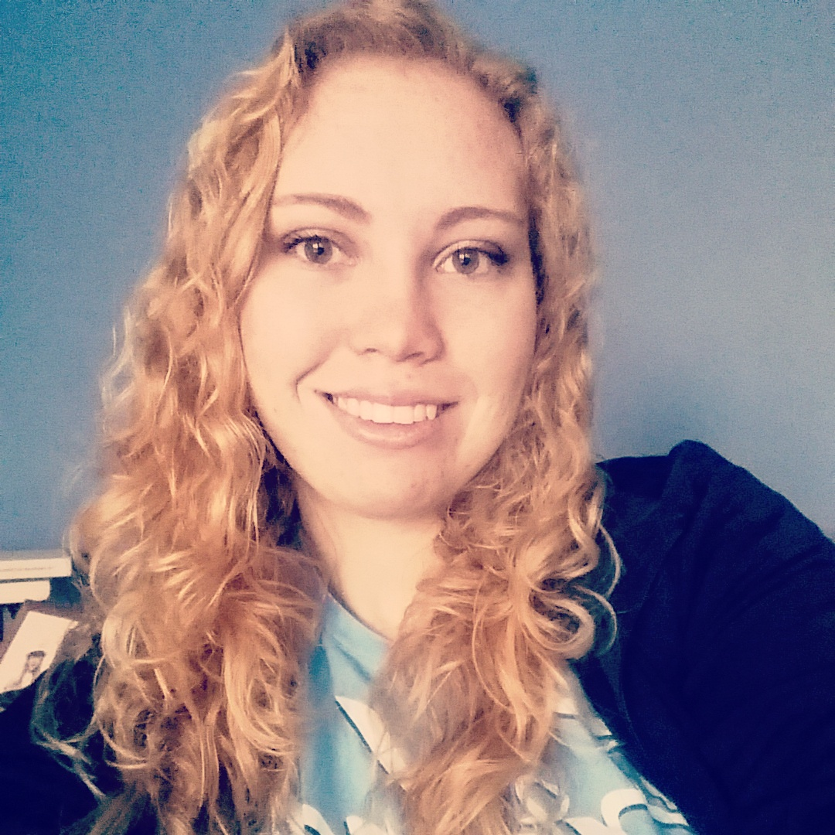
Shelbi Tippett for
Secretary/Treasurer
Major: Mechanical Engineering
Why run?
Support women in engineering and promote SWE as a valuable resource to them on campus.
Expand UMBC SWE’s outreach on campus and in the community.
Promote attendance and member participation.
Plans:
Get more professor involvement through fun activities such as a student/teacher scavenger hunt.
Host resume reviews and interview skills workshops in which we invite professionals.
Work on fundraising to help take members to conferences.
Fun Fact: I love Doctor Who and aspire to be a crazy cat lady
Past Leadership:
SWE Freshman Rep: Spring 2015
ASME Student Development chair:Spring 2015

Slide 7
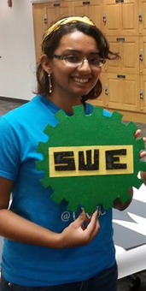
Tulsi Shukla for Vice President
Major: ChemE, bio track, math minor
Why run?
  Focus more on professional development
  Get general members more involved with committees
  Help develop a reference list of contacts for future use
  Regularly ask members what they want to see happen
Past leadership
  SWE Service Chair 2015-2016
  SWE Big Mentor 2015-2016
  Works at CIC
Fun Fact: I love arm balances and headstands

Slide 8
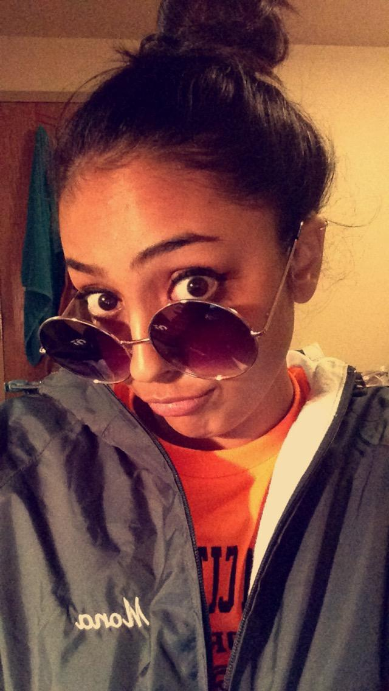
Mona Patel for President/ Vice President
Major: Chemical Engineering, Minor in Biology
Why Run?
To help expand SWE’s name on this campus by working with other organizations, but not only just engineering ones. Also, to collaborate with other schools around the area (HHC, UMD, JH)
What I Plan to do?
-Communicate to the National/Regional Board.
-Attend the National Conference
-Mainly Focus on Professional Development
-Develope Committees, to help out eboard
-Miss America Project ( http://ninadavuluri.com )
Past Leadership Roles:
-SWE Secretary: 2014-2015
-SWE Big Mentor: 2014-2015
-Phi Sig Standard Board: 2014-2015
-SWE Freshman Rep: 2013-2014
Fun Fact:
-Burp the alphabet
-I have uneven nostrils
-Recently obsess with my new sunglasses that I got for $10!!

