Slide 1
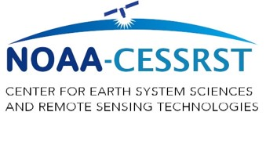
U.S. EPA, NASA and NOAA Research Opportunities at UMBC
Ruben Delgado
UMBC Atmospheric Lidar Group (ALG)
Joint Center for Earth Systems Technology
https://alg.umbc.edu
delgado@umbc.edu

Slide 2
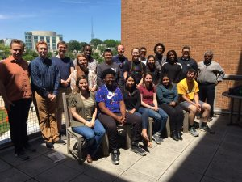
ALG Research Areas
Interdisciplinary Research
Undergraduate and Graduate Students
Atmospheric Physics
Biology
Engineering
Chemical, Computer, Electrical and Mechanical
Geography and Environmental Systems
Math and Statistics
Physics
Public Policy
Air Quality
Wind Energy
Numerical Weather Forecasting
Severe Storm Prediction
Remote Sensing and Environmental Technology
Social Sciences
Public Health
Planning and Policy
Environmental Economics
Sustainability Science

Slide 3
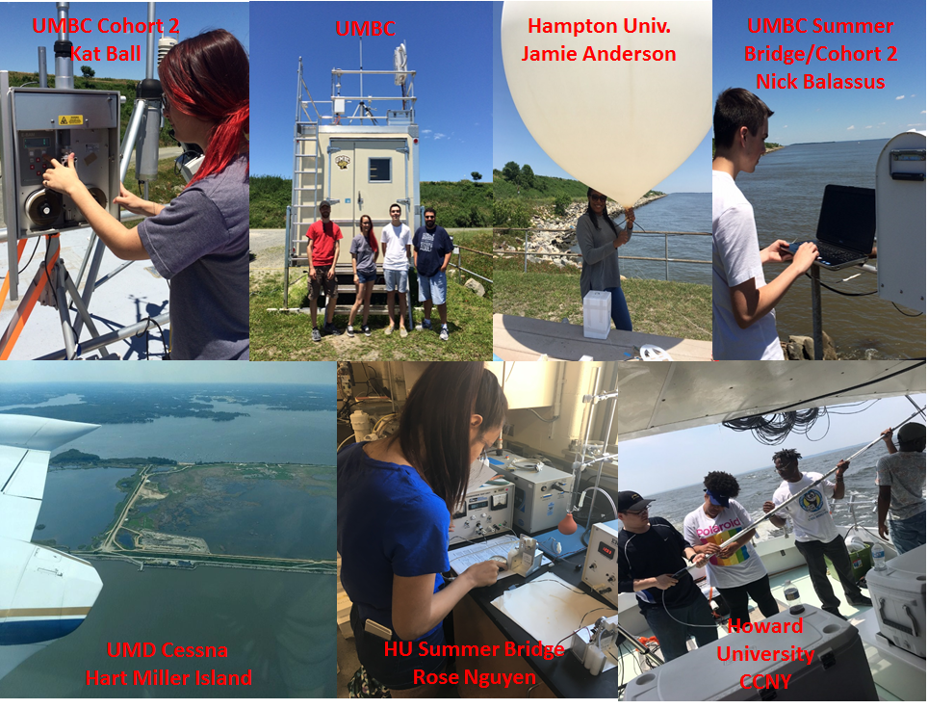
Field Campaigns

Slide 4
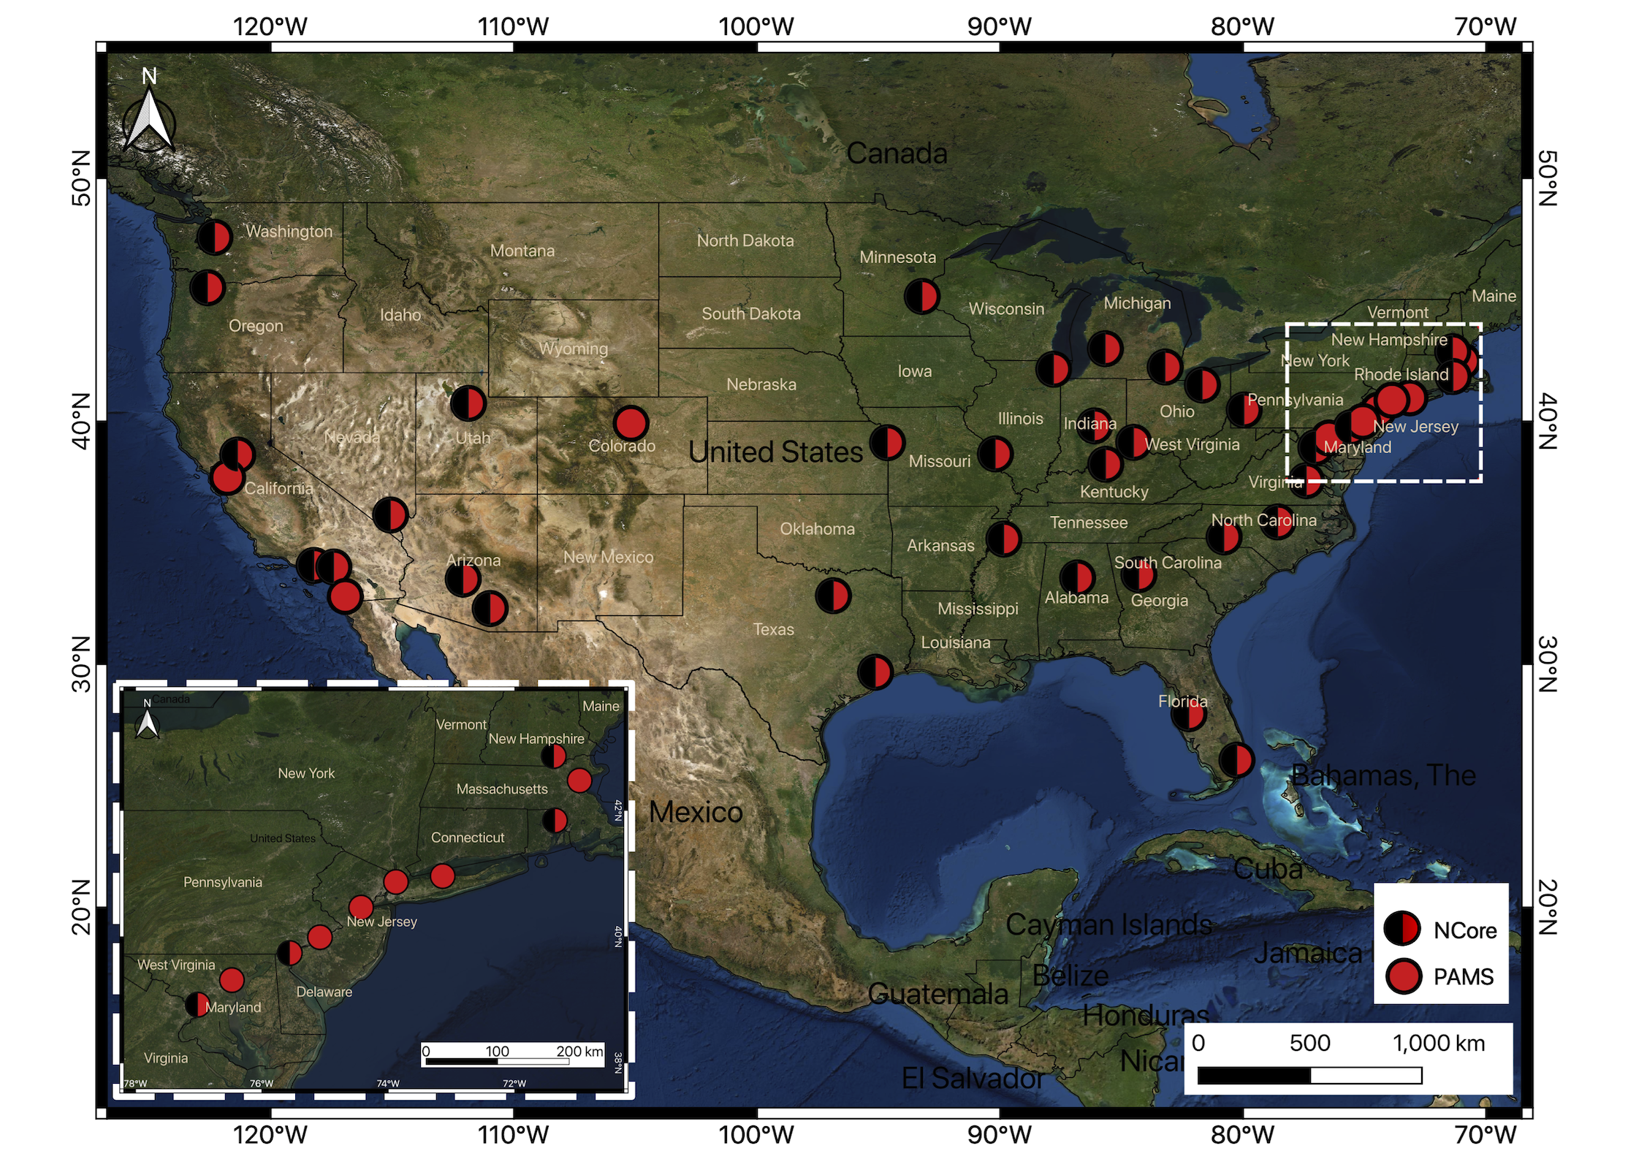
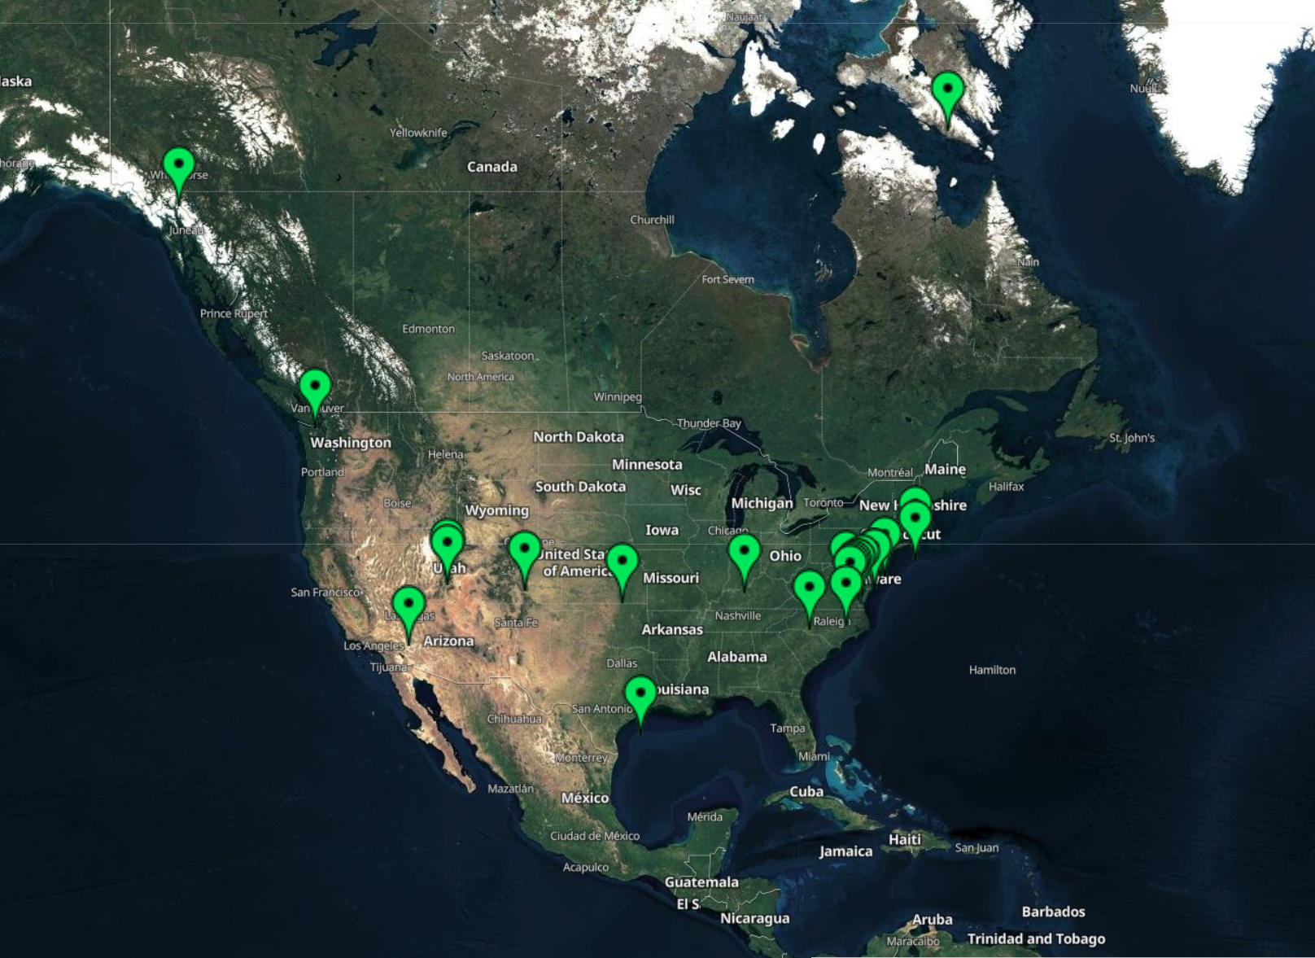
UMBC-EPA-NASA-NOAA Ceilometer Network
Ceilometer Network (UMBC-EPA-NASA-NOAA)
https://alg.umbc.edu/ceilometer-network/
Ceilometer/Lidars
Radar Wind Profiler
Piney Run, MD
Howard Univ./Beltsville, MD
Horn Point Laboratory, MD
Coming Soon Online:
SCAQ Management District
NJDEP/Rutgers Univ.
NASA JPL
Instrumentation:
Ceilometer, PANDORA, Auto GC
Ambient air database (met, PM_{2.5}, O₃, NO₂, NOx, speciated VOCs)
Validation/verification satellite products and meteorological/air quality forecasts.
CCNY | Fair Hill, MD | La Porte, TX
Howard Univ./Beltsville | Edgewood, MD | Lindon, UT
UMBC | Essex, MD | Jerome Mack, NV
Virginia Tech | Washington DC | Iqaluit, NU, CA
Providence, RI | Richmond, VA | Squamish, BC, CA
Londonberry, NH | Indianapolis, IN | Whitehorse, YK, CA
Ardentsville, PA | Rocky Flats North, CO
Bristol, PA | Konza Praire, KS
Philadelphia, PA | Hawthorne, UT

Slide 5
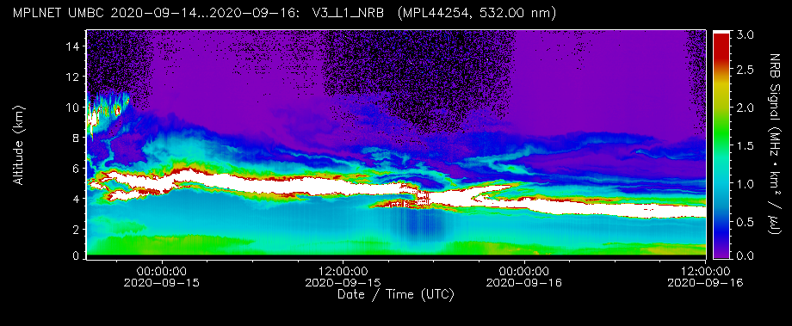
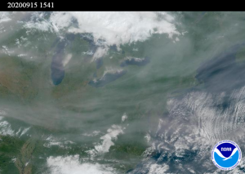
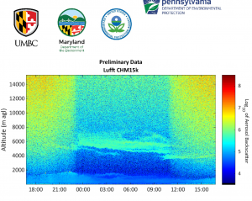
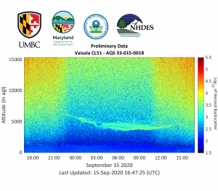
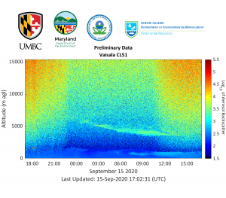
California Wildfires Sept. 2020
Bristol, PA Londonderry, NH Providence, RI

Slide 6
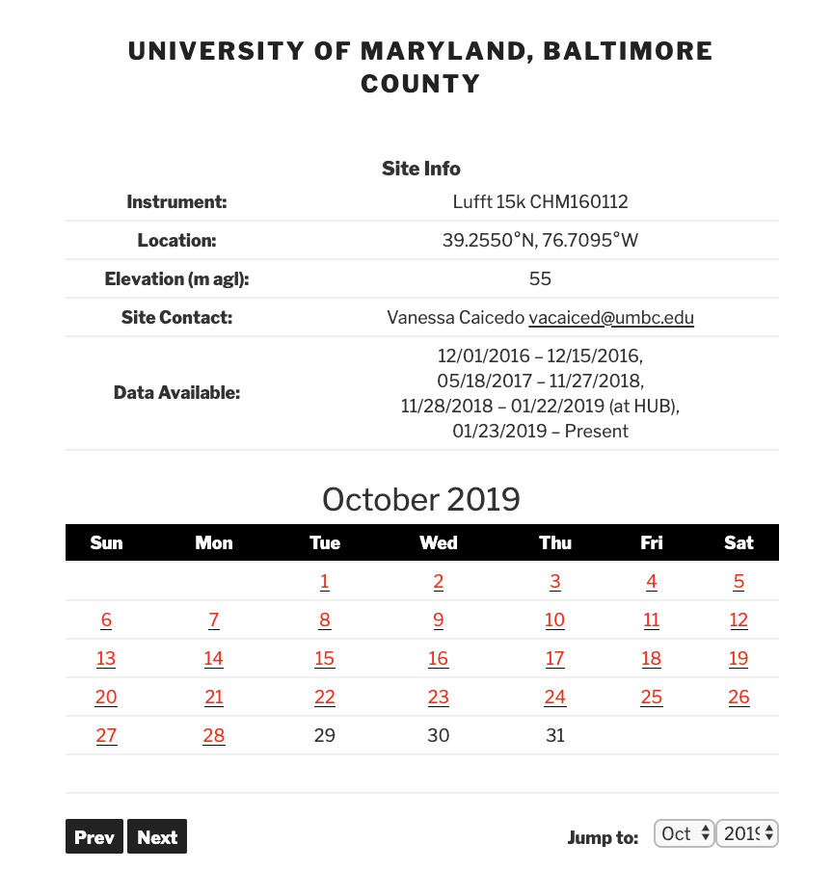
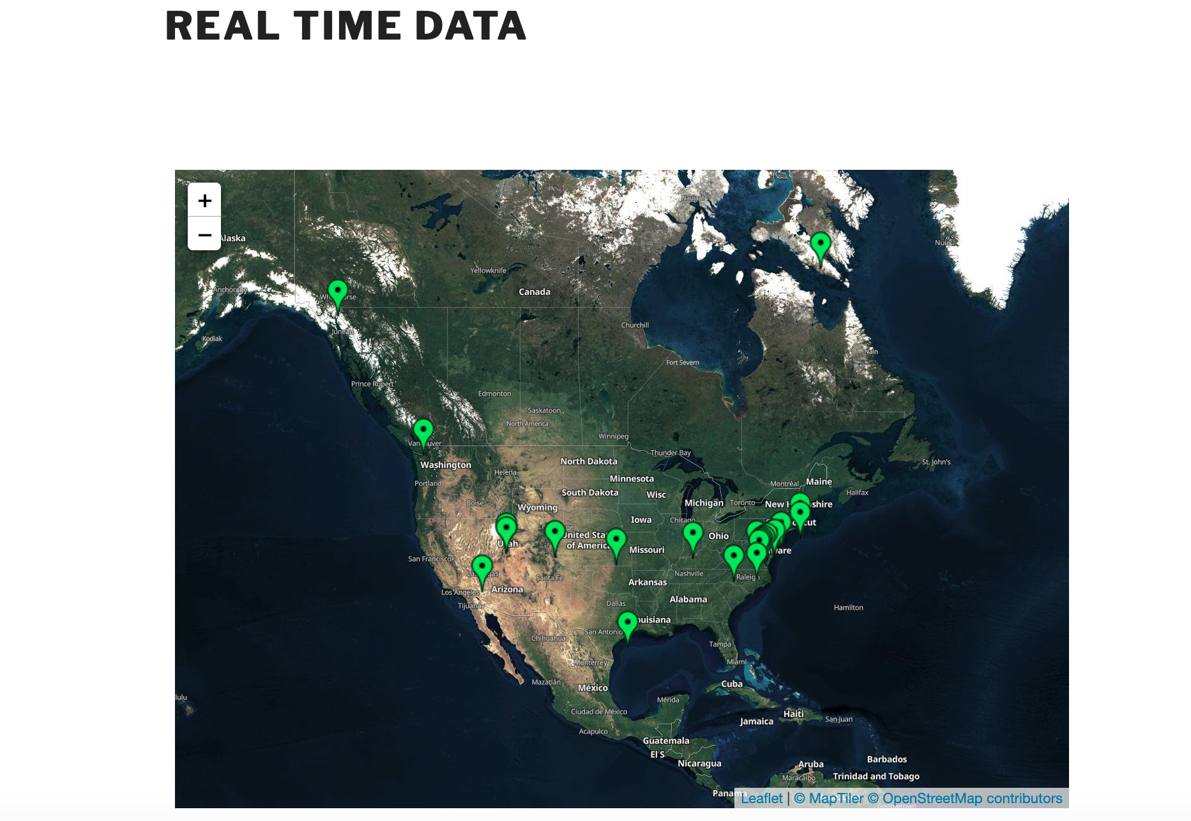
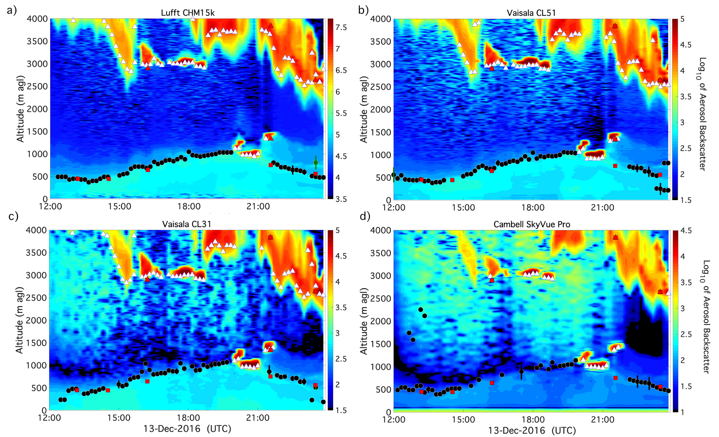
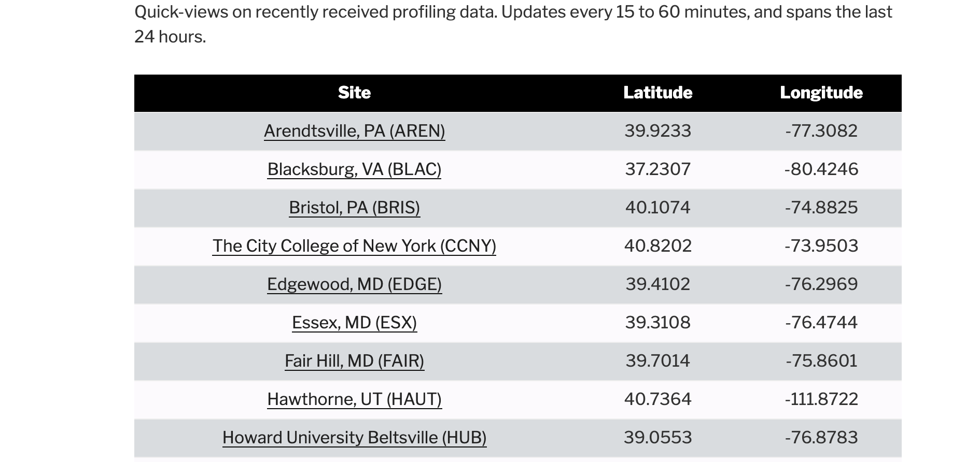
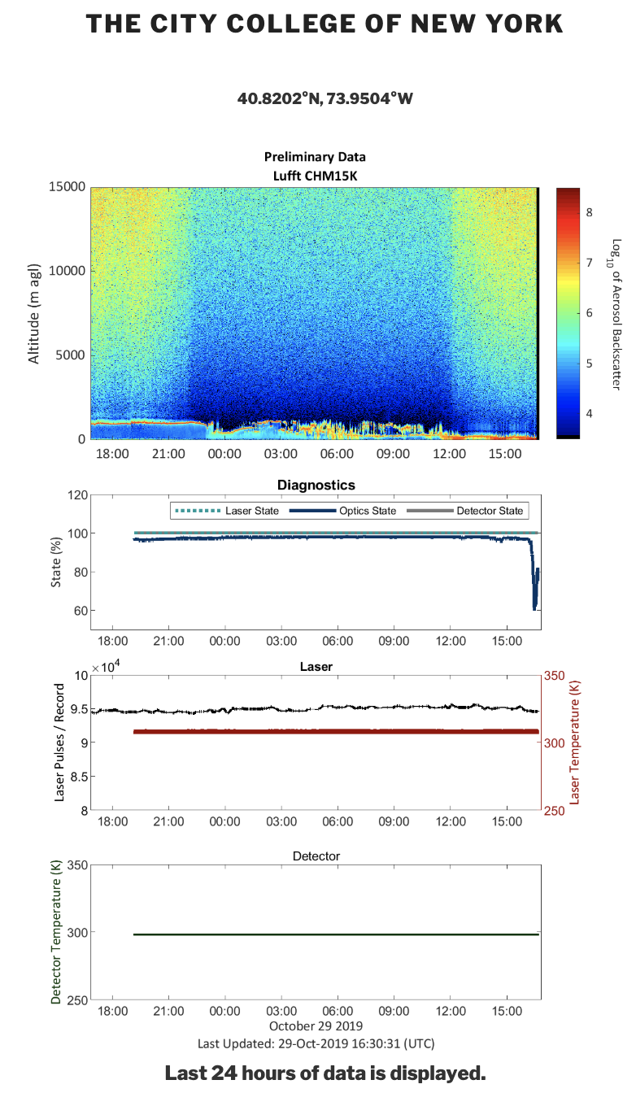
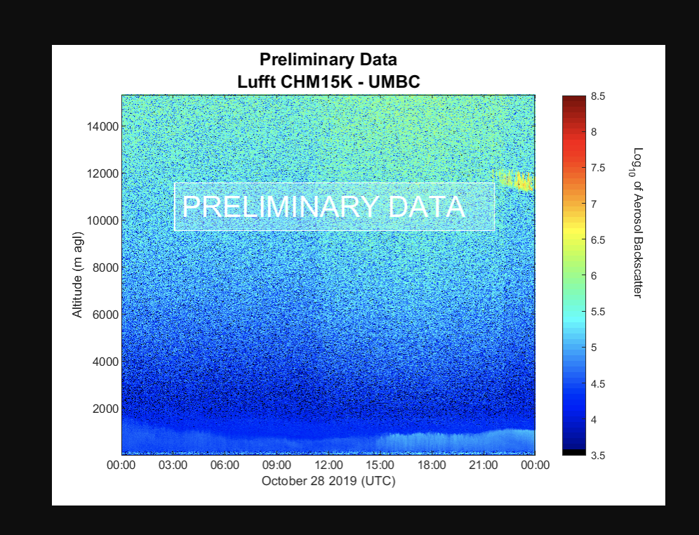
Real-Time Visualizations and Data Archive
Real-Time
Archive
PBL Automated Outputs:
Cloud-base heights
Precipitation flags
Filtered PBL heights (NSL, RL, MLH)
Uncertainties for PBL heights
www.alg.umbc.edu/real-time-data-info/
www.alg.umbc.edu/archives/
Caicedo et al. (2020) https://doi.org/10.1175/JTECH-D-20-0050.1
Notes:
UPDATE FIG

Slide 7
Lead Institution
City College of New York, NY
Partner Institutions
Hampton University, VA
San Diego State University, CA
University of Maryland Baltimore County, MD
University of Puerto Rico, Mayaguez, PR
University of Texas, El Paso, TX

Slide 8
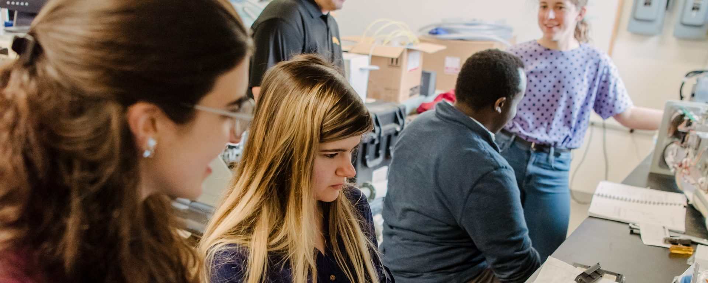
NOAA CESSRST
Coastal Resilience
Atmospheric Hazards
Social Science
Water Prediction & Ecosystem Services
Coastal Observations
Advanced Modeling
Environmental Assessment
Socio-economic Assessment
Mitigation of Stressors
Air Quality
Wind Energy
Heat Stress and Urban Modeling
Numerical Weather Forecasting
Severe Storm Prediction
Remote Sensing and Enviromental Technology
Public Health
Planning and Policy
Population Science
Environmental Economics
Sustainability Science
Risk Communication
Vulnerability Assessment
Socioeconomic Impact
Unified Prediction System
Natural Hazards Protection
Climate Adaptation, Mitigation and Drivers

Slide 9
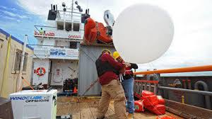
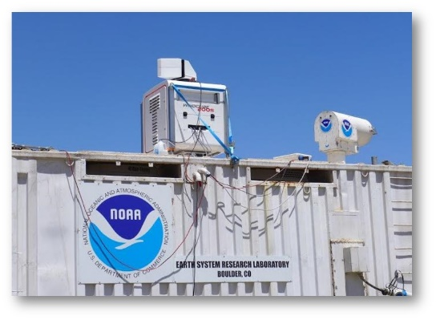
Undergraduate Research Opportunities
Eligibility
NOAA-CESSRST Institution
U.S. Citizen
GPA: 3.0 or greater ea. semester
Benefits
Undergraduate
A minimum of $12,000 a year for-up to 2 years
Tuition, Stipend and Travel
Summer internship at NOAA National Laboratories
National Conferences
Exposure to career paths at NOAA federal, state or local agencies and industries alike.
https://www.cessrst.org/apply/noaa-cessrst-application-overview

Slide 10
Graduate Opportunities
Full time College Student in– Engineering, Science Social Science
US Citizen with 3.0 GPA or above per academic semester
NOAA advisor/mentor required
Requires one NOAA Internship at NOAA Facility
Research Opportunities with 26 academic institutions (e.g. UMBC, Howard Univ., Hampton Univ. Jackson State Univ. UTEP, UPRM, SJSU, SDSU, UMES, FAMU)
Masters
Graduate Research Training
Minimum of $25,000 per year
(Stipend, Tuition & Travel)
$5,000 Internship / NERTO
Ph.D.
Doctoral Research Training
Minimum of $36,000 per year
(Stipend, Tuition & Travel)
$10,000 Internship / NERTO
https://www.cessrst.org/apply/noaa-cessrst-application-overview

Slide 11
2021 CESSRST Summer Bridge Program
8‐week paid summer internship for eligible students (US citizens and GPA 3.0 and above)
​Research opportunities in Social Science, and Earth System Science/​Engineering using NOAA data products with a goal of understanding & predicting changes in Earth’s Environment
​Workshops in Social Science, Remote Sensing, GIS and MATLAB
​​Training opportunities for rising Sophomores to apply for NOAA Undergraduate Scholarship Programs
​HANDS‐ON RESEARCH TRAINING & EXPERIENTIAL LEARNING IN NOAA-RELATED SCIENCES
​STRENGTHEN YOUR RESEARCH & DATA ANALYSIS SKILLS
​ACCESS TO SEMINARS & MENTORING FROM CREST ADVISORS & SCIENTISTS
​EARN $4000 INTERNSHIP STIPEND ​
https://cessrst.org/apply/summer-bridge
Deadline: March 31

Slide 12
NOAA Undergraduate Scholarship Program
ELIGIBILITY: Rising sophomore, US citizen, 3.2 minimum, must attend Minority Serving Institution
AWARD: Two year fellowship up to $45,000
STATS:
186+ Alumni
75% continue to graduate school
Over 20 different opportunities:
http://www.noaa.gov/office-education/scholarships

Slide 13
NOAA Ernest F. Hollings Scholarship Program
ELIGIBILITY:
Rising Sophomore or equivalent (projected to be enrolled two more summers before graduation), US citizen, GPA of 3.0 or greater
AWARD:
Two (2) year fellowship, $40,000 max,
STATS:
100 available per year
Alumni network = 1200+ from 300+ universities
75% continue to graduate school
90+ are National Science Foundation Graduate Research Fellowships
https://www.noaa.gov/office-education/hollings-scholarship
* UMBC/CESSRST will revise your essay if you make it available to before deadline

Slide 14
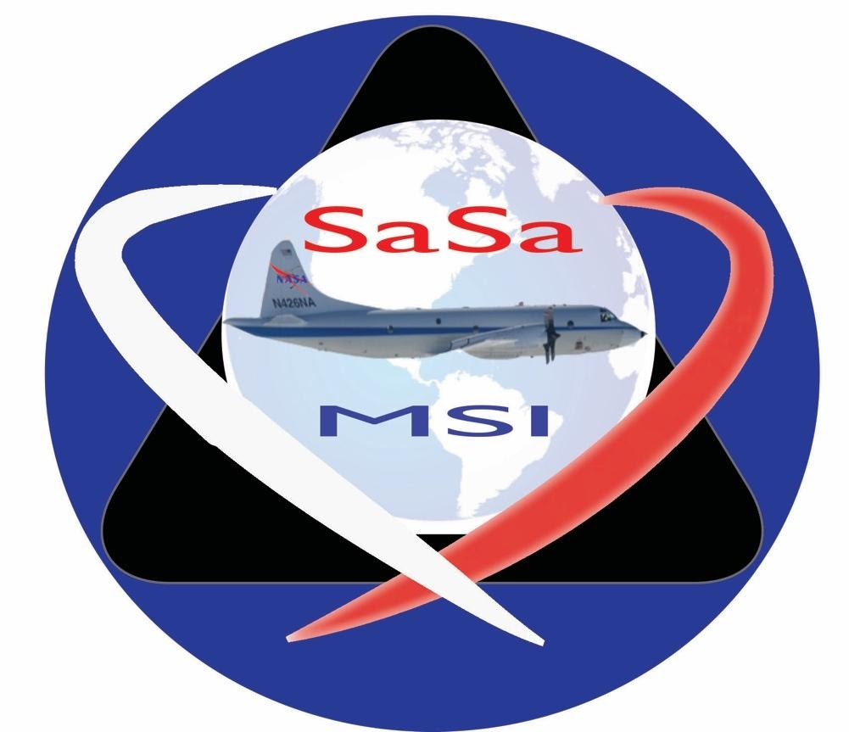
Student Airborne Science Activation for Minority Serving Institutions
NASA
Interdisciplinary NASA Airborne Campaigns
Summer 2022-2025
*More information will be available soon at https://alg.umbc.edu

Slide 15
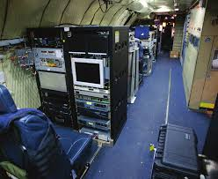
Eight (8) week program consist of:
Two-week introductory workshop and demonstrations (pre-airborne campaign) at the University of Maryland Baltimore County (UMBC) and Howard University in remote sensing, atmospheric science, instrumentation, data collection and analysis.
One-week (pre-airborne campaign) at Hampton Univeristy hands-on training on remote sensing/satellite application to disaster monitoring.
Three-week airborne field campaign based at NASA Wallops Flight Facility: NASA aircraft, and conducting measurements at ground validation sites.
Two-week (post airborne campaign) at UMBC, where students will be emerged to full research process (develop research idea, data analysis, scientific report and professional presentation.
*Paid internship with all transportation costs covered by Summer Program.

Slide 16
NASA Student Airborne Research Program
NASA
Provide students with hands-on research experience in all aspects of a major scientific campaign, from detailed planning on how to achieve mission objectives to formal presentation of results and conclusions to peers and others.
Students will work in multi-disciplinary teams to study surface, atmospheric, and oceanographic processes.
Participants will fly onboard the NASA DC-8 and assist in the operation of instruments to sample and measure atmospheric gases and to image land and water surfaces in multiple spectral bands.
Along with airborne data collection, students will participate in taking measurements at field sites. Each student will complete an individual research project from the data collected.
Deadline: January 2021

Slide 17
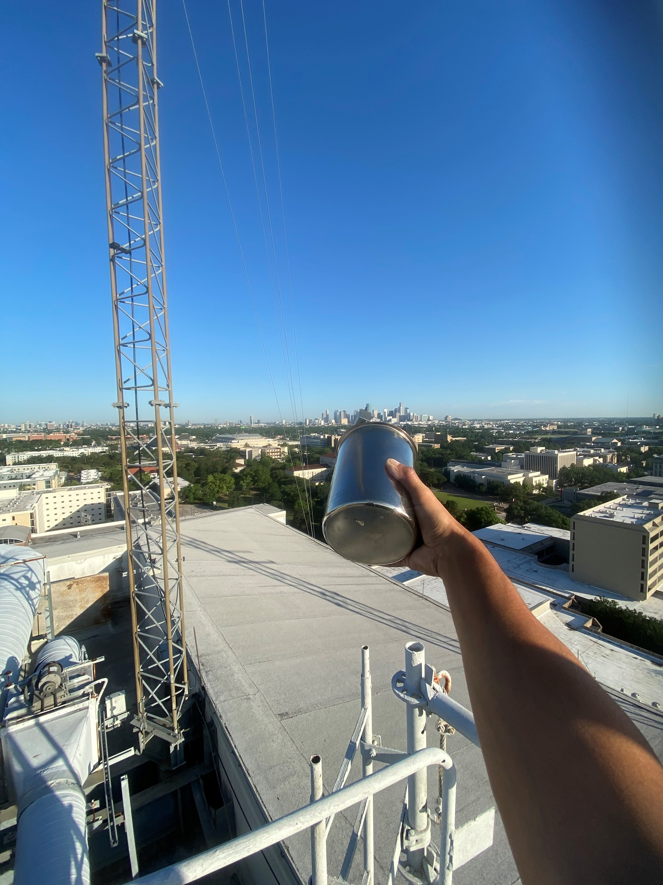
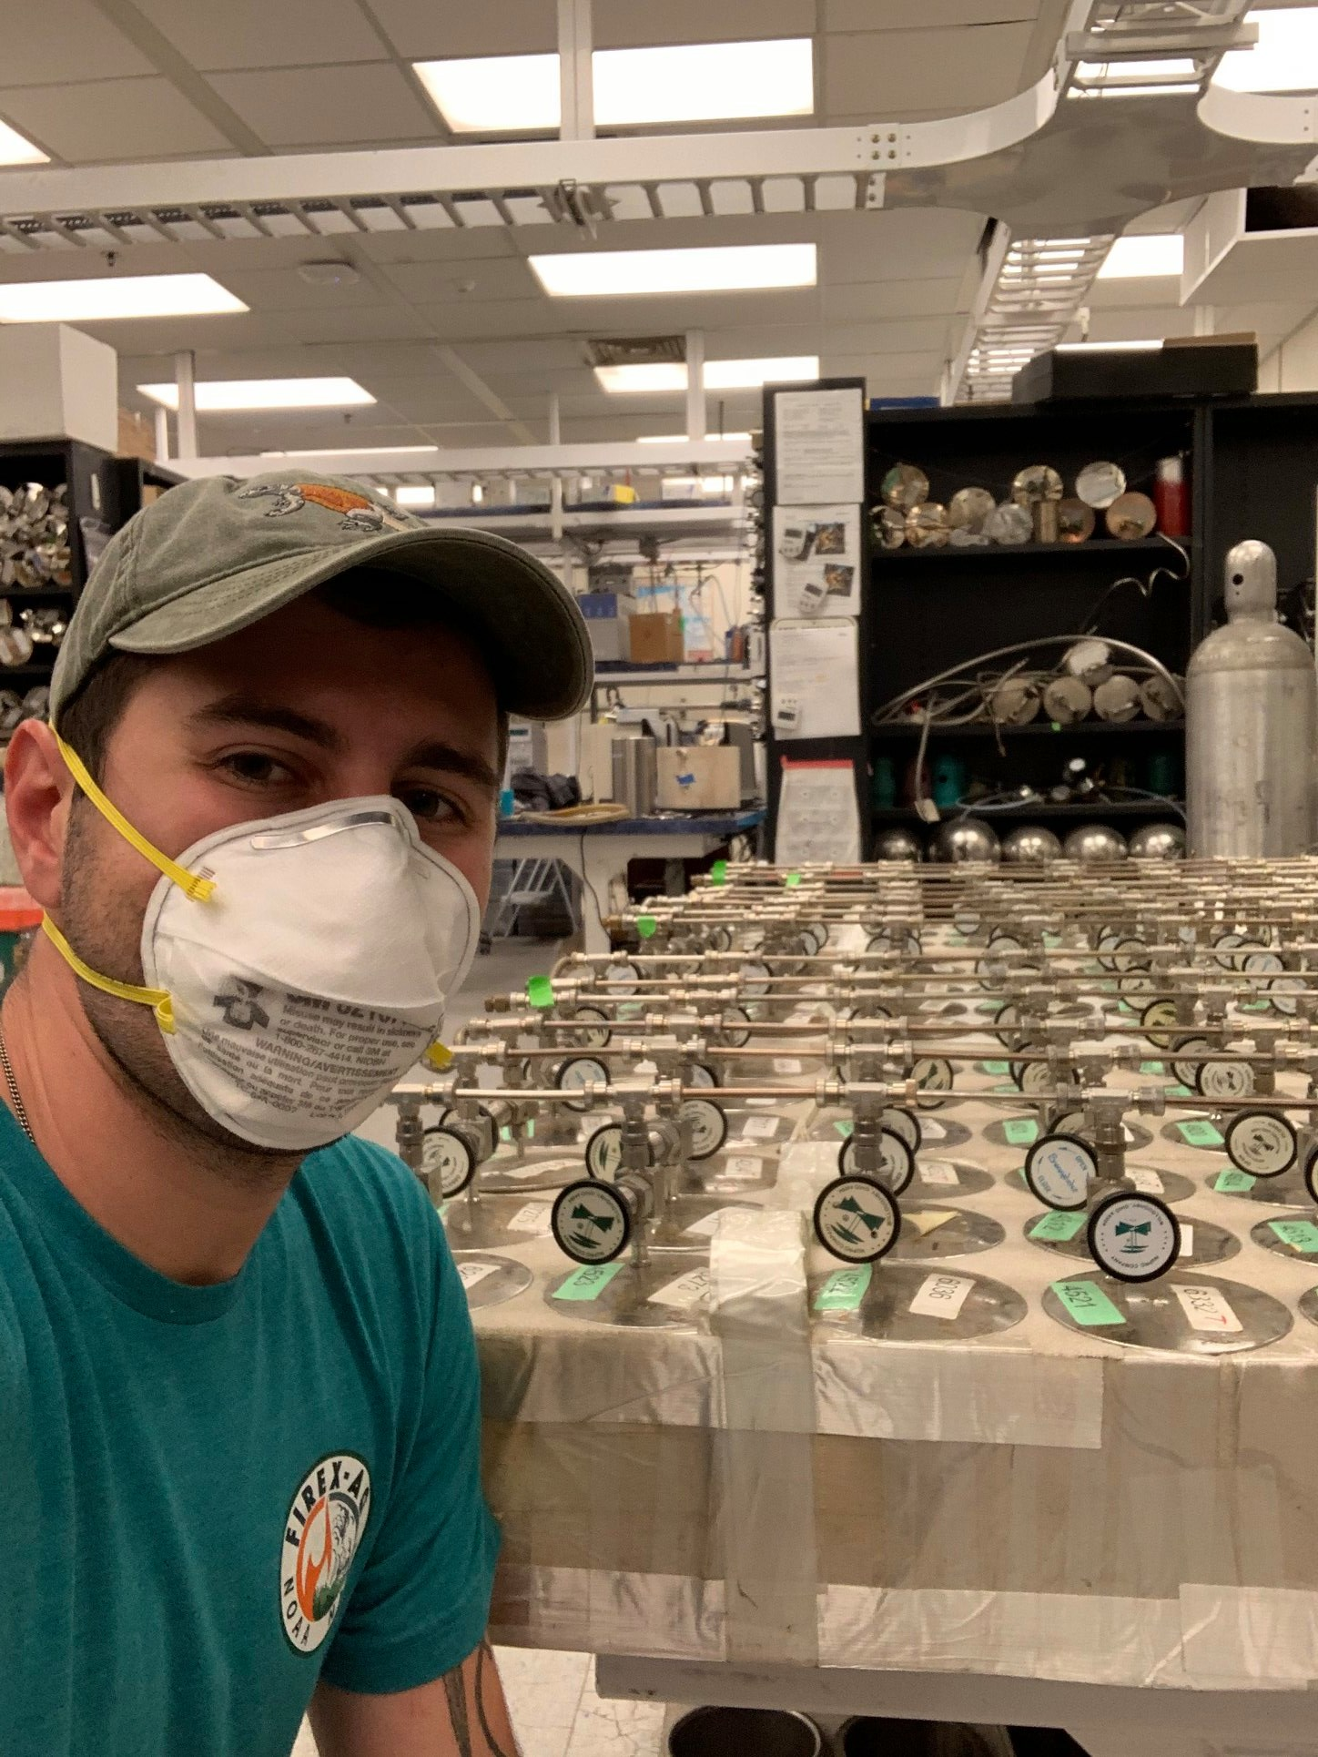
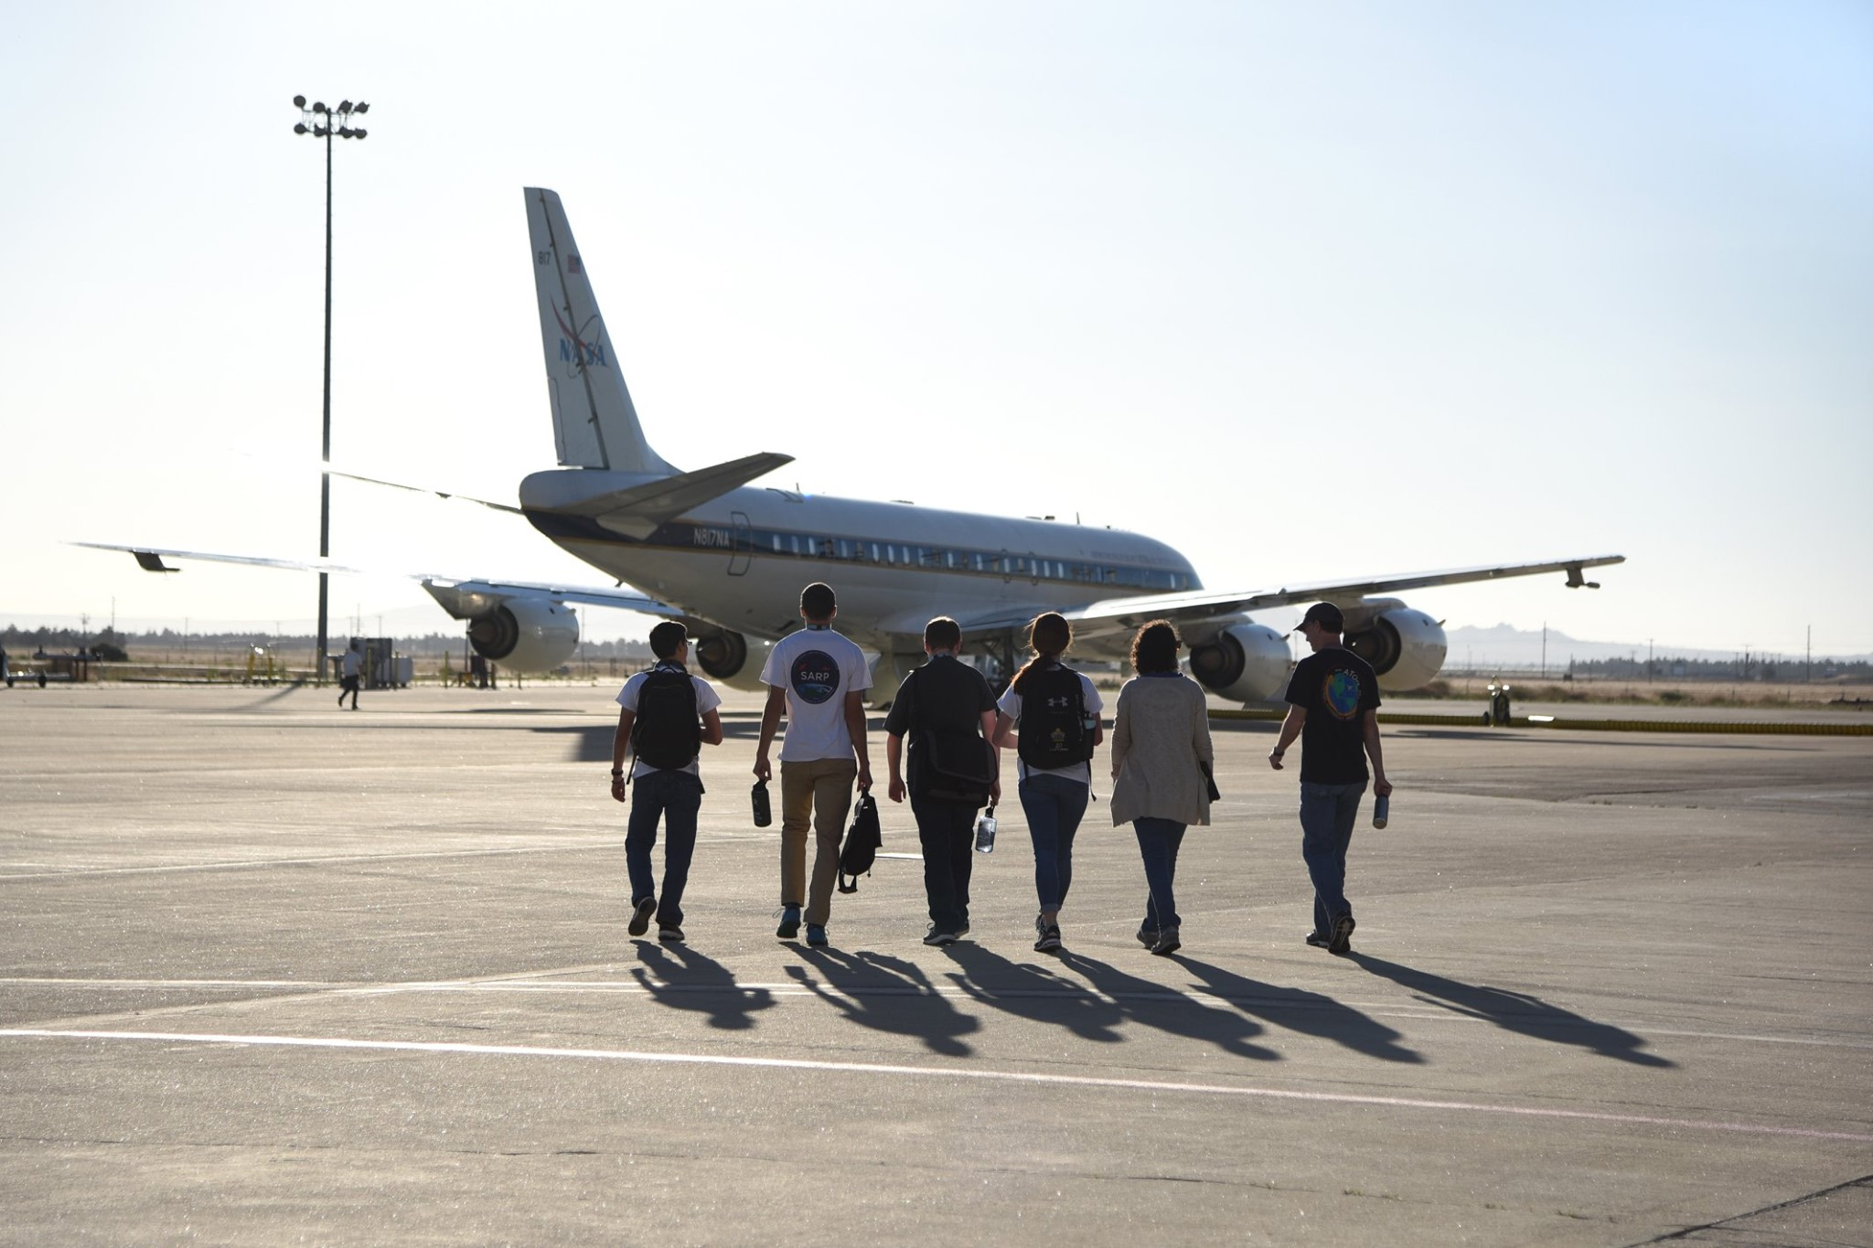
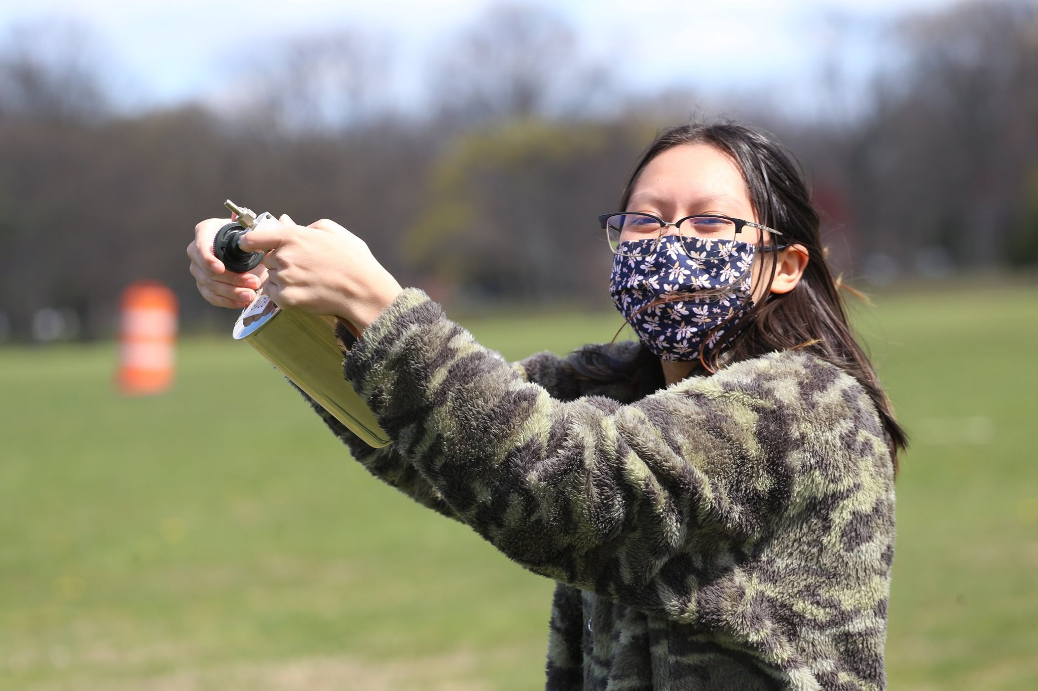
NASA Student Airborne Research Program
Apply:
https://baeri.org/sarp
Questions:
nasasarp@baeri.org

Slide 18
Acknowledgements
NOAA Office of Education
Educational Partnership Program
Maryland Department of the Environment
Maryland Energy Administration
U.S. Environmental Protection Agency
NASA
More info:
delgado@umbc.edu

