Slide 1
Tau Beta Pi GBM #4
February 14, 2020

Slide 2
Reminders
Active Requirements
  5 Social Hours
  5 Service Hours
  Attend GBMs and Initiations
Join Tau Beta Pi myUMBC Group

Slide 3
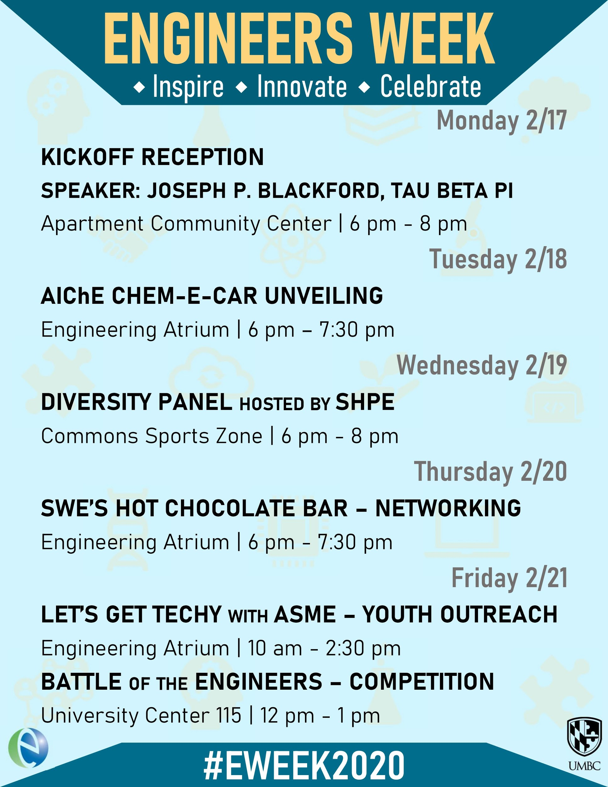
Notes:
All Events Count as Social Events!! Also make sure to pick up an EWeek Shirt! They were made by our very own Sanya :)

Slide 4
Keeping Track of Hours
Please fill out the google form for approved social and any service events that are not TBP hosted.
  https://forms.gle/G9akgZH1hkqjVhSa9
We will still have sign-in sheets at our events!

