Slide 1
First GBM of 2015!
Tau Beta Pi - 2/11/2015

Slide 2
TBP News
# of Initiates from Fall 2013: 12
# of Initiates from Fall 2014: 36!!
Far exceeded National goal of doubling
the number of initiates!!

Slide 3
TBP - Active Status
5 Social hours
5 Service hours
Attend Initiation

Slide 4
Engineer’s Week!
T-shirts - $5
Keychains!!
Social Hours
Service Hours
  FIRST Lego League (FLL)
    Contact Prof. Gurganus - jmedof1@umbc.edu
Schedule of Events...

Slide 5
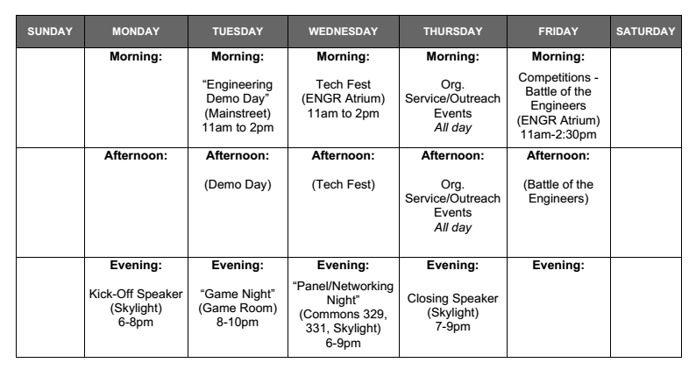

Slide 6
Social Events!
2/13 - Roller Skating - 7 to 11 PM
Pasadena Roller Skating Center
2/23 to 2/27 - Engineer’s Week Events
2/23 - Kick off Speaker
2/24 - Game Night
2/25 - Panel/Networking Event
2/26 - Closing Speaker
2/27 - Competitions
**Max of 3 social hours for all events during Engineer’s Week**

Slide 7
More Social Events!
UMBC Movies
Big Hero 6 2/19 - 2/21
Boyhood 2/26 - 2/28
Interstellar 3/5 - 3/7
The Hobbit: Battle of the Five Armies 3/26 - 3/28
LOTR: The Trilogy 4/2 - 4/4
Into the Woods 4/9 - 4/11
American Sniper 4/16 - 4/18
Night at the Museum: Secret of the Tomb 5/7 - 5/9
Game Night (TBD)
Laser Tag (TBD)

Slide 8
Tutoring
ENME 110, 303, 304, 320, 360
CMPE 212
ENES 101
Great way to get service hours
Don’t forget to fill out the poll!

Slide 9
Ratification Ballot
National Constitution & Bylaws
Deadline: April 1st
Need ratification by ALL active members
GBM next Wednesday, 11/18
12:00pm -ITE 102
  Food...

Slide 10
T-Shirts Still Available
Available for $10 cash please
**Wear it to GBMs**

Slide 11
Next GBM = Next WEDNESDAY
Food & Ratification Ballot
ITE 102 - 12:00pm

