Slide 1
GBM #2
Tau Beta Pi - 2/18/2015

Slide 2
TBP - Active Status
5 Social hours
5 Service hours
Attend Initiation

Slide 3
Engineers Week!
T-shirts - $5
Keychains!!
Social Hours
Service Hours
  FIRST Lego League on 2/28 - sign-up here: http://mdfirst.org/component/rsform/form/10-maryland-fll-event-volunteers

Slide 4
Engineers Week Volunteers
Tuesday 11am to 2pm - Demo Day
Wednesday 11am to 2pm - Tech Fest
Friday 11am to 2:30pm - Competitions
**Volunteering is for 30 minutes minimum**
Please sign-up in Google Drive Spreadsheet

Slide 5
Updated: Social Events!
UMBC Movies
Interstellar 3/5 - 3/7
The Hobbit: Battle of the Five Armies 3/26 - 3/28
Into the Woods 4/9 - 4/11
American Sniper 4/16 - 4/18
Game Night - March 13 @ 6-8 PM in Math/Psych 101
There’s gonna be pie!
Laser Tag (TBD)
Orioles Game - April 24 @ 7:05 PM (Student Night!!)

Slide 6
T-Shirts Still Available
Available for $10 cash please
Running low on size S - ordering more!
Contact Victoria Yun at vyun1@umbc.edu if you would like a shirt
**Wear it to GBMs**

Slide 7
Ratification Ballot
Ratifications to the TBP National Constitution
  Decided by voting delegates at convention last Fall
Each active member of every student chapter must vote for each question!
Six questions - we will all vote either "affirmative," "negative" or abstain from voting

Slide 8
Ratification Ballot - Sample Question
This is not a real question!!
Change A: Require that all collegiate chapters provide pizza to members at all GBMs.
Votes:
Affirmative ___ Negative ___ Abstain ___

Slide 9
Ratification Ballot - Change #1
1. Remove the details of the Headquarters retirement plan from the constitution.
Constitution Article V, Sec. 1&2

Slide 10
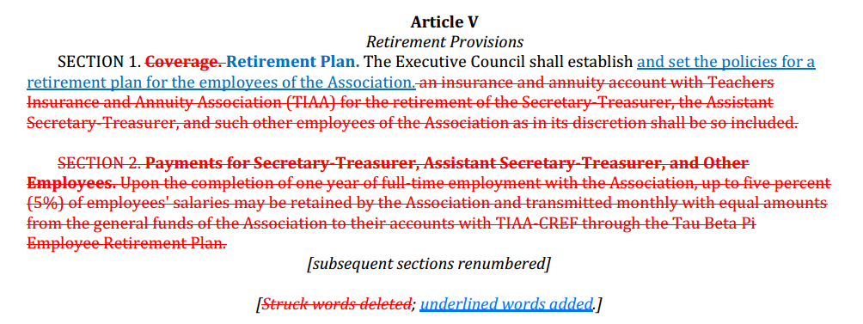

Slide 11
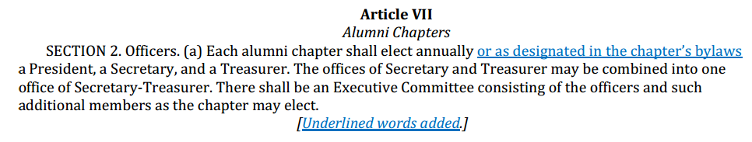
Ratification Ballot - Change #2
2. Allow alumni chapters to specify an officer election period in their chapter bylaws.
Constitution Article VII, Sec. 2 (a)

Slide 12
Ratification Ballot - Change #3
3. Modify the size and term length of the Fellowship Board.
Constitution Article IV, Sec. 2 (g) (2)

Slide 13
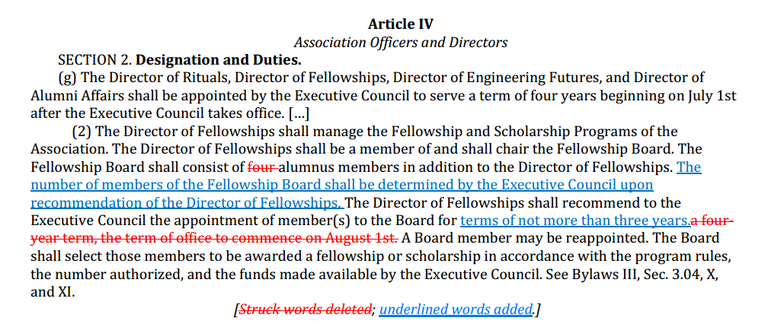

Slide 14
Ratification Ballot - Change #4
4. Clarify the eligibility requirements for graduate students
Constitution Article VIII, Secs. 4 (a) (5) and 5 (a) (5)

Slide 15
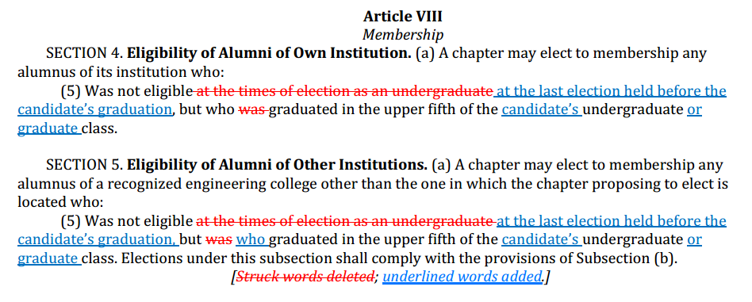

Slide 16
Ratification Ballot - Change #5
5. Provide flexibility in the position of Editor of the Association.
Constitution Article IV, Sec. 2 (d) (4); Bylaws III, Sec. 3.01 (a) and IX Sec. 9.02

Slide 17
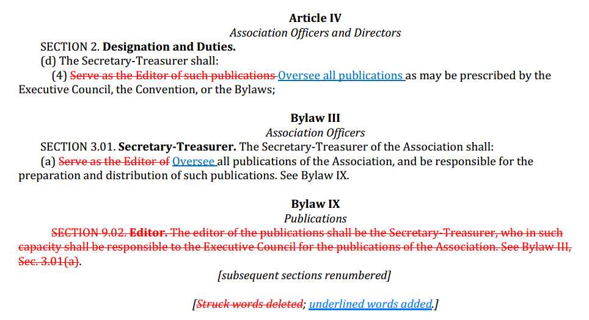

Slide 18
Ratification Ballot - Change #6
6. Adjust provisions regarding the salary determination of the Assistant Secretary-Treasurer.
Constitution Article III, Sec. 5 (a); Bylaw III, Sec. 3.01 (b)

Slide 19
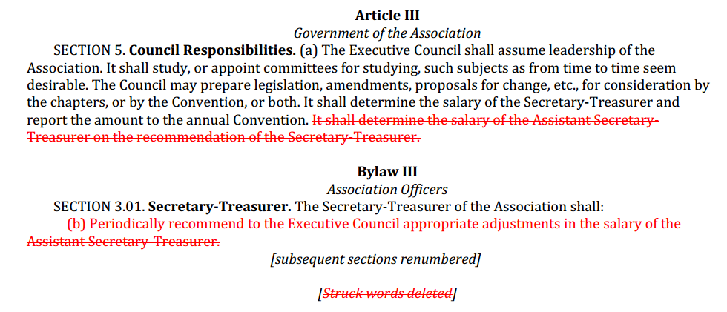

Slide 20
Next GBM = March 11th
ITE 102 - 12:00pm

