Slide 1
GBM #3
Tau Beta Pi - 3/11/2015

Slide 2
TBP - Active Status
5 Social hours
5 Service hours
Attend Initiation

Slide 3
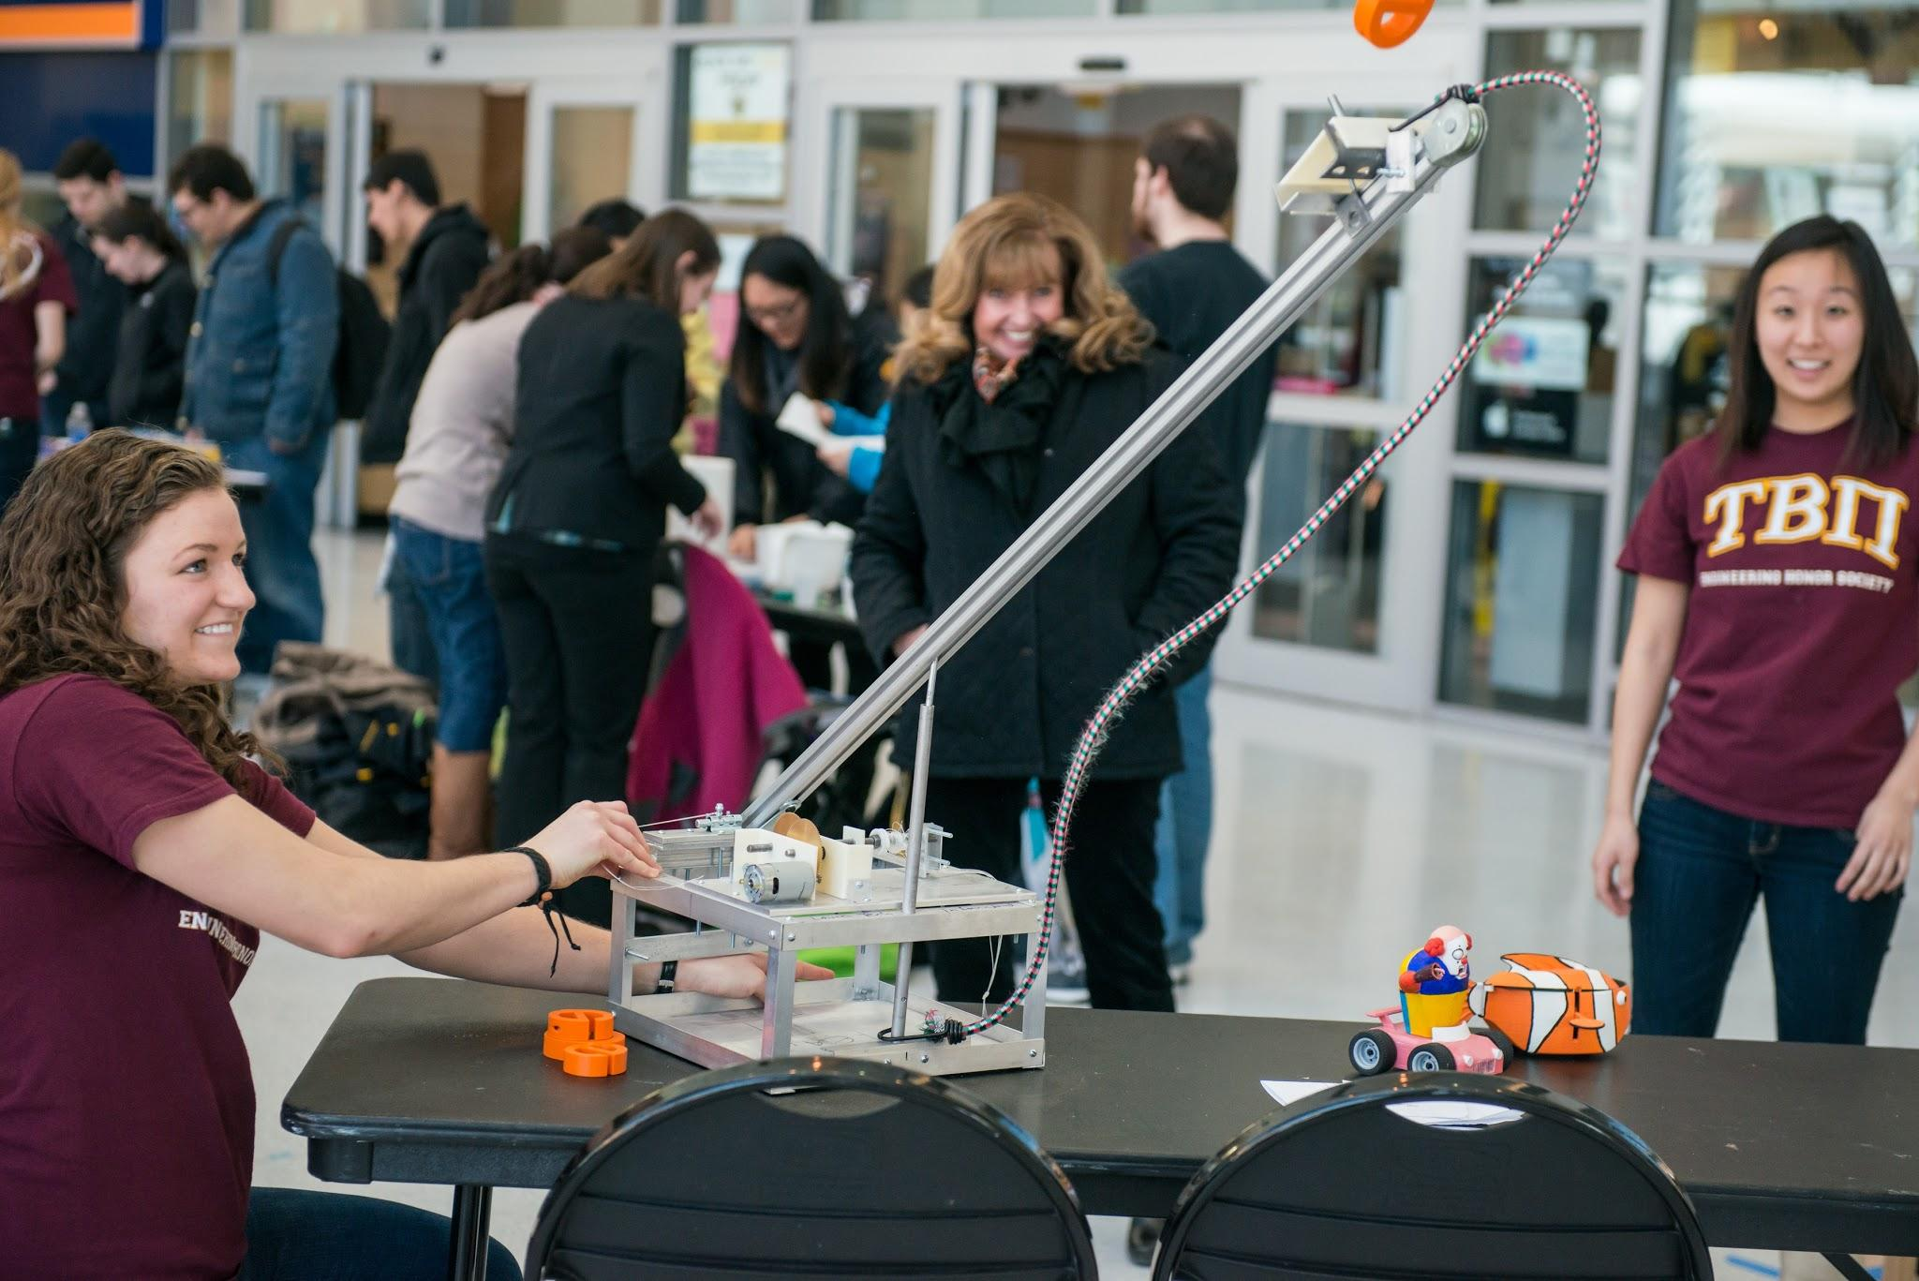
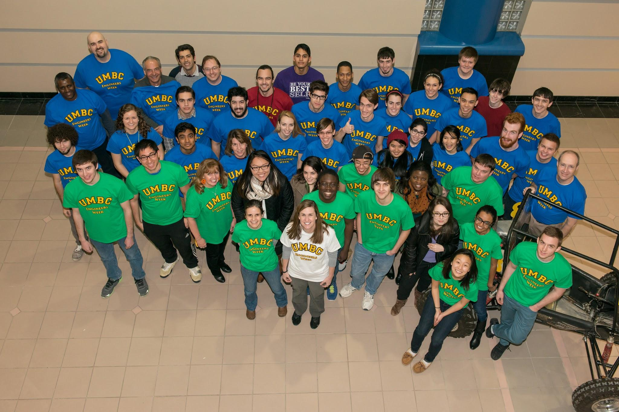
Engineers Week!
Thank you everyone for your participation and help!
T-shirts are still for sale - $5
photo by Marlayna Demond for UMBC
photo by Marlayna Demond for UMBC

Slide 4
Updated: Social Events!
UMBC Movies
The Hobbit: Battle of the Five Armies 3/26 - 3/28
Into the Woods 4/9 - 4/11
American Sniper 4/16 - 4/18
Game Day - March 13 @ 1-3 PM in ENGR 112
There’s gonna be pie & pizza!
Laser Tag (TBD)
Orioles Game - April 24 @ 7:05 PM (Student Night!!)

Slide 5
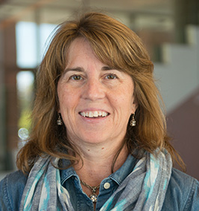
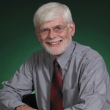
Pi Day - March 13th
12-1 PM in the Engineering Atrium!
Pie a Professor, Pizza Pie & Games, Pie Raffles and more!

Slide 6
Service/Tutoring
Blood drive - service opportunity Apr. 29th
-If you are interested in tutoring, please fill the form or speak to me in person.

Slide 7
TBP T-Shirts
Available for $10 cash please
Just restocked on all sizes!
Contact Victoria Yun at vyun1@umbc.edu if you would like a shirt
Wear it to GBMs!

Slide 8
Next GBM = April 1st
ITE 102 - 12:00pm

