Slide 1
GBM #6
Tau Beta Pi - 5/6/2015

Slide 2
TBP - Active Status
5 Social hours - due 5/13
5 Service hours - due 5/13
Attend Initiation - 4/25

Slide 3
Officer Election Results
President - Ken Foo
Vice President - Daniel Ocasio
Senior Treasurer - Victoria Yun
Junior Treasurer - Jordyn Schroeder
Corresponding Secretary - Sean Najmi
Recording Secretary - Asad Khan
Social Coordinator - Melissa Holmes
Service Coordinator - Nicole Demetrides
Tutoring Coordinator - Matt Glessner

Slide 4
Michael Bishoff
Community Events Coordinator
(Engineer’s Week Liaison)
Founder & President of HackUMBC
Organized various tech workshops
Communicated with UMBC Administration
Contacted Corporate Sponsors

Slide 5
Initiation Coordinator Candidates?

Slide 6
Tutoring
Planning to have a cram session for Statics Final

Slide 7
Service Opportunities
May 7th-10th Baja Volunteers needed

Slide 8
Social Events
Study Day Social (May 13th)
  Come study at Starbucks/Chick Fil-A on campus between 2 and 5 PM
Make Your Own Social
  5+ TBP members
  To make it official you must email the TBP account at least 24 hours in advance so we can send an invite to all members (48+ hours recommended)

Slide 9
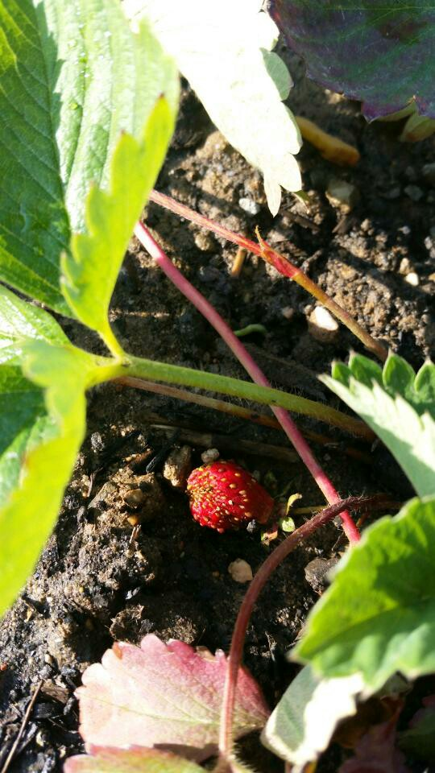
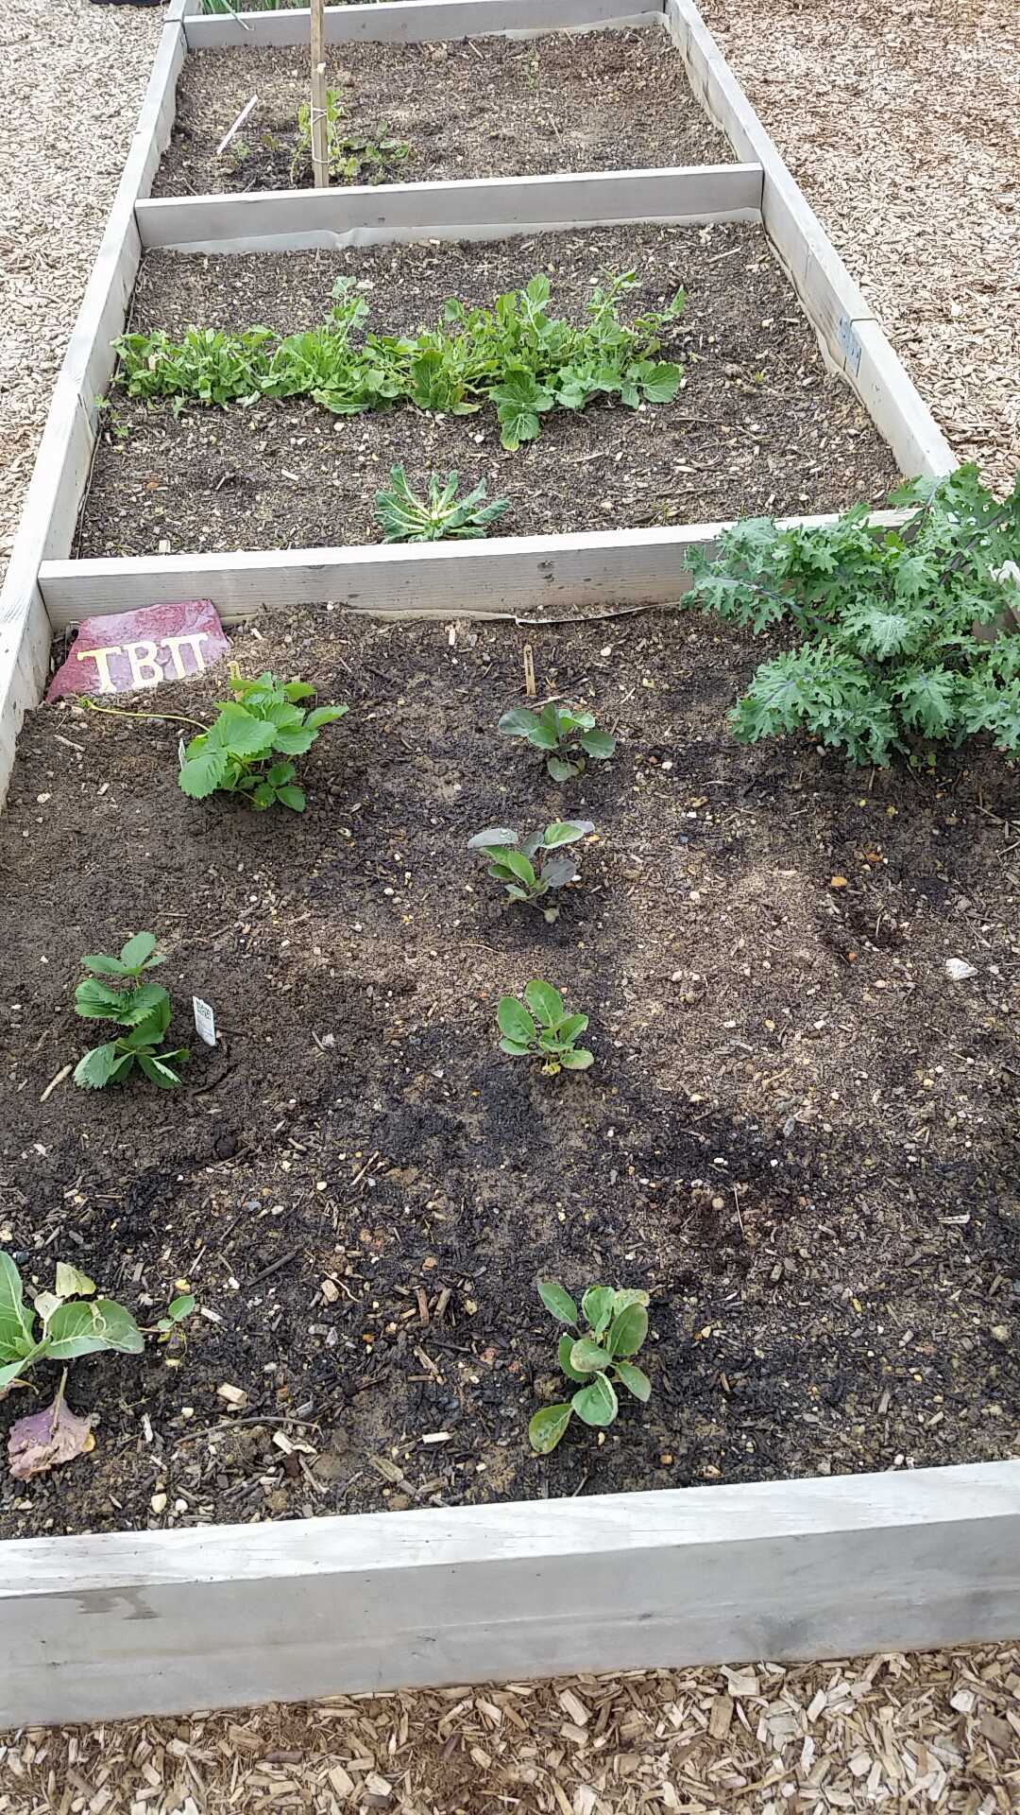
The Garden!
Join Stephanie on Thursday 5/7 @ Noon!
We also need volunteers to help with the TBP plot this summer!
If you are interested, please email Stephanie (stephb3@umbc.edu) or Sarah (shemler1@umbc.edu) after the meeting

Slide 10
TBP T-Shirts
Available for $10 cash
Contact Victoria (vyun1@umbc.edu) if you would like a shirt
Wear it to GBMs!

Slide 11
Bent Polishing Competition!
Unpolished miniature bents
Polisher of the shiniest bent gets a free TBP t-shirt or gift card!
If you are interested, come talk to us after the meeting (graduating seniors have priority)

Slide 12
Amazon Smiles
Donate 0.5% to TBP Headquarters
Jeff Bezos (CEO of Amazon) is a TBP member

Slide 13
Thanks For A Great Year :)
Good Luck on Your Finals!

