Slide 1
Welcome Back!
Tau Beta Pi - First GBM
9/16/2015

Slide 2
Active Membership Requirement
5 hours social
5 hours service
Attend all GBMs
Any absences must be excused - e-mail us in advance
Initiation attendance required
Need to be active the last two semesters to receive a stole for graduation

Slide 3
FE license
Pros:
Engineers with a PE license earn about $20,000 on average more than those without one
Recommended by most working engineers and graduate students
Typically, take during junior or senior year
Receive 30% discount on FE and PE exam preparation material
Offered in most months
Pass rates according to NCEES
Chemical→ 77%
Electrical and Computer→ 75%
Mechanical→ 81%
http://www.learncheme.com/screencasts/fe-review

Slide 4
Social Events
Crab Feast: Sept. 18 5-7pm
On Commons terrace
$10 - buy tickets at CIC
Renaissance Festival: Sept. 26, opens at 10am
Same day as Honors College Trip
$24 - buy tickets online or at the gate
Take picture of yourself for evidence
5k race with Brain Injury Association of Maryland: Oct. 4
Run it for social event - $35 to enter
Volunteer for service
Make your own social- At least 5 TBP members!

Slide 5
CHIPOTLE FUNDRAISER!!!!
Take a study break and get some nourishment!!
Fill your bellies with deliciousness!!
Date: Sept. 21
Time: 4pm - 8pm
Where: Arundel Mills
How: Tell cashier that you are with TBP!

Slide 6
Service Events
Volunteer for 5k race: October 4th
Dance-a-thon: October 9th
UC Ballroom 2pm-8pm
Help raise awareness for childhood cancer
FLL Team Volunteer (Date TBD)
Elizabeth Seton High School Mentor
Female mentors for one email a week commitment
JHU Robotics Outreach

Slide 7
T-Shirts
Available for $10 cash
Contact Victoria (vyun1@umbc.edu) or Jordyn (js18@umbc.edu) to purchase
Wear it to GBMs!

Slide 8
Tutoring
Last year, we had 33 tutors and 93 tutees ^_^
ENES 101, ENME 110, CMPE 212, ENCH 215
Respond to Poll if interested for service hours

Slide 9
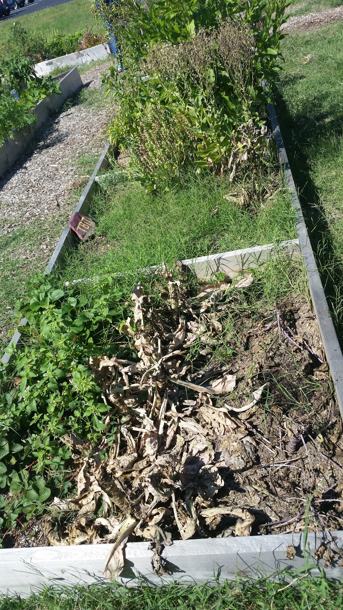
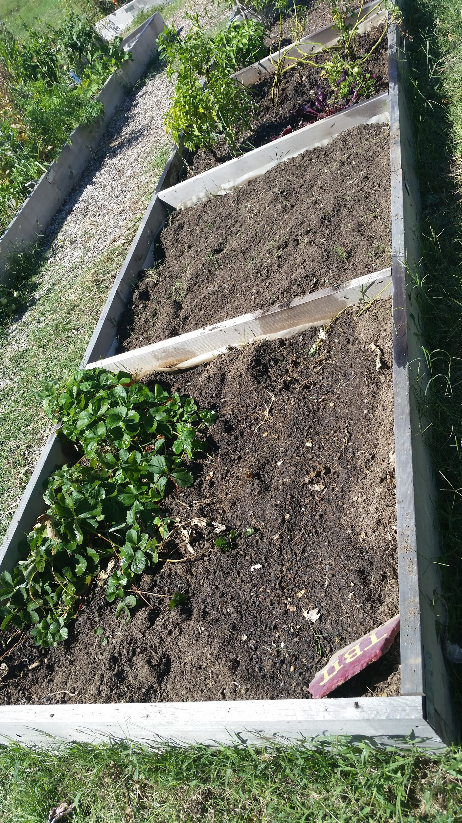
The Garden
3 TBP plots
Volunteer for service hours!
Before After

Slide 10
Miscellaneous
Donate 0.5% to TBP Headquarters through Amazon Smiles (Jeff Bezos is a TBP member)
Join the TBP group on Linkedin
Join myUMBC TBP page (We have over 100 members !)
If you are interested in Engineering Management and Systems Engineering or the BS/MS, the graduate director has set up an informational session on Oct 7th from (12-1ish pm) after our next GBM (Pizza and drinks provided!)
Congratulations to Sarah Helmer, Cheli Arrusy, Sydney Menikheim, Nicole Demetrides, Julianne Maclennan, and Daniel Ocasio for winning the TBP scholarship

Slide 11
Questions or Concerns?
The next GBM is October 7th
Don’t forget to sign in the attendance sheet!

