Slide 1
Welcome!
Tau Beta Pi - Second GBM
10/7/2015

Slide 2
Active Membership Requirement
5 hours social
5 hours service
Attend all GBMs
Any absences must be excused - e-mail us in advance
Initiation attendance required
Need to be active the last two semesters to receive a stole for graduation

Slide 3
Social Events
(seb) Movie Night: Jurassic World 10/15-10/17 Lecture Hall
Vegas Night: Oct 26th
Skyzone AIChE: Oct. 28, transportation leaving ~5:45
Game Night: Nov. 6 @ 7pm room X in Math and Psych
Trip to the Aquarium: Nov. 13 @ 5:30pm
Bowling Trip: Nov. 20 @ Brunswich Bowling
Make your own social- At least 5 TBP members!

Slide 4
Service Events
Dance-a-Thon: October 9th 2pm-8pm
Elizabeth Seton High School E-Mentoring
Robotics Program: October 24th and November 7th
Tutoring
Vegas Night needs dealers
Email Nick Rogers- nmkrogers@umbc.edu

Slide 5
Tutoring
ENES 101, ENME 110, CMPE 212, ENCH 215
Respond to Poll if interested for service hours

Slide 6
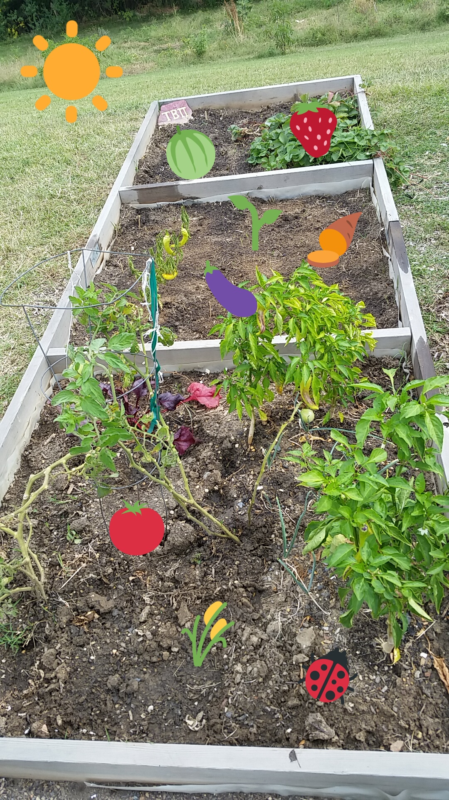
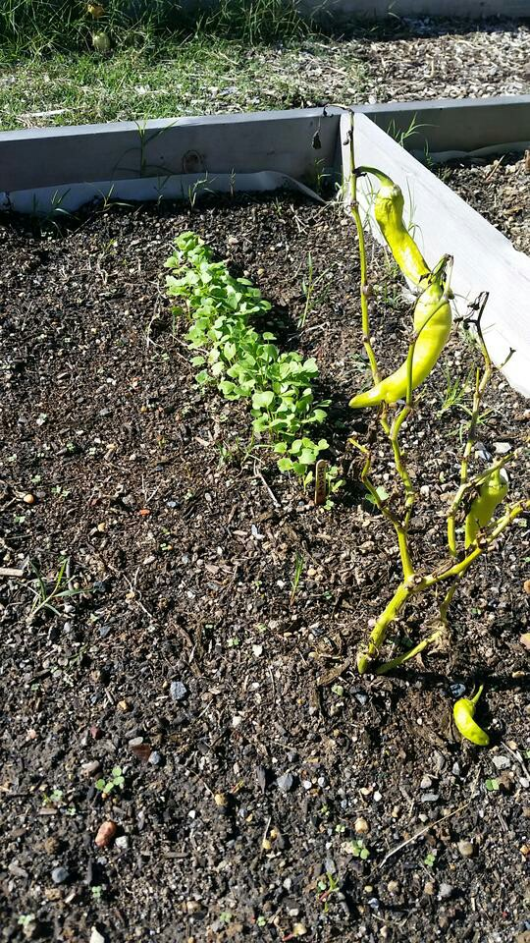
The Garden
Peppers, tomatoes, strawberries
Russian kale, winter radish, carrots
Volunteer to water/weed for easy service hours!
Above Photo Courtesy of Stephanie Bonadies

Slide 7
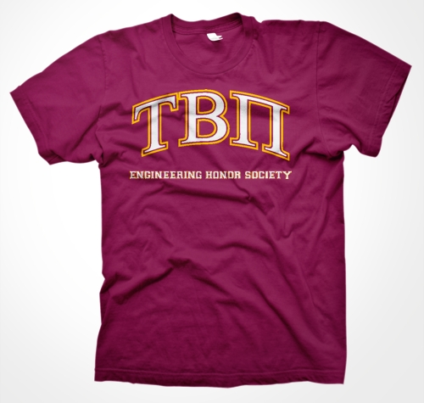
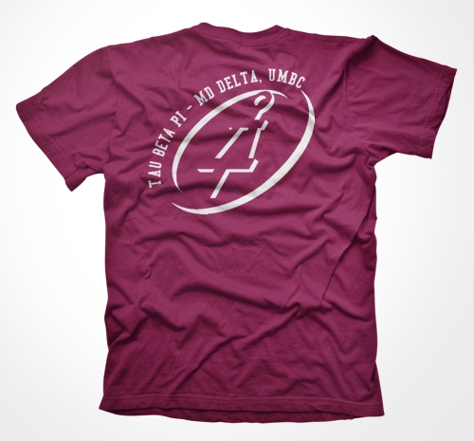
T-Shirts
$10 cash
Talk to Victoria (vyun1@umbc.edu)
or Jordyn (js18@umbc.edu) if you want to purchase yours
Wear it to GBMs!

Slide 8
Engineers Week 2016
If you have any suggestions or want to be involved in planning Engineers Week, please see one of the officers

Slide 9
The next GBM is November 4th in Admin 101
Don’t forget to sign the attendance sheet!
Stay for the info session!

