Slide 1
Welcome!
Tau Beta Pi - GBM #4
12/2/2015

Slide 2
Bents and Certificates
Current members: Get your bents and certificates if you did not get one
Initiates will get one soon

Slide 3
Active Membership Requirement
5 hours social
5 hours service
Attend all GBMs
Any absences must be excused - e-mail us in advance
Initiation attendance required
Must be active the last 2 semesters to receive a stole for graduation

Slide 4
FE Licence
Pros:
Engineers with a PE license earn about $20,000 on average more
Recommended by most engineers and graduate students
Typically, take during junior or senior year
Offered in most months
Pass rates according to NCEES
Chemical→ 77%
Electrical and Computer→ 75%
Mechanical→ 81%
http://www.learncheme.com/screencasts/fe-review

Slide 5
Fellowships
$10,000 in 10 Monthly Installments
For Full-time Graduate Study in the Following Academic Year
Begin Application Process Online at http://www.tbp.org/TBPAPPS/
Applications open November 1
Applications due January 31
Notes:
$10,000 towards graduate study
35 fellowship awarded out of ~200 apps (1 in 6 chance)
Some awarded without stipend, esp. if aid received elsewhere
Want high scholastic and extra-curricular involvement with clear plan for graduate study and demonstrated need
TBP members only
Need: application, class rank in engineering school and department, 2 reference letters
See http://www.tbp.org/pages/About/Programs/Fellowship/Fellowship.cfm for more information.

Slide 6
Scholarships
$2,000 for Full-Time Undergraduate Students in the Following Academic Year
Partial Scholarships are now available for the Following Academic Term
Begin Application Process Online at http://www.tbp.org/TBPAPPS/
Applications open November 1
Applications due March 1
Notes:
$2,000 for full senior year; $1,000 for semester, trimester, or 2 quarters
Look at high scholastic achievements, strong faculty recommendation, extra-curricular activities, and clear plan for future achievement
Need: application, class rank in engineering and department, 2 reference letters
See http://www.tbp.org/pages/About/Programs/Scholarship/Scholarship.cfm for more information.

Slide 7
Tutoring
ENES 101, ENME 110, CMPE 212, ENCH 215
Fill out service form if you have been tutoring

Slide 8
Service
Tutoring
First Lego League
NAMI’s Winter Wonderland (Thursday, 12/3 12PM-5PM)
Garden
Fill out service forms!!!

Slide 9
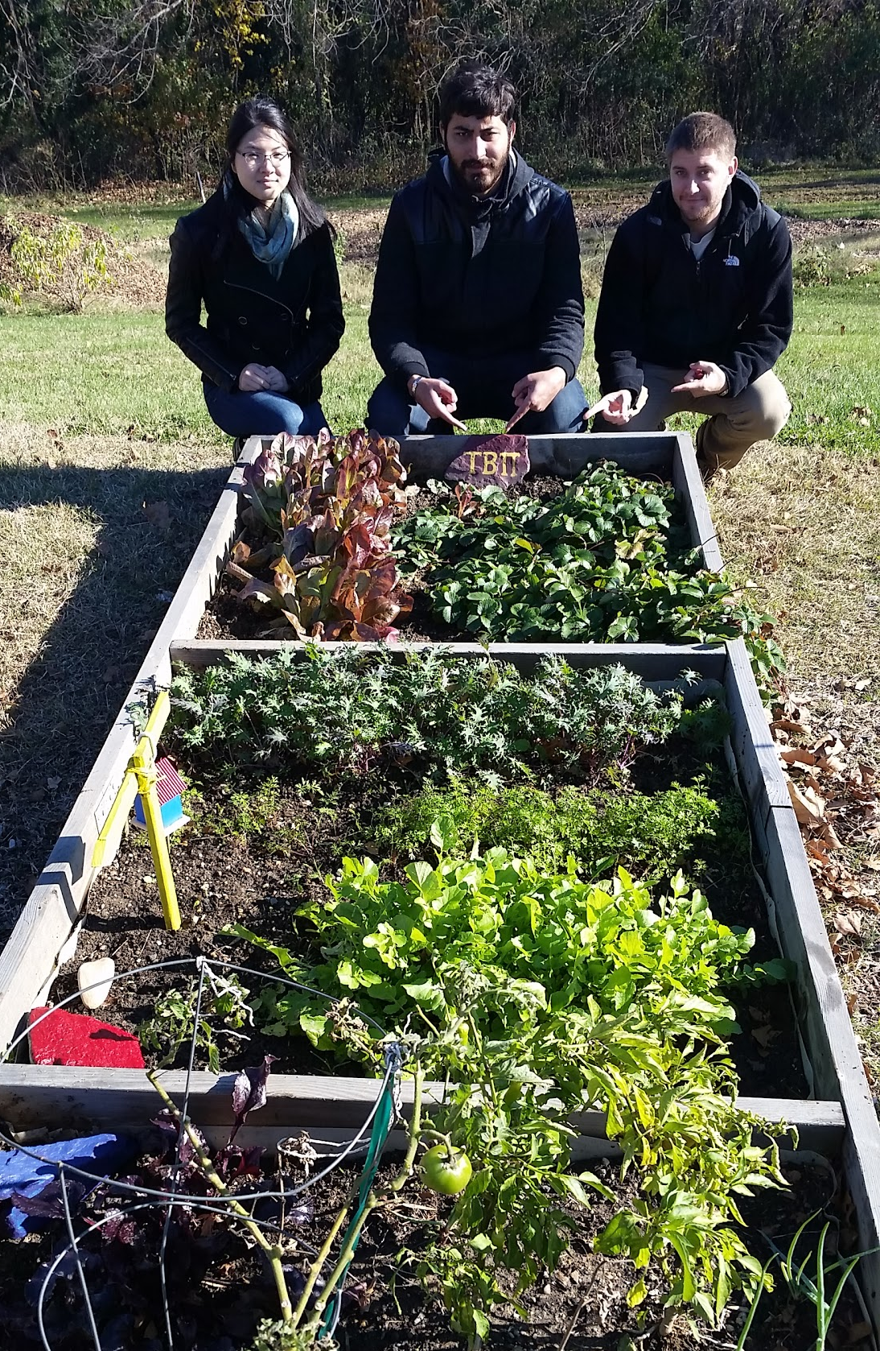
The Garden
Each visit to water/weed counts as 15 min of service
Successful work and decoration day

Slide 10
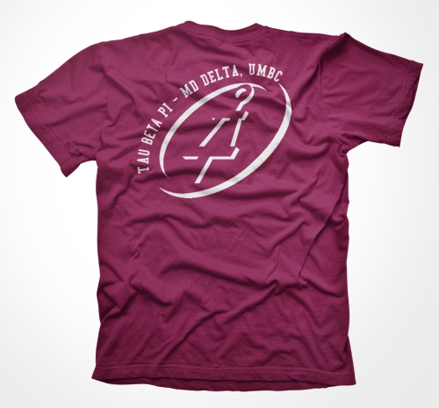
T-Shirts
$10 cash
Contact Victoria (vyun1@umbc.edu)
or Jordyn (js18@umbc.edu) to purchase
Wear it to GBMs!
Initiates can purchase theirs after initiation

Slide 11
Social
Buffalo Wild Wings (Columbia): Dec. 2 5-8pm
Must present the flyer
Must stay and be with 5+ TBP members for it to count - take a picture!
Ice Skating with: Dec. 5 after initiation (plan to leave 1:15pm)
Sign up on the google doc
Make your own social- At least 5 TBP members!

Slide 12
Alumni Chapters
Graduating seniors can join an alumni chapter
Baltimore Chapter
Samiul Amin → samiul_amin@yahoo.com
DC Chapter
dctbppresident@gmail.com or stephanie.bechtold@fda.hhs.gov
Stephanie Bechtold (Treasurer)
https://sites.google.com/site/dctbpac/home

Slide 13
Initiation is this Saturday!
Dec 5th, 10AM in ITE 104
Dress is business/business casual
Service forms & Initiation fee are due by this date
Initiatives stay for a few mins
Don’t forget to sign the attendance sheet

