Slide 1
Welcome Back!
Tau Beta Pi - First Spring GBM
2/17/2016

Slide 2
Active Membership Requirement
5 hours social
5 hours service
Attend all GBMs
  Any absences must be excused - e-mail us in advance
Initiation attendance required
Need to be active the last two semesters to receive a stole for graduation

Slide 3
Service Events
TBP Events
Engineer’s Week T-Shirts (2/22-2/26)
Let’s Get Techy (2/25)
FLL Keva Plank Activity (3/5)
Lakeland Campus Visit (3/8 and 4/8)
UMBC Events
hackUMBC (3/5-6)
First Lego Legue (3/5)

Slide 4
Engineer’s Week!!!!
https://prezi.com/wbvwsxiuzaz7/engineers-week/?utm_campaign=share&utm_medium=copy

Slide 5
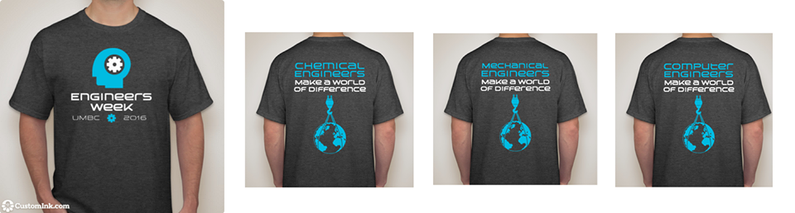
TBP & Engineer’s Week T-Shirts
TBP shirts are available for $10 cash
  Contact Victoria (vyun1@umbc.edu) or Jordyn (js18@umbc.edu) to purchase
E-Week Shirts are $5 cash (sold throughout E-week)

Slide 6
Tutoring
ENES 101, ENME 110, CMPE 212, ENCH 215
Tutoring Poll

Slide 7
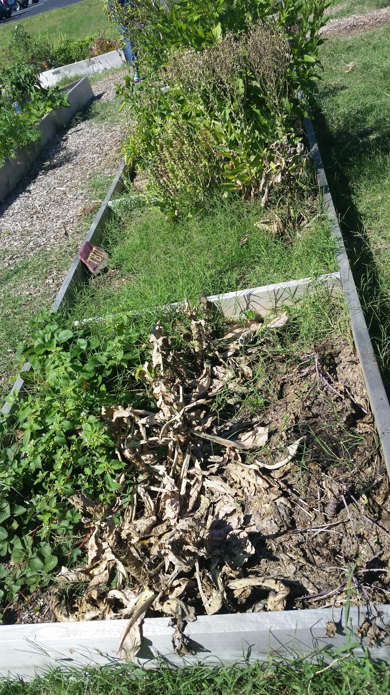
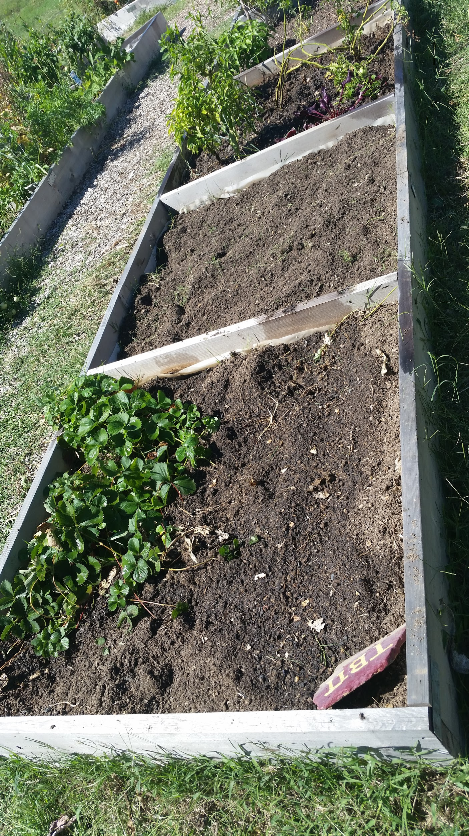
The Garden
3 TBP plots
Volunteer for service hours!
Before After

Slide 8
Ratification Ballot
Change the structure of the Executive Council to establish a 9-12 member Council with members elected annually to staggered 3-year terms, create Executive Council offices of Secretary and Treasurer, adjust employment provisions for the Executive Director, and remove the title of Assistant Secretary-Treasurer.

Slide 9
Social Events
Chipotle: @ Arundel mills, March 21 from 5-9! Tell cashier you’re with TBP
E-Week events: Kick-Off Speaker, Dodgeball, Panel Night,Closing Speaker, Battle of Engs., Engineering Futures - make sure to sign in
Make your own social- At least 5 TBP members!

Slide 10
Questions or Concerns?
The next GBM is March 9th
Don’t forget to sign in the attendance sheet!

