Slide 1
General Body Meeting
Tau Beta Pi - 2nd Spring GBM
3/9/2016

Slide 2
Active Membership Requirement
5 hours social and social
Attend all GBMs
  Any absences must be excused - e-mail us in advance
Initiation attendance required (April 23rd)
Need to be active the last two semesters to receive a stole for graduation
Please fill Graduation poll

Slide 3
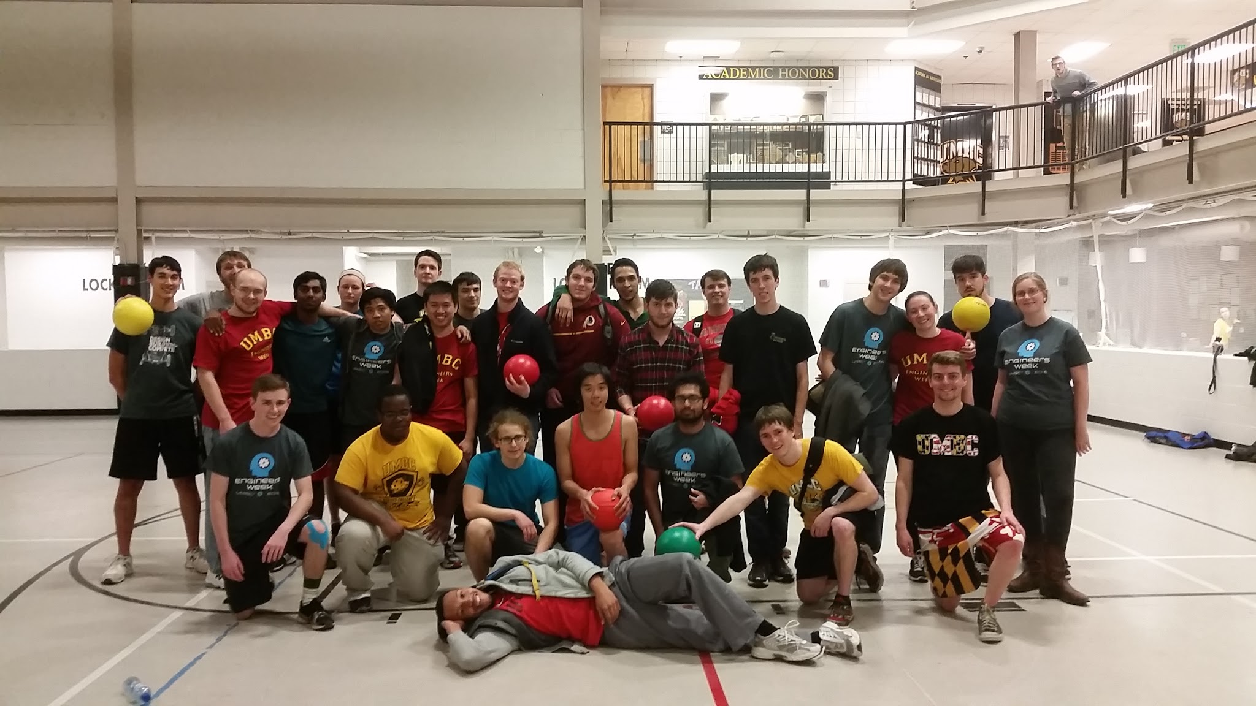
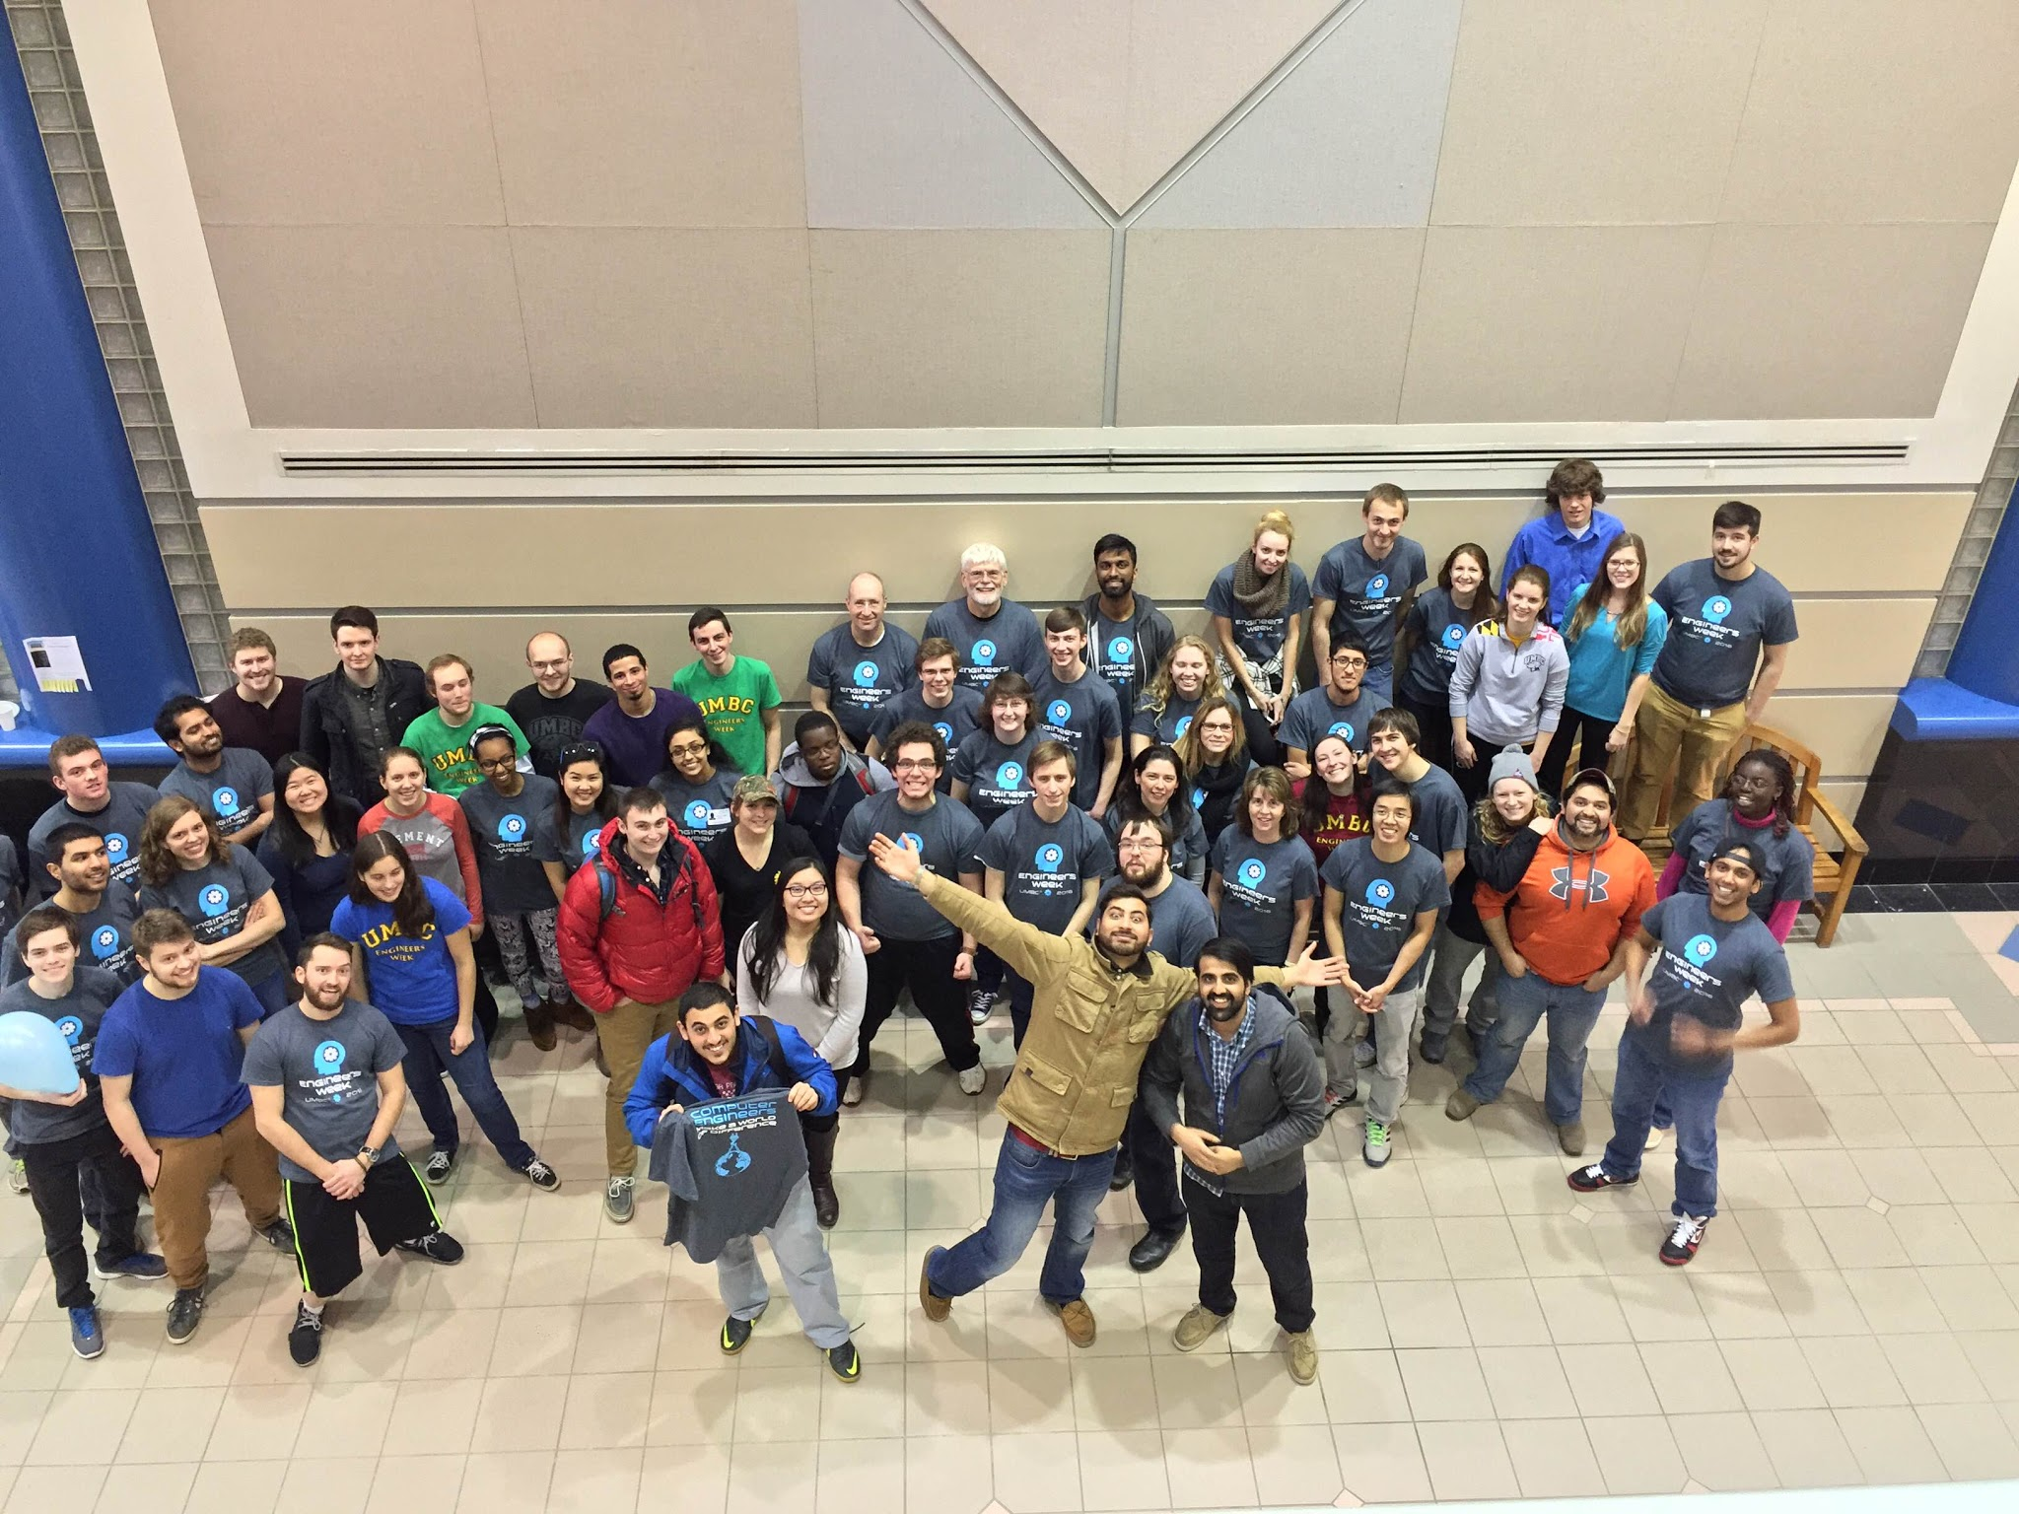
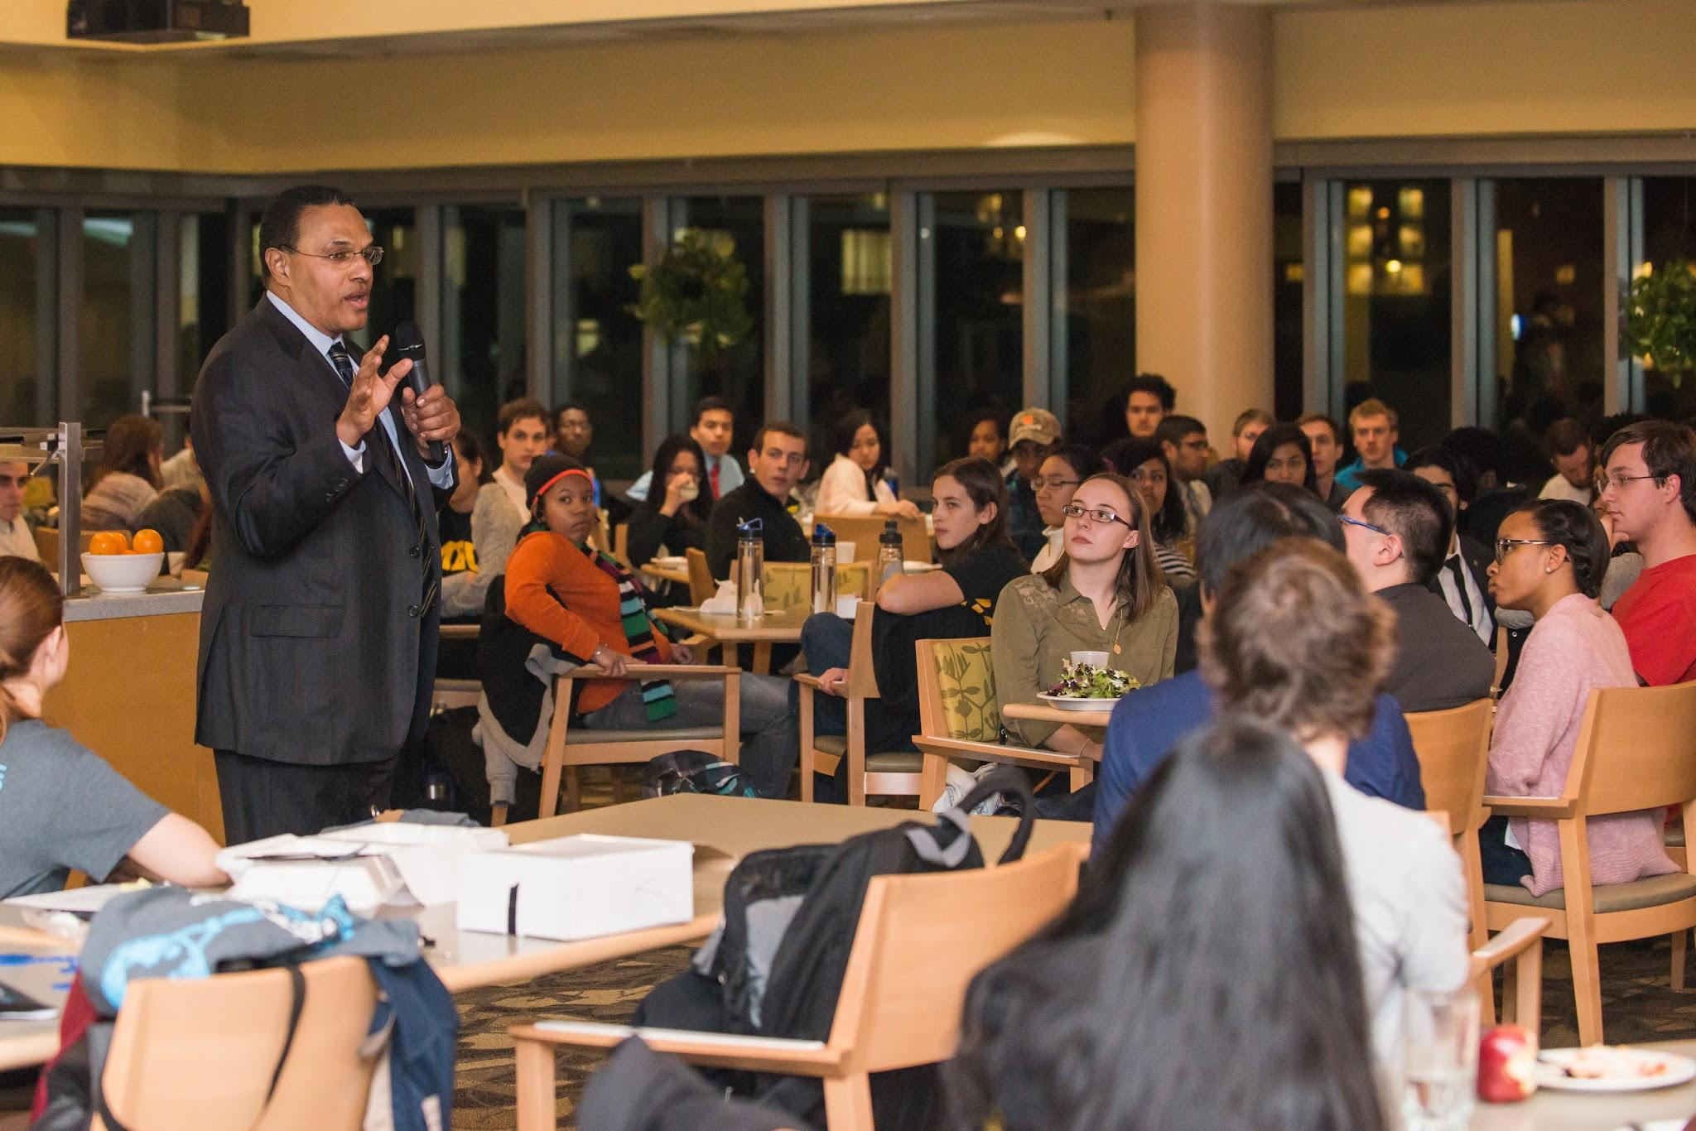
Engineers Week!!!!
Thanks For Coming Out!

Slide 4
Service Events
Lakeland April 8th (9:30-1:30pm)
Tour Guide, Lunch, and Engineering Outreach
URCAD Wed April 27th (Earn up to 4 hours!)
Need Volunteers to do AV setup/monitoring
Contact Sean Najmi snajmi1@umbc.edu if interested

Slide 5

TBP & Engineer’s Week T-Shirts
TBP shirts are available for $10 cash
  Contact Victoria (vyun1@umbc.edu) or Jordyn (js18@umbc.edu) to purchase
E-Week Shirts are $5 cash (sold throughout E-week)

Slide 6
Tutoring
ENES 101, ENME 110, CMPE 212
Tutoring Poll

Slide 7
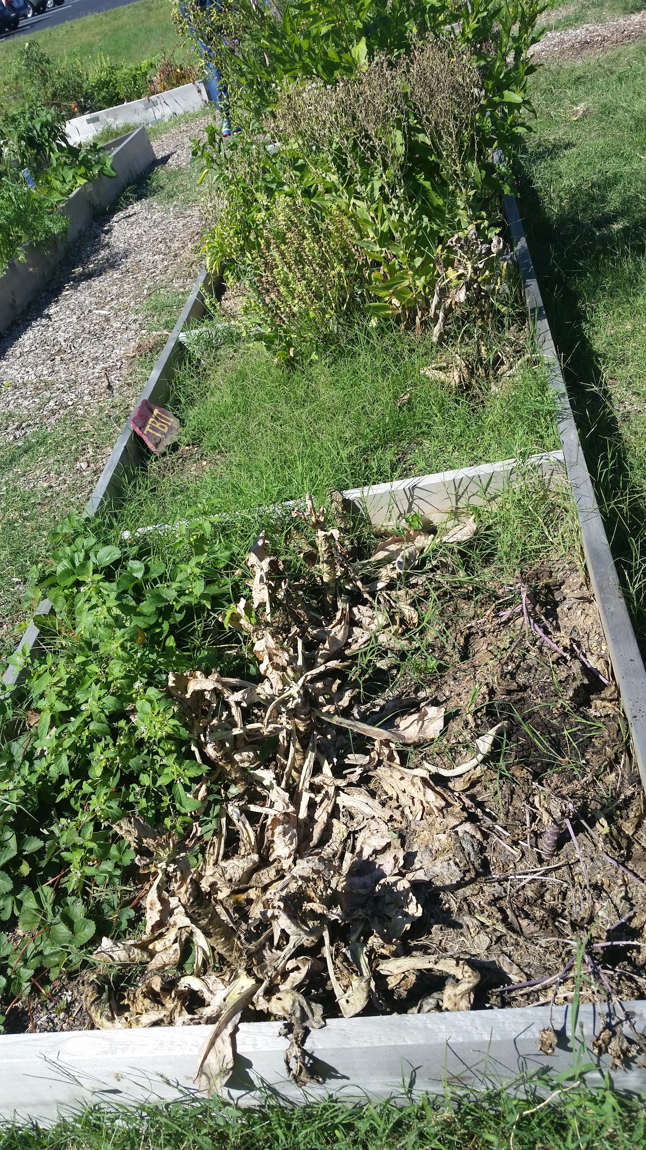
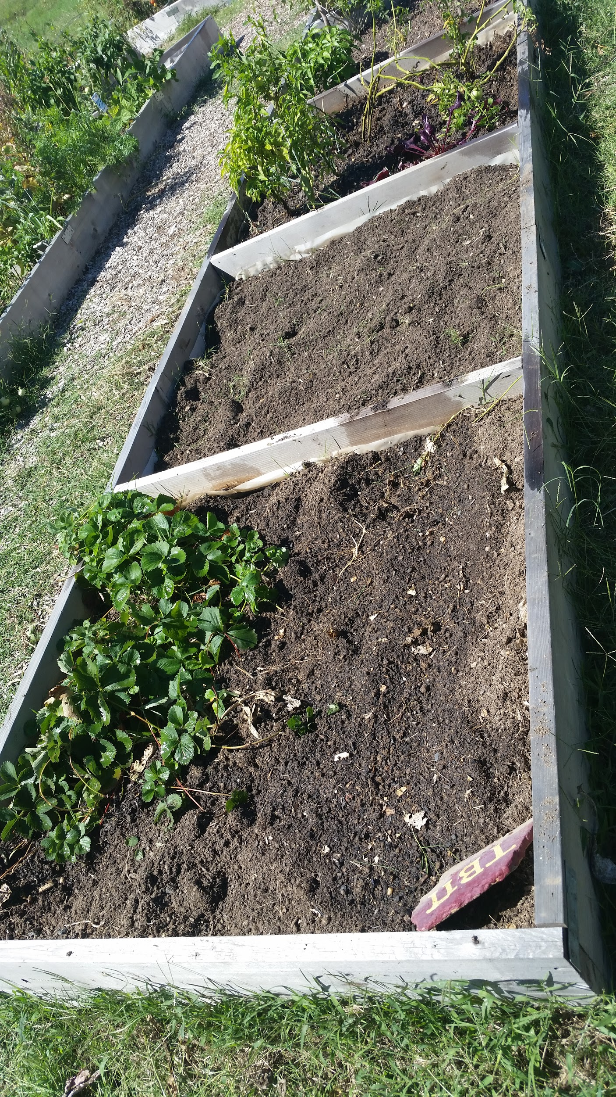
The Garden
3 TBP plots
Volunteer for service hours!
Before After

Slide 8
Social Events
Chipotle: @ Arundel mills, March 21 from 5-9pm! Tell cashier you’re with TBP
Pi Day Social: March 11 @12, location TBA
  Lots of pie and a pi-digit competition
(seb) Movie - Star Wars: April 14 (6pm)-15(8pm)
Make your own social- At least 5 TBP members!

Slide 9
Questions or Concerns?
Have a fabulous Spring Break!
Don’t forget to sign in the attendance sheet!

